Slide 1


Enter the Gungeon
Review
By: Jaxon Pecora

Slide 2

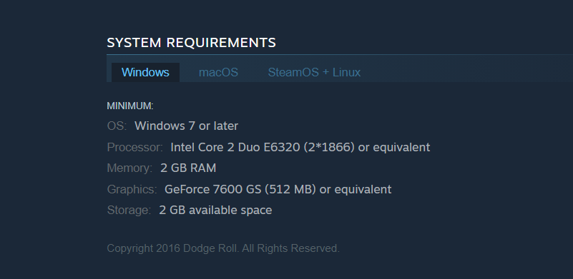
Game Title: Enter the Gungeon
Company: Dodge Roll Studios
Genre: Roguelike, bullet-hell price: $14.99
Minimum specs: xbox, PS4, switch or pc with specs below

Slide 3
Game summary
Quick overview – wacky guns / darks souls difficult
Story line – story is a little vague
Player’s role – very intense action-packed dual stick shooter
Installation – download from online or buy disk only 2gb
User interface – wasd, space and mouse configurable
Game play – fun but frustrating
Scoring – speed runs(unofficially but popular)
Artwork – 2.5d game
Sound and music - edm, cheery up beat
Special features – various items combo together and various easter eggs
Manual –none is a walkthrough however
Bugs – minor bugs(total time played 49.8 hour currently)

Slide 4

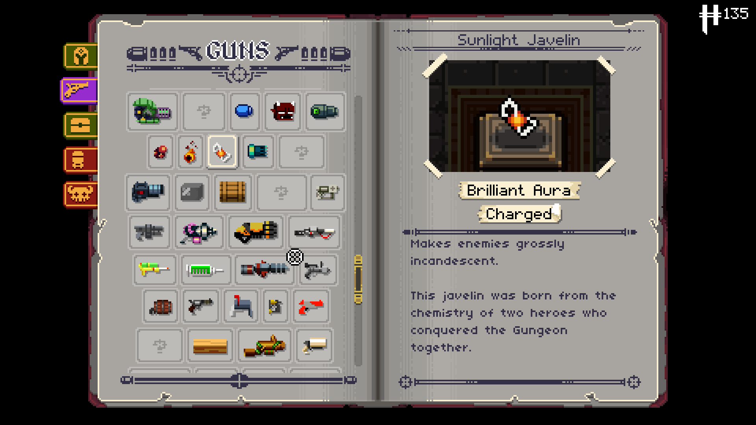
Game review pro and cons
What is fun – wacky guns, cute characters, sense of skill level and variety of events
What is bad – can get repetitive if your bad, heavily rng dependent and difficult can be rage inducing

Slide 5


Comparison to similar games
Similar game - binding of Issacs, kingdoms new lands and hades
Audience – 14 and up
Mistake – no difficulty slider, rng , and unexplained mechanics , end game screen

Slide 6
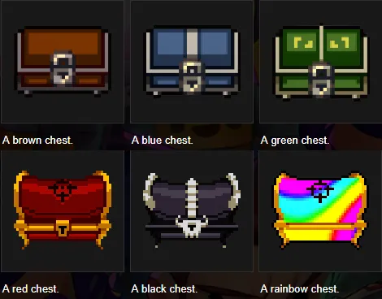
Summary
Strengthens –
Fun combat, lots of replayability
Weakness – Rng
Difficulty (for some)
Worth purchasing – yes
How could be improved – hidden mechanic explanation, better hints

