Slide 1
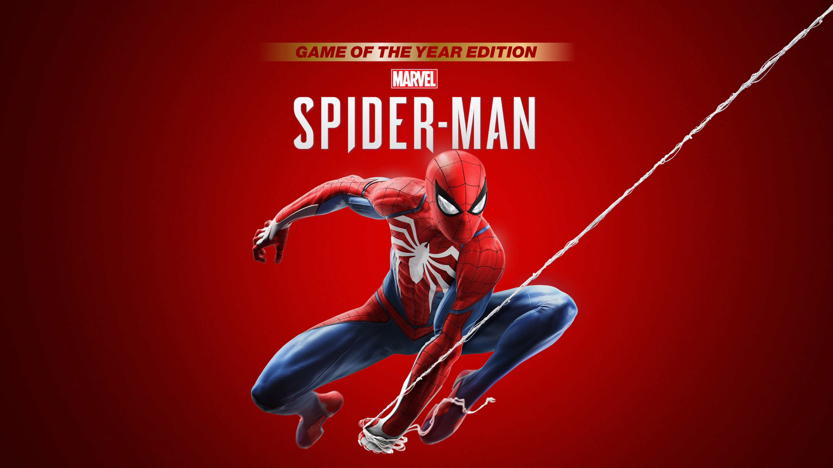
Marvel’s Spider-Man Game Review
Nathan Yomtoob

Slide 2
General Information
Title: Marvel’s Spider-Man
Platform: PS4 exclusive (PS5 version released now)
Release Date: 9/7/2018
Game Developer: Insomniac Games
Publisher: Sony Interactive Entertainment
Genre: Action-Adventure
Hardware: PS4/PS5
Installation: 50 GB of space needed
Price:
On Release: $59.99
Current: $35.82

Slide 3
Quick Overview
Single Player – Third-person open-world action-adventure
Story driven, linear storyline with a ton of side quests and random appearing fights that occur frequently. The player can play at their own pace
The character unlocks new skills, gadgets, and spider suits as you progress through the game
Ability to freely roam New York City if you want and fast travel points are throughout the map if you do not want to swing

Slide 4
Storyline and Player’s Role
Peter Parker is taking a nap in his New York apartment when he is woken up by a call from the police scanner talking about how a SWAT team is going to invade Fisk Tower, which is home to Wilson “Kingpin” Fisk. Once he is defeated and sent to jail is when the story really begins and the story spirals from there.
The player controls Peter Parker AKA Spider-Man and is attempting to save New York City from despair from many different foes and the Devil’s Breath Poisoning. After completing side missions, upgrades to skills and equipment are available with a combination of the different types of points earned.
The player has to fight almost all of Spider-Mans greatest enemies while also defending himself from the police and attempting to save the city from a mass disease.

Slide 5
Gameplay and Interface
Unlock new gadgets and suits by progressing through the main story and completing other tasks. The player can complete side missions to unlock additional content and collectable items
There is a gadget wheel that is used to cycle through the different types of web shooters you can use
Third-person, traversal through web slinging physics, with a plethora of different types of missions including fighting, stealth, and missions where you play as a secondary character.
Pause menu: The player can enter the pause menu to view the map, change suits, equip and upgrade gadgets, and upgrade character skills as well as view all progress that has been made.

Slide 6
Artwork and Audio
The visual aspect of the game is very pleasing and lively compared to a lot of similarly styled games and previous Spider-Man games. It’s a close representation of New York City, but with minor differences and set in the marvel universe.
The entire environment is a sandbox playground for you to maneuver around. You can swing off any building, wall-run, jump off platforms, use things like trash cans, car doors, and sewer lids to attack the enemies.
The character design is a fantastic representation of how Spider-Man looks and feels
The music is a great aspect of the game as well. It is specifically played at certain points while swinging across the city and to fit the mood of where you are in the game.
The soundtrack is done by composer John Paesano who has worked on movies as well as other marvel shows.
The audio helps make the city environment come to life as you can hear people murmuring as you are going through the city as well as hear people shouting out to you as you swing by whether it be a positive or negative statement.

Slide 7
Bugs
The odds of coming across a bug in the game are pretty slim. I’ve played through the game a few times and never noticed any bugs are glitches that I had, but I will link a video of some visual bugs and glitches that are more funny than harmful to the actual gameplay.
Video: https://www.youtube.com/watch?v=_1BKqKnUlxE

Slide 8
Game Review
What is good about the game?
The main storyline is amazing.
Traveling around the map is the most fun out of any open world game I have ever played.
The combat system is engaging.
Ability to customize your Spider-Man and make it your own.
Practically every character is well developed over time.
What is bad about the game?
Side missions get repetitive
Being PlayStation exclusive
Missions as secondary characters get boring
I wish it was longer

Slide 9
Comparison
Batman: Arkham Series
The main comparison that Marvel’s Spider-Man has is the Batman: Arkham Series of games. They have a similar combat system, and are both superhero games, but that is kind of where the similarities end in my opinion. Spider-Man has a more evolved combat system than from the Batman. Batman is focused on one main villain with fewer side missions to do.
Sunset Overdrive
Spider-Man was developed by the same people who created Sunset Overdrive. They took the momentum filled movement from Sunset Overdrive and adjusted it to fit the Spider-Man world. I think this was a good enhancement, both the games feel very smooth and fluid once you have the mechanics down.

Slide 10
Intended Audience / Design Mistakes
The intended audience for this game is any Marvel or Spider-Man fan, as well as fans of any single-player, open world games like this.
When I played the game, I never noticed and design mistakes.

Slide 11
Summary
Overall, Marvel’s Spider-Man really does its job in making you feel like you are Spider-Man. The game uses everyone’s basic knowledge of Spider-Man and throws you into a unique story of the hero. From fighting the measly villains that can’t hurt you, to fighting Doc Ock at the end of the game, I was fully invested and didn’t want to stop playing the game until I completed it. I would give the game a 9.5/10. There are only minimal things that could have been changed to make me enjoy the game more than I did.
I would recommend this game to anyone I know that plays video games. I think once you get started playing it, the playthrough flies by because the pacing is so well kept. The only way I would improve the game would be to make the missions playing as Mary Jane or Miles not last long because these missions do slow down the story to a point where it is a little bothersome. I also wish that the game was not a PlayStation exclusive as that keeps away a lot of people that would play it.

