Slide 1
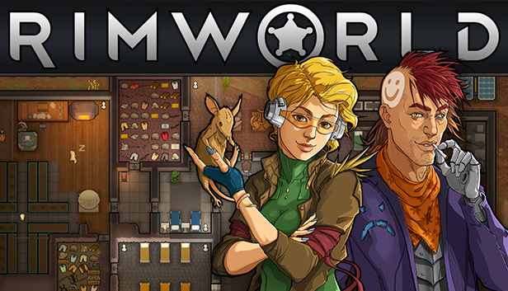
Ryan Wiesenberg
CIS 587: Fall 2021

Slide 2
Basic Information
RimWorld is a 2D colony-sim with a generative AI storyteller initially solo-developed by Tynan Sylvester, and is now developed and published by Ludeon Studios, founded and led by Tynan.
Originally funded and released as part of a Kickstarter campaign on October 2nd, 2016.
The game is available on Steam for Windows, macOS, and Linux.
Price: $34.99

Slide 3
Minimum System Requirements
Same for all Windows (7+), macOS (10.12+), and Linux
Processor: Core 2 Duo
Memory: 4 GB RAM
Graphics: Intel HD Graphics 4000 (or other shader model 4.0)
Storage: 1 GB available space
These requirements accurately reflect the minimum but there is a very active mod community and colonies with large number of pawns (characters) or a large number of mods can drastically increase needed compute power.

Slide 4
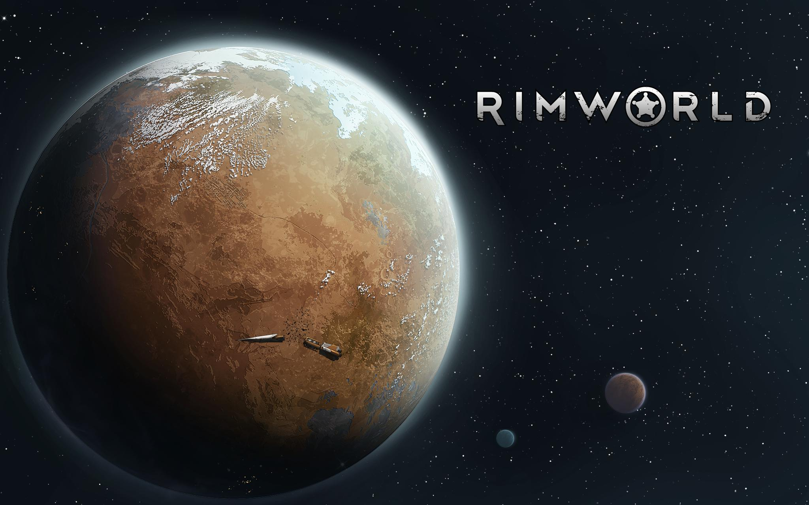
Game Summary
In RimWorld, the player controls a group of colonists newly crash-landed on a planet at the edge of the known universe, a rim world. These colonists are far from perfectly suited for this harsh existence and their skills vary from cooks to artists to simple street urchins.
The player’s main goal is to keep the colonists alive and happy while utilizing the colonist’s unique skills and backgrounds. How you go about this is entirely up to the player.
A life of non-violence, holing up in a cave and growing mushrooms for food
The path of a raider, pillaging nearby settlements to steal resources and weapos
Or anything the player can imagine and wants to pursue

Slide 5
Special Features
The story evolves with the help of an AI storyteller who shapes the story and presents events based on the colony’s strengths, weaknesses, and historical choices.
The player then reacts to these events deciding to build structures, weapons, crops, defenses, or research new technologies based on how they believe they will be the most successful while adhering to their own story.
“Losing is Fun” – the game attempts to promote engaging, unique stories over any one definition of success, similar to Dwarf Fortress. Accordingly, scoring is largely not present as the measure of success is player-decided and the ultimate goal is in creating a compelling story.

Slide 6
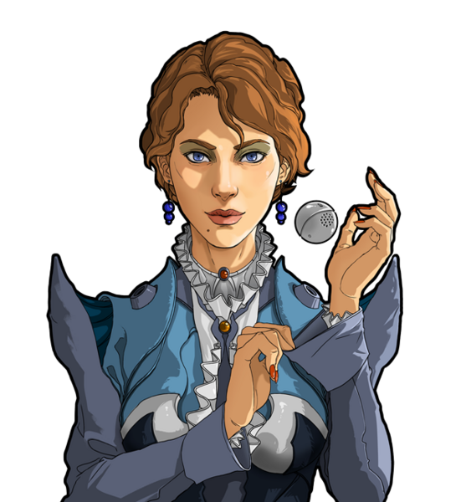
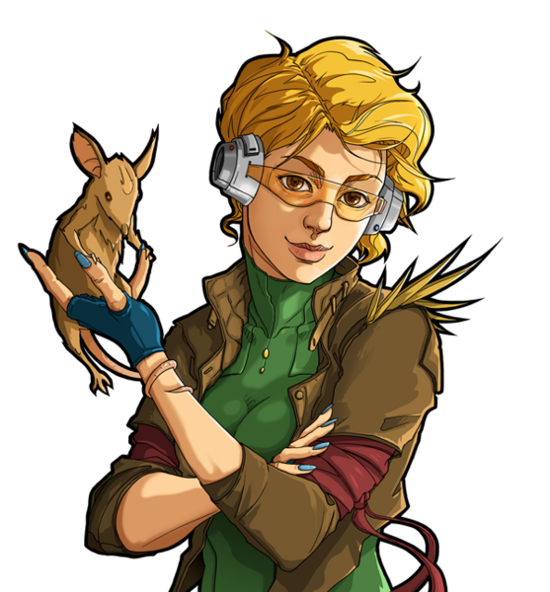
Interfacing
User Interface
Several “tabs” containing objects to build, colony roles and directions, animal status, and colony and world statistics
Colonists are semi-autonomous able to decide when to eat and what to work on by player-set schedules and jobs
Players can also direct specific colonists to defend an area or work on a specific task out of order if needed
Tutorials and Setup
RimWorld provides several high-level tutorials on how to interact with colonists and the colony, but story generation is left up to the player.
Players select their preferred storyteller, difficulty, starting colonists, landing zone and climate on the planet when embarking

Slide 7
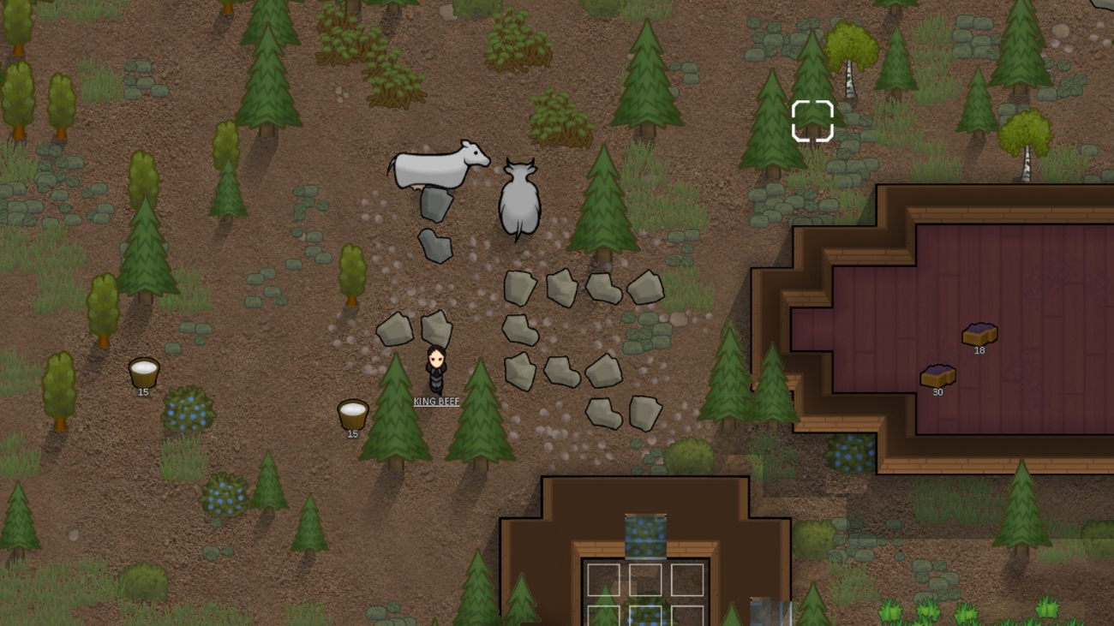
Artwork and Music
Artwork
Static character models with simple color pallets and customizable clothing colors
Foliage and shadows are time and season dependent
Music
Original space-western music soundtrack composed by Alistair Lindsay
Soundscapes match game theme of frontier survival

Slide 8
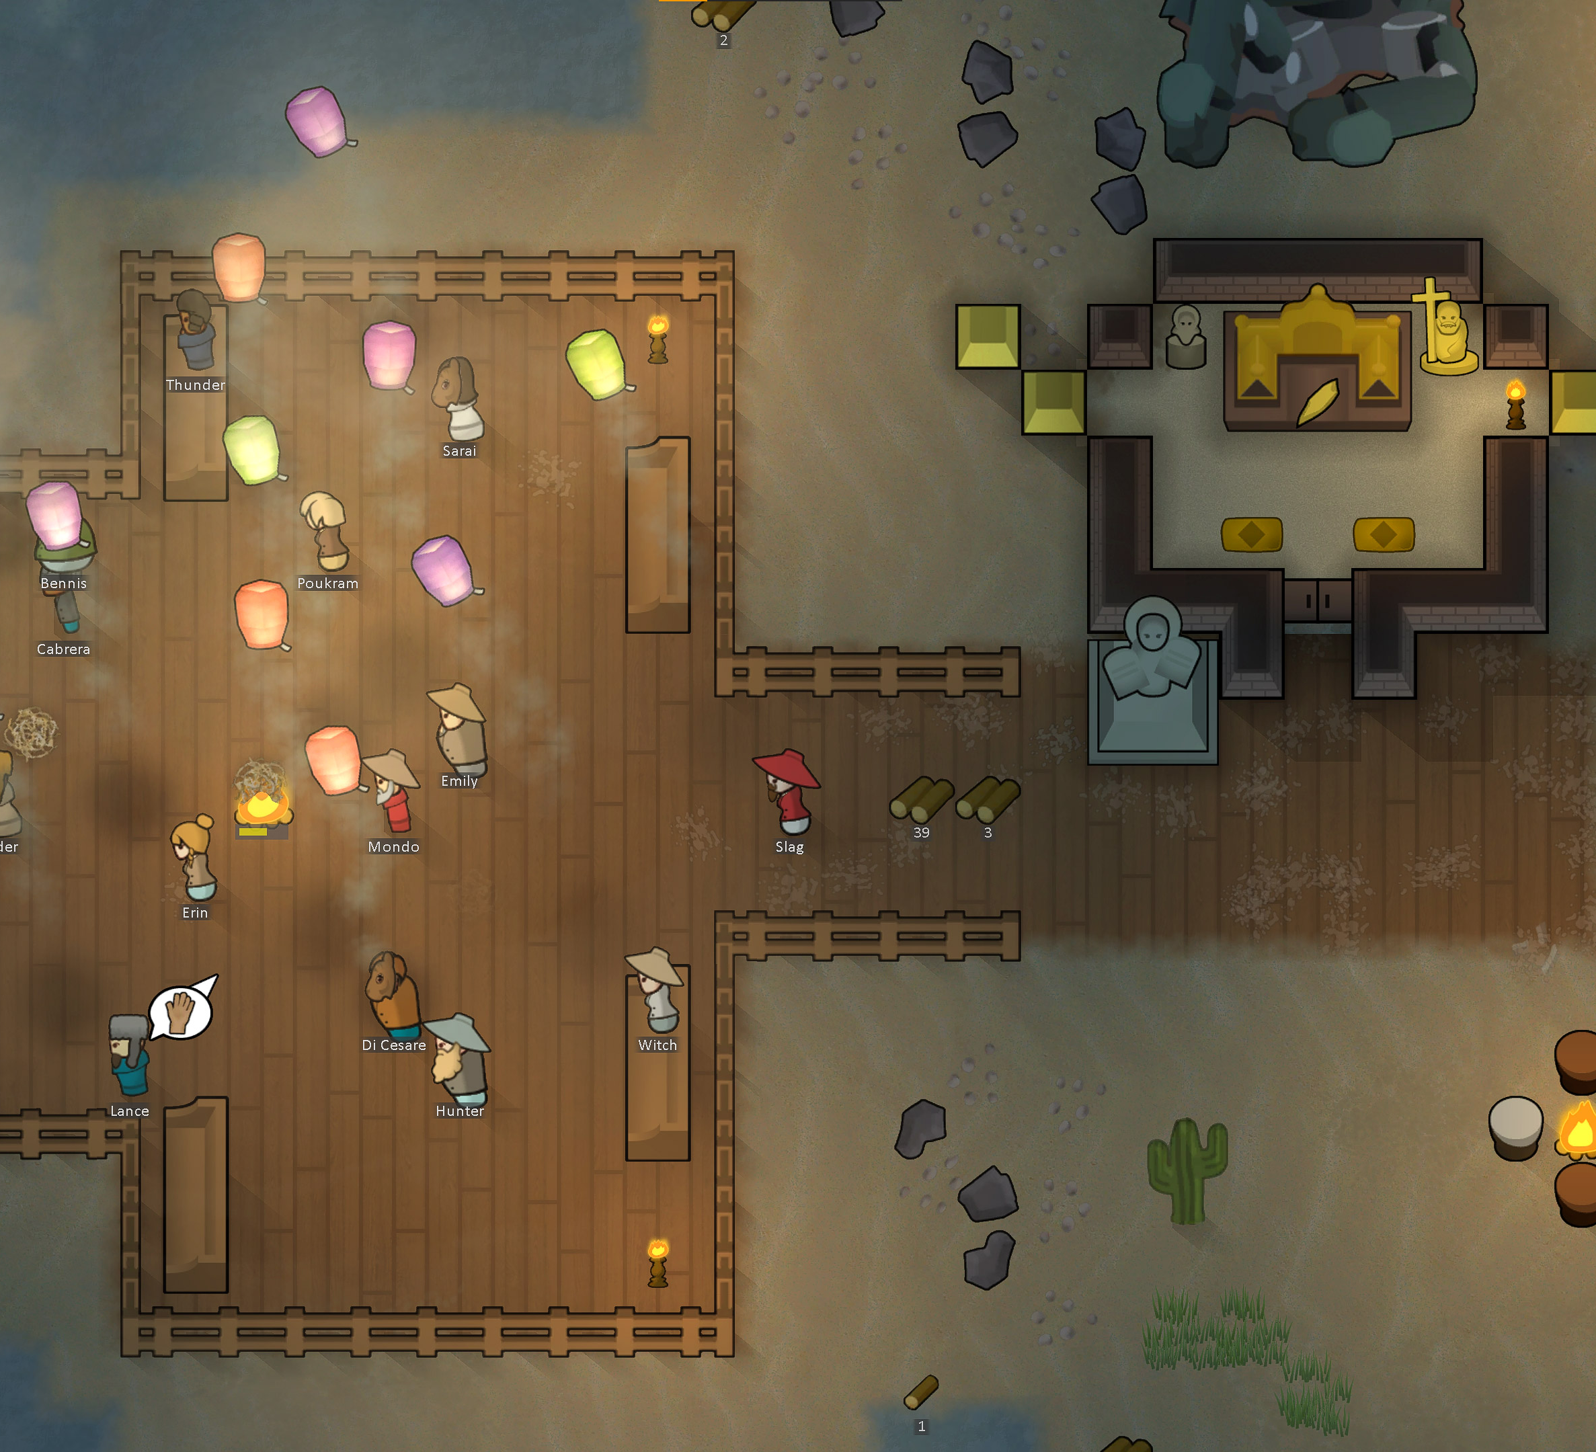
Game Review
Appropriate Audience: Adults which enjoy collaborative storytelling
The Good
Micro-management is optional
Colonist interactions are interesting but do not overshadow the colony story
Customizable difficulty adds to story-building process
Ample side quests and game paths
The Bad
First-time play can be overwhelming
Non-immersive if a player is expecting a clear, intentionally directed story
Ambiguous priorities and immediate effects of player decisions

Slide 9
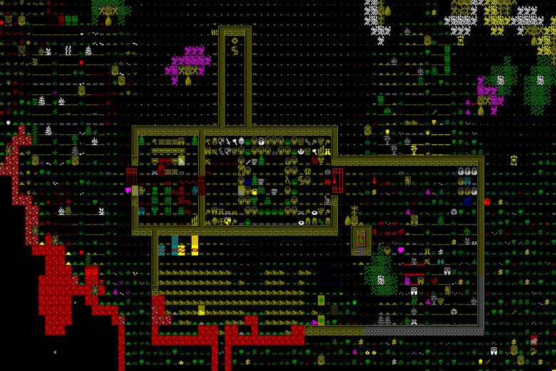
Game Comparison
Most similar game is Dwarf Fortress
Both have procedural storytelling with an emphasis on telling a story over a directed endgame.
RimWorld has a significantly lower learning curve in graphics, gameplay, and controls but lacks some of the depth of Dwarf Fortress
Items, events, and kingdoms in can span back decades as Dwarf Fortress pre-generates history and embeds these details into the lore of the world
Other titles in the colony-sim genre (Surviving Mars, Dawn of Man, etc.) are similar in game mechanics but lack much of the generative storytelling which sets RimWorld and Dwarf Fortress apart

Slide 10
Closing Thoughts
Strengths:
Strong, collaborative, procedural storytelling
Diverse side objectives and storylines
Weaknesses
Learning curve for how actions effect the colony
Potential fix: more directed tutorial
Shallow world-building depth
Potential fix: add some historical events and object lore generation
Worth Purchasing: Yes, generated content creates hours of replay ability

