Slide 1
Genshin Impact Game Evaluation
TAP TO BEGIN

Slide 2
Game Title: Genshin Impact Publisher: miHoYo
Genre: Action role-playing game, Adventure game Release Date: September 28, 2020
Price:
Free (in-game purchases) Platforms: PC, Mobile (iOS/Android), PlayStation
Minimum Hardware Requirements:
CPU: Intel Core i5 equivalent or higher
RAM: 8 GB
OS: Windows 7 SP1 64-bit, Windows 8.1 64-bit or Windows 10 64-bit
VIDEO CARD: NVIDIA GeForce GT 1030 and higher
PIXEL SHADER: 5.1
VERTEX SHADER: 5.1
FREE DISK SPACE: 30 GB
DEDICATED VIDEO RAM: 2048 MB
Recommended Hardware Requirement:
CPU: Intel Core i7 equivalent or higher
RAM: 16 GB
OS: Windows 7 SP1 64-bit, Windows 8.1 64-bit or Windows 10 64-bit
VIDEO CARD: NVIDIA GeForce GTX 1060 6 GB and higher
PIXEL SHADER: 5.1
VERTEX SHADER: 5.1
FREE DISK SPACE: 30 GB
DEDICATED VIDEO RAM: 6 GB

Slide 3
Game Summary
TAP TO BEGIN

Slide 4
Storyline:
You have arrived in Teyvat — a fantasy world where the seven elements flow and converge.
In the distant past, the Archons granted mortals unique elemental abilities. With the help of such powers, people formed a bountiful homeland out of the wilderness. However, 500 years ago, the collapse of an ancient civilization turned the universe upside down...
Though the calamity the world suffered has ceased, peace has yet to be restored.
Gameplay Mechanics:
Open world exploration and puzzles, limited events, combat with different elements and weapons, the domain system (talents/artifacts), the character/weapon wish system, team-building, and co-op mode.
Overview/Player’s Role:
As a traveler from another world in an adventure rpg, you will embark on a journey to reunite with your long-lost sibling and unravel the mysteries of Teyvat, and yourself. You can head-on into battles solo, or invite friends to join the fight against dangerous monsters with 4-player cross-play for PS4, iOS, Android, and PC. You also have the ability to manipulate the various elements which is the key to defeating powerful enemies and solving challenging puzzles
Installation:
Google Play Store (Android)
Apple App Store (iOS)
Playstation Store (Playstation)
https://genshin.mihoyo.com/en (PC)

Slide 5
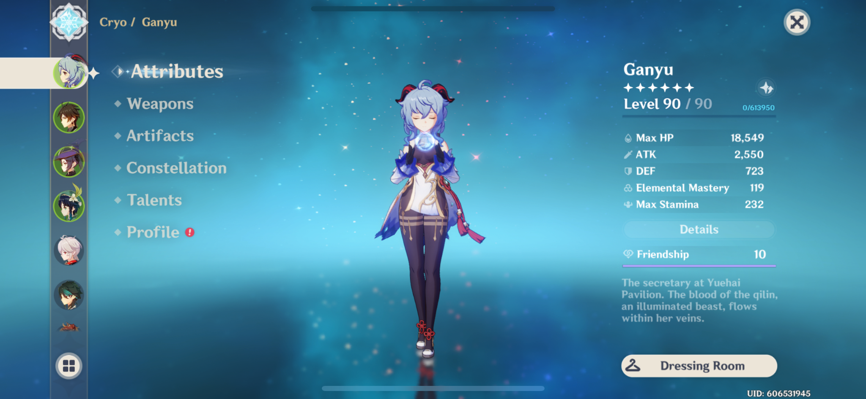
User Interface

Slide 6
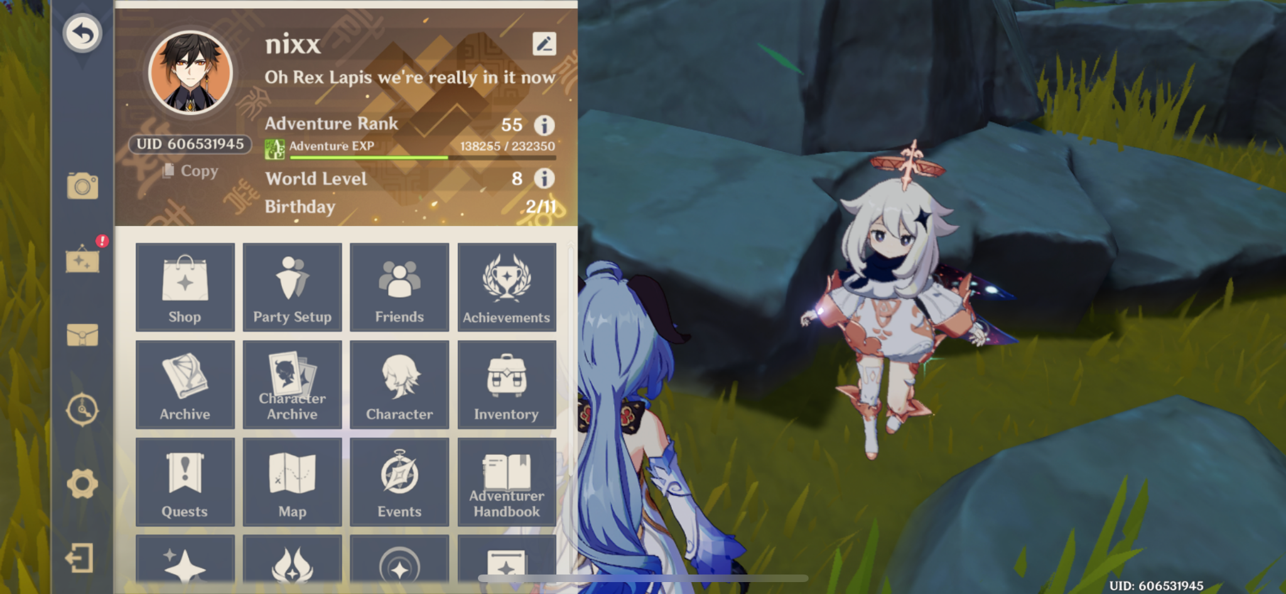
User Interface 2

Slide 7
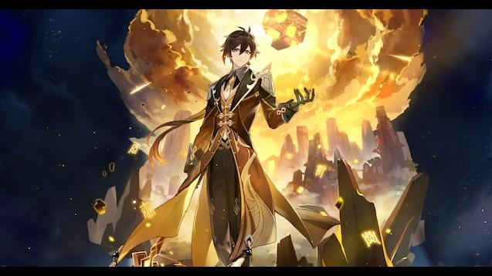
Artwork

Slide 8
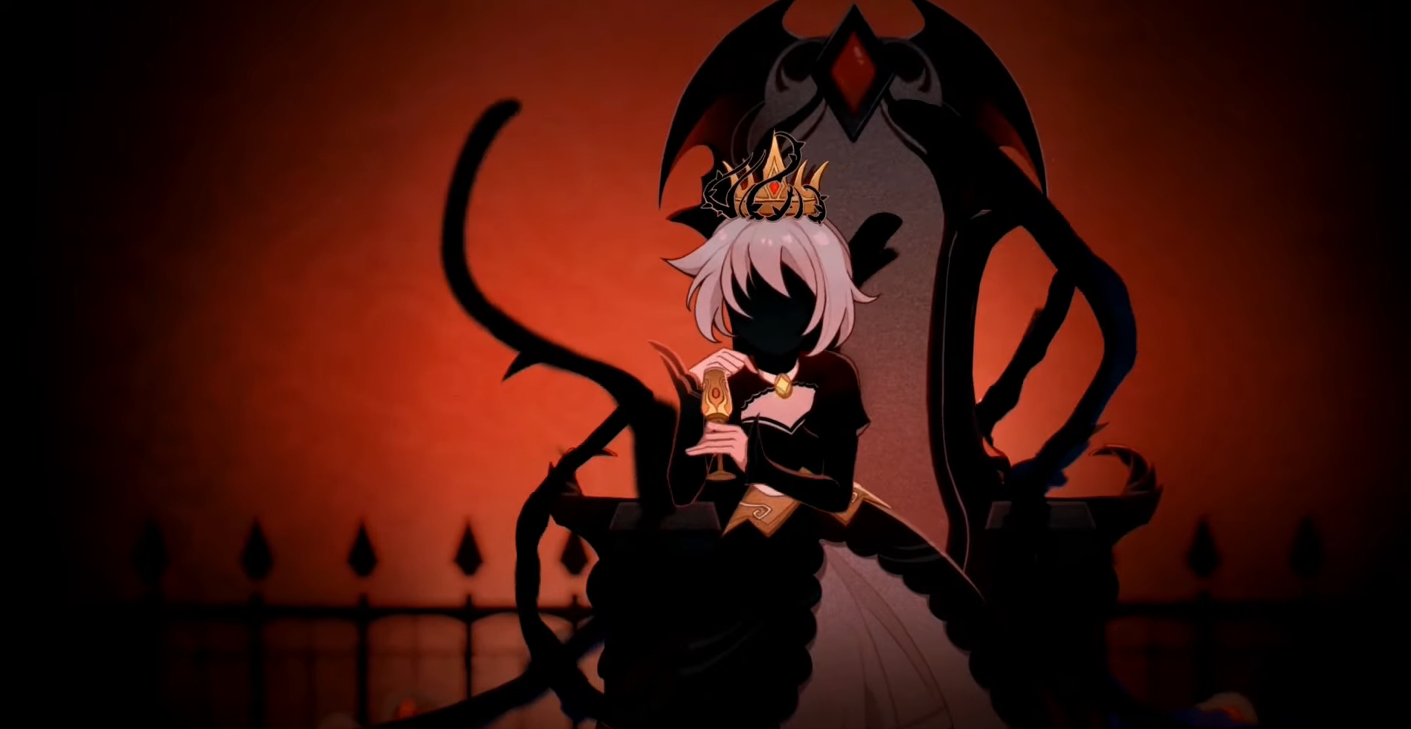
Artwork

Slide 9
Sound and music:
The sound in Genshin Impact encompasses a wide range of things. The most important is that playable characters are voiced and have a section to view all their voice lines. A good chunk of the lines are also combat lines that you will hear in the open world to make the world feel active. The characters also say other lines while exploring the world like commenting on weather changes. The music is also expansive as each region in the open world has a different style of music. This is usually influenced by the country the regions are based off of. For example, Liyue is based of China and the music in that region is inspired by that.
Manual:
There is no manual for the game, but there is a tutorial at the beginning of the game that lasts for the first few adventure ranks.
Bugs:
I have never personally experienced any bugs, but they have existed. The game is regularly updated, so they get patched out fairly quickly.

Slide 10
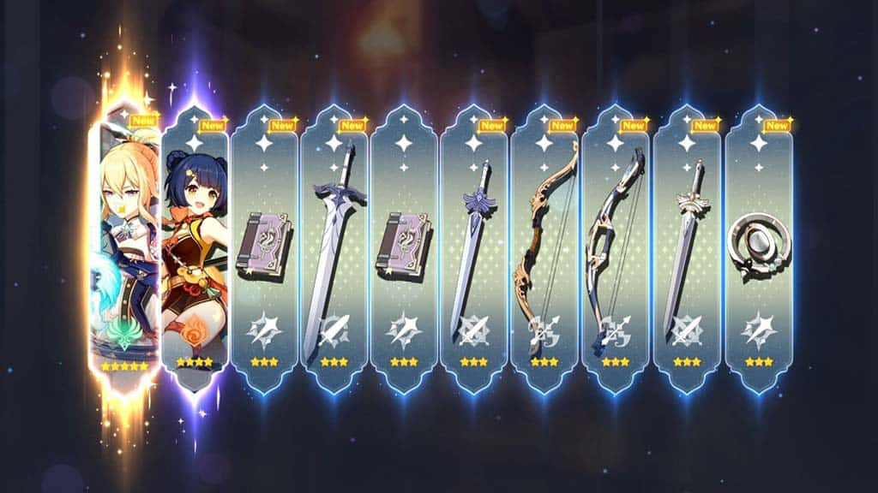
Special Features:
In Genshin Impact, there is a system known as the character/weapon wish system which is how you get characters or weapons to play the game with. This is based on rolling for the characters/weapons with primogems and the higher the rarity, the harder it is to roll.

Slide 11
Game Review
TAP TO BEGIN

Slide 12
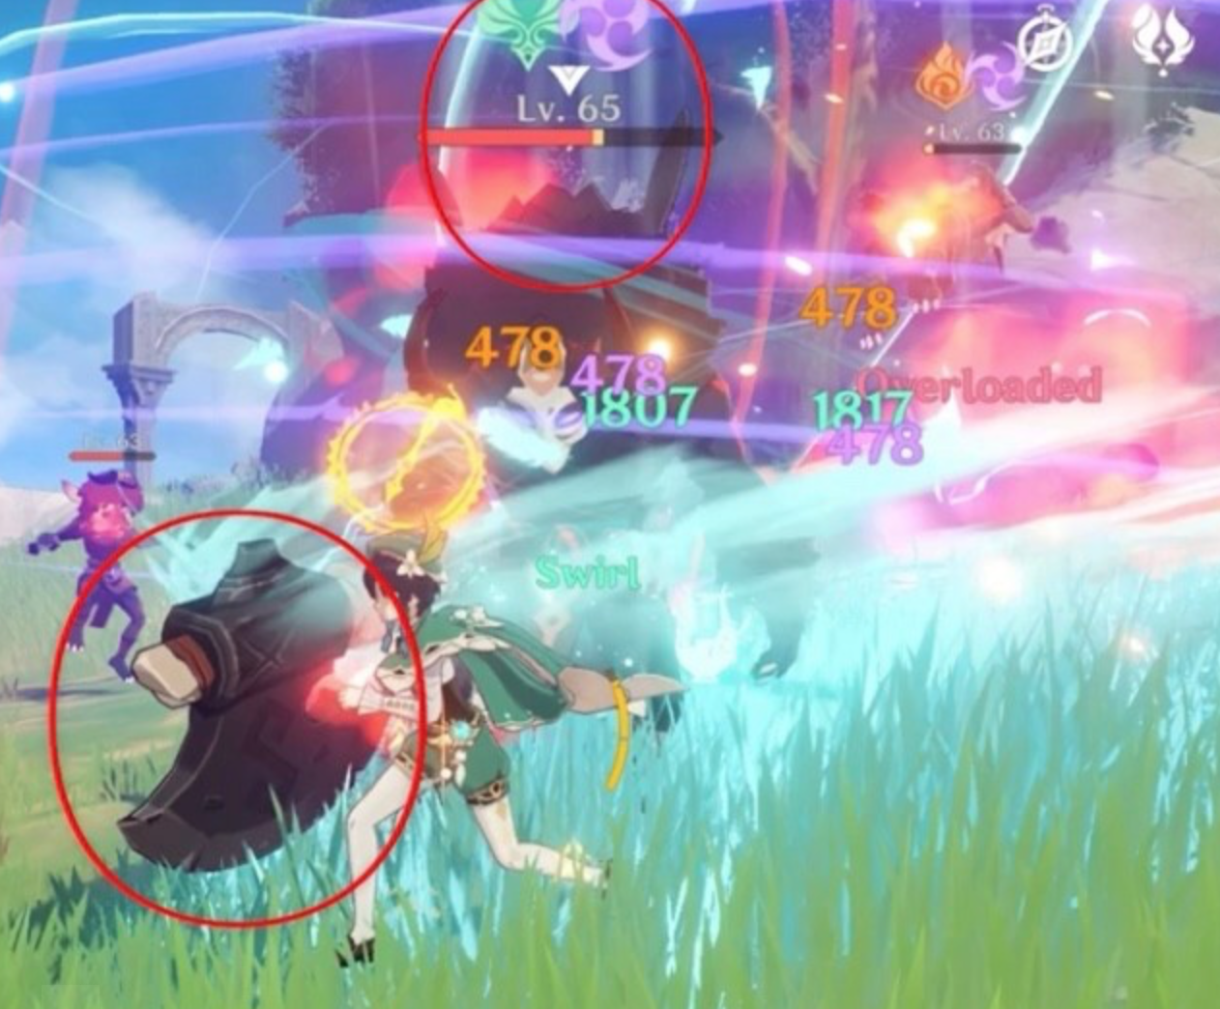
The Good
Exploration of the world is interesting because of the different regions and large, open world map
Puzzles and items to collect in the map are fun and give good incentives to do them
Combat and different character skills are easy to understand and fun to engage with because of elemental reactions
Characters feel different and unique to play
Daily and weekly missions give you a reason to log in everyday and play at least a little bit
Different limited events are unique (tower defense, fishing, challenge combat quests)
Although there is no PvP, the Spiral Abyss gives you a challenge to test your team-building skills and strategies on a solo level (and great rewards too!)
The game is updating often and still expanding
Characters and weapons at lower rarities are still useful
Wish system has a “pity system”

Slide 13
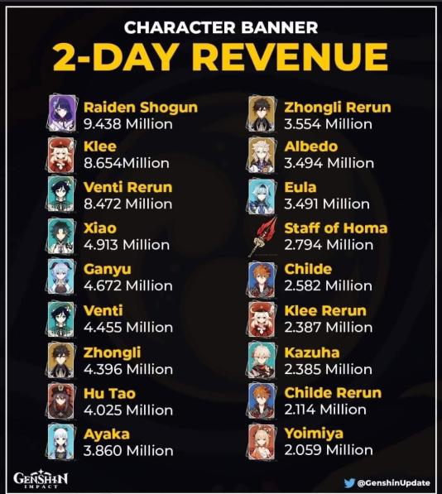
The Bad
Character/weapon wish system rates are very low and difficult to get higher rarity (0.6% for a 5* which is the highest rarity)
Limited banner character on rate up is NOT guaranteed unless you get “pity-broken” once before
Essentially a gambling game
Artifacts for characters also have rng issues with substat leveling
You can not grind infinitely because of the resin system which is essentially stamina for farming artifacts, weapon leveling materials, character leveling materials, and talent books
The resin system also has very limited resin (you can use resin moons to get more, but not a full refill)
Primogems (currency for wishing) is handed out very scarcely
Security system for your account is not well handled or very secure

Slide 14
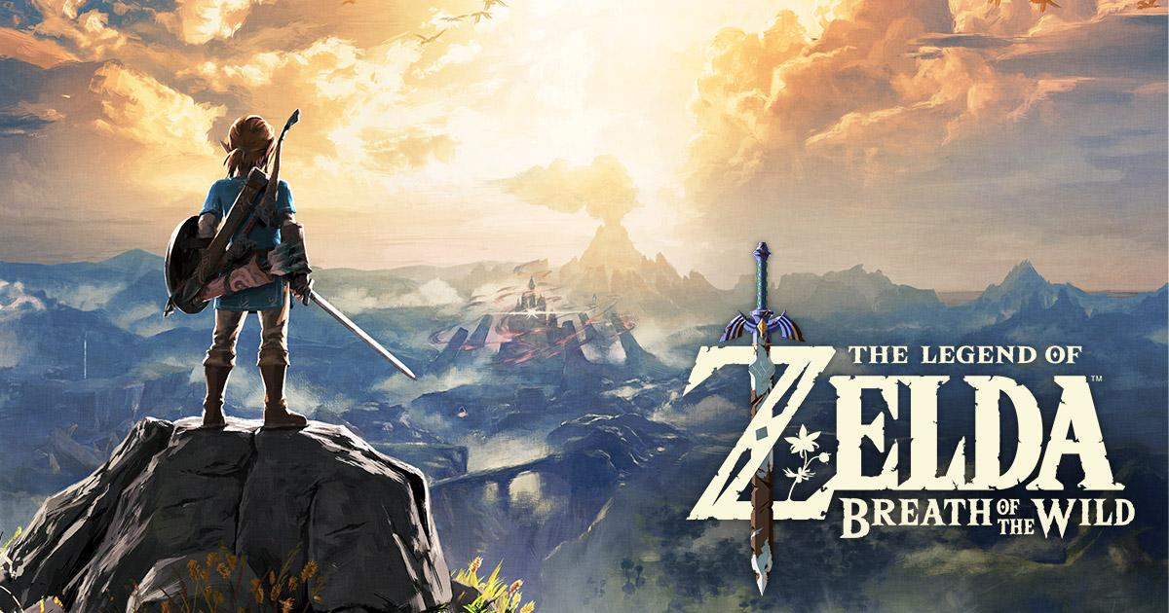
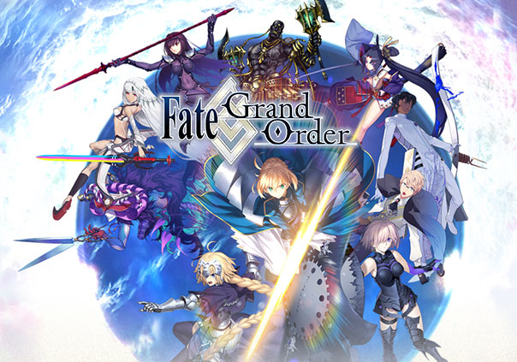
Comparison:
At Genshin’s best, it is discount BOTW. Genshin gets regularly compared to Breath of the Wild because of its open world adventure rpg format and the look of the world. They also have other similar features such as gliding and climbing that require stamina. Although, Breath of the Wild has a better designed map, puzzles, and is solely an open world adventure rpg with no gambling aspect. At Genshin’s worst, it is better Fate/Grand Order. Fate/Grand Order is game that also heavily relies on a wish like system to get characters and is one of the original types of this game to get big. It is way more simplistic in nature with poor QOL and a poor combat system with boring repetition. Genshin Impact is way more expansive and the combat is more thought out with the repetition in farming not being boring.

Slide 15
Design Mistakes:
The biggest design mistake is the rng rates for artifacts. There is also no way to fix your substats which becomes increasingly frustrating and makes farming a pain. The rates of the wish system compared to the amount of primogems we get is also at an imbalance and makes trying to get new characters that you want hard.
Appropriate Audience:
Since there is gambling and the ability to buy more primogems with real money, I don’t really think anyone under 18 should play. This game and its system is meant to be predatory in regards to getting new characters and weapons.
Summary:
The game does have good strengths in its world design (puzzles, collecting, map, etc) and fun combat system because of elemental reactions, but the poor rng that permeates through the game and the foundation of the game being built around wishing which is gambling is very off-putting. The game is free, so you technically don’t lose anything trying it. It is hard for me to actually recommend it though because of its predatory nature. The game could be improved by removing these elements or making the rates easier, but since a pity system is already in place these improvements are unlikely.

Slide 16
Sources:
https://genshin.mihoyo.com/en/game
https://www.systemrequirementslab.com/cyri/requirements/genshin-impact/20275
https://screenrant.com/genshin-impact-wish-characters-weapons-banner-pull-rates/#:~:text=A%205%2Dstar%20Banner%20character,but%20are%20still%20fairly%20low.

Slide 17
Thanks for watching!

