Slide 1
Game Evaluation
Notes:
Hello! My name is Nicole Stark and I will be doing a game evaluation of Terraria.

Slide 3
Basic Information
Company: Re-Logic
Developers*:
Andrew Spinks (“Redigit”)
Whitney Spinks (“Cenx”)
Yorai Omer (“Yoraiz0r”)
Chris Bednarz (“Skiphs”)
Charles Hanrahan (“Grox”)
Type of Game: 2D Sandbox RPG
Price:
PC: $9.99
PS4/XboxOne: $19.99
Nintendo Switch: $29.99
Android/iOS: $4.99
Minimum Hardware Requirements:
OS: Windows Xp, Vista, 7, 8/8.1, 10
Processor: 2.0 Ghz
Memory: 2.5GB
Hard Disk Space: 200MB
Video Card: 128mb Video Memory, capable of Shader Model 2.0+
DirectX®: 9.0c or Greater
Recommended Hardware (diff.):
OS: Windows 7, 8/8.1, 10
Processor: Dual Core 3.0 Ghz
Memory: 4GB
Video Card: 256mb Video Memory
*Full list of all contributors: https://terraria.fandom.com/wiki/Re-Logic
Notes:
Terraria was developed by a company called Re-Logic. Re-logic is an independent game dev studio founded by Andrew Spinks, who is credited as the creator of Terraria.
Terraria is a 2D sandbox RPG game sold for 9.99 on PC and varying prices on other platforms. There is not any major requirements for Terraria, most computers should be able to handle it without issue, but the minimum and recommended requirements are shown here.

Slide 5
Game Summary
Overview: Explore, craft, build, survive!
Dig through different layers and biomes to gather materials
Fight monsters and bosses
Upgrade armor and weapons through crafting
Customize with cool vanity items and build whatever you want
Player’s Role:
Improve by exploring, killing enemies, and crafting better items
Start fresh on new worlds with the same character
Notes:
Terraria is a sandbox game based around exploring, crafting, building, and surviving. You can gather a wide variety of materials by digging through the different layers of the map and fighting different monsters, including bosses, in order to craft better armor and weapons, buy cool vanity items, and create new structures.
The player’s role in Terraria is to explore the world, loot items, kill monsters, and craft different items. The player can also build structures, go fishing, and have small interactions (such as purchasing items) with some NPCs.

Slide 6
Getting Started
Installation: Virtual download
Can get physical disk for consoles
User Interface:
Side scroller centered on player
Inventory hotbar, health, map display
Full inventory can be opened
Game Play:
Start with basic resources
Gather materials and craft better equipment
Minimal guidance
Manual: Terraria Wiki*
Written and maintained by players
*Terraria wiki link: https://terraria.fandom.com/wiki/Terraria_Wiki
Notes:
Getting started with Terraria is very easy, just a simple download.
The user interface is really easy to learn. The camera is centered around the player with movement being your typical WASD and mouse controls, as well as a few extra keys for things such as opening your inventory, hotkeys for taking health, mana, or buff potions, and a few more things. On the screen, you will see a hotbar with your top 10 inventory items for easy access, as well as a map (which can be hidden), your health and mana, and possibly a few other pieces of information depending on your accessories.
To begin playing, you create a character and a world (which can either be randomly generated or you can specify a world seed). You start off with some basic equipment, like a pickaxe and a sword. You then must gather resources by digging, fighting, and exploring in order to craft better armor, tools, and weapons, as well as create a base for yourself.
There is a Terraria Wiki on the web which is maintained by the Terraria community of players that provides information on everything in the game.

Slide 7
More Information
Artwork: 2D 16-bit Style
Lots of depth
Large variety of visuals and colors
Sound/Music:
Over 80 music tracks!
Music composed by Scott Lloyd Shelly
700+ sound effects
Bugs*:
Has received many updates/patches since original release
“Hoiks”, clipping, block placement
*Full list of known bugs: https://terraria-archive.fandom.com/wiki/Known_Bugs_And_Glitches
Notes:
The artwork of Terraria is 2D 16-bit style.
As for the sound and music, Terraria has over 80 music tracks which change depending on the biome you are in or what event might be going on at a given time. There are also over 700+ sound effects built into the game for different actions with weapons and tools, as well as enemy noises, movements, and more.
Terraria has received many updates and patches since it’s original release, so the number of bugs is minimal, however there are still a few which are noted on the Terraria wiki.

Slide 8
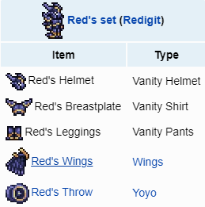
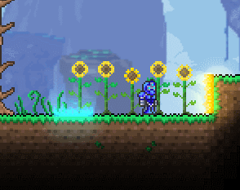
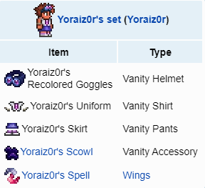
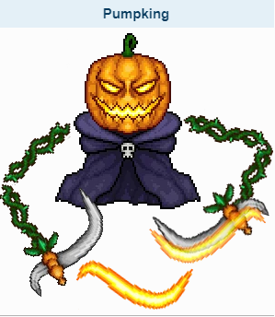
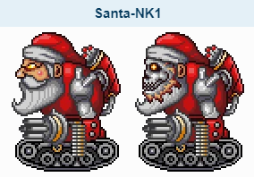
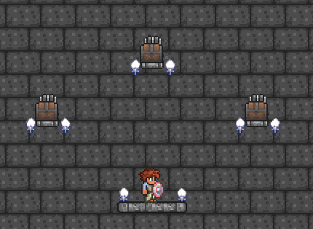
Special Features
Easter Eggs:
Developer items
Secret world seeds
Popular media references
Seasonal Events:
Halloween events
Christmas events
Notes:
Now for one of my favorite parts of Terraria: the special features. Terraria contains a large number of easter eggs, in the form of popular media references, developer items, and even secret world seeds.

Slide 10
Why is it fun?
You play how you want to
Progress through bosses
Customize your character and build cool structures
Just explore
Every time is different
Worlds generate differently
Play different character types
Play on harder modes
Special events
Community involvement
Ability to mod the game
Notes:
I believe Terraria is fun for a lot of reasons. A big part of this is that you can play how you want to. You can work on game progression by upgrading your armor, weapons, and tools and defeating the various bosses. Or you can work on customizing your character with fun vanity items and building cool structures. Or you can just spend your time exploring the world.
As an extension off this previous point, every time you play Terraria can be different. The worlds will generate differently, sometimes certain items may spawn in one and not the other. This is especially true if you change difficulty levels, as setting a world to expert mode introduces new boss drops. There can also be different bosses and enemies depending on the evil biome you choose (Crimson or Corruption). You can build your character differently, as well, one time you might play as a summoner and the next you might play as a Melee/Ranged hybrid.
The special events, from new updates to seasonal events, also make the game more interesting, as new content is introduced. This is especially great due to the dev involvement and general Terraria community.
The community behind Terraria also allows you to draw inspiration from other players, such as cool things they’ve built or even mods they’ve designed.

Slide 11
Why is it NOT fun?
Minimal guidance
Hard to get started
Not much help on finding items or bosses
Lots of grinding
Low drop rates for certain items
Beat bosses more than once
Random generation means some items won’t spawn on world
Difficulty disparity
Boss progression doesn’t always mean harder
Notes:
Now all of that being said, there are some downsides to Terraria. It can be difficult to get started given the very small amount of guidance available. There is really not much help with finding items, learning how to craft certain things (or even knowing what’s available TO craft), and finding bosses to progress the game.
In addition to that, the game requires a LOT of grinding. Some items require mining a LOT of materials that aren’t always easy to find, or require defeating a lot of enemies, or even require defeating bosses more than once. The drop rates on some items are crazy low, and even then aren’t a promise. On top of all that, given the random world seeds and randomization of what items might spawn and where, there is a chance that some items may not even spawn on a world you generate, FORCING you to create another world just to be able to craft certain items.
Finally, beyond the lack of guidance and massive amounts of grinding, there can be a lot of disparity of difficulty through the game. Just because a boss isn’t unlocked until after another boss is defeated doesn’t guarantee that it’s more difficult (or vice versa).

Slide 12
Compared to Similar Games
Commonly compared to Minecraft
2D vs 3D
Sandbox games
Lots of crafting
Larger focus on exploring and action than many sandbox games
Larger focus on crafting/building than many action games
No storyline or definitive ending
Minimal guidance provided
Notes:
Terraria is most commonly compared to Minecraft, since they are both on a basic level sandbox action RPGs. To state the obvious, one of the biggest differences between the 2 games is the graphics: obviously Terraria is 2D and Minecraft is 3D. Beyond that, they both have sandbox environments where players can build basically whatever they want, and they both offer the ability to craft a variety of items.
In general compared to similar games, Terraria has a larger focus on exploration and action than many sandbox games (which usually are more focused on building things). However, compared to action games, Terraria has a larger focus on crafting and building. It really plays the cross-section in order to give you the best of both worlds.
Finally, compared to many games, there is not a lot of guidance in Terraria. There is no tutorial, no helpful tips that show up throughout gameplay, just trial and error.

Slide 13
Better or Worse?
Better:
Large amount of content
Easy to install and get started
Opportunities for creativity
Worse:
Lack of guidance and confusing progression
No storyline
Lots of grinding
Multiplayer servers have virtually no moderation capabilities
Notes:
All that being said, is Terraria better or worse than similar games?
Now, as any sort of review, this is largely related to preference.
However, there are some aspects that I think many people can agree on that make Terraria better than many other games. For one, Terraria has a huge amount of content. You could play for hundreds of hours and still have new things to find or create. Also, Terraria is really easy to just jump in and play. You may not know everything you can do or craft, but you can certainly start exploring right off the bat and finding new things to work with. Finally, given the wide variety of materials and customization, you can get really creative with your building and characters.
As for worse, you’ll note a common theme that the lack of guidance is a huge pain point.
Another common theme: the large amount of grinding it takes to get or craft certain items can be a huge pain point. If you are trying to get an item that only has a .2% drop rate, you could easily find yourself getting bored and quitting as a result.

Slide 14
Other Game Review
Audience:
Something for everyone
Rated for teens and up
Cartoon violence
Mature themes
Design Mistakes:
Lack of guidance
Some items found late-game are weaker
Notes:
On some final notes: Terraria is a game that I think has something for everyone. There are a lot of fun references, there’s a lot to do, and you can play how you want to. That being said, many sites agree that Terraria is not a great game for younger kids, since there is a lot of cartoon violence, including some gore, as well as some mature themes like drinking alcohol
As for design mistakes: again, the lack of guidance is a huge pain point, especially if you don’t want to go scouring a wiki for everything.
Finally, there are some items that are dropped by later bosses or simply not available to make until later in the game that are ultimately pointless, as they are often weaker than other items already available to the player.

Slide 16
Summary
Strengths:
So much content!
Variety of play styles
Developer involvement & community
Weaknesses:
Grinding
Lack of guidance
Is it worth it? YES!
Content updates
Something for everyone
Lots to do
How could it improve?
More in-game guidance, such as a crafting catalog or guide for finding items
Improve drop rates to prevent overgrinding
Notes:
In summary, Terraria is a very strong game due to the amount of content available and the ability for players to play how they want to. Not only that, but the developer involvement and community behind Terraria makes for a really enjoyable experience.
However, as commonly noted throughout this review, the lack of guidance and amount of grinding required really hinder the game.
Overall, would I say Terraria is worth the money? Absolutely! The game has a lot of content, you can do whatever you want and build whatever you want, and frankly the game play itself is just fun.
How do I think the game could improve? More in-game guidance could be provided so users don’t have to reference the wiki so much and drop rates could be improved so you don’t have to kill 1,000 of one enemy just to receive a mid-level drop.

Slide 17
https://terraria.fandom.com/wiki/Terraria_Wiki
https://store.steampowered.com/app/105600/Terraria/
https://en.wikipedia.org/wiki/Terraria
Email: nistark@umich.edu
Notes:
That concludes my evaluation of Terraria, if you have any questions or just want to play some Terraria, feel free to email me! Thanks for watching!

