Slide 1
Game Evaluation: Club Penguin
Mustafa Soby

Slide 2
Basic Information
Technically called Club Penguin Rewritten now
Originally bought out and popularized by Disney (shutdown and rewritten by CPRewritten.net)
It is a multiplayer online RPG
Free to play
Minimum hardware - A web browser.
The game does not run well, even on great hardware.

Slide 3
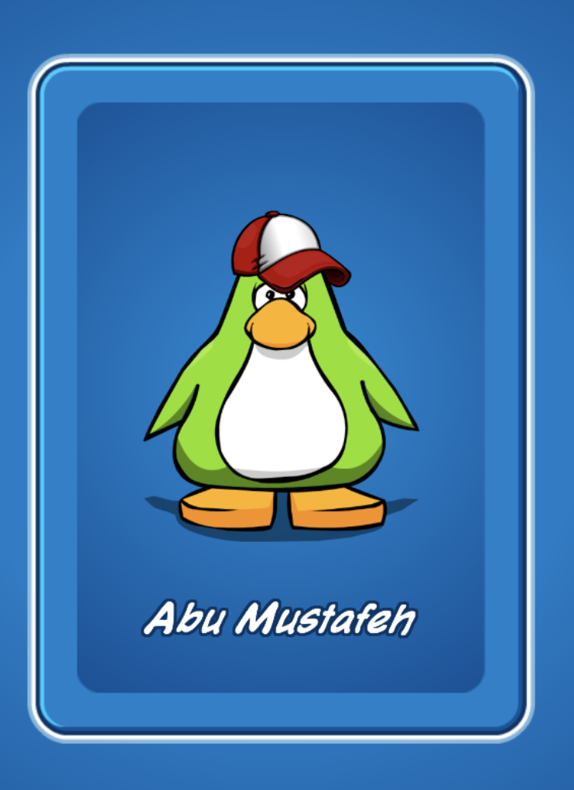
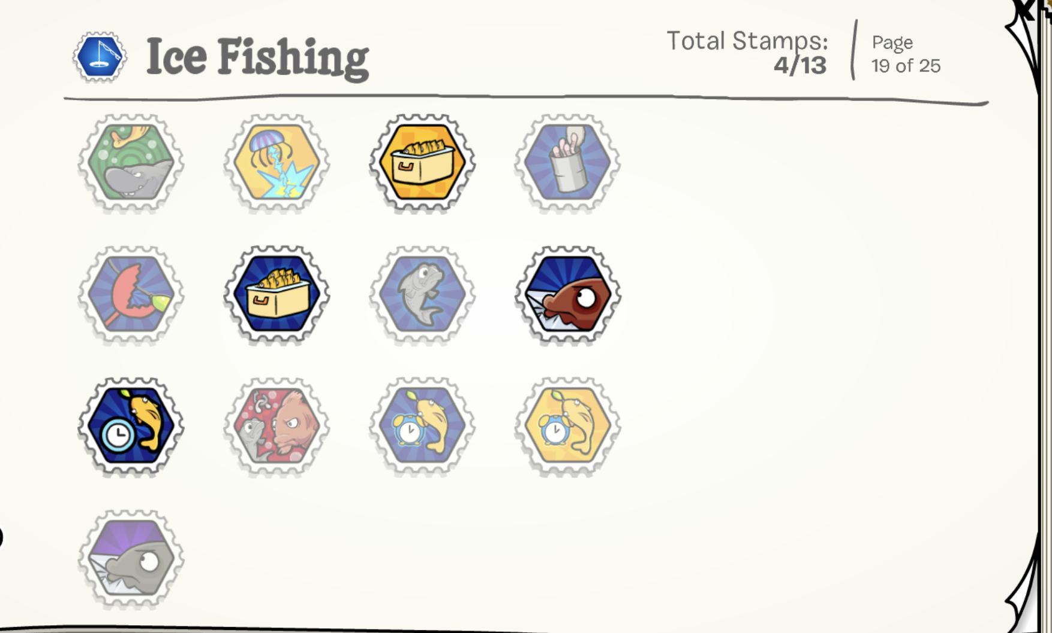
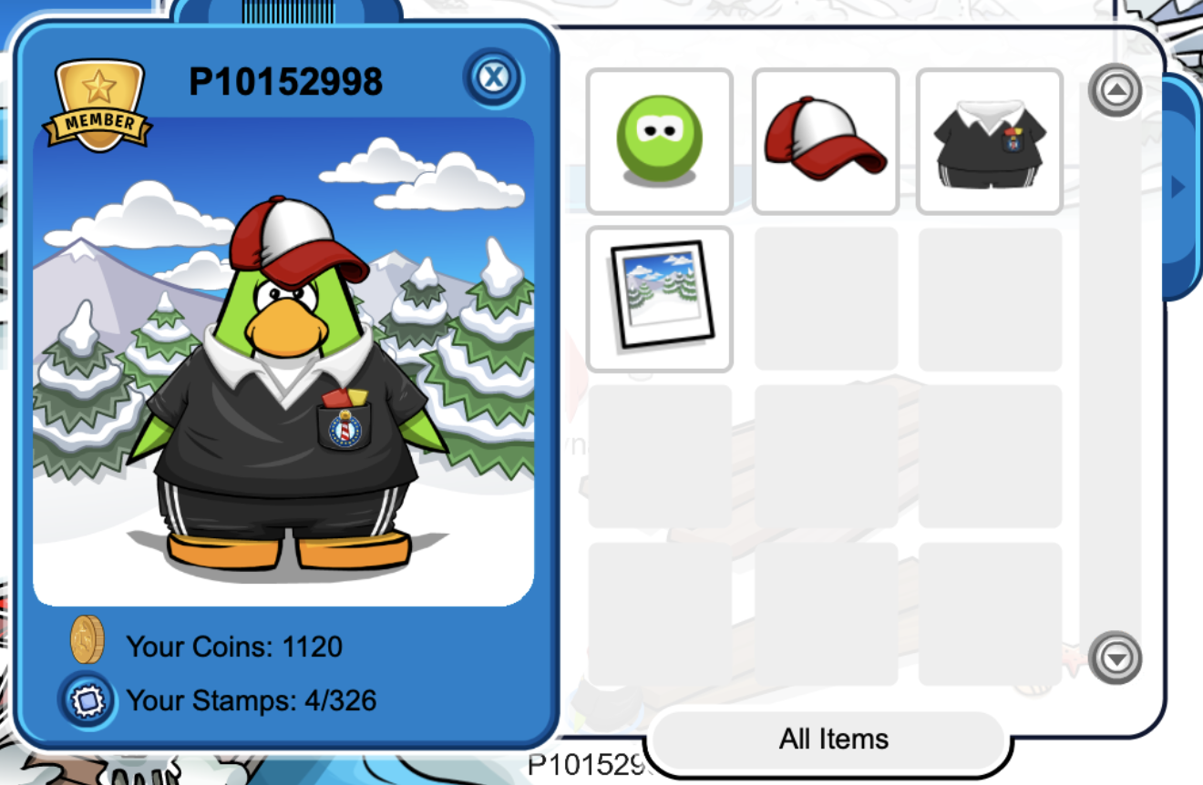
Game Overview
Club Penguin was an extremely popular game in its time. Essentially each person has their own avatar penguin that they can dress and change how they like. There are many games, some multiplayer and some single player, all around the map. The goal is to improve one’s penguin to the maximum and gain badges.

Slide 4
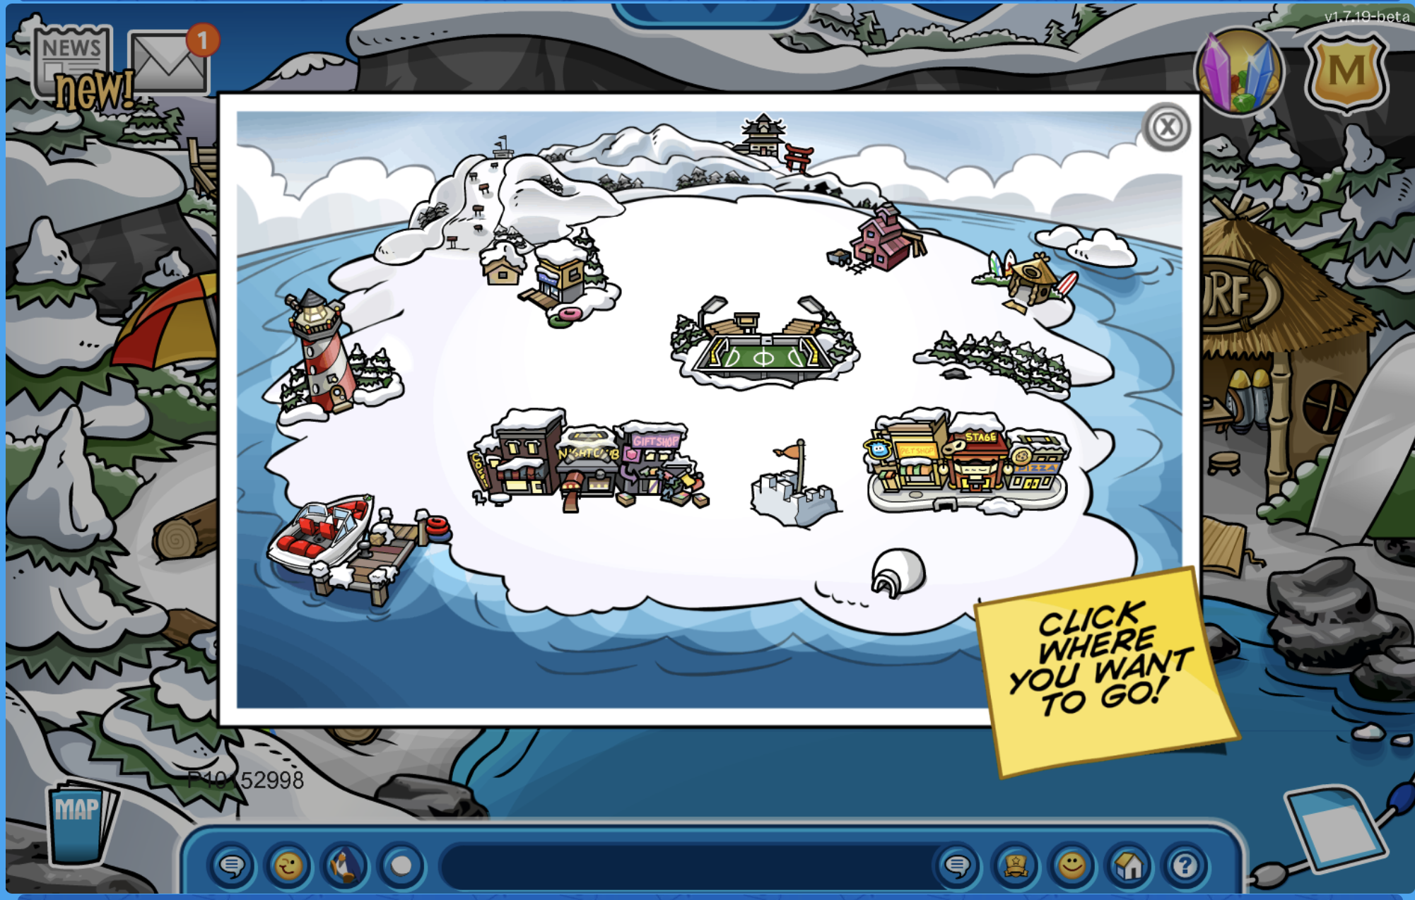
Game Overview pt. 2
There is no overarching story, although there are sometimes season/holiday themed mini-games that take place all across the map.
Player’s role is to advance through higher levels of each mini-game and gain status.

Slide 5
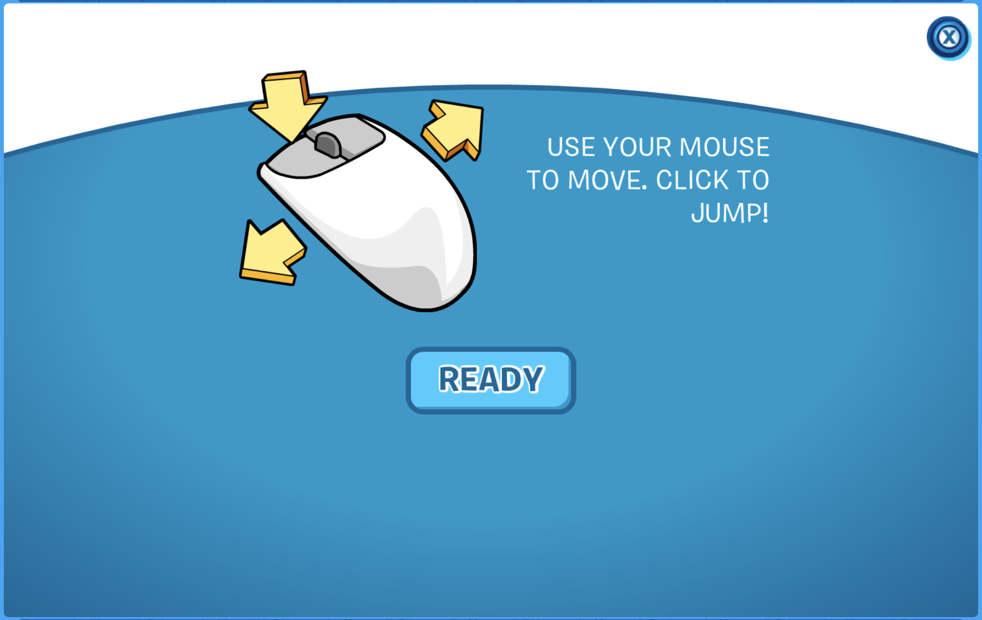
Game Play
No installation involved. Simply needs a basic web browser to run inside.
User Interface is only the keyboard and mouse. The UI of the actual game is easy to understand and use. It gives directions on how to play before every game.
Game play is simple and straightforward. There are multiple mini-games involved, each has its own instruction set.

Slide 6
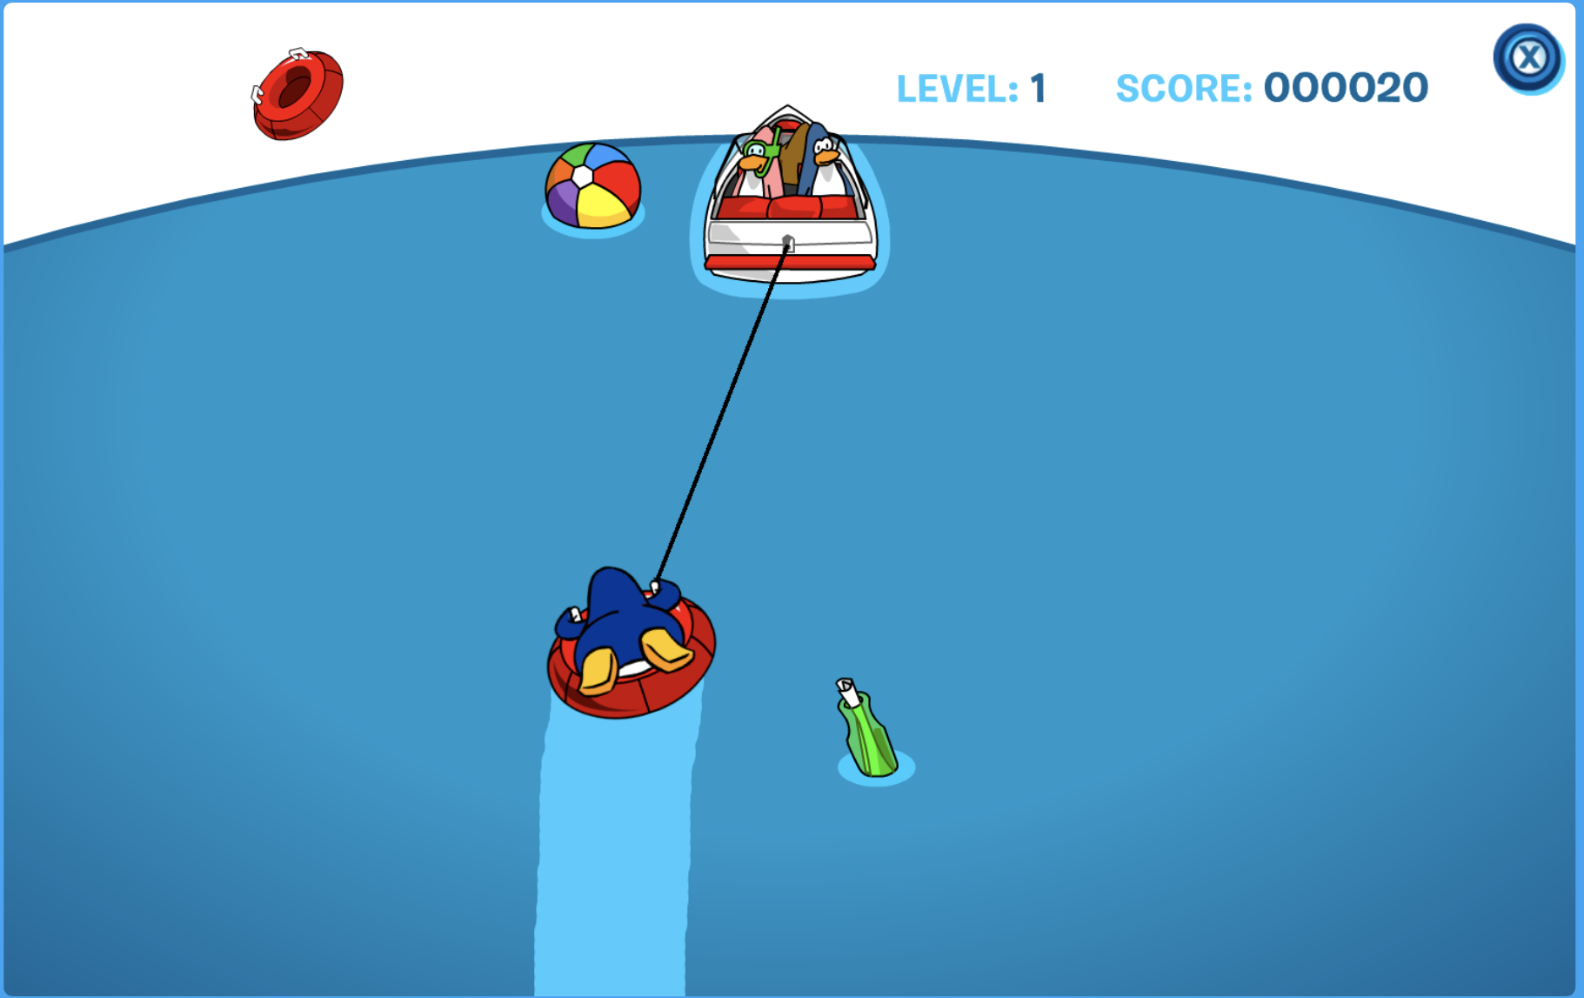
Points system and Artwork
The scoring is determined by which mini game the player is in. In general, there is a points system for each game that usually increments by 10. At the end, points are converted to coins.
The artwork is mostly clipart and very low quality. It’s not like a high quality game such as Call of Duty.

Slide 7
Features
The music and sounds are very important to the gameplay because they make it more enticing and fun.
There are no special features in the game. However the avatars are very complex and the mini-games are elaborate and have levels to them.
There is no manual for the whole game, but there are directions to how to play each mini-game before the game starts.
Club Penguin was buggy from its start, and even today Club Penguin Rewritten is also buggy. That seems to be the drawback of running a complicated game like that in a web browser.

Slide 8
What Makes it fun?
Character Customization
Social Status System (Bragging rights)
Has multipurpose fun (mental, physical, and social) all at once
There is the desire to beat other people or challenge them to revenge matches if you lose
Capitalizes on the desire to be dominant even though it’s an online realm

Slide 9
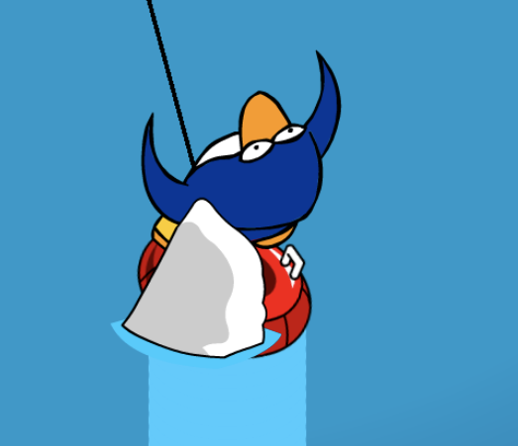
What makes it not fun?
Bugs
Too simple or repetitive
The only concept of difficulty is making the obstacles move faster or adding more of them.
There is little instances of progressing the difficulty with new and diverse challenges.
Fighting against the computer is too easy at times.

Slide 10
Comparison to other games
It has a very small genre, there are few games similar to it. One example is poptropica, which is more based on puzzles than minigames.
I would say poptropica is more enjoyable because the puzzles are more complex than the simple and repetitive mini-games.

Slide 11
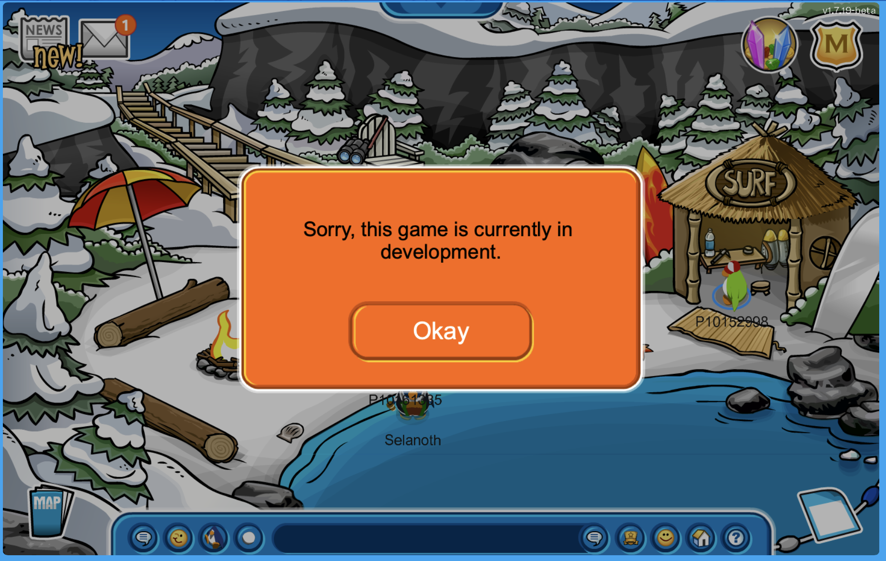
Audience and Design
The appropriate audience is children in elementary school. Maybe some kids would enjoy it in middle school.
There are no major design mistakes that I noticed. However there are several minigames that are not implemented on the new version of Club Penguin. The original game did not have these problems.

Slide 12
Strengths and Weaknesses
Strengths
Easy to use.
Matches the difficulty level of the intended audience.
Wide variety of games and types.
Weaknesses
Might be too simple and easy for some players even if they are children.
Buggy and requires advanced hardware.
Software is poorly written.

Slide 13
Suggestions
It could be improved by adding some mini-games that are puzzle or adventure themed, like other games in this genre do.
Could be made a downloadable program so that it can take full advantage of the hardware it is on. Rather than run in the browser.

