Slide 1
PlayerUnknown’s BattleGrounds
PUBG
Gurnoor Sandhu

Slide 2
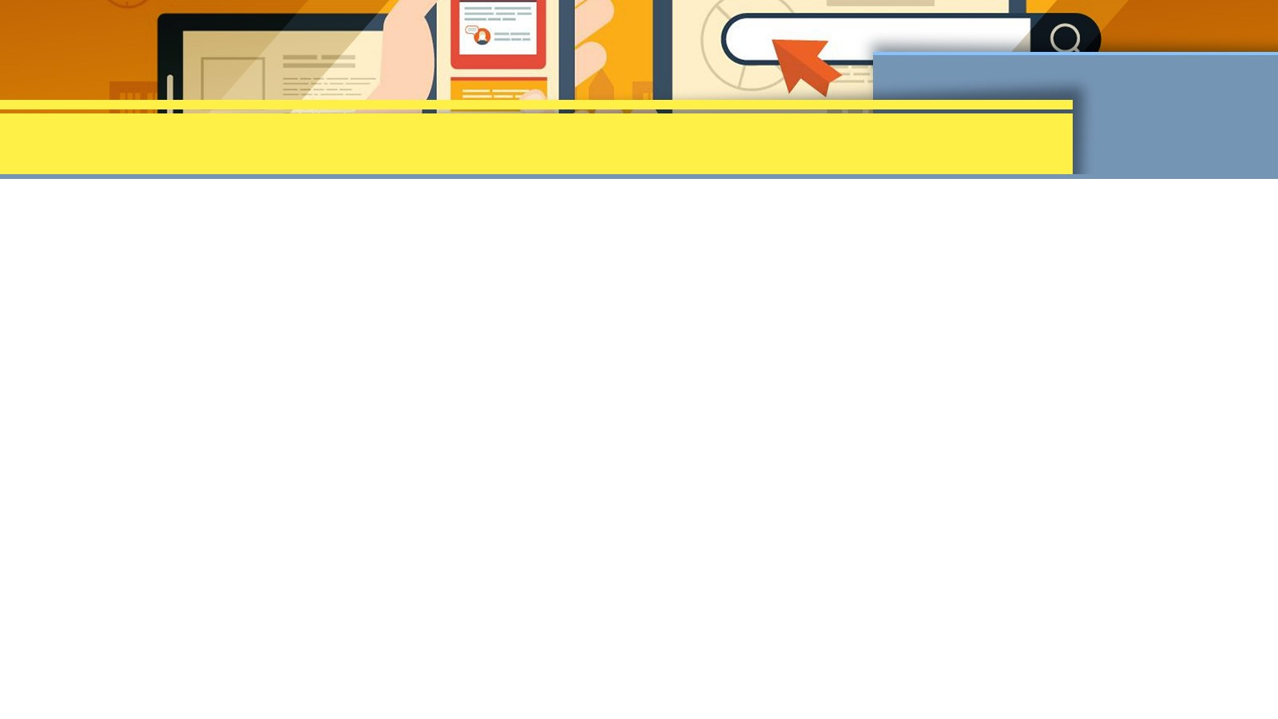
1. Basic Information
Game Title | PlayerUnknown’s Battlegrounds
Company & Author | PUBG corporation, Brendan Greene
Type of Game | Battle Royale
Price | $30
Minimum stated hardware Requirements Actual hardware required | OS: 64 bit windows7, 8.1, 10. Processor: Intel Core i5-4430/AMD FX-6300 Memory: 8GB RAM Graphics: NVIDIA GeForce GTX 960 2GB/ AMD Radeon RR7 320 2 GB Direct x : version 11. Network: Internet Connection Storage: 30 GB available space.

Slide 3
2. Game Summary
a- Quick Overview:
PlayerUnknown's Battlegrounds (also known as PUBG) is a multiplayer online battle royale game developed and released by Bluehole, a South Korean business. PUBG is based on a version for ARMA 2 called "DayZ: Battle Royale" produced by Brendan "PlayerUnknown" Greene, similar to other popular esports games. The notion of a Battle Royale game mode was largely influenced by the Japanese film "Battle Royale," in which a group of students is forced to battle to the death by their government on an island. The game was originally launched as an early access game in March 2017 for Microsoft Windows via the Steam platform.
b- Story line:
PlayerUnknown's Battlegrounds transports up to 100 players to an island by air, and each player must decide when to parachute onto the island, where they must immediately scavenge and loot buildings and smaller compounds for weapons and equipment that they will need to survive and eliminate their enemies. The landscape is large in the beginning of the game, but the playable region shrinks over time. Players will gradually lose health as they leave the playable area, until they either die or manage to get back into it before losing all of their health. With up to four players, the game can be played in Solo, Duo, or Squad mode. The objective of the game is to be the last one standing to win.

Slide 4
(cont.)
c- Players role:
PUBG may be played in first or third person, and players can choose between the two options in the matchmaking interface. When it comes to esports, first-person is always the best option because it emphasizes skill and prevents you from peeking around corners without exposing yourself. Each game begins with all players assembled in a lobby until the number of players reaches 90-100, at which point a one-minute countdown begins.
After one minute has passed, all players will be flown in an aircraft to their final drop zone and parachute down onto the island. You can visit multiple small villages and complexes, which is advised because weapons and equipment are most typically discovered within structures. The loots are randomly scattered over the area, therefore the same exact loot will never be found in the same location. If you die during the game, you will be kicked out and will have to find a new lobby to participate in.
d- Installation:
On the computer- 1. Go to steam website and install steam for windows PC. Create a steam account, on the bottom left corner click on ADD A GAME, search for PUBG. You will be able to purchase the game for $30 by adding it to the cart, You can play it through the steam website once you paid for it.

Slide 5
(cont.)
e- User interface:
PUBG uses elements of spatial UI, the user interface is straightforward where on the homepage you can see options like home, character, play, rewards, statistics and more. It also shows the squad information and your teammates you that you will be playing the game with. You can select any region that you would like to play on from America to Asia to Europe. You can change your player’s appearance, even things as little as their socks. You can leave the team easily, you can see how many friends are online, invite friends and buy stuff from the store.
f- Game play:
Battlegrounds is a multiplayer shooter game in which up to 100 people compete in a battle royale, a large-scale last man standing deathmatch in which players compete to be the last one standing. Players can enter the match as a lone player, a duet, or a small group of up to four players. The match is won by the last individual or team standing. Every few minutes, the map's playable area shrinks towards a random location, with any player caught outside the safe zone taking increasing amounts of damage and eventually being eliminated if the safe zone is not entered in time; in game, the boundary appears as a shimmering blue wall that contracts over time. As a result, the map becomes more constrained, increasing the possibilities of encounters. During the match, randomly selected areas of the map are colored in red and bombed, creating a hazard to players who remain in that area.

Slide 6
(cont.)
g- Scoring:
The playable zones in PUBG will get narrower and smaller as the game progresses, driving all players together and resulting in numerous clashes. While the zone shrinks, it's a good idea to decide ahead of time where you'll go, whether it's high ground, different buildings and compounds, or weighing out the other players. Whoever wins in the standoff between the last two players wins the game. The more enemies you shoot, your score and rank goes up as you get points for eliminating each player from the game but whoever remains alive till end of the game no matter with 1 kill or multiple, they win.
h- Artwork:
A lot of scenic views can be seen in the game from dense jungles to houses to details in the sky from clouds, sunsets, sunrise, night and evenings. Small details on the grass and ground can be seen as well.

Slide 7
(cont.)
i- Sound and music:
There are a lot of choices from picking up given music in the game as PUBG combined with top singers and music producers to develop music for them. Some of the famous soundtracks in the game are PUBG X Lost frequencies: Rise, PUBG x Alesso: Going dumb, R3hab x PUBG: stars align etc.
j- Special features:
PUBG, unlike other Battle Royale games, includes special characters who can help players gain an advantage on the virtual battlefields. While they will not compensate for weak aim or lack game sense, they will provide you a competitive advantage over your opponents. While PUBG Mobile only has four special characters, there are a handful that stand out in the current meta. It also includes various special features like unique guns, vehicles, in store purchases that comes time to time during special holidays or events.

Slide 8
(cont.)
k- Manual:
Manual for the game:
https://guide.pubg.com/en/control/pc
l- Bugs:
Bugs occur often in games and PUBG is no exception to it. Some of the bugs that this game recently has observed are wall glitches, a gun did not display the scope correctly, titles were displayed incorrectly, issue with text descriptions, display issue caused by image resources.

Slide 9
3. Game Review
What is good (fun) about the game? Why? | The game is tactical, and you have the urge to play it over and over by how simple and fun it is made. You can produce your own strategies to win the game.
What is bad (not fun) about the game? Why? | If you lose you need to start over again for example out of 100 players you end up being in top 10 but are eliminated, you need to find a new lobby and start over with 100 players again.
How does it compare to similar games in the same genre? | It compares to other games in the same genre as it is a battle royale shooters game with different rules but same concept.
Why is it better or worse than similar games? | It is better because you can switch to first person or third person perspective given it is a battle royale game and you don’t have the option to do that in most of the similar games.
What is the appropriate audience for this game? | Appropriate audiences are mostly teenagers, but it is designed in such a way that everyone can play it, in recent study average age of a PUBG player ranged from 12-50.
Are any design mistakes present? | While playing the game additional information like team chat and icons could be hidden giving the player more room on screen.

Slide 10
4. Summary
Overall strengths and weaknesses? | Strengths: multiplayer, online, switch between FPP and TPP. Weaknesses: Must play online, requires internet access all the time.
Is the game worth purchasing? | Yes, the game is worth purchasing as you can play it by yourself or with your friends and can never get bored completing challenges and playing online with different people.
How could it be improved? | More vehicles and new guns could be added in the game, also a free mini version of the game should be released to public so that they can try it out first before purchasing it.

