Slide 1
CIS 487 Game Evaluation Valorant Evaluation
Tommy Rennolds

Slide 2
Game Details & Hardware
Company: Riot Games
Genre: Tactical Shooter
Price: Free (cosmetic microtransactions)
Minimum Hardware Requirements
RAM: 4 GB
CPU: Intel Core 2 Duo E8400
GPU: Intel HD 4000

Slide 3
Overview, Gameplay, Player Role
Overview: Valorant is a 5v5 character-based tactical shooter
Valorant’s main game mode consists of two opposing teams alternating between attack and defense. Each player selects a unique Agent for each game
Attack: Eliminate all defenders or plant the bomb (referred to as Spike) and defend it until detonation
Defense: Eliminate all attackers or defuse the Spike (if planted)
Scoring: First team to win 13 rounds wins the match

Slide 4
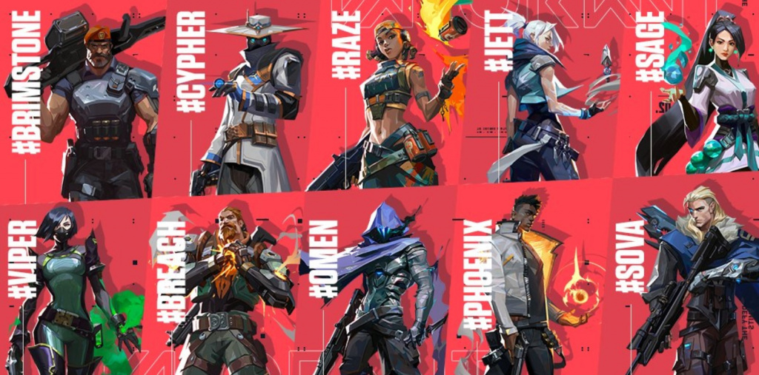

Slide 5
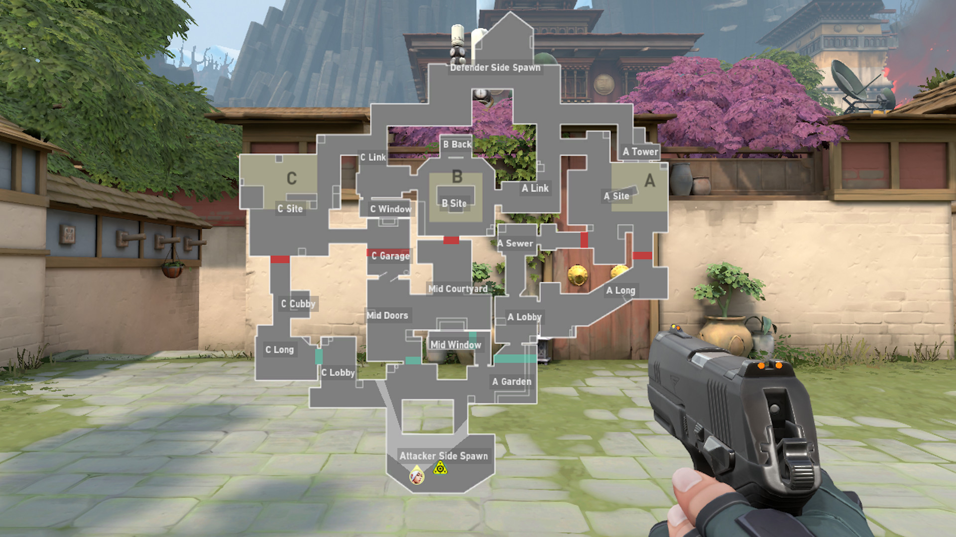

Slide 6
Storyline
Storyline: Valorant is exclusively multiplayer, but explores its wider universes through cinematics, hidden clues on maps, and agent audio lines
This creates a unique storytelling experience and inspires the community in an interesting way
Two earths: Valorant’s lore is designed to make every round consistent with the Universe

Slide 7
Artwork, Music, User Interface
Valorant is completely driven by multiplayer, and thus aims for simplicity above all else in it’s artwork, music, and UI
Artwork: The artwork for maps and characters is all based on real world places and cultures
Music: Simple, in the background, not distracting. However, sound design is excellent
UI: Clean, easy to navigate, minimalistic

Slide 8
The Good
Mechanics: The game is incredibly smooth in movement, gun control, and sound design. Everything about playing the game feels seamless
Agents: A unique twist that takes what would be a Counter Strike clone and gives Valorant a unique identity
Level Design: Levels are designed in such a way that Agents can interact with the maps in meaningful and interesting ways, creating a unique experience in each match
Microtransactions: Good example of microtransactions. Entirely cosmetic, adds fun variety to the game

Slide 9
The Bad
Inaccessible: Valorant is highly competitive and be difficult for new players or casual players to enjoy
Re-playability: Few game modes/levels, makes the game repetitive unless you really enjoy the base game mode

Slide 10
Comparisons
Valorant drew a lot of criticism on launch for being a ”Counter Strike” clone
Improvements: Agent inclusion gives players more identity than their shooting ability. Promotes specialization and creates more meaningful individual contributions to the team
Drawbacks: Extra mechanics dumb down “gun-play”

Slide 11
Summary
Polarizing: Ideal game for it’s target audience, not ideal for wider audiences
Unique contributions to the genre: Story-telling, character selection
Is it worth it? Even with the game being free to play, I would steer away some people from even trying it
Improvements: More game modes with a more casual focus

