Slide 1
Cyberpunk Game Evaluation
Jasmine Rabie

Slide 2
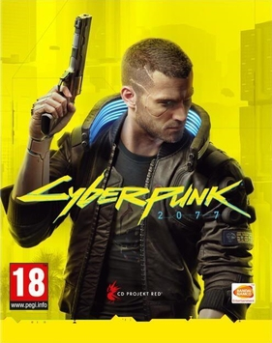
Cyberpunk 2077 Overview
Action RPG (Role-playing game) and open world
Customizable character and storyline
All characters in game are augmented with cybernetic implants
Developed by CDProjekt
Release September 2020
Starting price $59.99
Sales go for $10

Slide 3
Minimum Requirements
Intel core i5-3570k or AMD FX-8310
GTX 780 3GB or RX 470 4GB
8GB RAM
3GB VRAM
70 GB Storage
Windows 7 or above
Target: 1080p Low
Console: PlayStation 4 or Xbox one

Slide 4
Actual Requirements
Intel core i7-4790 or Ryzen 3 3200
GTX 1060 6GB or R9 Fury
12GB RAM
6GB VRAM
70GB SSD Storage
Windows 10
Target 1080p High
PlayStation 4 Pro or PlayStation 5

Slide 5
Story
The story starts out in Night City in the Cyberpunk universe. You start out as a mercenary named V, who can hack and is well-versed about machinery as well as combat.
V is hired to steal a relic, but the mission goes wrong and receives unwanted attention when V witnesses a murder. The relic’s case is damaged and V is forced to insert the chip found into the cyberware of their head.
V is shot in the head, yet wakes up due to some immortality enhancement chip implanted and slightly regenerating the brain. V wakes to see a ghost of Johnny Silverman due to the chip inserted.

Slide 6
Story Cont.
V is living on borrowed time now. Silverman’s memories are slowly re-writing over V’s memories due to the chip. V must find a way to remove the chip and survive.
V eventually finds out that the damage done to the body is irreversible. V can either choose to live out whatever life expectancy is left, allow johnny Silverman to take over V’s mind, or commit suicide.
This last choice is up to the player.

Slide 7
Player’s Role
Three lifepaths (nomad, streetkid, or corpo) to start off with different skills.
Player gets to customize V.
Gender
Appearance
Player gets to make choices and build more skills throughout the game.
Player decides what happens to V at the end of the story.

Slide 8
Installation
Digital download or hardcopy
70GB large download
Initial release had a bug that would not allow game to be installed properly. Needed to manually remove one file.

Slide 9
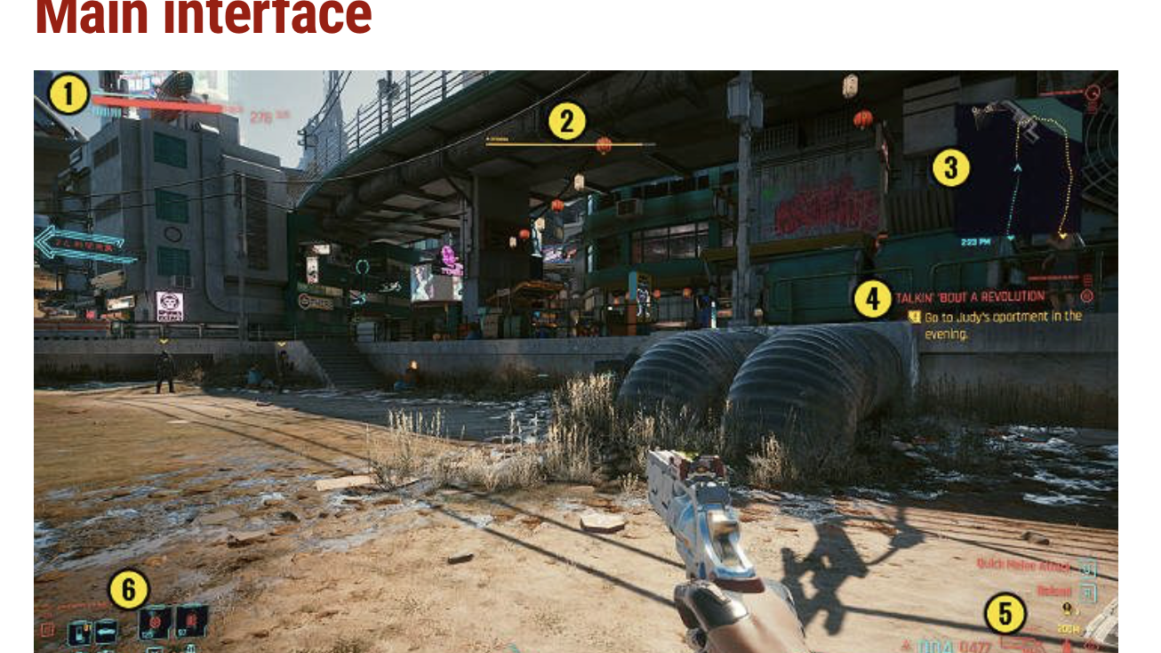
User Interface
The user interface is very straightforward. There are no unnecessary elements on the screen to cause distractions
Some of the elements of the interface only appear in certain circumstances.

Slide 10
Gameplay
The main storyline takes an expected 20-30 hours to finish.
Gameplay can be re-played multiple times as certain missions only appear based on player’s choices.
Similar to tell-tale games
Combined side content and exploration could take upwards of 70 hours of gameplay.
Multiplayer expected soon. No date determined as of now.

Slide 11
Game Summary Cont.
Scoring
Rated 53 out of 100 by critics
Rated 3.4 out of 10 by users
Artwork
Dystopian futuristic setting
Sound and Music
Features original tracks and real-world artists
Special Features
Secret upgrades
Spawning cars
Manual
Physical manual with physical copy of the game
In-game tutorial, but not as comprehensive for digital download players

Slide 12
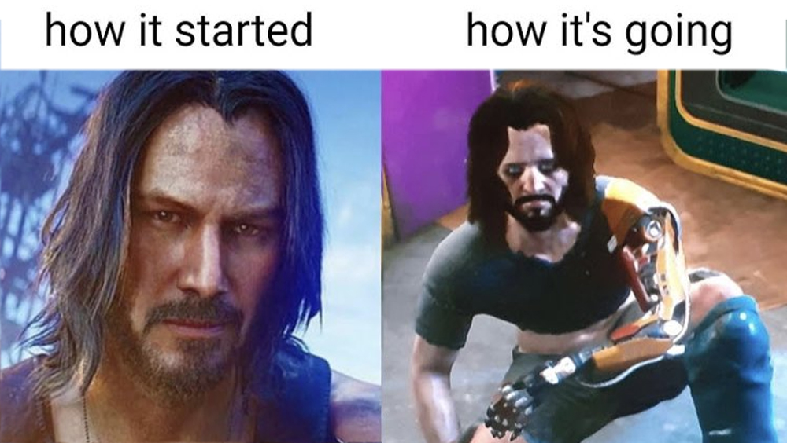
Bugs
Pulled from PlayStation store only 1 week after release and gave refunds due to excessive amount of bugs and glitches
Was not released back on the store until months later
Developer had to release patches for hundreds of bugs
CPU/GPU could not handle the game, even high-end ones
Characters would glitch in place
Game would crash
Unplayable at times

Slide 13
Game Review
What is fun about this game?
Multiple storylines
Customization
Scenery/dystopian setting
What is not fun about this game?
Glitches
Single-player

Slide 14
Game Review
How does this game compare to similar games within the same genre? Why is it better or worse than the similar games?
Compared to other RPG, this game is NOT polished in the slightest.
Too many bugs, intimidating features, single-player
Using GTA as an example, GTA online was released afterwards which allowed the game to continue its success form 2013. However, before the online release, the single-player option was polished and ahead of its time.
Audience
Rated M for mature
Young adults/adults

Slide 15
Design Flaws
Due to the large number of bugs in the game, characters wouldn’t be fully optimized at times.
Characters would appear unfinished.
Caused seizures
Journalist had a seizure due to the excessive number of flashing lights and flickering

Slide 16
Summary
Strengths
Storyline
Gameplay
Customization
Artwork
Weaknesses
Online capability
Optimization
Bugs

Slide 17
Summary
Is this game worth purchasing?
As of now, this game is worth purchasing only if it is on sale. Many bugs have been patched but the game is still nowhere near as polished as desired.
How could this game be improved?
More bug fixes
Reduces flickering
Added storyline
Online capabilities

