Slide 1
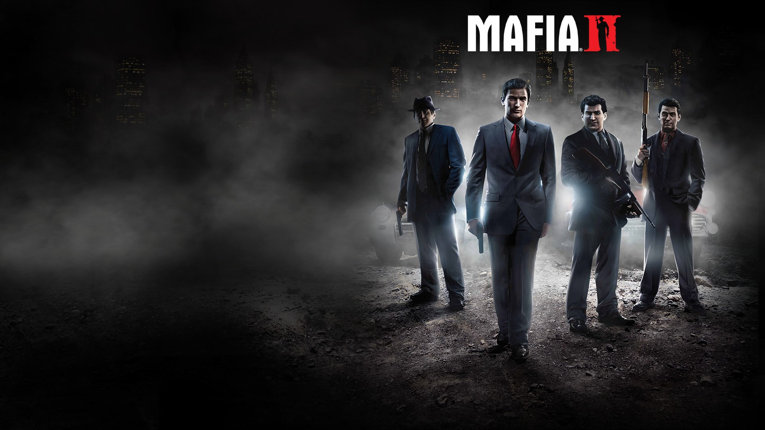
CIS 487
Game Design
Fall 2021
Tasneem Obeid

Slide 2
Basic Information

Slide 3
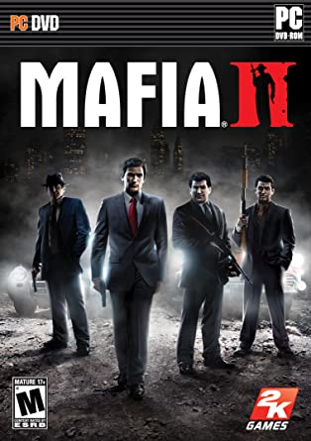
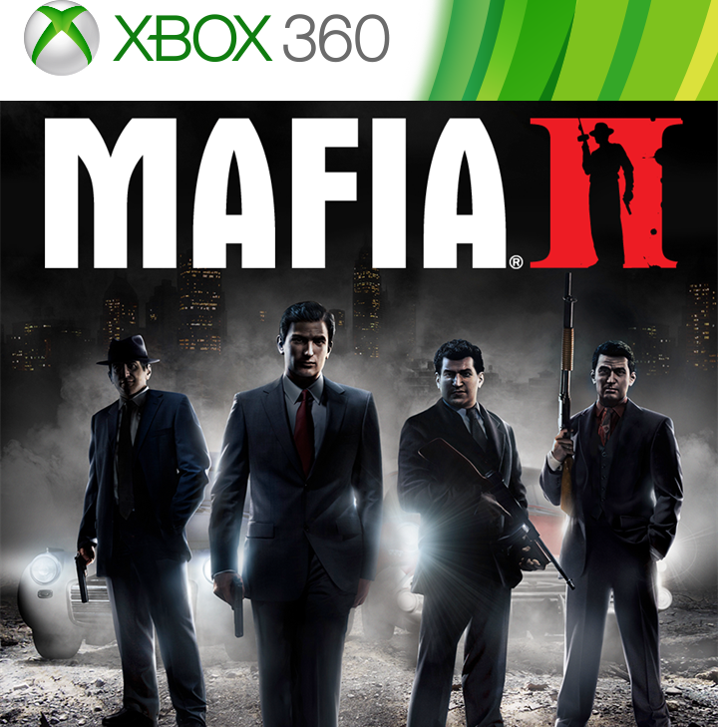
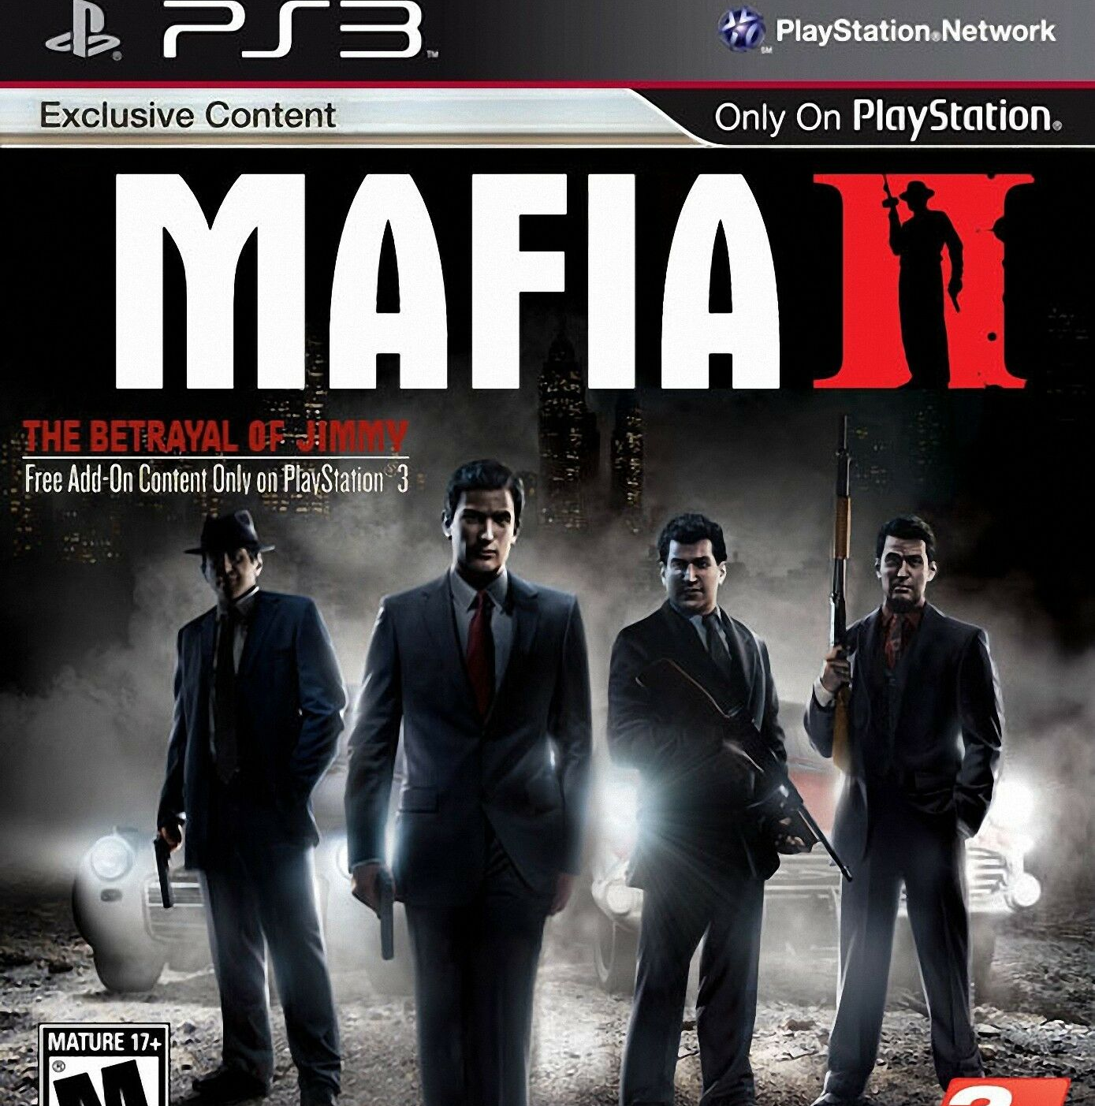
Mafia 2
Developed by 2K Czech
Published by 2K Games
Single Player Action-Adventure Game
Price: $29.99

Slide 4
Minimum Hardware Requirements
OS: Microsoft Windows XP (SP2 or later) / Windows Vista / Windows 7
Processor: Pentium D 3Ghz or AMD Athlon 64 X2 3600+ (Dual core) or higher
RAM: 1.5 GB RAM
Hard Disk Space: 8GB
Video Card: nVidia GeForce 8600 / ATI HD2600 Pro or better
Sound Card: 100% DirectX 9.0c compatible sound card
Keyboard and mouse or Windows compatible gamepad

Slide 5
Actual Hardware Required
OS: Microsoft Windows XP (SP2 or later) / Windows Vista / Windows 7
Processor: 2.4 GHz Quad Core processor
RAM: 2GB
Hard Disk Space: 10GB
Video Card: nVidia GeForce 9800 GTX / ATI Radeon HD 3870 or better
Sound Card: 100% DirectX 9.0c compatible sound card
Keyboard and mouse or Windows compatible gamepad

Slide 6
Game Summary

Slide 7
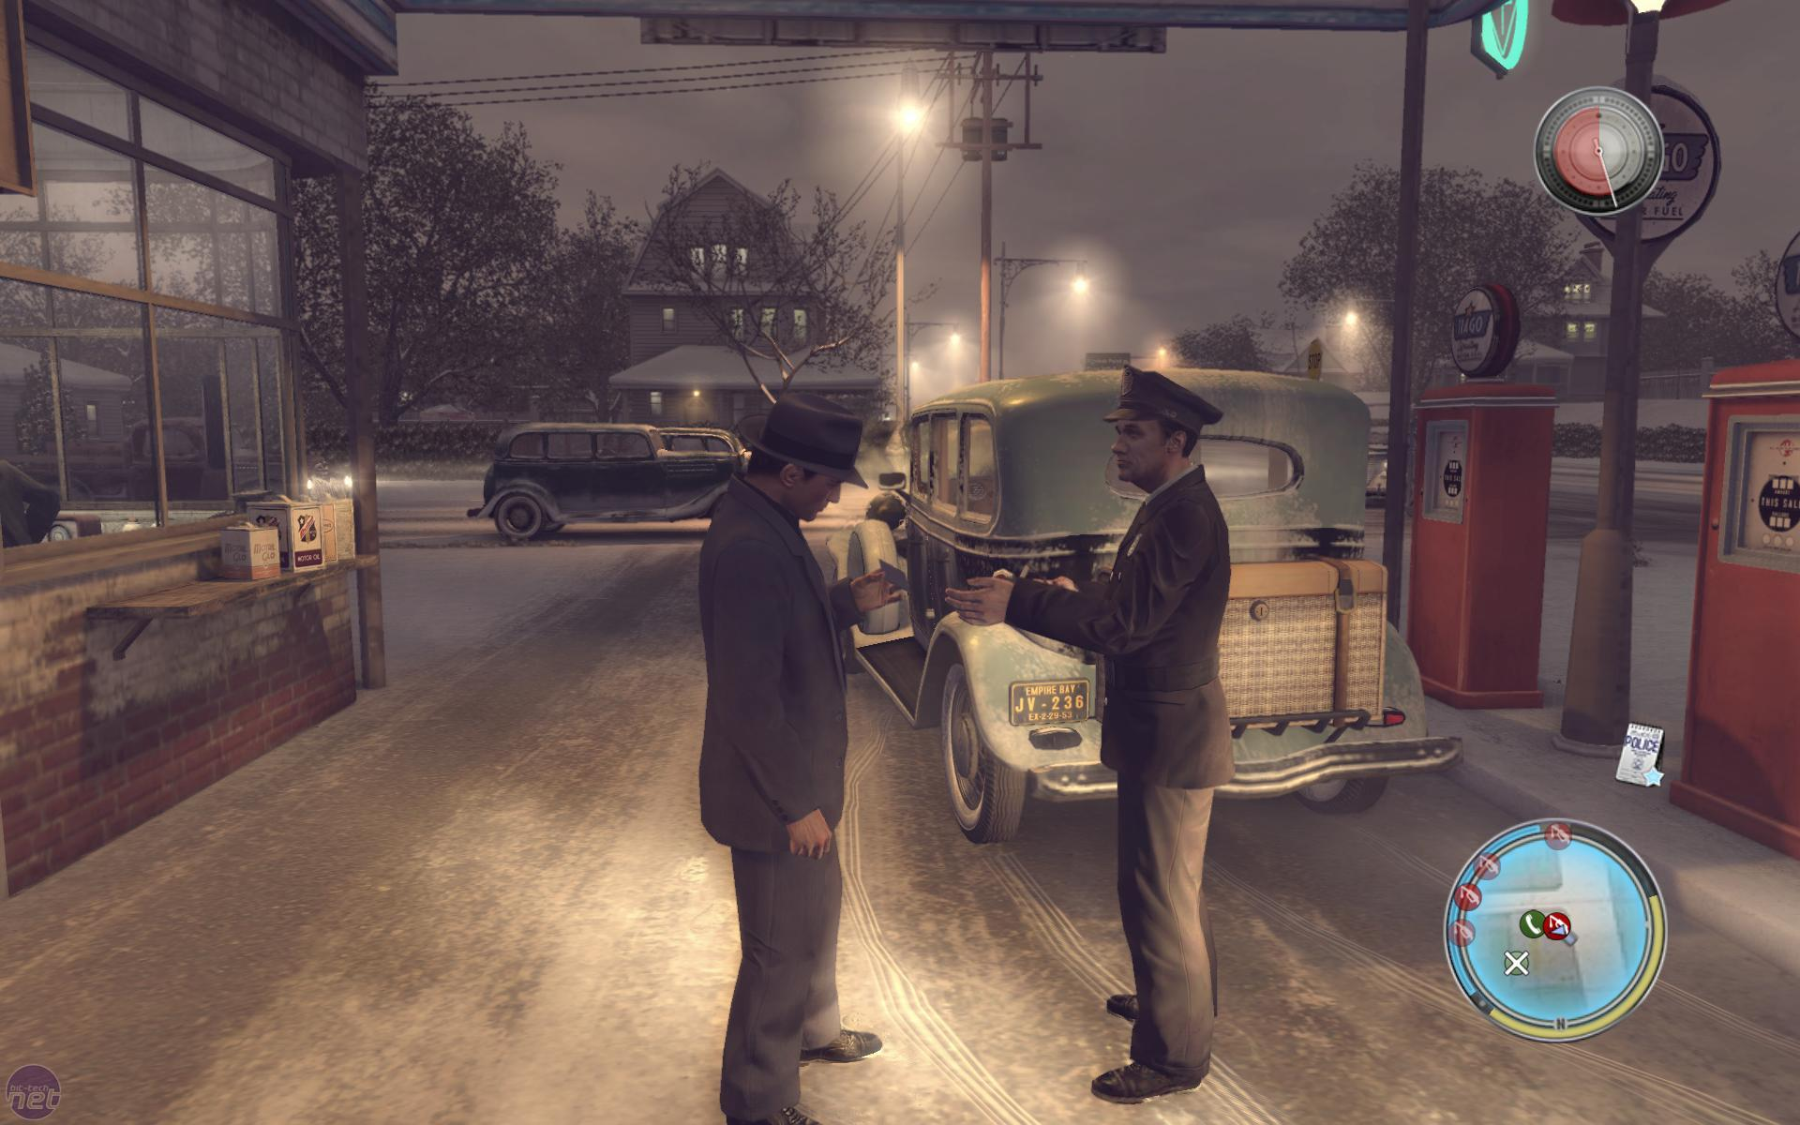
Quick Overview:
Vito Scaletta (the character you play as) wants to make a name for himself on the streets of Empire Bay as someone who can be trusted to get a job done. He works with his best friend Joe to prove himself to the Mafia.
Player’s Role:
Complete tasks for the mafia in order to pay off debts.

Slide 8
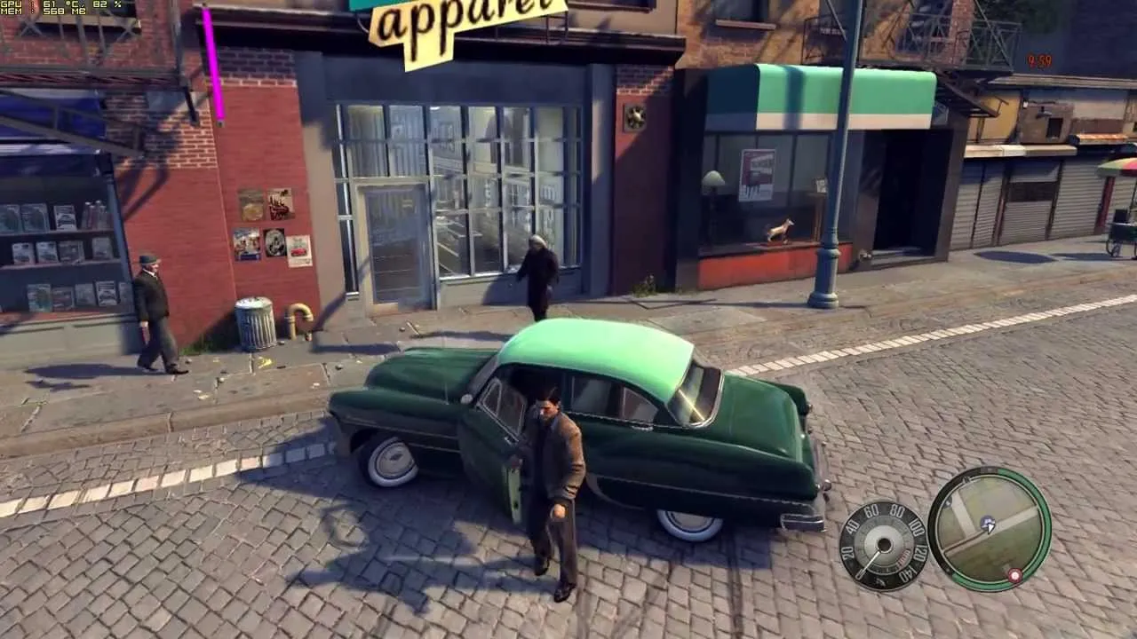
Installation:
Game is available for download on Microsoft Windows, PlayStation 3, Xbox 360, Mac OS X, PlayStation 4, and Xbox One.
The game also comes in CDs.
User Interface:
Health, Map, Weapon, Point of View (changeable), Time Remaining on Task, Speedometer.
Interacted with mouse and keyboard/remote controller.

Slide 9
Storyline
Vito Scaletta is arrested during a robbery and opts to join the United States Army to avoid jail.
Vito returns home on leave to Empire Bay and reunites with his childhood friend Joe Barbaro, who has joined the Clemente crime family in his absence, and supplies Vito with counterfeit discharge papers.
Vito and Joe eventually become made men within Falcone's organization, allowing them to secure a better lifestyle.
Vito’s sister, Francesca distances herself from him because of his mobster lifestyle, and his house is destroyed in a firebombing by the Irish Mob.
Vito and Joe take on jobs to pay off the debt, including the assassination of retired mobster Tommy Angelo.
Vito and Joe’s actions have sparked a war between the Mafia and the Triads.
Vito finally pays off his debt to Bruno, (the same loan shark his father was indebted to).
In order to stay alive, the Triads order Vito to kill their common enemy: Carlo.

Slide 10
Gameplay
Diff game modes (DLCs) and 3 levels of difficulty
Setting: the 1940s–early 1950s era of Empire Bay
Change characters clothes/car/weapons
Drive/walk to missions and complete them
Avoid the cops/gangsters on streets.
Many firearms from the previous game return. The game’s cutscenes are created by the game engine in real-time.
The game features three different in-game radio stations (Empire Central Radio, Empire Classic Radio and Delta Radio) with licensed music, news, and commercials.
The radio stations include music from different genres including rock and roll, big band, rhythm and blues and doo-wop, with licensed songs.

Slide 11
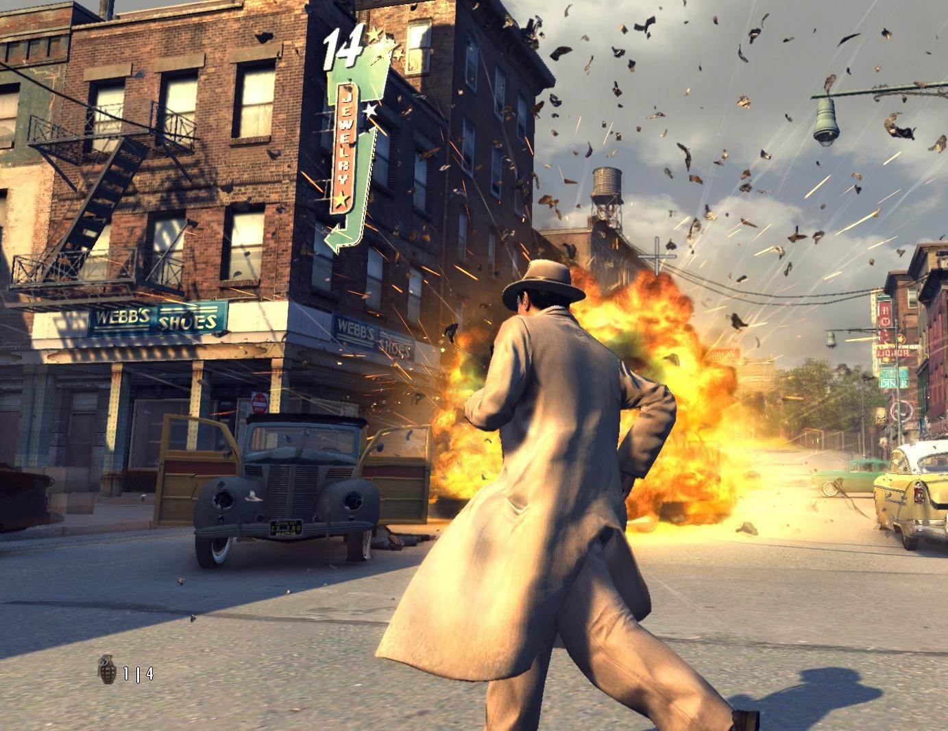
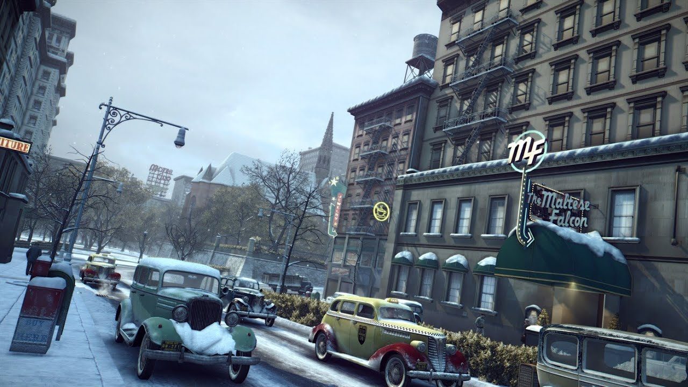
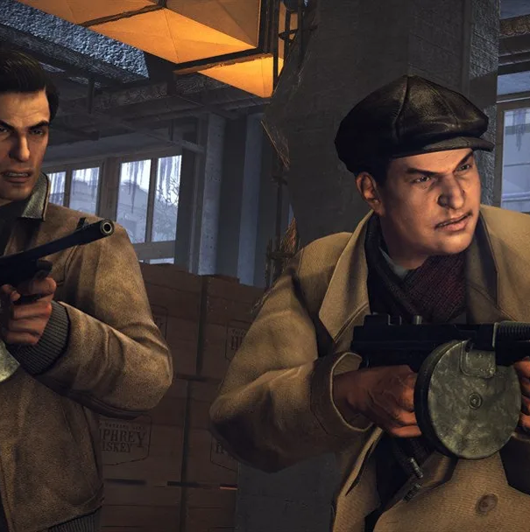
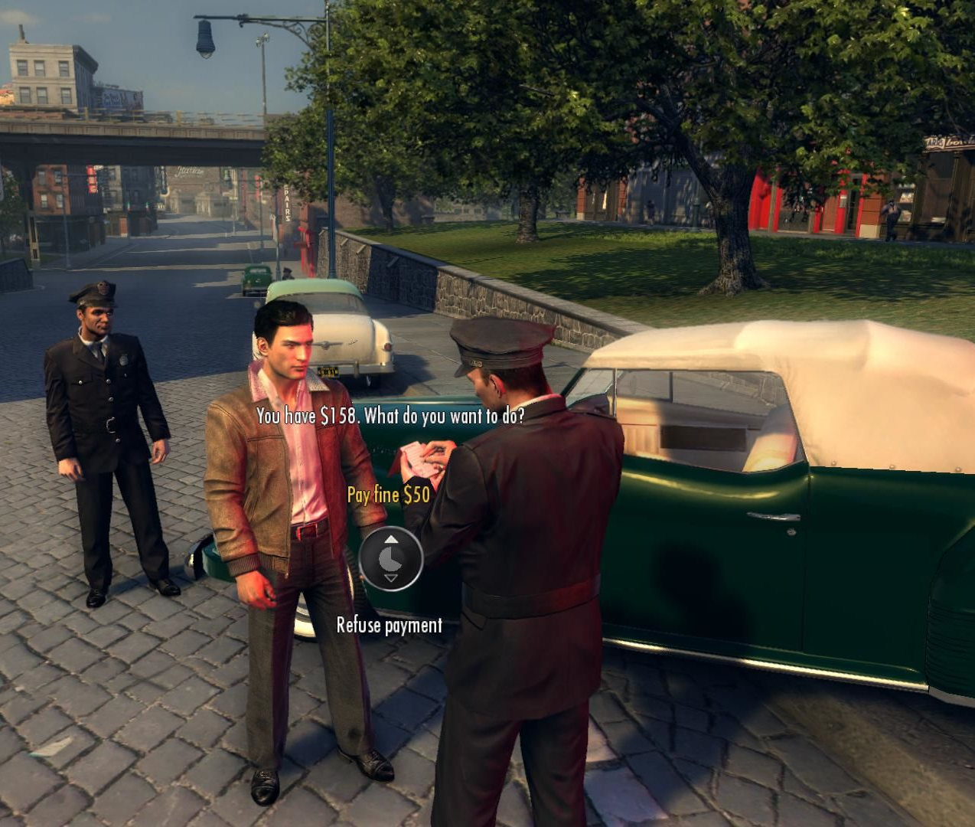
Scoring
You progress through storyline and get awarded when you complete some missions. Awards are typically money.
Artwork:
Cars, buildings, people, look realistic.
Animation and cutscenes is kind of off.
City looks very detailed and close enough to the reality.
Sound & Music:
Music is played on radio when you drive.
Choice of music is brilliant, matches time period.
Sound affects are accurate and very realistic.
Cars, weapons, door opening, etc.

Slide 12
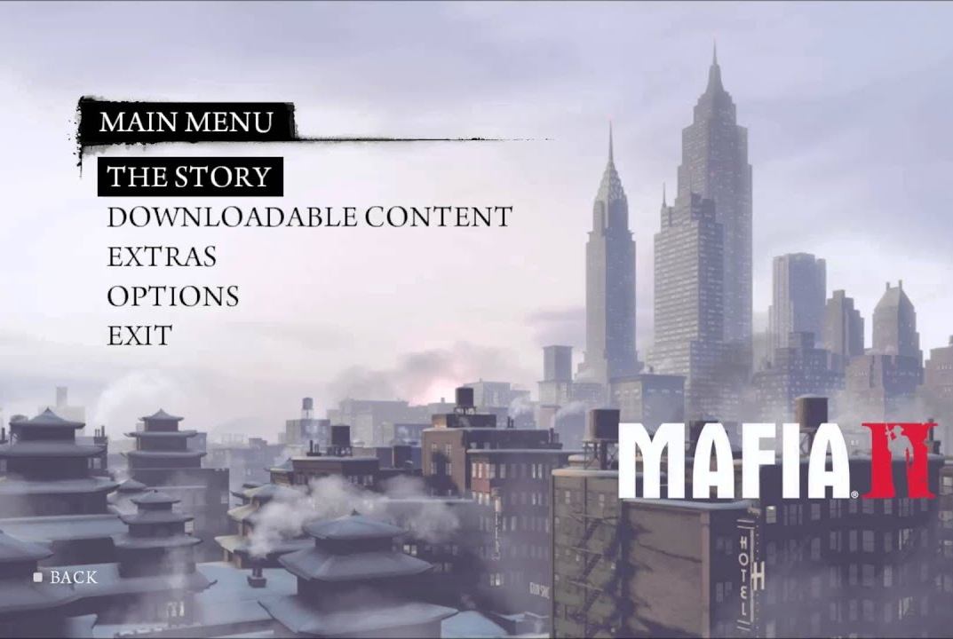
Special Features
DLCs
The Betrayal of Jimmy
Jimmy’s Vendetta
Joe’s Adventures
Bonus Content Packs (Greaser Pack, Renegade Pack, Vegas Pack, and War Hero Pack). Bonus pack content will unlock through chapter completion of the main story.
Alternative Editions
Mafia 2: Collector’s Edition
Mafia 2: Special Extended Edition
Mobile Version

Slide 13
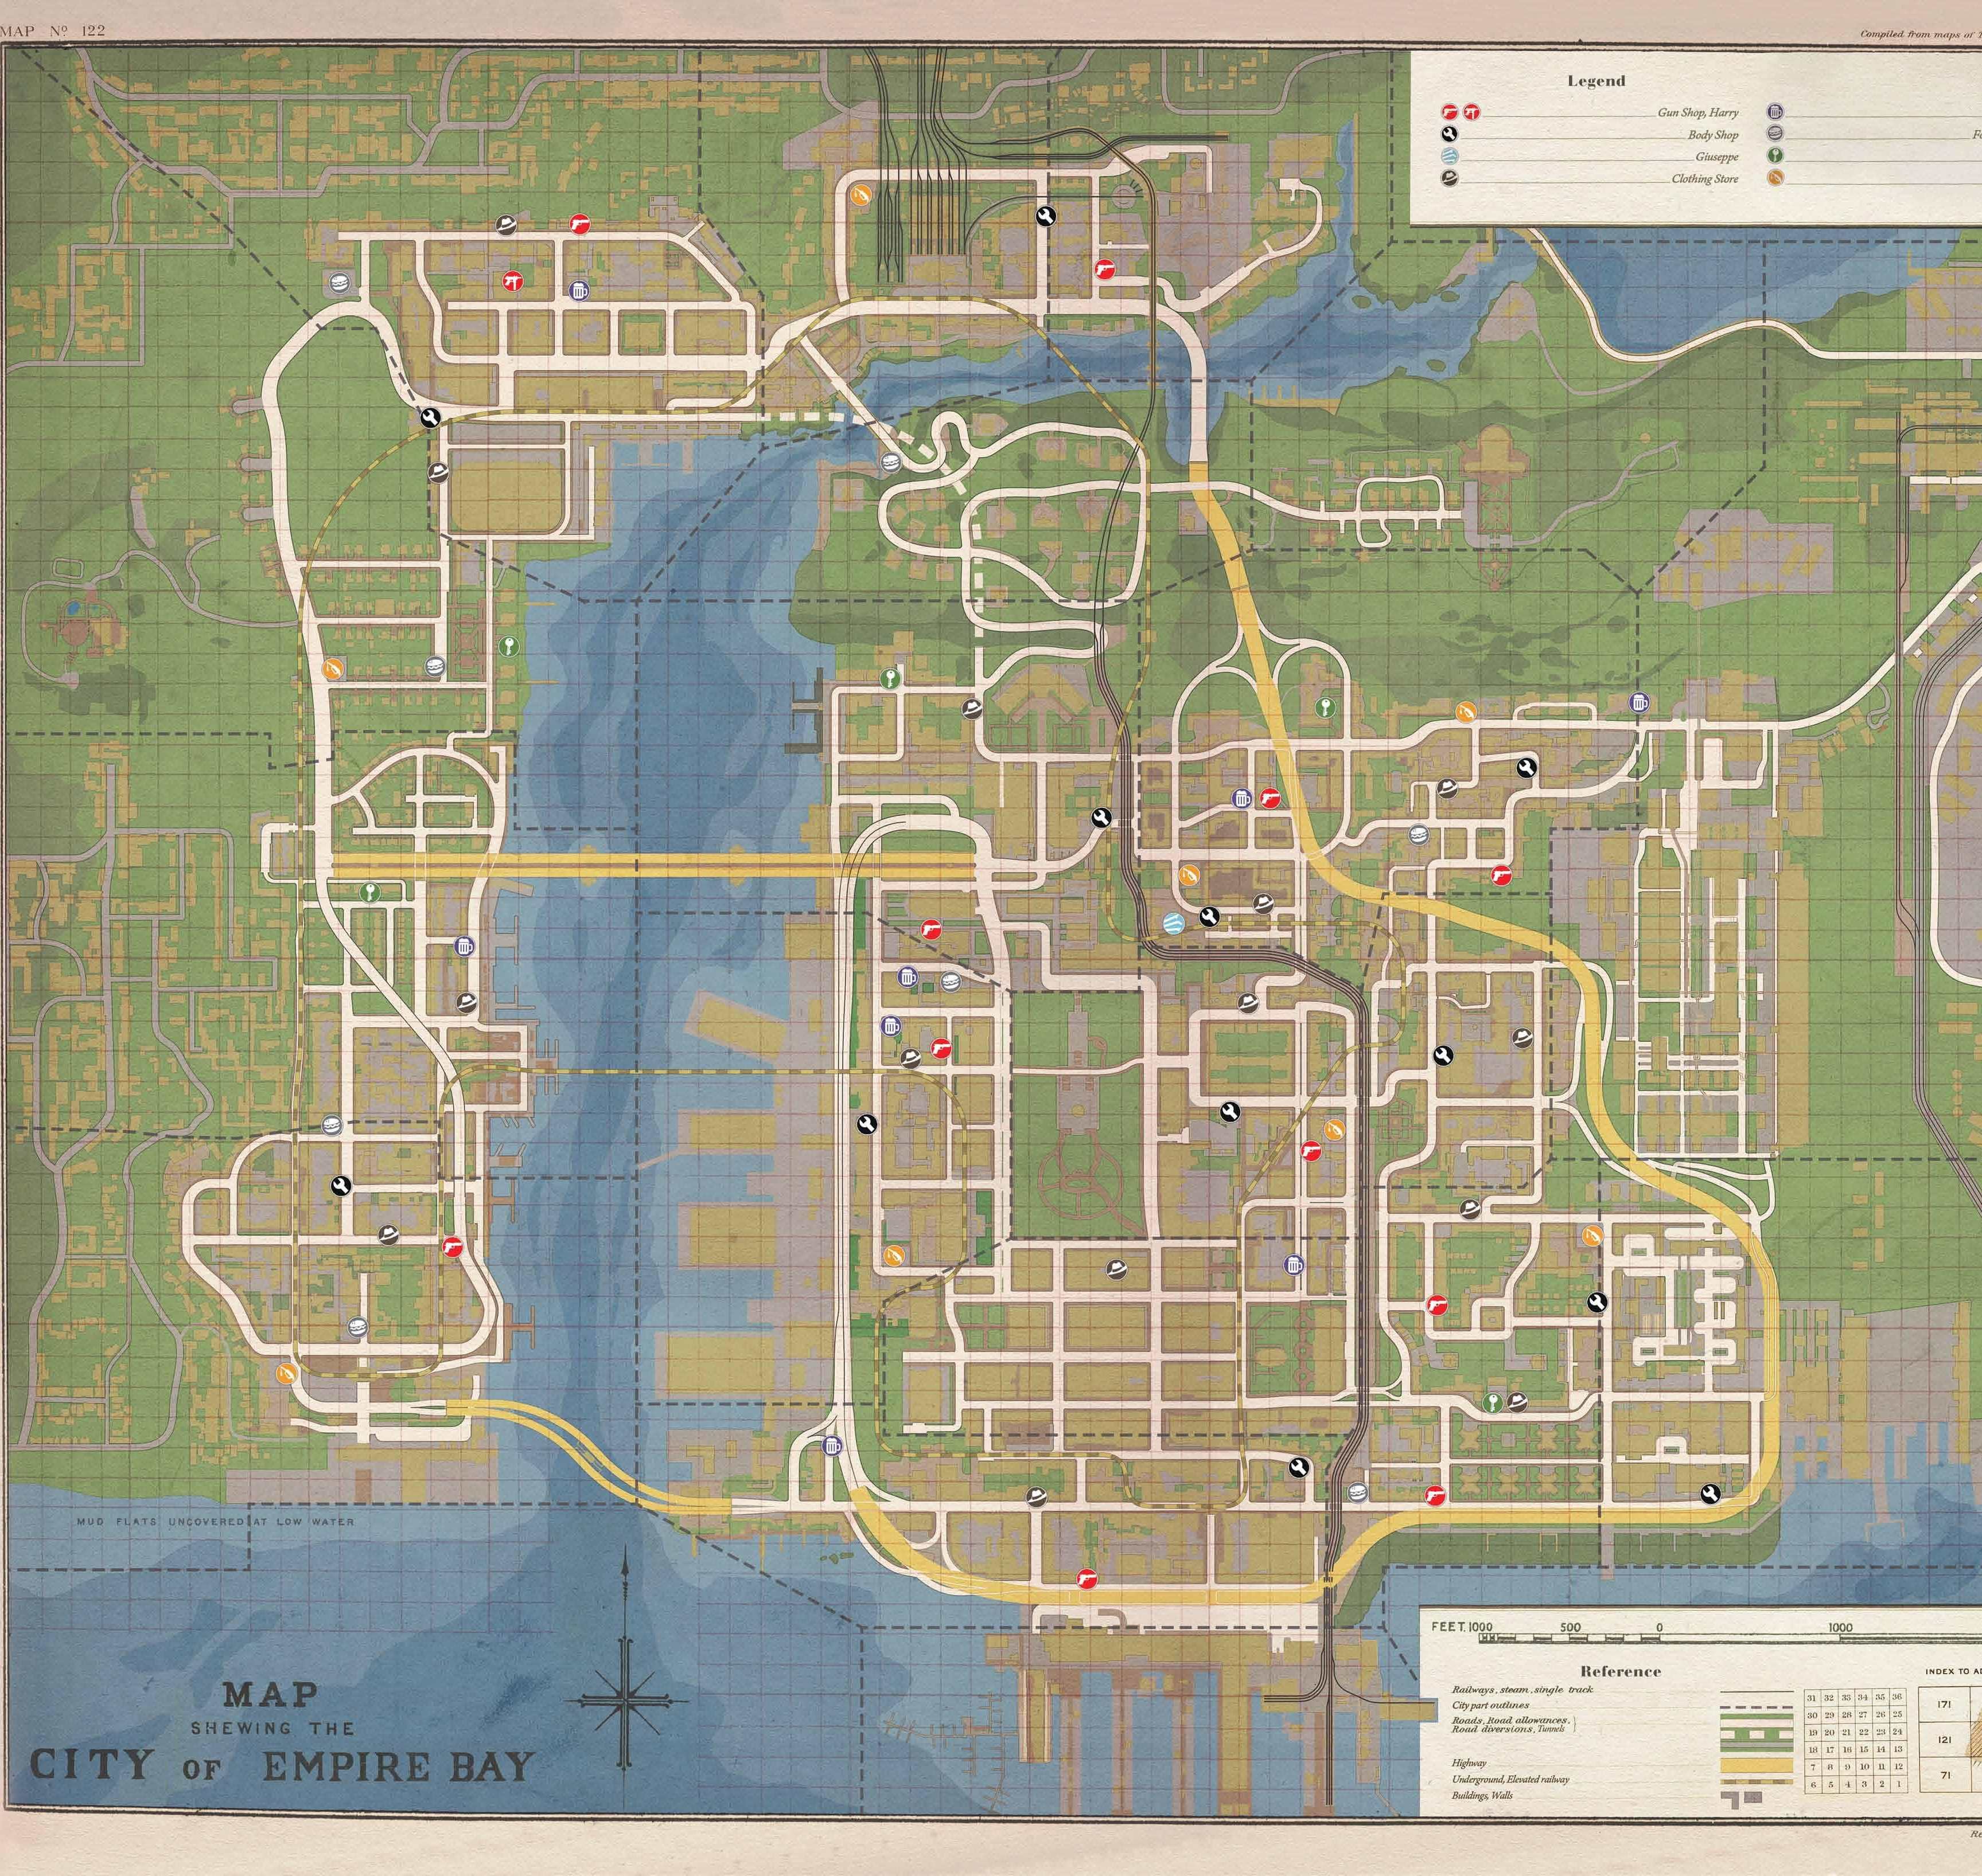
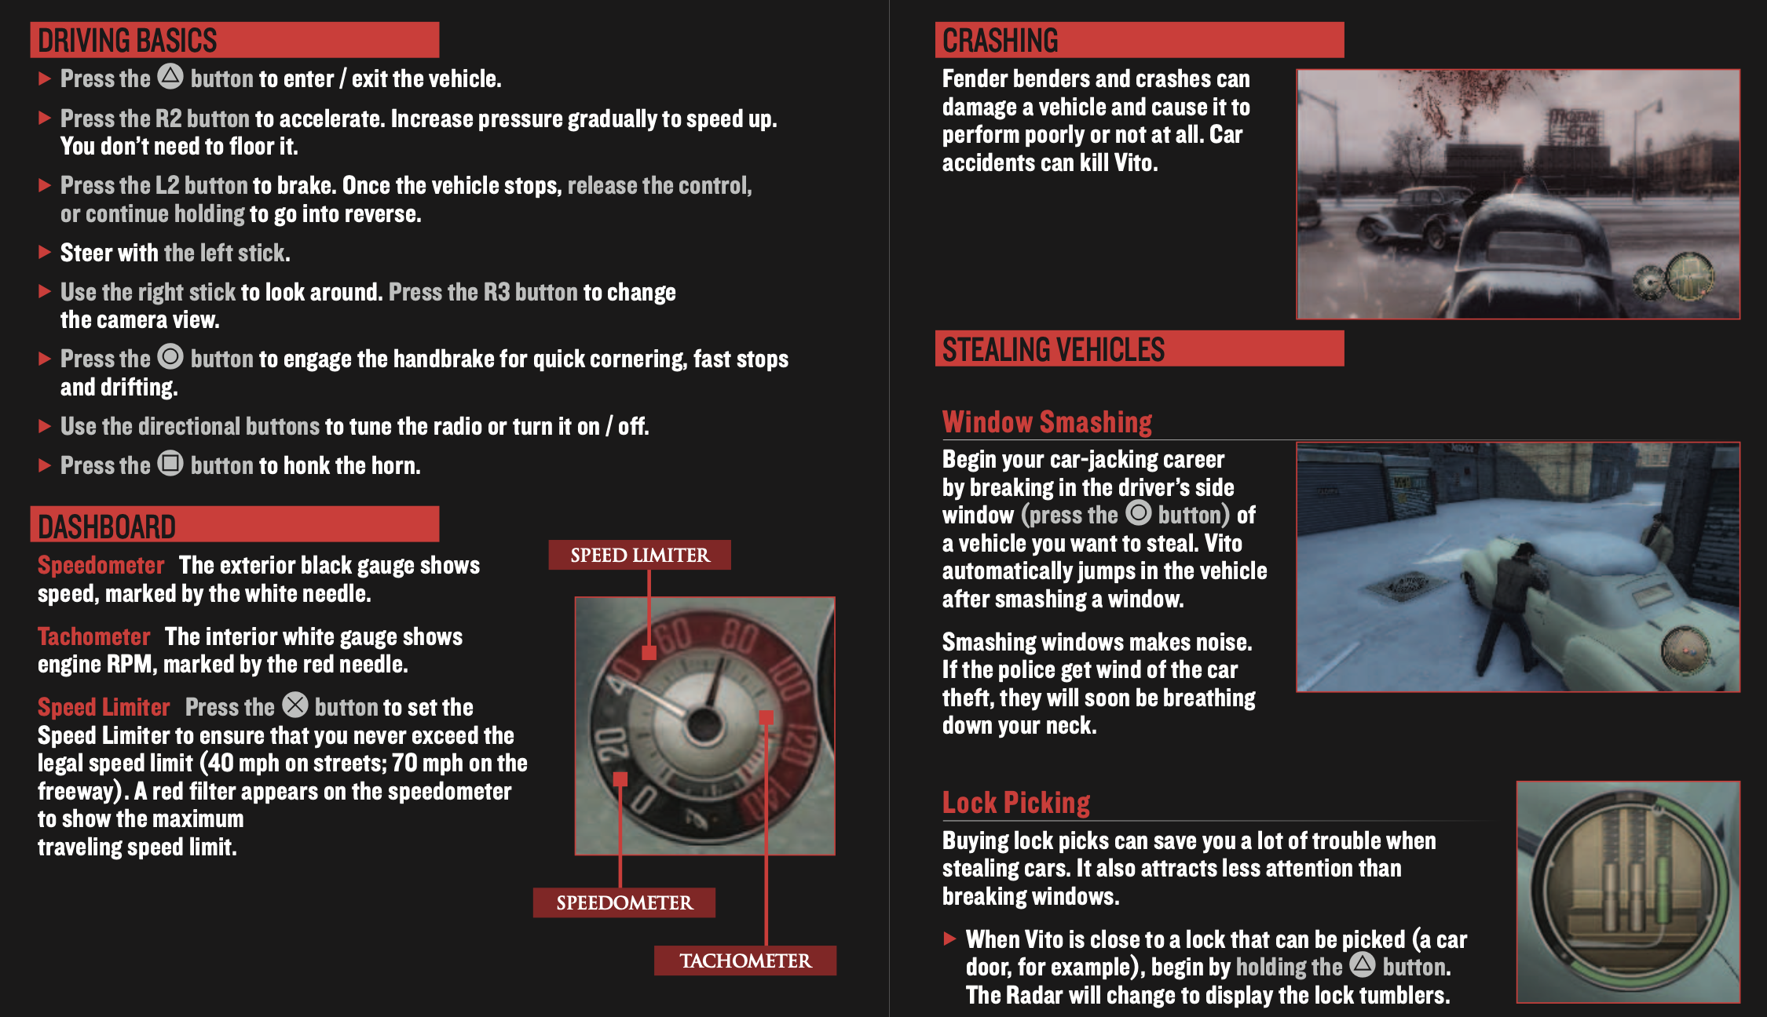
Manual
Setting Up
Saving Game/ How to Play
Character & Weapon descriptions
City map
Controls
Bugs
Joe’s apartment door not opening
Infinite loading screen
Stuck in slow motion when being chased by police

Slide 14
Game Review

Slide 15
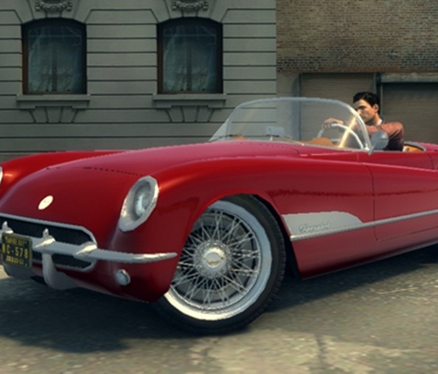
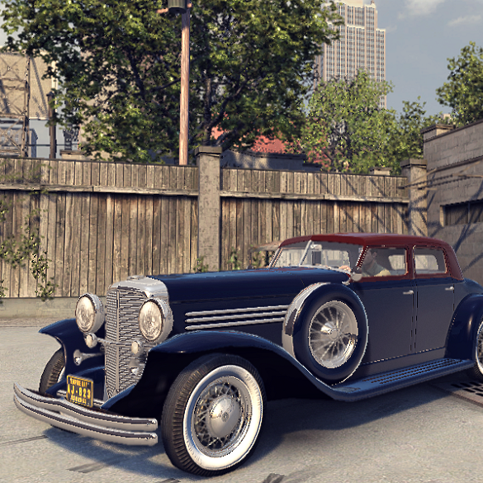
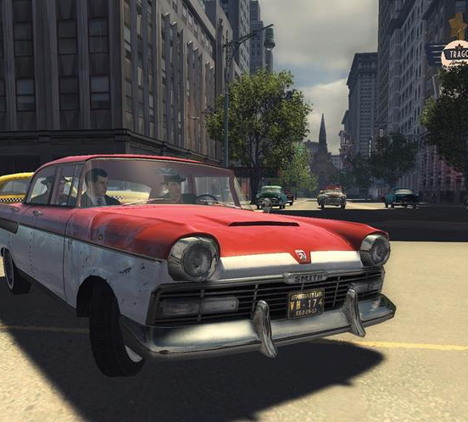
What is good about the game?
Driving around when not on task
Realistic environment
Storyline goes well with gameplay
Music, cars, and clothes match the time period.
Appropriate difficulty
What is bad about the game?
Forced to drive to task
Animations in cutscenes/video clips were acceptable.
Entry into some buildings.
Not much car/clothes options

Slide 16
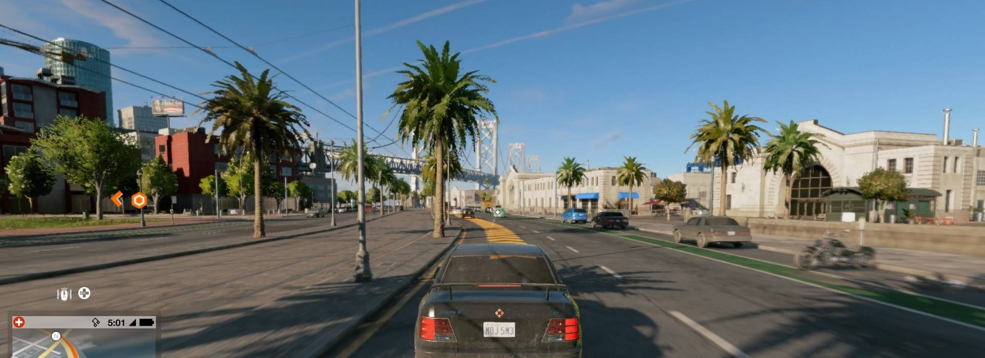
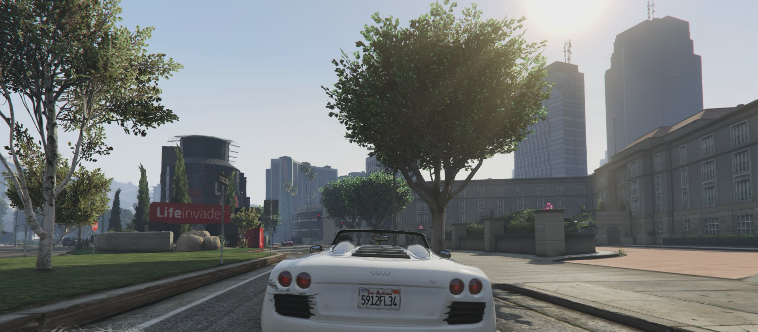
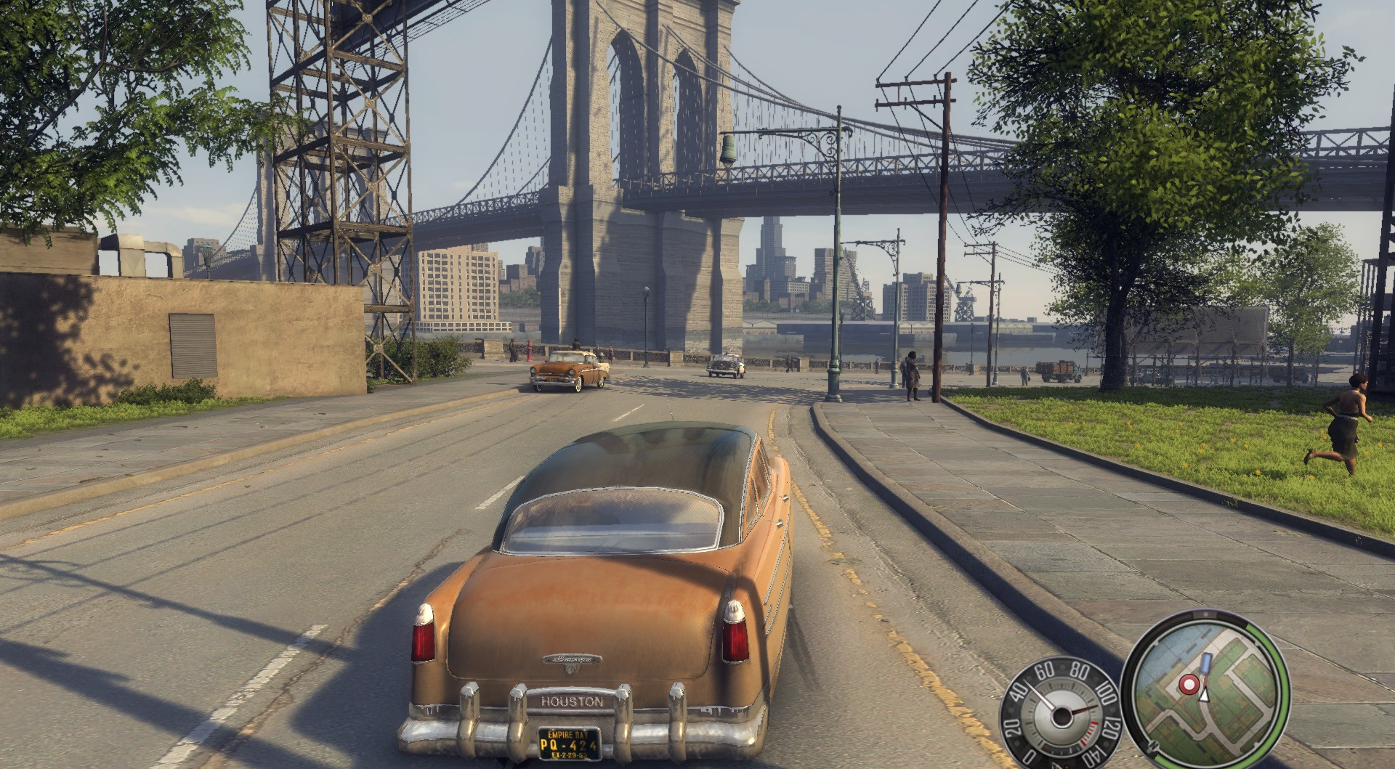
WATCH DOGS 2
How does it compare to similar games in the same genre?
Control the player to however you desire
Similar to real life world
Why is it better or worse than similar games?
Unique in its own way
Interesting storyline
Single player without multiplayer option
GTA V
MAFIA 2

Slide 17
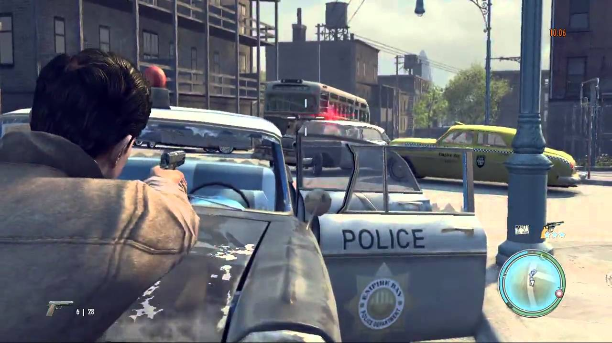
What is the appropriate audience for this game?
Adults
Nudity, intense violence, sexual content, blood, strong language, use of drugs and alcohol (Mature 17+)
Are there any design mistakes present?
Story Length
Not open world
Not enough weapons
Too many cops
Small map

Slide 18
Summary

Slide 19
Strengths
Storyline very well incorporated with gameplay
Realistic environment
Interesting Story
Weaknesses
Animations
Small map
Not much to do in city.
Is the game worth purchasing?
Worth it.
How could it be improved?
More weapons, cars, clothes, etc.
Bigger map
Open World

Slide 20
Thank you!

