Slide 1
Bioshock
By: Ahmad Mazeh

Slide 2
Basic Information
Game title: Bioshock
Company & Author: Irrational Games & 2K Games
Type of game: FPS/RPG
Price: $20

Slide 3
BASIC INFORMATION CONT’d
Minimum stated hardware:
Operating System: Windows XP (with Service Pack 2) or Windows Vista
CPU: Intel single-core Pentium 4 processor at 2.4GHz
RAM: 1 GB
Video Card: Direct X 9.0c compliant video card with 128MB RAM and Pixel Shader 3.0 (NVIDIA 6600 or better/ATI X1300 or better, excluding ATI X1550)
Sound Card: 100% direct X 9.0c compatible sound card
Hard Drive Space: 8GB
Recommended stated hardware:
CPU: Intel Core 2 Duo processor
RAM: 2GB
Video Card: DX 9 - Direct X 9.0c compliant video card with 512 MB RAM and Pixel Shader 3.0 (NVIDIA GeForce 7900 GT or better), DX 10 - NVIDIA GeForce 8600 or better
Sound Card: SoundBlaster(r) X-Fi(tm) series (optimized foruse with Creative Labs EAX ADVANCED HD 4.0 or EAX ADVANCED HD 5.0 compatible sound cards)

Slide 4
Game Summary
Quick Summary:
While exploring the underwater dystopia, Rapture, the player is urged to turn everything into a weapon: biologically modifying their own body with Plasmids, hacking devices and systems, upgrading their weapons, crafting new ammo variants, and experimenting with different battle techniques are all possible.
Storyline:
BioShock takes place in 1960, where Jack, the sole survivor of a plane crash in the middle of the Atlantic Ocean, discovers the entrance to the recluse underwater city of Rapture, at the end of a civil war which left most of it in disrepair. Finding himself trapped in a strange and dangerous dystopia, and with only a mysterious man called Atlas helping him, Jack has no choice but to fight for his survival against Rapture's mutated and monstrous denizens, using all types of weapons and genetic enhancements, as he searches for a way to return to the surface.

Slide 5
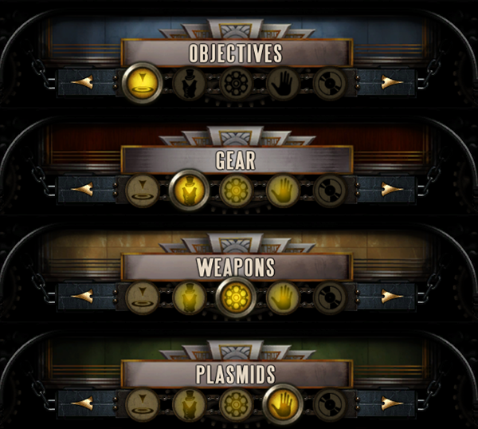
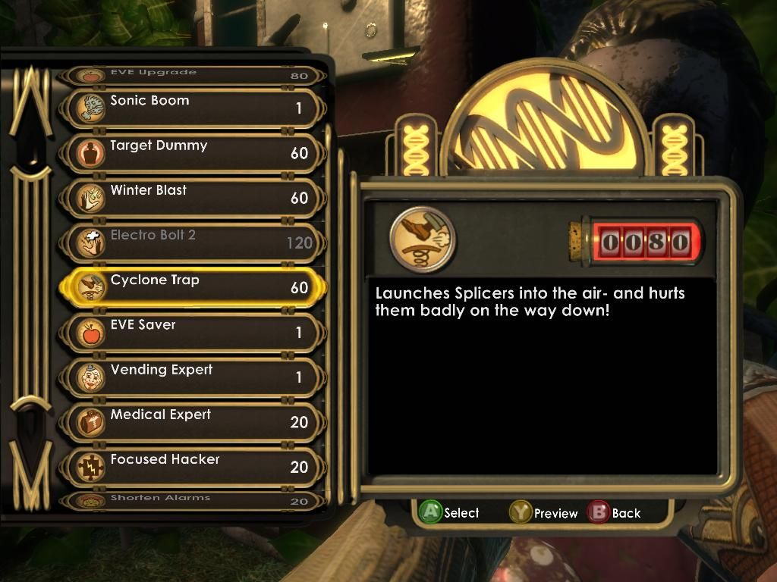
Game Summary Cont’d
Instillation:
Instillation is through various stores depending on the platform. The game is available on Xbox 360, PS3, iOS, Xbox One, PlayStation 4, Nintendo Switch.
User Interface:

Slide 6
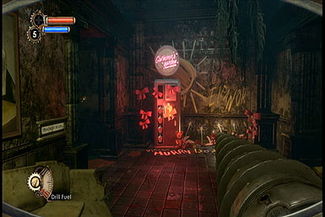
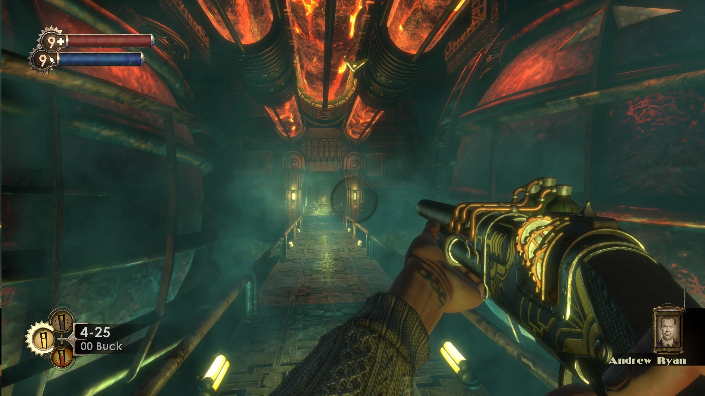
Game Summary Cont’d
Gameplay:
BioShock expands beyond traditional FPS games, providing player choice when deciding how to complete objectives. Stealth is viable as enemies have vision ranges, blind-spots, and awareness. The player can hack safes, vending machines, automated security, and other mechanical or electronic devices. All ranged weapons can be loaded with up to three different kinds of ammo that provide an advantage over some enemies.

Slide 7
Game Summary Cont’d
Scoring:
Money system using dollars and player upgrades
Buy or sell through “vending machines” found throughout Rapture
Ammo, med kits, upgrades to plasmids and weapons can be purchased in vending machines
Various gear presents hidden throughout Rapture
ADAM used to buy plasmids and new abilities

Slide 8
Game Review
What is good (fun) about the game?
I found this game fun because of the unique story and the horror feel it had to it. The gameplay itself was fun and allowed you to get creative with how you can take enemies out. It gave you various options, but it never felt overwhelming.
What is bad (not fun) about the game?
Sometimes it feels like you must check every corner and crack to see if you’re missing something vital. It made playing sometimes repetitive and dull.

Slide 9
Game Review Cont’D
How does it compare to similar games in the same genre?
As a shooter, it’s like most, not much strategy to it other than having specific ammo types do more dmg to specific enemies. But a new element comes into play when you have plasmids.
Why is it better or worse than similar games?
I consider this game better than most because of the amazing storyline that just connects you to the character. The unique gameplay also offers flexibility and allows you to play how you want. There is no right or wrong way to play the game.

Slide 10
Game Review Cont’D
What is the appropriate audience for this game?
This game is targeted to a wide range of gamers
Big world, action-adventure with a great story and fast gameplay
Men and women 17+ would enjoy this game, fans of shooters or adventure games

Slide 11
Summary
Overall strengths and weaknesses
Strengths
Fast, fluid and creative gameplay
Amazing story
Beautiful artwork
Weaknesses
Inability to continue playing the game after the main story line has ended
Makes you feel like you need to search every spot
Hacking is a bit repetitive and takes too long

Slide 12
Summary cont’d
Is the game worth purchasing?
Considering that it’s $20 nowadays, I would say that’s a steal for a masterpiece.
How could it be improved?
Have more than just one way of hacking
Different ways to acquire items other than scouring the map

