Slide 1
Anno 1800: Game Evaluation
Cody Lovelace
CIS 487
09/15/2021

Slide 2
What is Anno 1800?
Anno 1800 is a city-building, real-time strategy video game on Microsoft Windows.
Developed by Blue Byte and published by Ubisoft, Anno 1800 was released on April 16th, 2019.
Gameplay and overall aesthetic closely modeled around the Industrial Revolution period of Europe and America.
Features a variety of DLC packs and a Complete Edition, with the standard base game priced at $59.99 on the Ubisoft Store.

Slide 3
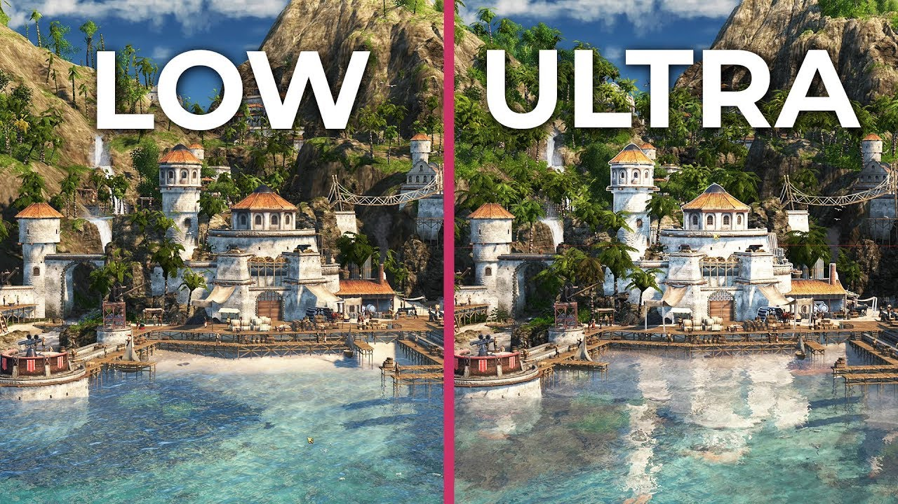
Hardware Requirements
Anno 1800 is relatively graphics intensive and requires high FPS for split-second decision-making.
Best played with a keyboard and mouse, though Windows compatible controllers can be used.

Slide 5
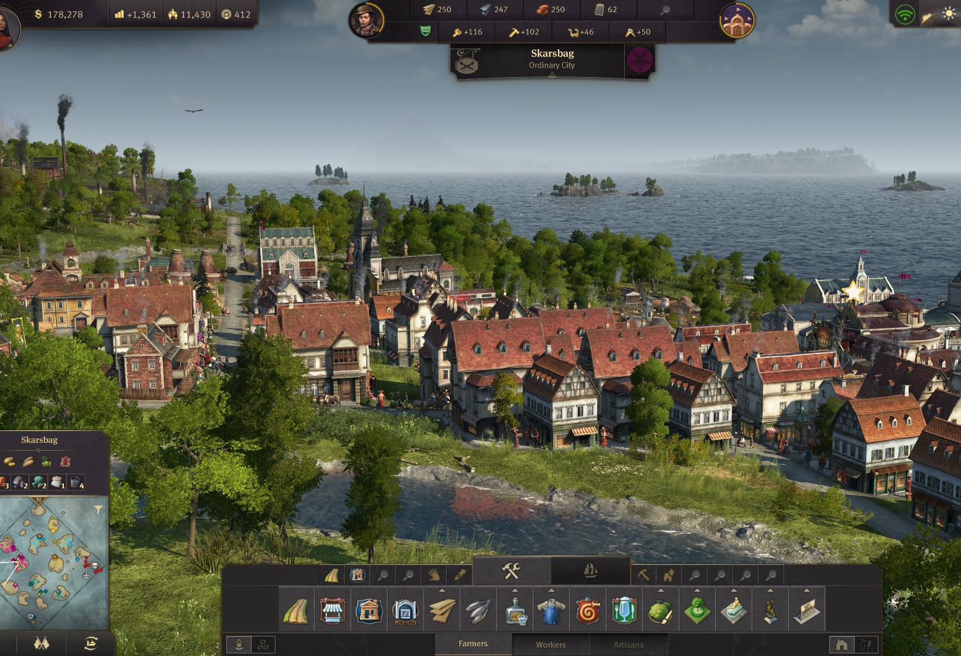
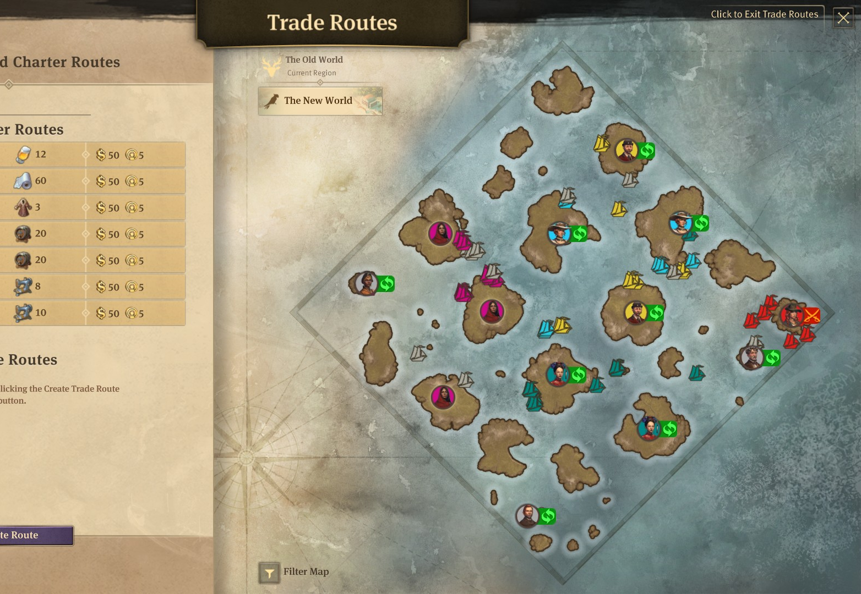
Basic Gameplay – What is Anno?
You are an explorer with big dreams and little supplies.
Sail the world to find your island.
Manage resources and build civilization.
Fight pirates, make allies, and find the New World.
Humble beginnings to full-scale industrial revolution.

Slide 6
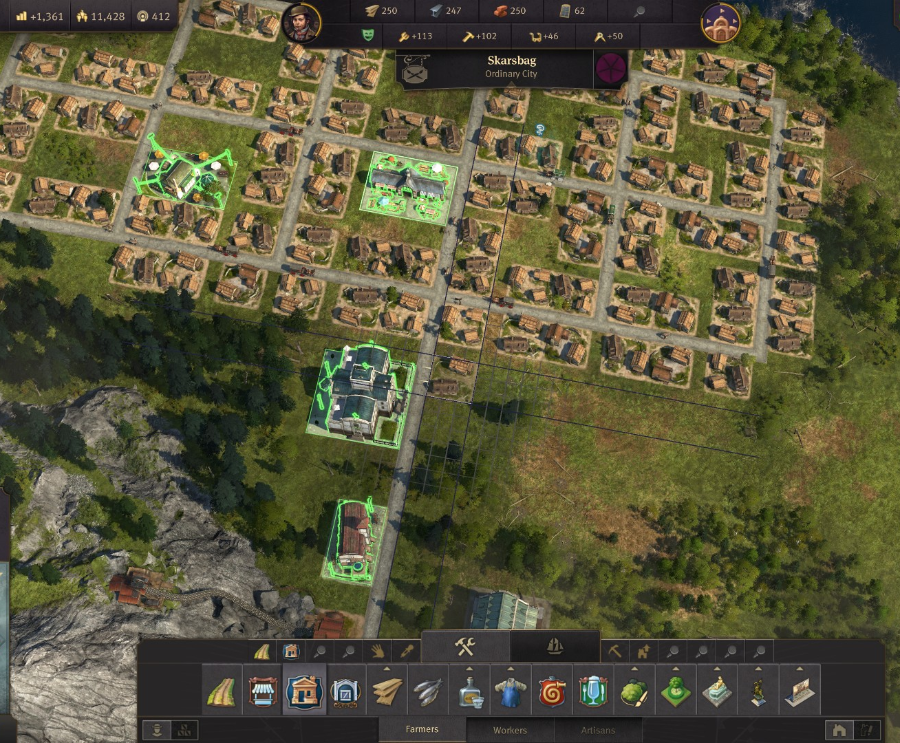
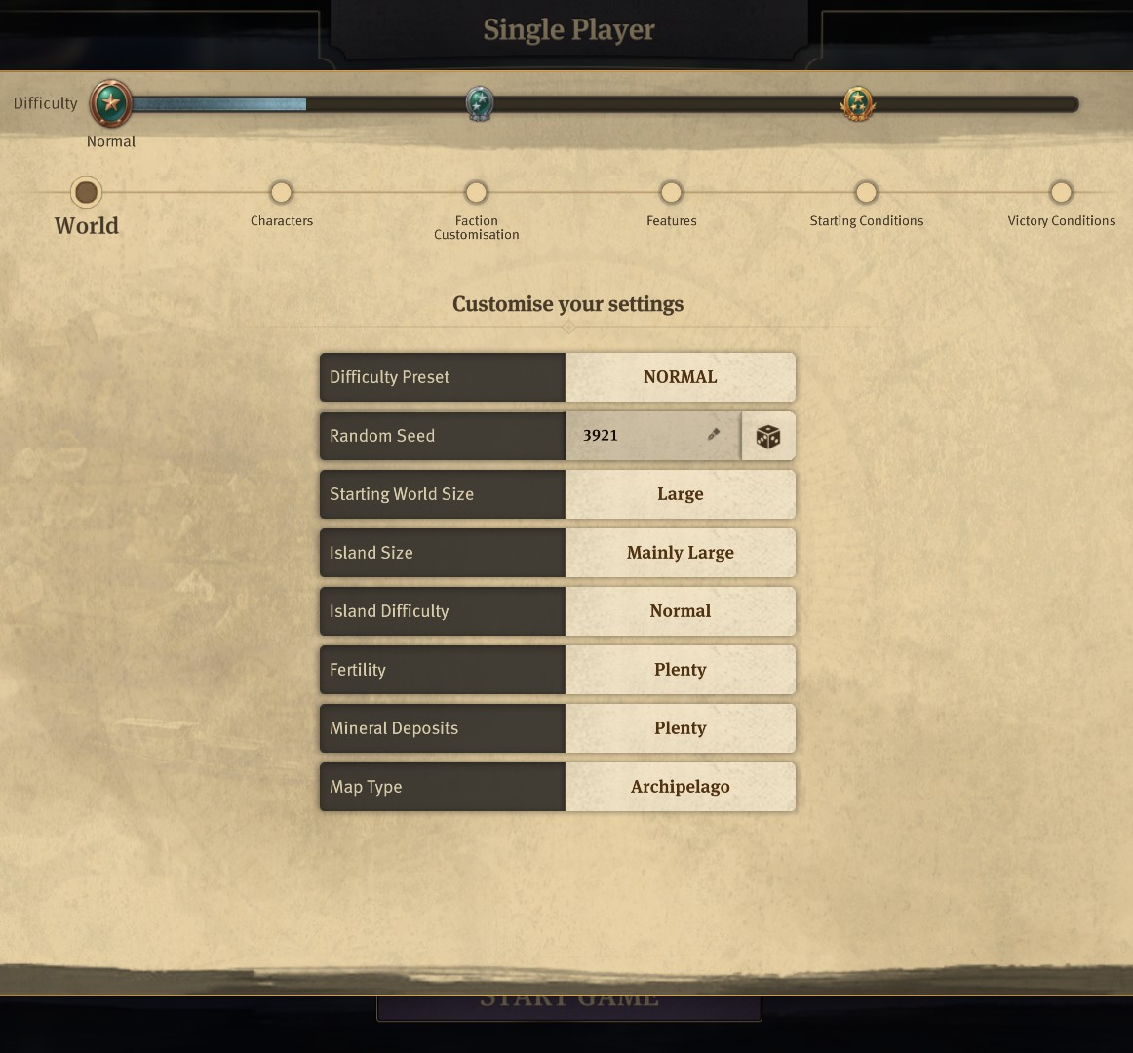
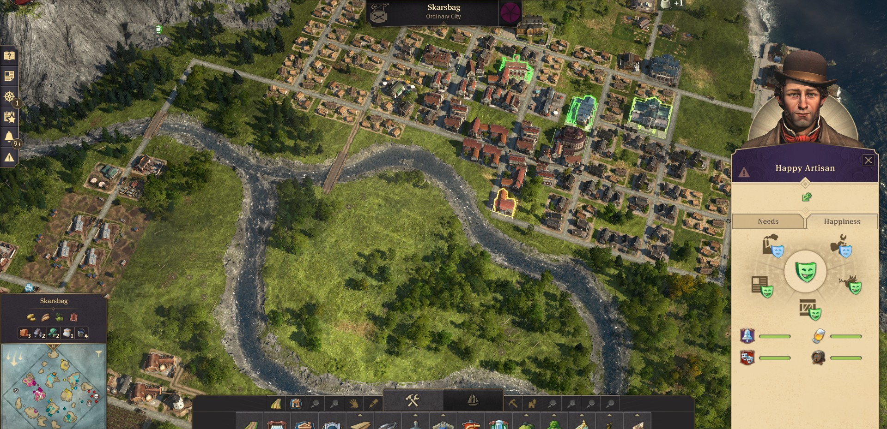
The Good
Progression system of cities, goods, and global influence
Grid system lends to near infinite customization
Game encourages and rewards expansion
Settings allow users to tailor difficulty and randomization of world to their liking
World feels lively and dynamic

Slide 7
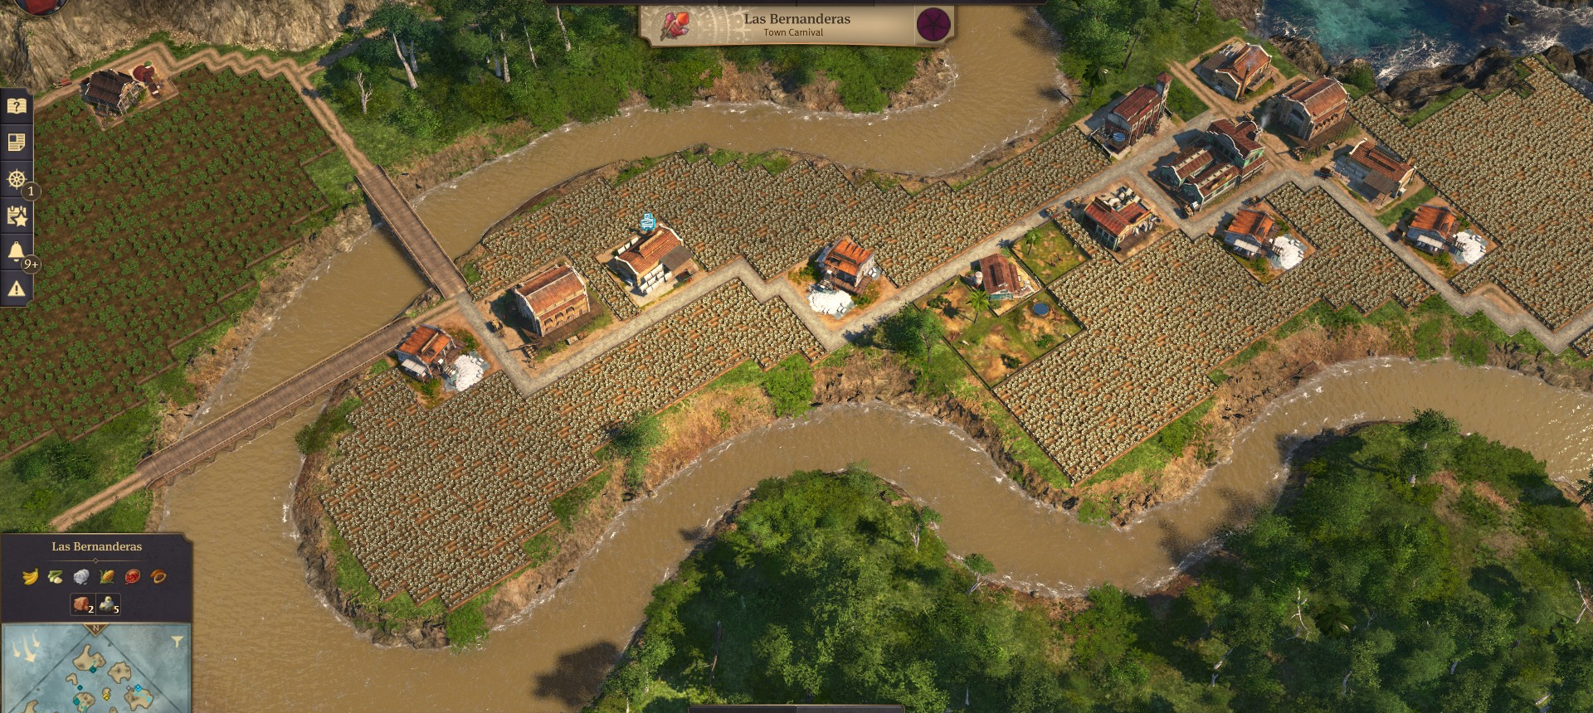
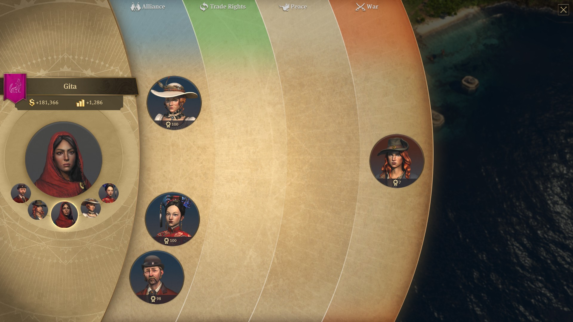
The Bad
Steep learning curve for new players
Aesthetic and efficiency clash
Island and region management becomes overwhelming quickly
Diplomacy system feels flat

Slide 8
Similar Titles
City Building | Diplomacy
Resource Management and Moodlets | Efficiency and PVP/PVE

Slide 9
Is Anno 1800 worth your time?

Slide 10
Yes, if | No, not if
You enjoy building cities You enjoy progression-based games You like the idea of researching about the game outside of playing it Managing inputs/outputs of resources appeals to you | You want Civilization 6 level political warfare You want a casual gameplay experience You prefer simple mechanics You don’t have hundreds of hours to spare

Slide 11
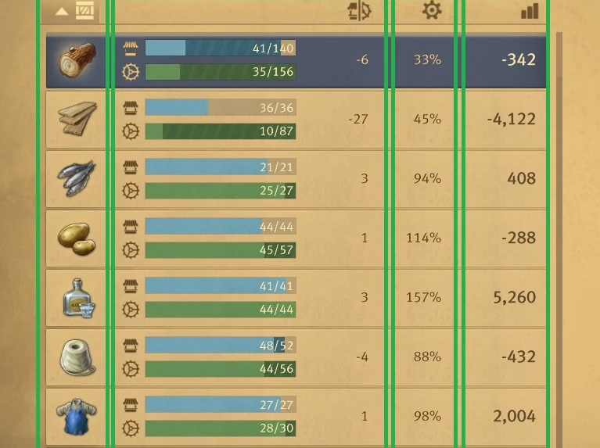
Improving Anno 1800
The learning curve is the biggest issue with this title.
Suggested improvements:
Expand the beginning tutorials.
Reveal citizen tiers and what resources are needed for them ahead of time.
Have intuitive menus that explain where your money is coming from or going.
Teach efficiency using scaffolding of previous knowledge.

