Slide 1
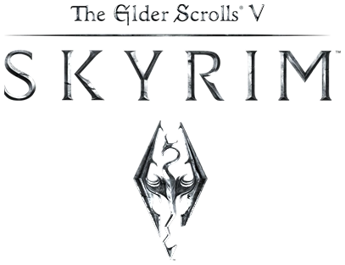
The Elder Scrolls V: Skyrim
Review by: Nathan Lipski

Slide 2
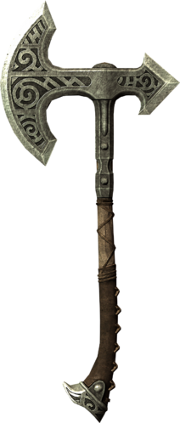
Basic Information
The Elder Scrolls V: Skyrim (called Skyrim in short) is an open-world, fantasy, role-playing game developed by Bethesda Game Studios and released November 11, 2011 (11/11/11) on console and PC.
Skyrim had an MSRP of $59.99 at launch as is typical nowadays.

Slide 3
Hardware Requirements
Consoles are already outfitted with proper hardware requirements.
PC Minimum Requirements (From Steam) consist of:
OS: Windows 7/Vista/XP PC (32 or 64 bit)
Processor: Dual Core 2.0GHz or equivalent processor
Memory: 2GB System RAM
Hard Disk Space: 6GB free HDD Space
Video Card: Direct X 9.0c compliant video card w/ 512 MB of RAM
Sound: DirectX compatible sound card
Game is available on PC, Xbox 360, Xbox One, Xbox Series X, PS3, PS4, PS5, Nintendo Switch, or Amazon Alexa (Yes really)

Slide 4
Game Overview
Vast open-world roaming.
Multiple levels of combat difficulty that can be changed at any point in your adventure.
Ability to save anywhere during gameplay.
Large number of side-quests allow for players choose their own path rather than simply follow the main questline.

Slide 5
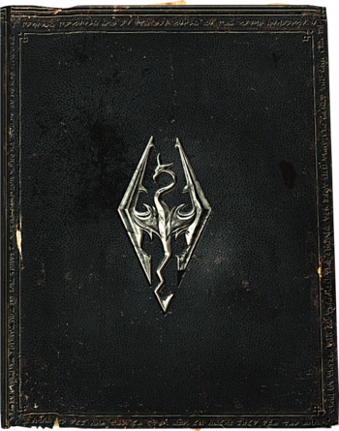
Storyline & Player’s Role
The main story focuses on the main character and their quest to defeat Alduin the World-Eater, who has been prophesied to destroy the world. All while the protagonist discovers how to wield their special abilities given as “The Dragonborn”.
Story takes place on the continent of Tamriel, approximately 200 years after the events of The Elder Scrolls IV: Oblivion
There are a vast number of side-story questlines involving allies, enemies, and other random NPCs throughout all holds of Tamriel.
Upgrade or train your Warrior, Thief, or Mage based abilities to build your characters stats however you like during gameplay.

Slide 6
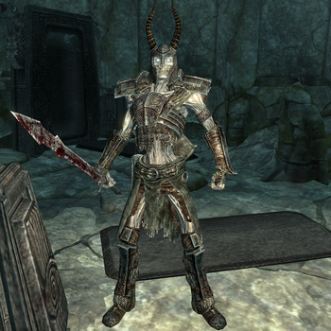
User Interface & Gameplay
Stamina, Health, and Magicka bars
Skills, Perks, Special weapons (magic, melee and ranged)
Defeat enemies to level skills and your character
Absorb dragon souls to unlock new shouts
Earn perk points by leveling to unlock new abilities
Enchant and upgrade your weapons and armor
Interactive Map (Follow quests, fast travel,
waypoints)
Multi-option dialogue with NPCs

Slide 7
Bugs
Skyrim is a Bethesda game, which means it has bugs. Many bugs encountered in a regular playthrough will not be game-breaking, and some will be un-noticeable to the average player. There are still several bugs that one may encounter, that can change the course of the game.
Some bugs will allow players to get large amounts of loot that wouldn’t normally be possible or can allow players to get infinite enchanting power.
Other bugs are just inconvenient, where you may get stuck in a certain state and have to go back to a previous save to fix the bug.

Slide 8
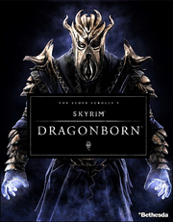
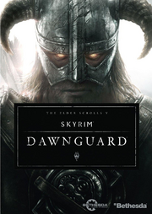
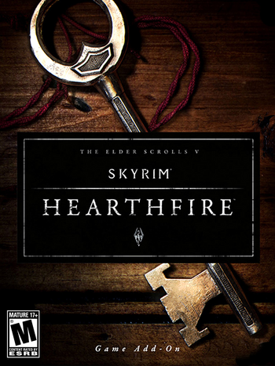
Special Features (DLC)
Dragonborn DLC
The Dragonborn DLC has the most content added of the 3 official DLCs, adding a completely new island called Solstheim to the map. There is a main questline of 7 quests, plus 28 side quests, and over 90 new locations are added
Dawnguard DLC
Dawnguard was the first added DLC, adding a questline following Vampires and Werewolves. There are 12 new main quests and over a dozen new side quests. About 20 new locations are added, and a new tier of weapons are added.
Hearthfire DLC
Hearthfire is the smallest of the 3 DLCs, and only cost $4.99 versus $19.99 for the others. Hearthfire added the ability for the player to create their own homestead and create a family to live in it.

Slide 9
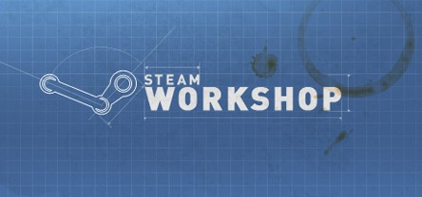
Special Features (More)
Mods and Workshop
PC players are able to add their own mods to the game, free content created by other players of the game, many of these add content to the game, change up existing content, or are quality of life improvements to the game. Utilizing mods, the game can feel brand new all over again.
Creation Club
The Creation Club was introduced in 2017 and allowed for more ‘official’ DLC to be added to the game. The Creation Club features content that was originally introduced as un-official mods of the game, but since have been picked up by Bethesda themselves to be added to the game. This acts as a method for mods to be added to console versions of the game (albeit at a cost)

Slide 10
Visual and Audio Ambience
Visual:
Medieval fantasy continent of Tamriel.
Wood and brick cabin-style buildings, lush rivers and forests, large mountains and hills.
Day and Night cycles that affect enemies and NPCs.
Audio:
Peaceful and serene soundtrack on surface, fast-paced combat music

Slide 11
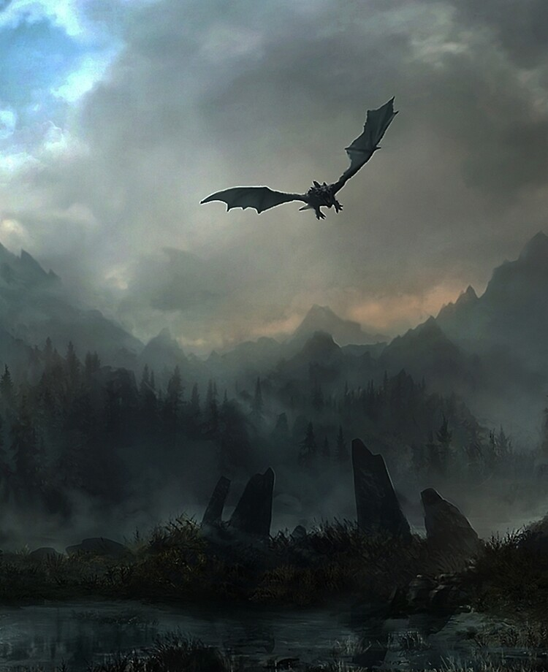
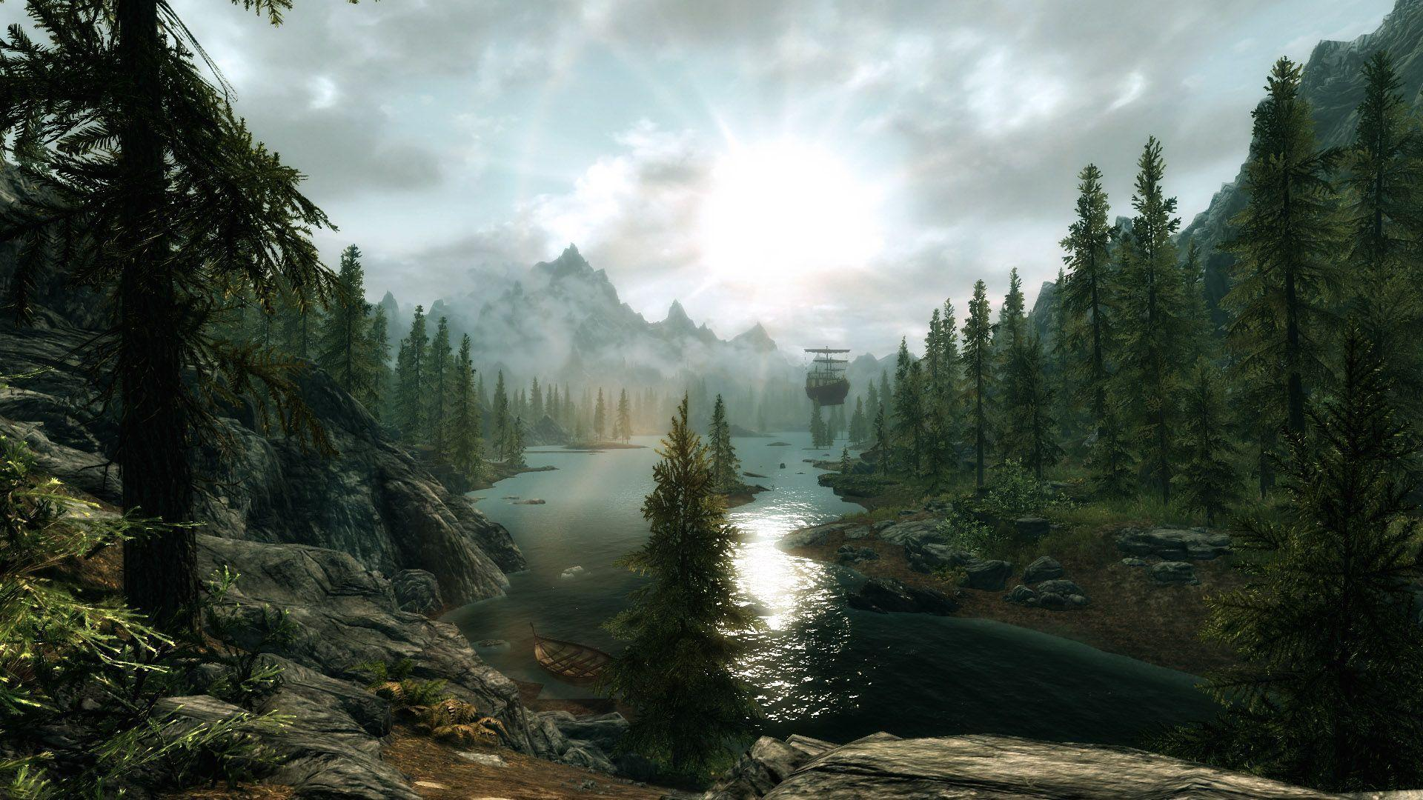
Landscapes

Slide 12
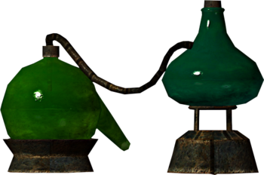
Game Review
What is good about the game?
Skyrim is a unique experience that isn’t captured well in other series. The combat and world building that is available is unlike any other.
The large number of quests and items allow for the player to spend well over 100 hours on a single playthrough, and the options for character builds make it great to replay over-and-over again.
What is bad about the game?
The game features lots of bugs and glitches which can make the game irritating to play at some points.
World is almost too vast, can seem like certain characters and quests are unfinished or forgotten about

Slide 13
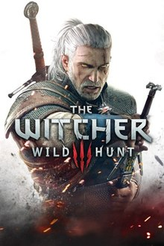
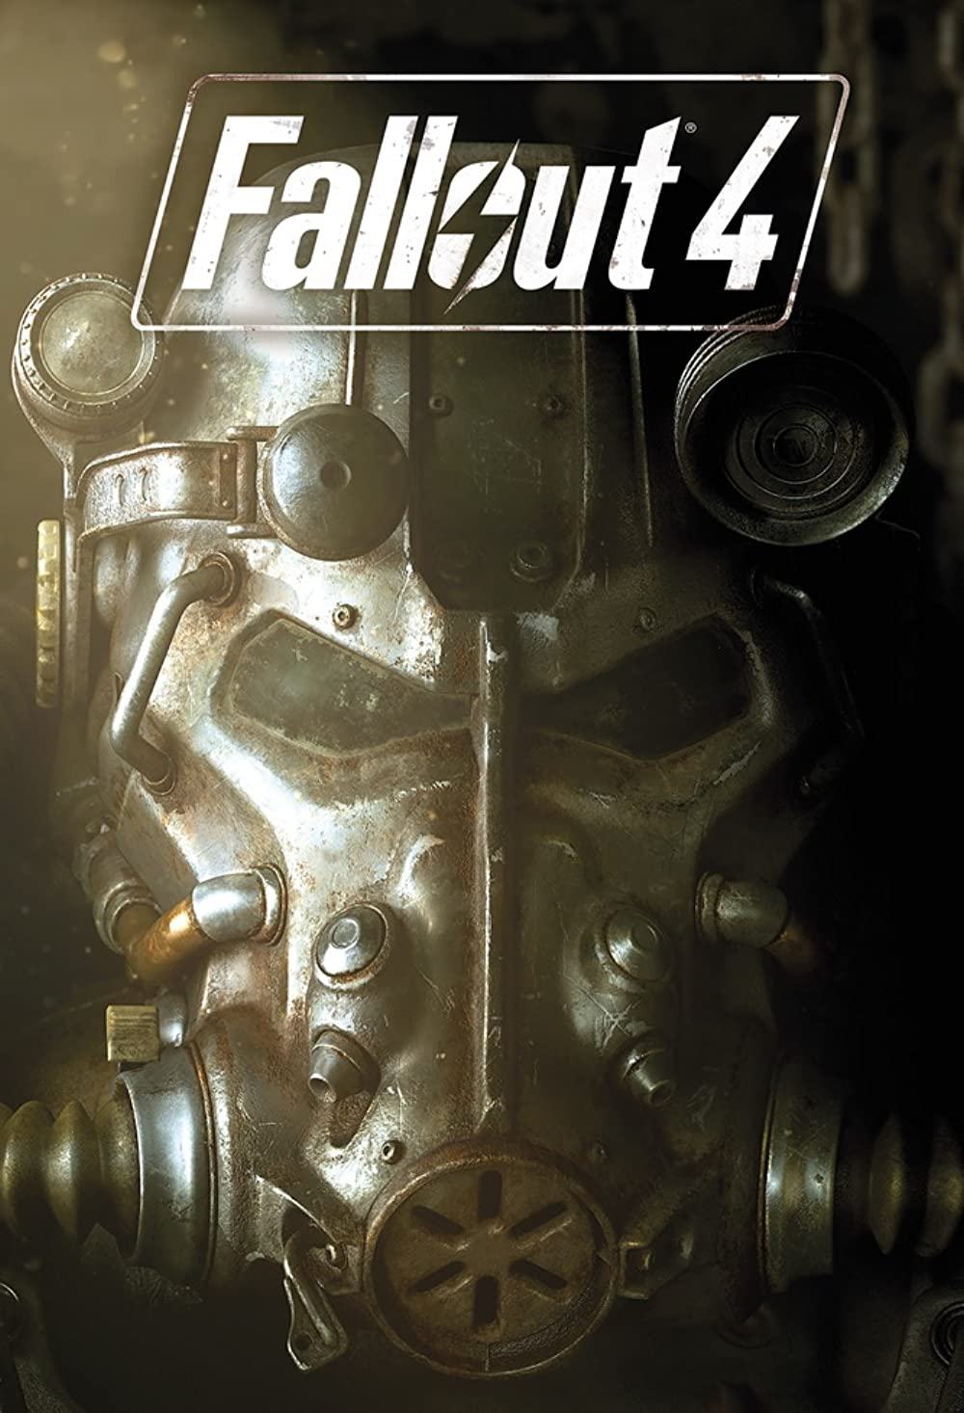
Comparisons to similar games
Witcher Series: It shares several aspects like choice of dialogue, time-period, open-world gameplay, and both linear and non-linear quests. I have never played any games in the Witcher Series, but it appears to be the most like the Elder Scrolls games.
Fallout Series: Fallout is produced by the same studio as Skyrim and provides a similar type of gameplay. The main difference is the time period being post-apocalyptic. It tends to suffer from the same issues as Elder Scrolls since it is produced by the same studio (bugs and incomplete content).

Slide 14
Comparisons to similar games (Cont.)
Why is it better than similar games
The main gameplay aspect that Skyrim has going is the replay-ability. Other games can have just as good of a story available to the player, but those tend to be through the eyes of a single character. With Skyrim, every playthrough, the character can be different
Intended Audience
Based on the ESRB, it is intended for an adult (17+) audience, but to be honest, it was suited to a 14+ audience given the type of game that it was.

Slide 15
Design Mistakes
Most design mistakes stem from the bugs that are present in the game. Many bugs allow for players to break the flow of progression (Like receiving end-game content at level 1) and can make the game feel boring.
You rarely encounter non-hostile NPCs outside of major cities making the world seem small in contrast.

Slide 16
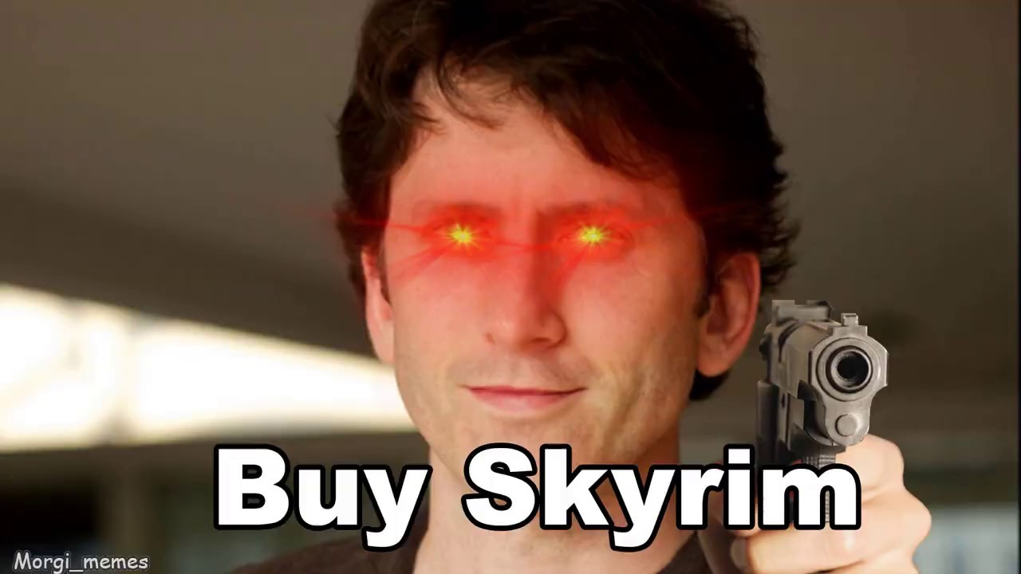
Is the game worth buying?
At the initial MSRP of $60 in 2011, plus an additional $45 worth of DLC it would have been hard to recommend purchasing. After several years, and a few re-releases, the game can be bought new for under $40 with all DLCs included, or $20 without. With the amount of content and replay-value the game has. I would be stupid to not recommend anyone buy the game.
So, yes, the game is very much worth buying, even if the game is a decade old

Slide 17
Overall Summary
Overall, the game seems quite buggy if you look at it now, but when the game was first released and many bugs weren’t known, the game was one of the most expansive and complete open-world RPGs on the market.
Rating: 9.2/10
How could it be improved?
Needed more play-testers to catch some more significant bugs and other flaws

