Slide 1
Street Fighter III: 3rd Strike
By:Johnathan Khalil

Slide 2
Basic Information
Game Title: Street Fighter III: Third Strike
Publisher: Capcom
Genre: Fighting Game
Initial Release Date: May 12, 1999
Price Range: $30-60
Platforms: Arcade, Dreamcast, PlayStation 2, Xbox, PlayStation 3, Xbox 360, PlayStation 4, Xbox One, Nintendo Switch, Microsoft Windows
Minimum Hardware Requirements:
CPU: Intel Pentium IV @ 2 GHz or better
RAM: 512 MB
Video Card: 64 MB
Hard Drive: 600 MB available space
Recommended Hardware Requirements:
CPU: Intel Pentium IV @ 2.2 GHz or better
RAM: 1 GB
Video Card: 128 MB
Hard Drive: 600 MB available space

Slide 3
Game Summary
Overview:
Arcade fighting game taking place during the Third World Warrior Tournament where fighters around the world come to showcase their abilities and proclaim themselves the world’s greatest. As the tournament progresses, personal motivations are revealed and the threat of an apocalypse is on the horizon
Story:
Each character has their own personal motivations for entering the tournament (ex. Akuma continues to search for an opponent strong enough to beat him). However they are brought together in a fight against Gill and Urien. Brothers and members of the Illuminati organization that practices extreme eugenics and social darwinism, they look to restore balance to the world by creating an apocalyptic event to wipe the world clean and restore humanity in a utopian-like state. Thereby creating a nation comprised of the fittest and best that humanity had to offer in order to bring about their salvation

Slide 4
Game Summary Pt 2
Player’s Role:
You control one of 19 characters and proceed through the tournament. Defeating whoever stands in your way. Culminating in a battle with Gill in a fight for humanity’s survival.
Manual:
The original releases of the game on console had a manual that contains a list of each character’s moves and their corresponding input
Scoring:
While score does not have any impact on the game, you do earn points for each hit you land, how quickly you defeat your opponent, and from minigame stages in between fights.

Slide 5
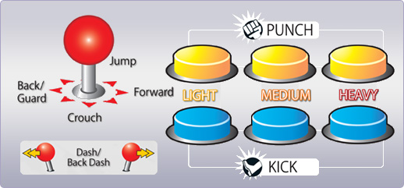
Game Summary Pt 3
Gameplay:
-3 Punches: Light, Medium, Heavy
-3 Kicks: Light, Medium, Heavy
-Move character in all 8 directions
-Hold back to block and tap forward to dash
-Input different button and movements to unleash special moves and super moves
Ex: Quarter circle forward + punch = Hadouken

Slide 6
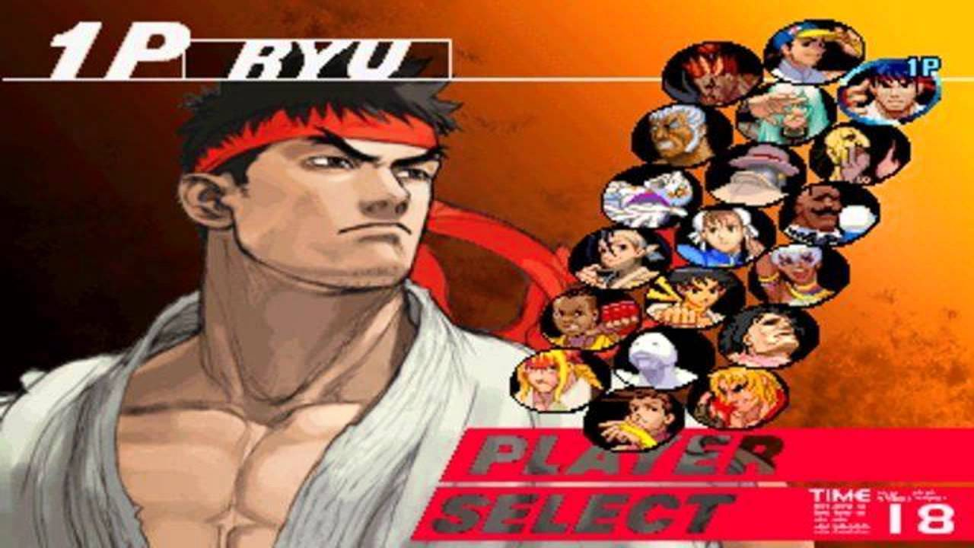
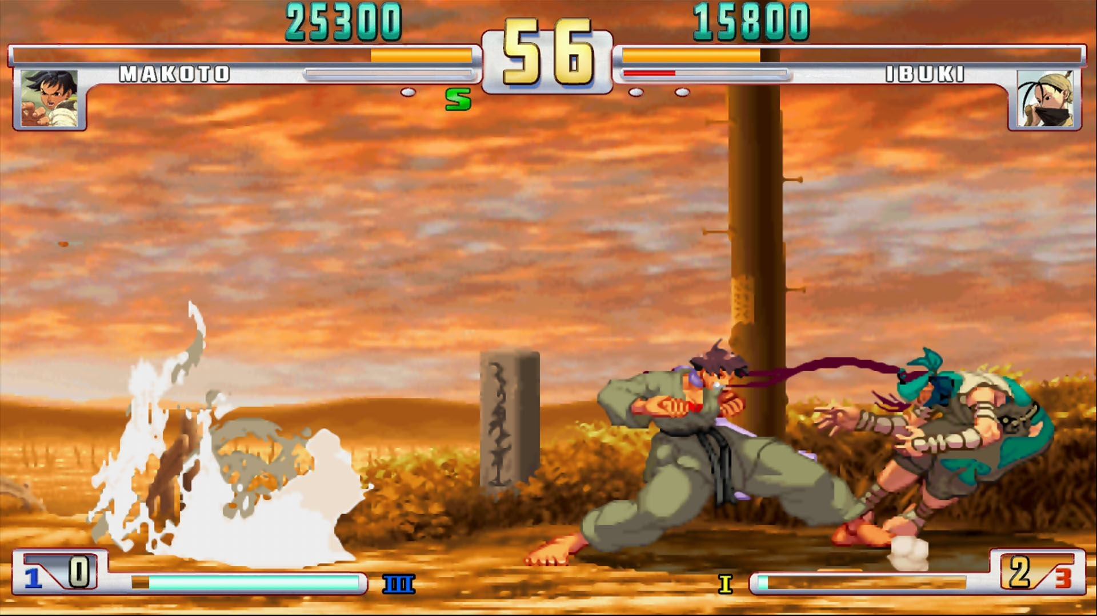
Game Summary Pt 4
User Interface:
-Player select screen of 19 characters
-Health bar, score, and time displayed on the top of the screen
-Stun bar placed under the health bar next to player name
-Number of rounds won underneath stun bar
-Super meter bar at the bottom of the screen, with the number of supers available to the left of the bar and the type of super attack to the right of the bar

Slide 7
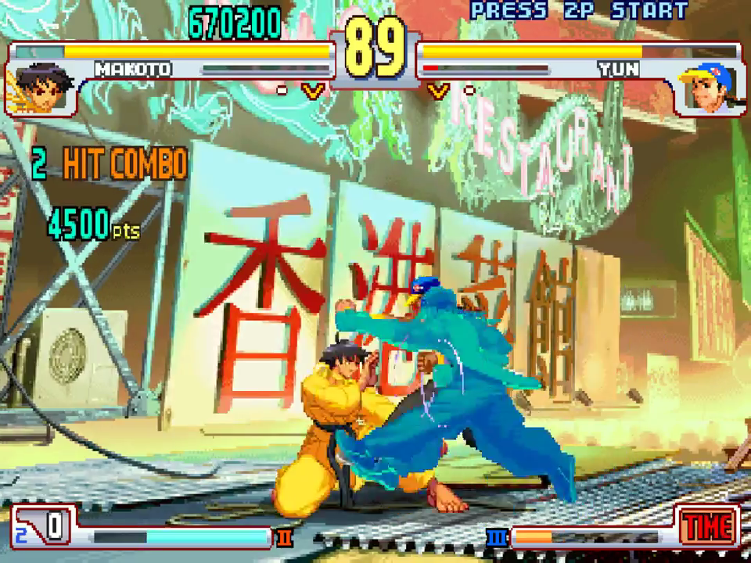
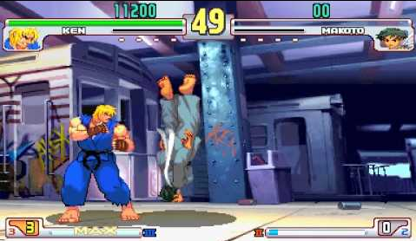
Game Summary Pt 5
Artwork:
2D animated artwork of both fighters with animated backgrounds. The art may be outdated for present arcade fighters.
Bugs:
In the original arcade version, if you win as Ken against Makoto by landing a neutral throw, the game will crash

Slide 8
Game Summary Pt 6
Installation:
PlayStation (PS Store)
XBox (Microsoft Store)
PC (Steam)
Sound/Music:
The soundtrack draws inspiration from many backgrounds. Jazz, 90’s hip hop, and traditional japanese music are all fused throughout the various tracks. Each theme setting the tone for the character you’re about to face and the environment they live in
Special Features:
Each player has access to a super move which they gain by building up their super meter through getting hit or hitting their opponent. Once full, they can input a unique command that performs the move, dealing high amounts of damage to the opponent
3rd Strike introduced the concept of parrying a move. Parrying does the same as blocking but prevents chip damage and gives the player frame advantage to counter-attack. To parry a move, a player must press forward exactly as the opponent’s move connects, thus leaving you open to being hit if you time the parry incorrectly

Slide 9
Game Review
The Good:
Really intense game that can be enjoyed by casuals with a high competitive ceiling.
A variety of playstyle’s such as zoning, aggression, and grappling are available to the player to really allow them to express themselves
Forces a player to think of how to beat their opponent in an optimal way and rewards you with large combos and damage output for outthinking your opponent
The game punishes those who try to play using cheap tricks such as overblocking resulting in block stun and moves that go under, through, or above projectiles for those looking to spam zoning moves
Fairly balanced player roster in which gameplay isn’t dominated by a single character
The Bad:
Most likely introduction to the game is by facing competitive players resulting in potential future players being discouraged
Large move list and inputs can be difficult to memorize without constant repetition

Slide 10
Game Comparison
Compared to similar games:
The gameplay mechanics are maintained throughout later Street Fighter sequels, however the roster would become unbalanced in later games with characters like Sagat dominating SFIV meta. Other fighting game brands such as Mortal Kombat focused more on making the impact of the hits too realistic, leading to an uncanny valley scenario, while Marvel vs Capcom had no impact behind the hits, diminishing the reward felt by the player
Design Mistakes:
Online play in later re-releases were awful due to the use of delay-based netcode resulting in input lag
Better or Worse?:
While sales for other fighting games surpass SF3, its gameplay is still superior to MK or MvC. Street Fighter 2 may be considered the “perfect” fighting game, SF3’s gameplay is faster and involves less gimmicks for each character.
Appropriate Audience:
The audience for this game are fighting game fans both casual and competitive alike. The fusion of pop culture at the time (characters based on famous wrestlers, hip hop style music, etc.) was meant to appeal to the teenage/young adult generation of the time

Slide 11
Summary
Strengths:
Balanced Roster
Replayability
High gameplay ceiling
Wide variety of gameplay style
Intense on-edge feeling while playing
Weaknesses:
Poor online play in re-releases
Worth Purchasing?:
This game is worth purchasing for players trying to get into the Street Fighter genre. The faster paced gameplay with a balanced roster lends itself to newer players looking to establish themselves in the series. The game is available on so many platforms that anyone can access the game with relative ease and its age makes it cheap to obtain as well
How It Can Be Improved:
If there were to be a new remastering of 3rd Strike, Capcom could improve upon the game with more cutscenes to explain character story and improve the netcode to make online play viable for competitive players

