Slide 1
CIS 487 Game Evaluation - Omori
By Noel Jensen

Slide 2
Basic Information
Omori is an adventure RPG developed by indie company OMOCAT, LLC, and published by OMOCAT, LLC and PLAYISM.
Available on Steam for $19.99.

Slide 3
Basic Information
Minimum hardware requirements:
Requires 64-bit processor and operating system
OS: Microsoft windows 8.1 (32bit/64bit)
Processor: Intel N4100 or better
Memory: 4 GB of RAM
Graphics: DirectX 9 or OpenGL 4.1 capable GPU
DirectX: Version 9.0c
Storage: 2 GB of available space
Additional Notes: 1280x720 display is recommended at x2 resolution but is not required

Slide 4
Basic Information
Actual hardware requirements (recommended):
Requires 64-bit processor and operating system
OS: Microsoft windows 10 (32bit/64bit)
Processor: Intel Core i3-6100 or better
Memory: 8 GB of RAM
Graphics: OpenGL ES 2.0 hardware driver support required forWEBGL acceleration
DirectX: Version 9.0
Storage: 2 GB of available space
Additional Notes: 1280x720 display is recommended at x2 resolution but is not required

Slide 5
Game Summary
Overview
Adventure RPG with aspects of psychological horror.
Main character is a boy named Sunny, who is struggling deeply with something that the player is not yet informed of.
Gameplay involves controlling four characters - Sunny and his friends.
Player goes on quests, fights monsters, levels up characters.
Main goal is to uncover what happened to Sunny.

Slide 6
Game Summary
Storyline
Sunny has gone through a traumatizing event that he struggles to remember.
He develops tragic coping mechanisms to handle this.
His real name is Sunny, but he lives in an imaginary world where his name is Omori.
This world is called “HEADSPACE,” and this is where most of the gameplay occurs.
He always enters HEADSPACE by first navigating “DARK SPACE” - a miserable, empty room.
In the real world, Sunny is in the process of moving out of his hometown.
He has become nonverbal and withdrawn from his friends and real life.
Before he leaves, Sunny slowly uncovers the memory that caused his misery
The player learns that his lost memory involves the death of his sister.

Slide 7
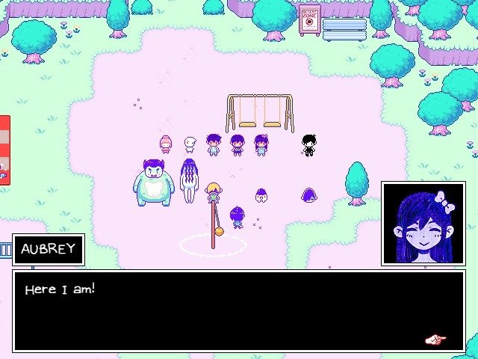
Game Summary
Player’s Role
Player’s main role is to make Omori’s (sometimes Sunny’s) decisions for him.
Player chooses which NPCs and inanimate objects to interact with.
Player can start fights with monsters or run away from them.
There are many quests to choose from - player can do all or none of them.
Installation
Omori can be installed via Steam, which is linked on the official website:
https://www.omori-game.com/en
User Interface
2D game, viewed in 3rd person while adventuring.
Combat has a separate interface.
Allows player to view all four characters’ health and skills.
Turn-based selections allow user to view each character’s attack methods one by one.

Slide 8
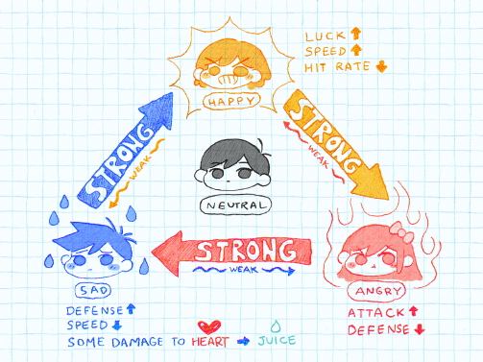
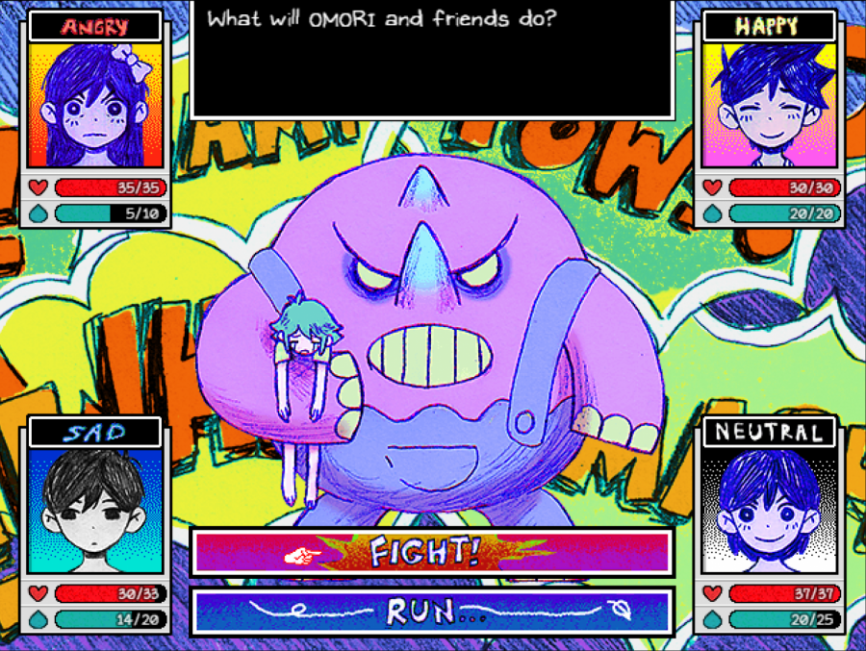
Game Summary
Game Play
Navigate with arrow keys.
[X] key to view menu, [Z] key to select, [A] to switch characters, [Shift] to run.
NPCs offer quests that are often irrelevant, but give more depth to the game world.
Combat is turn-based but quick. Involves some strategy.
Each character has their own strengths, which are triggered by emotions that the player can inflict.
Save points are important - player can fail in combat.
Quests are introduced by using [Z] to talk to various NPCs.
Omori’s sister is alive in HEADSPACE - she is a save point, gives advice, and keeps track of unfinished quests.

Slide 9
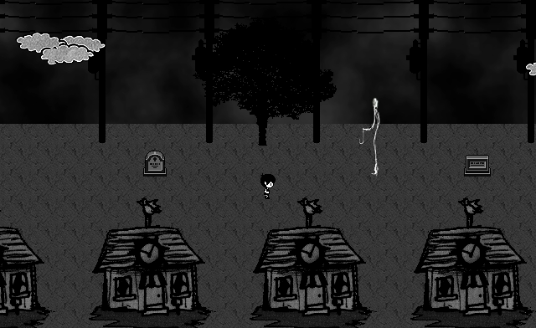
Game Summary
Scoring
There is no point system, but player can level up characters.
Artwork
Detailed, colorful - or scary and dark.
2D, pixelated design.
Some scenes are static cartoon images rather than pixelated animations.
Playful font.
Sound and Music
179 soundtracks - different areas have different soundtracks.
Very emotional music - nostalgic, sad, playful, scary.
Electronic and simple.

Slide 10
Game Summary
Special Features
Each NPC has a unique personality.
Notes are sometimes left by Sunny’s mother.
Player can take care of a garden.
Players can fly to different areas of the HEADSPACE world.
Manual
Decent manual can be found on the wiki fanpage:
https://omori.fandom.com/wiki/Wiki_Guidelines/Manual_of_Style
Bugs
No known bugs - but there is a forum to post about any:
https://steamcommunity.com/app/1150690/discussions/0/2995422276377408303/

Slide 11
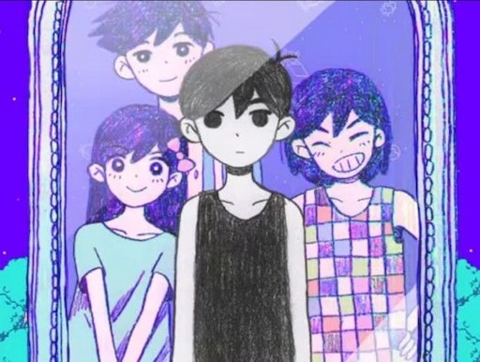
Game Review
What is good about the game, and why?
Story is an emotional experience.
Elements of psychological horror.
Player is left wondering and searching for clues about what happened to Sunny/Omori.
Player can be social and talk to many NPCs.
The ending changes depending of the player’s choices.
Visually pleasing, memorable soundtrack.
Endless exploration, cute cutscenes, and easter eggs.

Slide 12
Game Review
What is bad about the game, and why?
Easy to get lost in the quests.
Dialog disappears and sometimes cannot be reviewed.
How does it compare?
Omori explores worlds within a world with great depth.
Explores Omori/Sunny;s poor mental health.
Great implicit storytelling.
Very long game and is good to replay, despite being relatively cheap.

Slide 13
Game Review
Why is Omori better than similar games?
Exploring and fighting are big aspects of the game, but so is the storyline.
Why is Omori worse than similar games?
Number and length of quests can be overwhelming.
Game controls are easy to forget/confuse.

Slide 14
Game Review
What is the appropriate audience for this game?
Steam requires ages 18+
Are there design mistakes?
No known design mistakes.

Slide 15
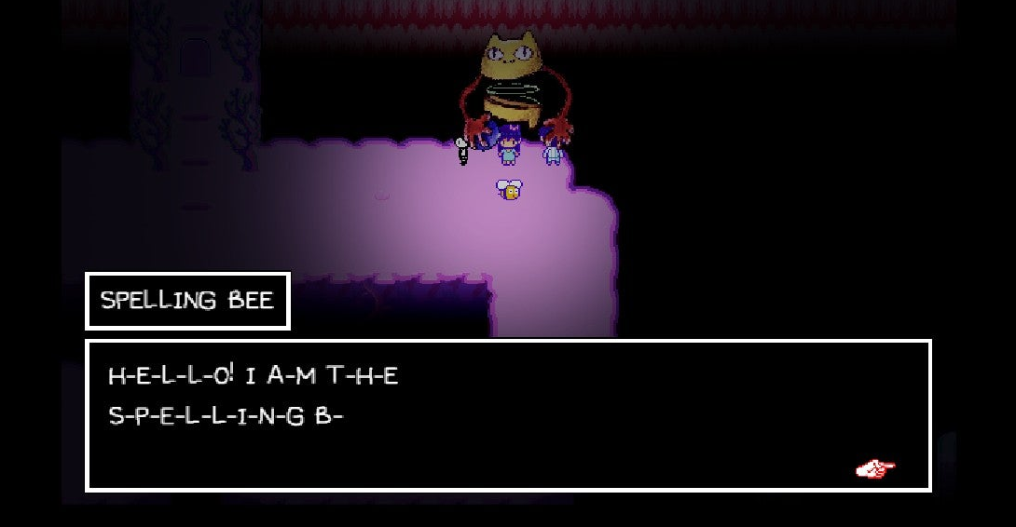
Summary
Overall Strengths:
Strong storyline
Enticing gameplay and combat
Pleasant artwork and soundtracks
Plenty of comic relief
Doesn’t take up too much space on your computer
Cheap game for the quality and time spent playing.

Slide 16
Summary
Overall Weaknesses:
Poor navigation methods - easy to get lost in such a large world.
Default keys are confusing and easy to forget.

Slide 17
Summary
Is Omori worth purchasing?
Worth the money!
Just $20 can give the player at least 4 different endings and over 100 hours of gameplay.
Easily replayable.
Good for covering missed quests and achievements.
Also good for hunting for more symbolism.
The emotional experience and plot twists are worth the time and money spent.
The player spends so much time guessing what happened to Omori, so finally reaching the end is satisfying.

Slide 18
Summary
How could Omori be improved?
Allow players to review the past actions they have made.
No player likes to be unintentionally lost in such a long game.
Quests should be better tracked.
Players are left guessing what they have to do next in some quests, as there is no in-game explanation of how to complete them.
The story can be lost in the quests.
The storyline has so much depth and mystery. Too many quests distracts the player.

