Slide 1
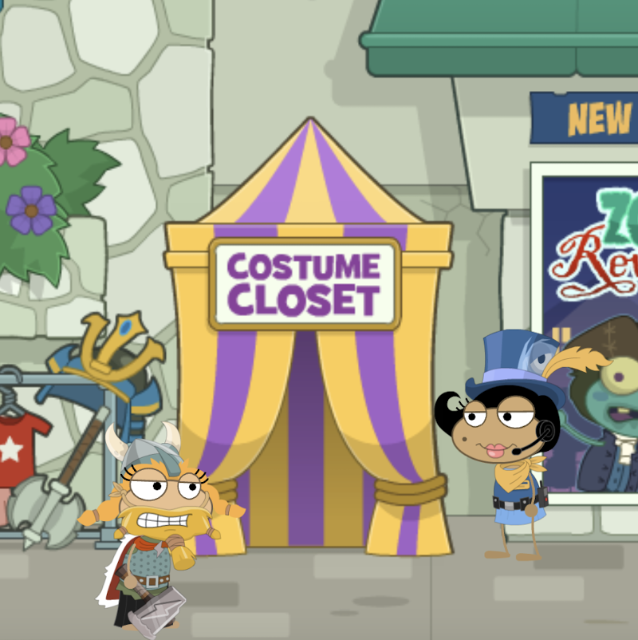
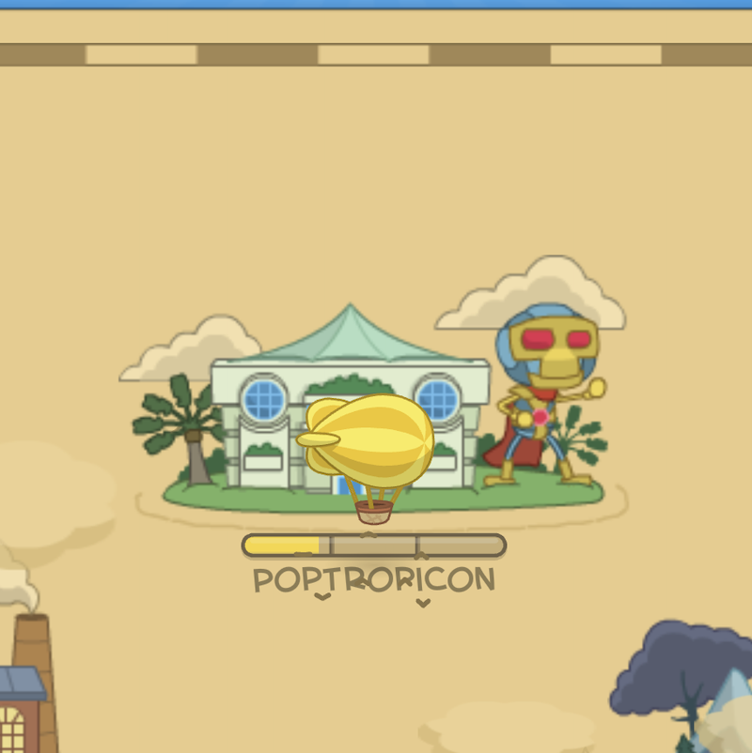
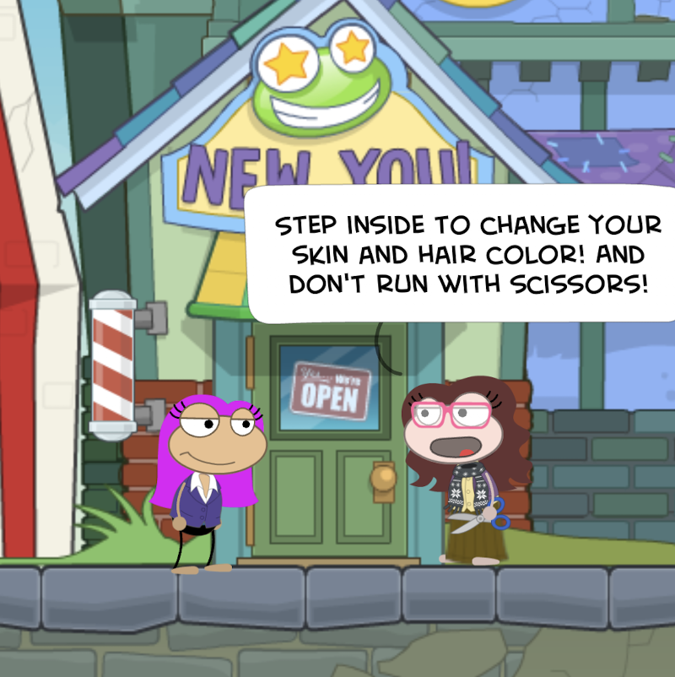
Poptropica
By Maryam Jaratli

Slide 2
Basic Information

Slide 3
Company & Author
Type of Game & Price
Developed in 2007 by Pearson Education’s Family Education Network¹
Primarily developed by Jeff Kinney¹
Puzzle
Genre is story
Free in the Apple Store
Free in Google Play
$30 for the Nintendo DS game
Memberships costs
$3.99 per month
$10.99 per 3 months
$19.99 per 6 months
1 “Poptropica.” Wikipedia, Wikimedia Foundation, 24 July 2021, en.wikipedia.org/wiki/Poptropica.

Slide 4
Hardware Requirements
Apple Store
Mac - requires mac OS 11.0 or later and a Mac with an Apple M1 chip
iphone/ipad/ipod touch - requires iOS 9.0 or later
Google Play
Requires Android 4.3 and up
Web Browsers
Can’t find specifics but should be supported by most web browsers

Slide 5
Game Summary

Slide 6
Quick Overview

Slide 7
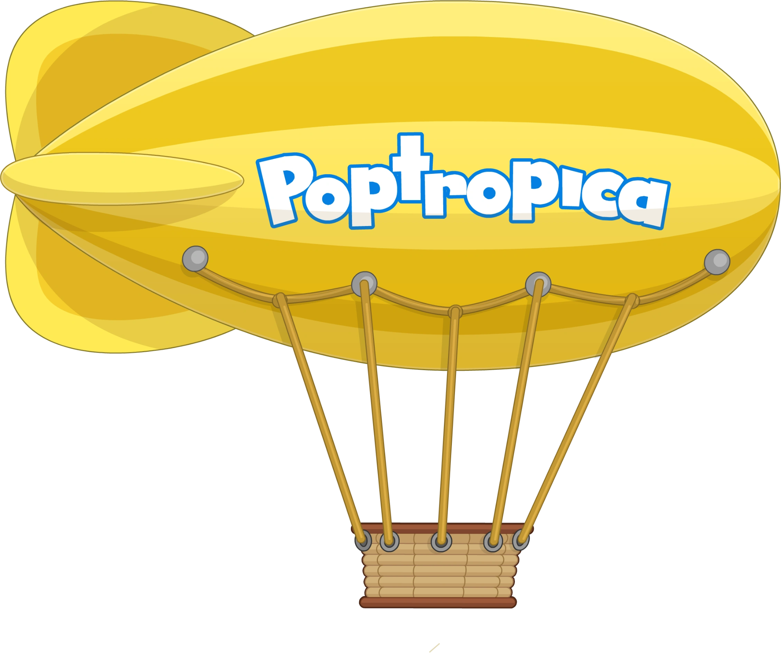
Storyline
Every island has a different storyline
Player’s role
The player solves the puzzles
Installation
Download from the app store or google play
User Interface
Easy to use
Buttons show up on every screen
Decent amount of bugs

Slide 8
Game Play
Player goes around and interacts with other players (artificial intelligence) to get clues and solve puzzles
Scoring
Every island has a completion bar at the bottom as the player goes on
The player is done with an island when the bar is full
Artwork
Cartoon like and very consistent throughout the islands
Sound and Music
Classical like music background
Jumps, pulleys, running noises, etc.
Special features
Customizable costumes
Manual
None
Bugs
Artificial intelligence bug
Some games don’t have exit buttons
Freezing in the same spot more than once

Slide 9
Game Review

Slide 10
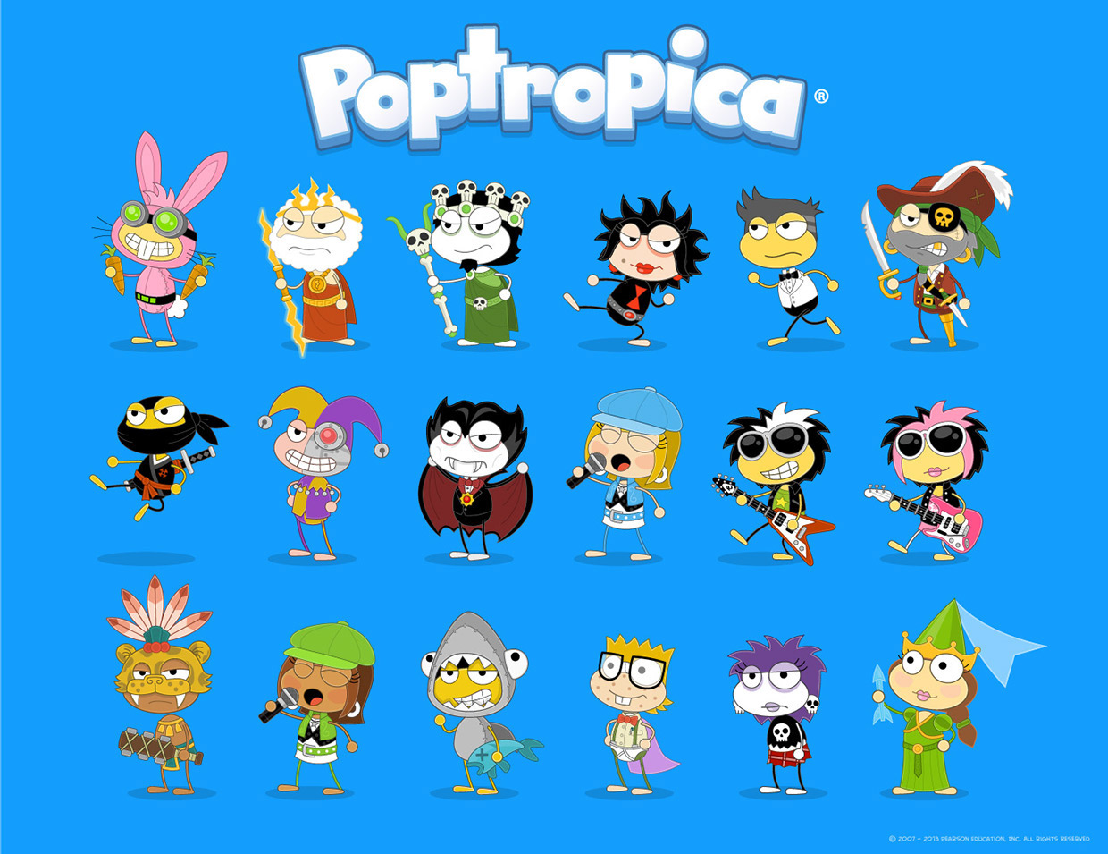
What is good (fun) about the game? Why?
Evolutionary roots
Gathering
Social/Tribal interaction
Physical fun
Hand eye coordination
Social fun
Interact with players to receive hints
Dialog
Mental fun
Abstract reasoning
The light bulb moment
Character Creation
Characters are unique and have a personality
Feedback
The progress bar
Storyline
Incremental
Plot points

Slide 11
What is bad (not fun) about the game? Why?
Storyline is slightly random
Bad sense of direction
Goals are ambiguous at first
At times I had to overly hunt for information
Long sequence of keyboard operations
Significant amount of bugs

Slide 12
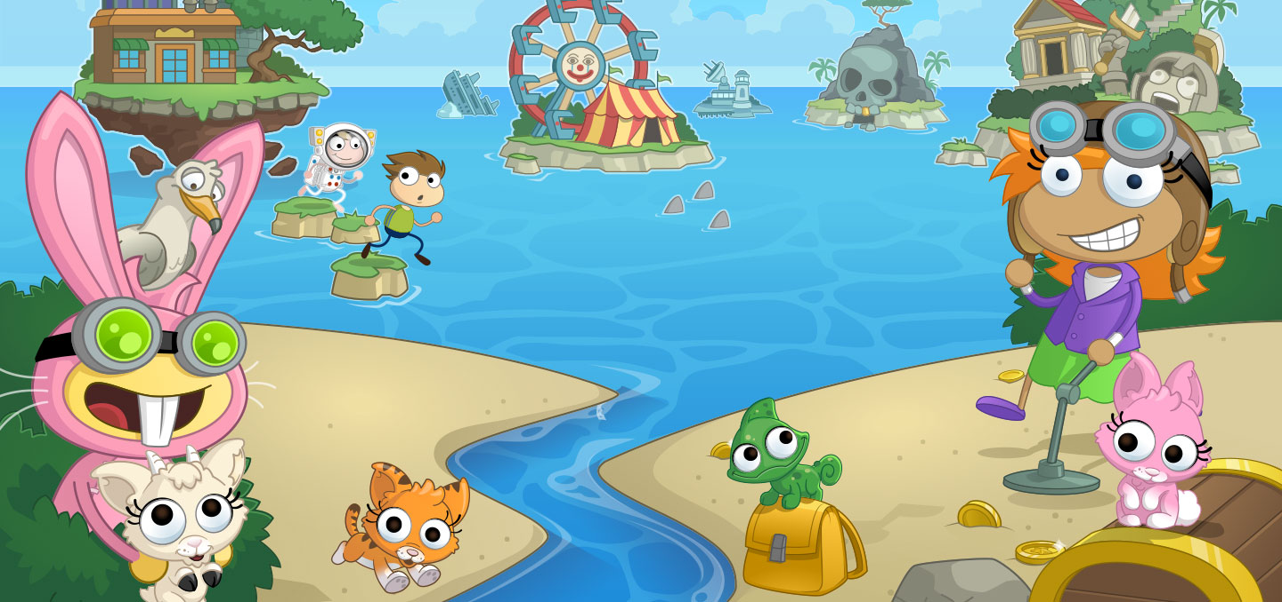
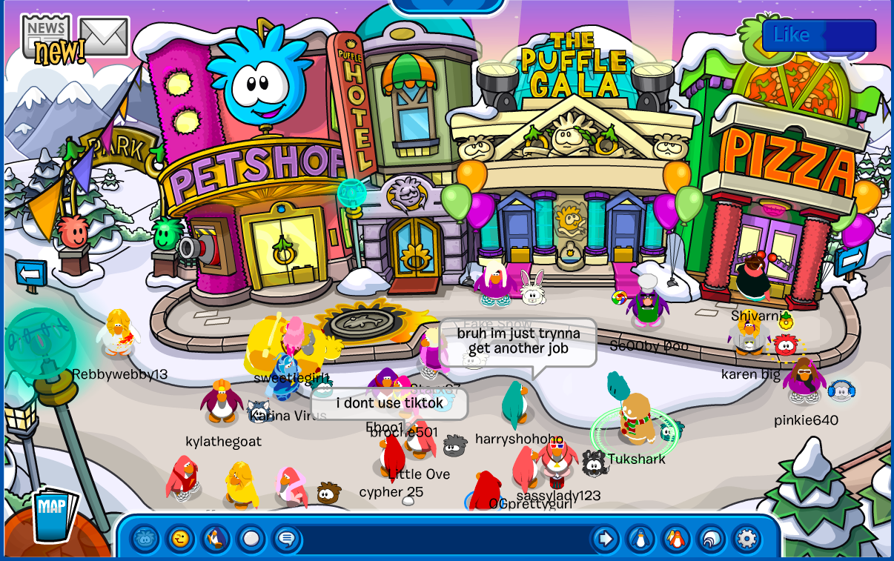
Comparison to Club Penguin
Similarities
Customizable character
Interact with other players
Mini games
Differences
Poptropica is more like “solve the puzzle” while club penguin is just interacting with others and playing mini games
Social interaction in club penguin is between real players, while poptropica is artificial intelligence

Slide 13
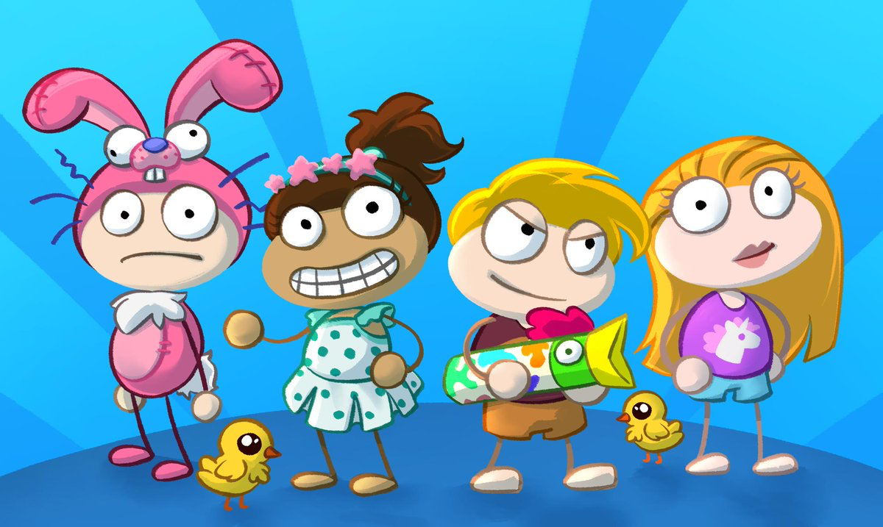
Appropriate Audience
Design Mistakes
No manual
Was hard to figure out how to play the game
This can be very frustrating for a new player
Storyline and goals are ambiguous and random at times
Developers claim the audience is kids aged six to fifteen
I disagree with the developers
Ages ten and up
Hand eye coordination is too difficult
Puzzles require higher level thinking skills
Dialog is too fast

Slide 14
Summary

Slide 15
Overall Strengths
Overall Weaknesses
Very interactive
Dialog with other players
Gathering and socialization
Have to move around the screen a lot
Storyline
Incremental
There are plot points
Utilizes the three categories of fun
Mental
Physical
Social
No manual
Was difficult to figure out how to play and make a sense of the overall game theme
Storyline
Ambiguous at times
Bugs
Too many and very noticeable
Have to restart more than once to avoid some of them
Social

Slide 16
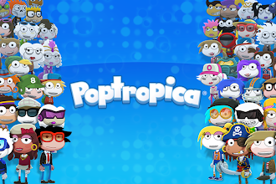
Worth Purchasing?
Improvements
The game is free, in my opinion it’s worth playing despite the game's weakness.
Better sense of direction
Manual
Fixing bugs
Shorter sequences of keyboard operations to accomplish tasks
Improved storyline in some islands and less ambiguity
Social

