Slide 1
Christopher Hill
CIS 487 - Fall 2021

Slide 2
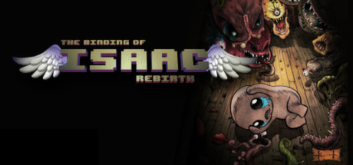
Basic Information
Image Credit: https://store.steampowered.com/app/250900/The_Binding_of_Isaac_Rebirth/
Game title – The Binding of Isaac: Rebirth
Company & Author – Nicalis Inc, Edmund McMillen
Type of game – Roguelike
Price – 14.99 for base game, additional 10.99 for afterbirth DLC, 9.99 for Afterbirth Plus, 14.99 for Repentance
Information obtained from the Steam store page: https://store.steampowered.com/app/250900/The_Binding_of_Isaac_Rebirth/
Available on Steam, Epic, Mac, Linux, Nintendo Switch, PS Vita, PS4 and PS5, Xbox One, New Nintendo 3DS and Wii U, and iOS devices
Minimum stated hardware requirements –
OS: Windows 10, Processor: i7, Memory: 4 GB RAM, Graphics: GeForce 900 Series, Storage: 666 MB available space, Sound Card: Yes, Additional Notes: ༼つ ◕_◕ ༽つ
Actual hardware required –
OS: Windows 10, Processor: i9, Memory: 8 GB RAM, Storage: 666 MB available space, Sound Card: Yes, Additional Notes: ༼つ ◕_◕ ༽つ
Information obtained from the Steam store page: https://store.steampowered.com/app/250900/The_Binding_of_Isaac_Rebirth/

Slide 3
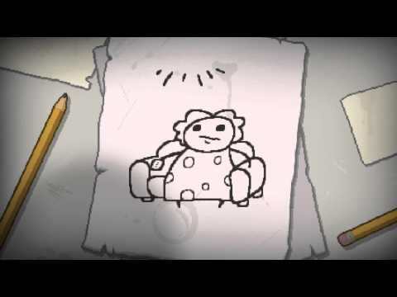
Game Summary
Storyline:
Quick Overview - TBOI:R is a rougelike that was rebuilt from the ground-up as a sequel to the original The Binding of Isaac flash game
Player's role – In the game, you play as Isaac once he falls down into the basement. You must defeat enemies and gather items to become strong enough to defeat mom and escape.
Installation – Done automatically once downloaded via Steam or any other game distribution store.

Slide 4
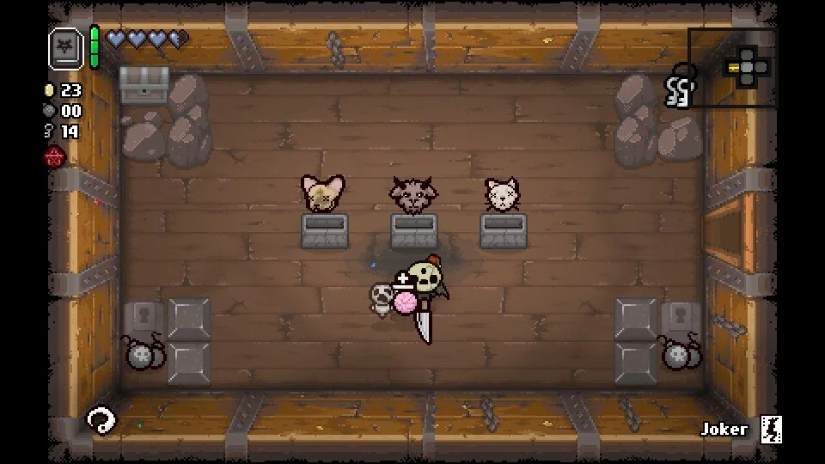
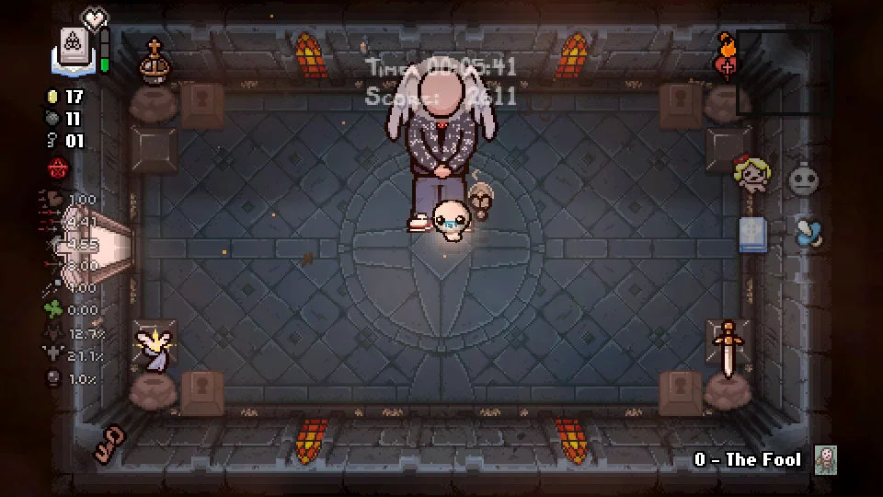
User Interface

Slide 5
Game Summary Continued
Game Play - You need only your keyboard. Standard WASD is used to control your character, and arrow keys to aim the direction of your projectiles.
Scoring - Discussed in more detail here: https://bindingofisaacrebirth.fandom.com/wiki/Daily_Challenges but the basic idea is that for each floor reached and subsequently cleared, certain rooms entered and cleared, enemies killed and items picked up your score goes up by the specified amount for that achievement.
Artwork - Pixel art except for cutscenes
Sound and Music – Easily considered one of the best and most engaging parts of the game
Manual - No manual included
Bugs - No major game breaking bugs
Appropriate Audiences – Anyone over the age of 13 due to graphic content, although the difficulty level is much lower.

Slide 6
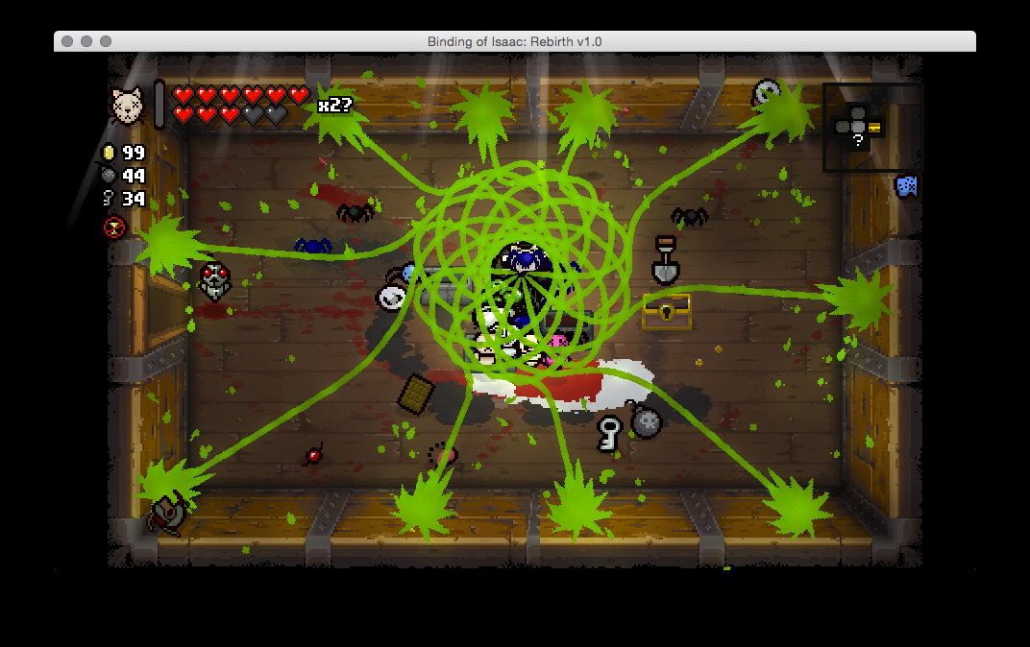
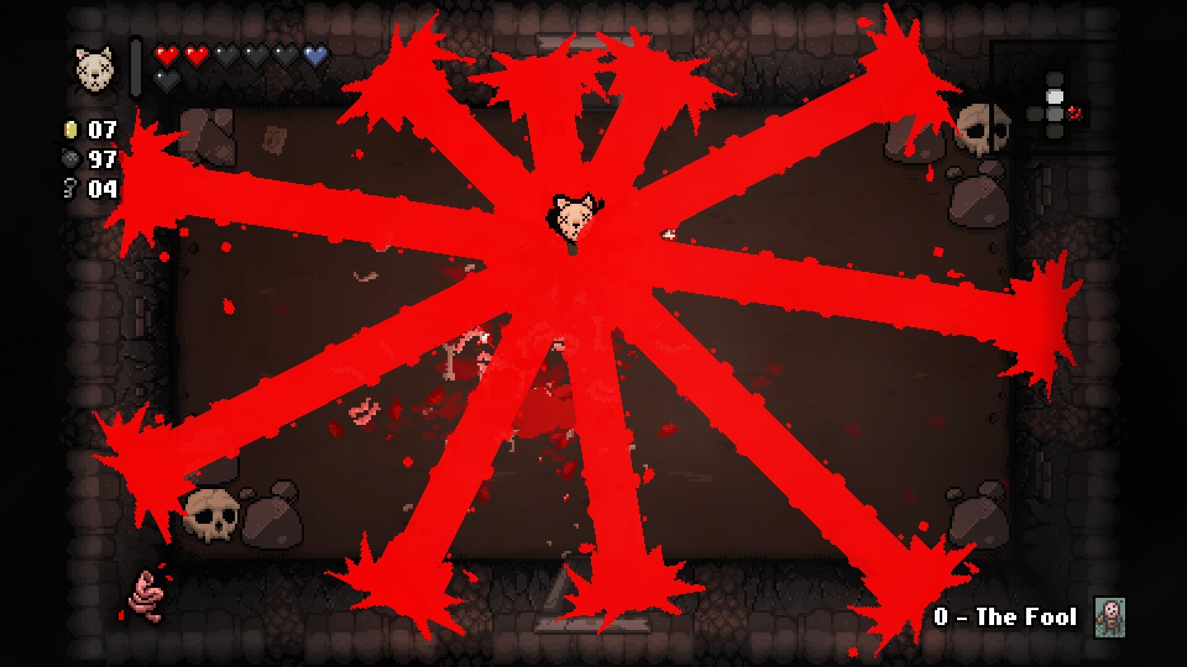
Why is it fun?
The biggest “mechanic” in TBOI:R - luck
Wacky combos

Slide 7
Why is it not fun?
Example Tier list
Credit: Northernlion
The biggest mechanic: luck
Lack of synergy

Slide 8
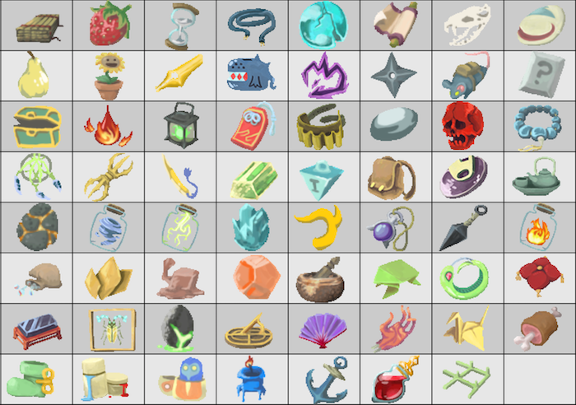
Similar Genre Games
Roguelike vs Roguelite
Slay the Spire
Enter the Gungeon
Small assortment of StS items
Roguelike vs Roguelite
Slay the Spire
Enter the Gungeon

Slide 9
Summary
Strengths :
Fun and challenging
Often on sale
Hundreds of hours of replayability
Weaknesses:
Bad luck
Bad items
Many resets or wasted time
Improvements:
Less bad items
Less resets
More fun!

Slide 10
Image Credits
User Interface -
Screenshot 1: u/comrade_dyngus. “R/Bindingofisaac - 3 Stone CHESTS, 3 Heads.” Reddit, 9 Sept. 2021, www.reddit.com/r/bindingofisaac/comments/ple039/3_stone_chests_3_heads/.
Screenshot 2: u/_lemonnsex_. “R/Bindingofisaac - Possibly the Hardest Choice in My Entire Life.” Reddit, 19 Aug. 2021, www.reddit.com/r/bindingofisaac/comments/p7jw0p/possibly_the_hardest_choice_in_my_entire_life/.
Why is it fun -
Darth_Pokey. (2014, November 11). Screenshot :: I love it when i get crazy item combos like this. Steam Community. Retrieved September 16, 2021, from https://steamcommunity.com/sharedfiles/filedetails/?id=340478000.
Meowzerz. (2014, November 7). The binding Of ISAAC REBIRTH. The Binding Of Isaac Rebirth - Bazaar.tf. Retrieved September 16, 2021, from https://bazaar.tf/thread/5708/3
Title slide art -
u/Remschied. “R/Bindingofisaac - i Made a Background Transparent Rebirth Logo Feel Free to Use It for Video Thumbs or Art!” Reddit, 5 Nov. 2014, www.reddit.com/r/bindingofisaac/comments/2lce53/i_made_a_background_transparent_rebirth_logo_feel/.
Similar genre games -
mushymisha. “Slay the Spire Starter, Common and Uncommon Relics.” Sporcle, www.sporcle.com/games/mushymisha/slay-the-spire-starter-common-and-uncommon-relics.
Summary -
Grayson, Christopher. “BibleThump Meaning & Origin - TWITCH Emote Explained.” StreamScheme, 13 July 2020, www.streamscheme.com/resources/biblethump-meaning/.
Maxxify. “Isaac Buddy Does a Pog.” Imgur, 11 Apr. 2021, www.imgur.com/gallery/BCcE9iS

