Slide 1
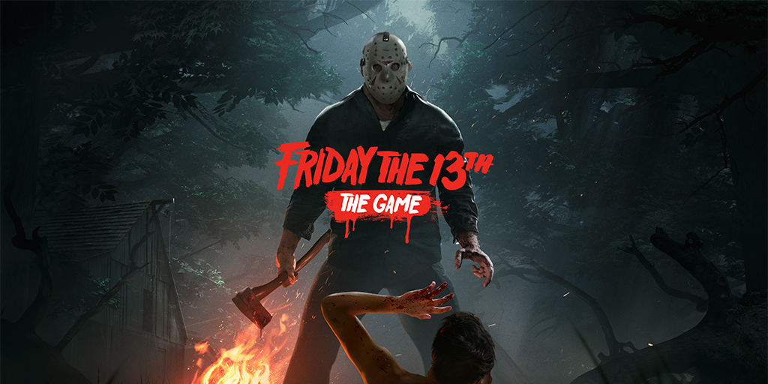
Sami Hamid
15 September 2021

Slide 2
Info
Developed by IllFonic and published by Gun Media
Horror multiplayer survival game
Retail Price: $14.99
Hardware requirements:
64 bit Processor and OS
Intel Core i3, Amd Athlon II
4 GB of memory and 1 GB of video memory

Slide 3
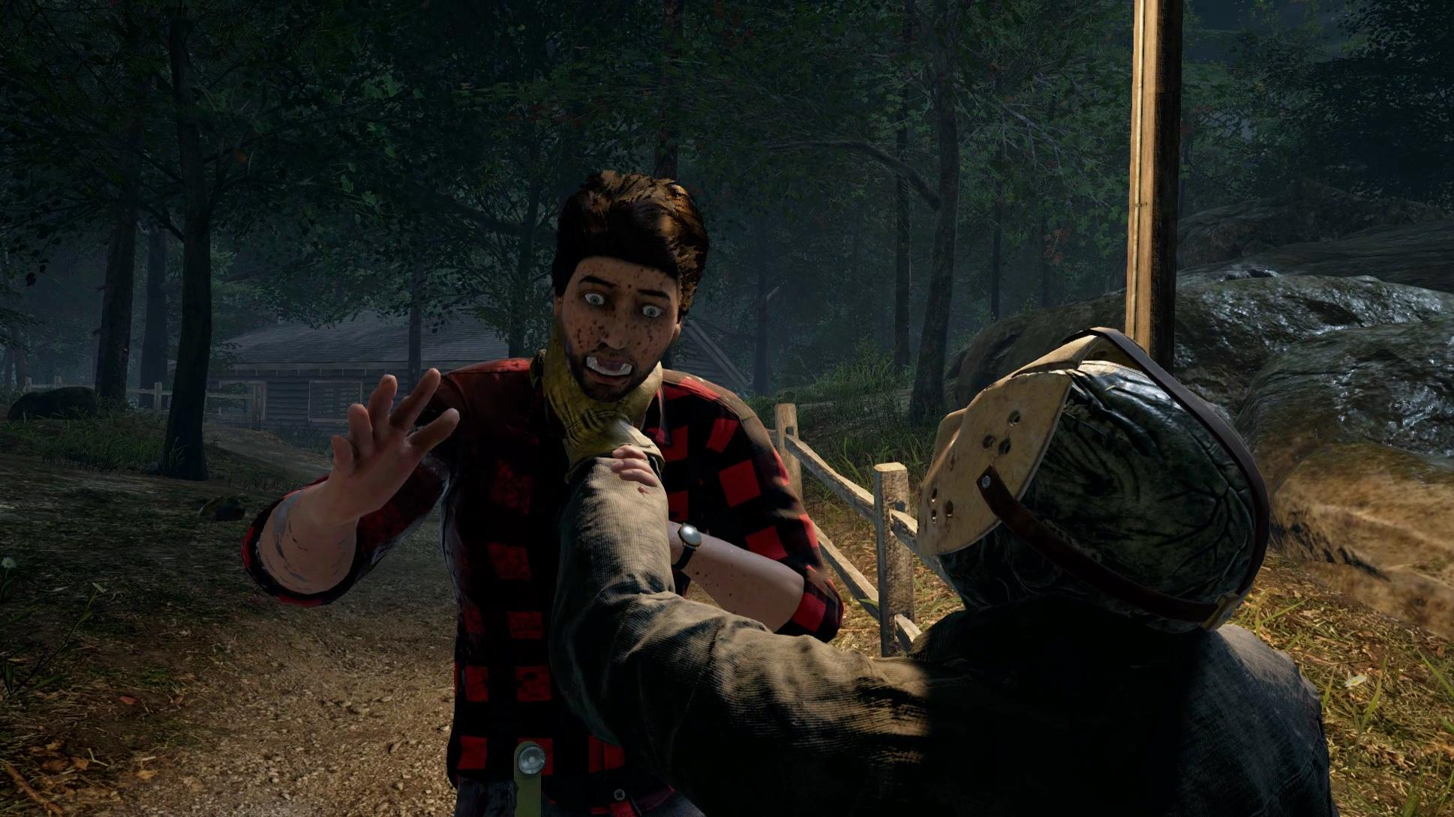
Background
Based on the movie, Friday the 13th
Storyline is nearly identical to movie
Jason killing, counselors running
Tommy Jarvis
Retro Jason (NES 1989)

Slide 4
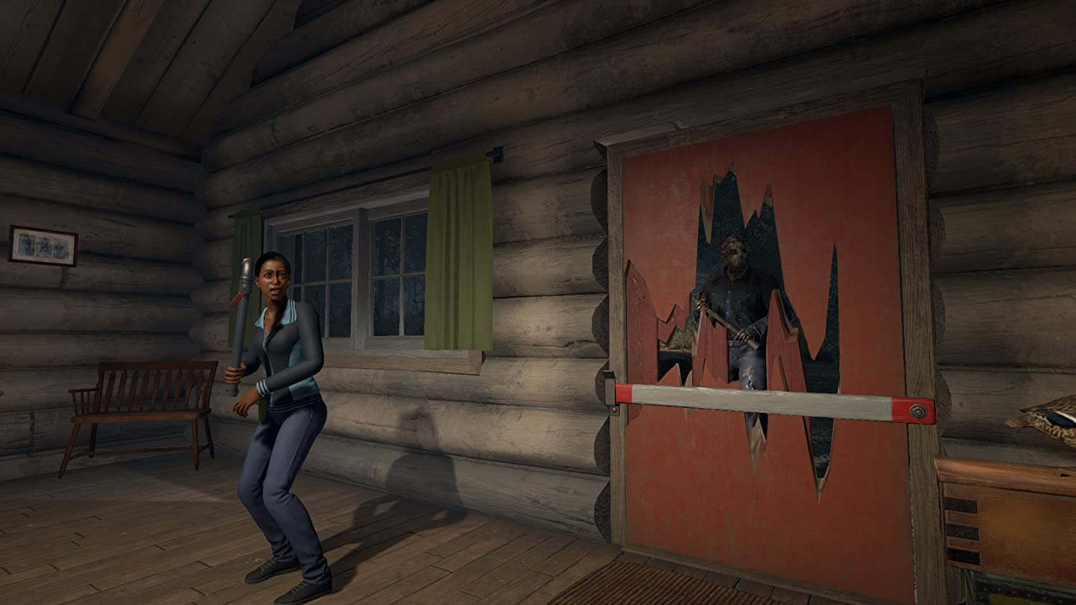
Gameplay
Third person horror survival game
Players are randomly selected to control 1 of 8 camp counselors,
1 player is selected to play as Jason Voorhees, the main antagonist
Player’s must either escape or kill Jason as counselor, Jason must kill all counselors
Friendly fire
Player’s can return as Tommy Jarvis
Earn points through gameplay

Slide 5
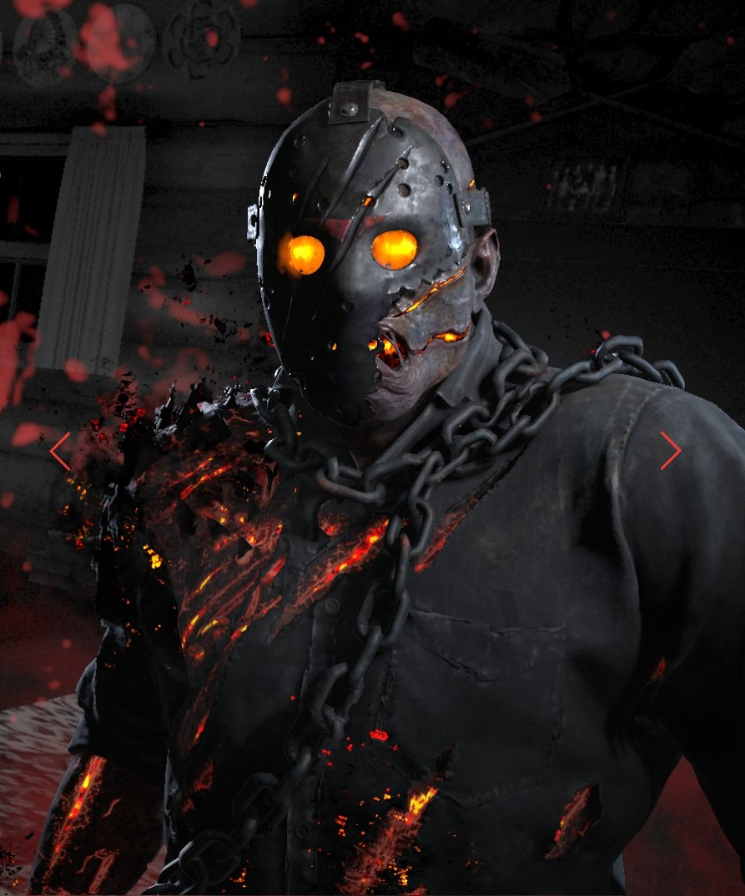
Special Features
Included many easter eggs
First person cabin view
Nightmare on Elm Street Gravestone “Grab a crucifix. Seven, eight, Better stay awake, Nine, ten, Never Sleep again!"
Special Jason skin for kickstarter donors
Lots of callbacks to movie

Slide 6
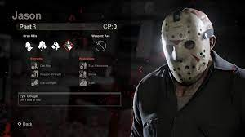
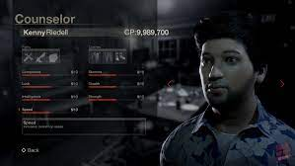
Installation and User Interface
Installed through Steam or Playstation Store
Players have the option to select from multiple counselors or Jason skins
Players can spend their points on skins
Sounds were based off movie and prior games

Slide 7
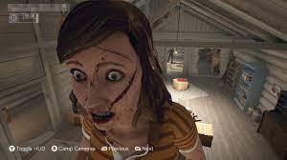
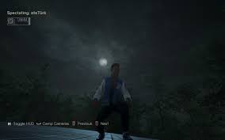
Bugs
Clipping
Flying
Mainly caused by counselor crouches
Invincibility

Slide 8
Review
The Good:
Thrilling game
Replayable
Required teamwork
Made by passionate developers
The Bad:
Filled with bugs on release
Jason required lots of skill
Required teamwork
Jason and counselor working together
Game Comparisons:
Often compared to Dead by Daylight
Had larger maps
More strategies
Smoother gameplay
Design Mistakes:
Clippable walls
Broken mechanics
Unreachable areas (Jason)
Appropriate Audience: Older audiences

Slide 9
Summary
Strengths:
Fun gameplay
Multiple methods to win
Not very easy
Frequent updates
Maps
Weaknesses:
Bugs
Jason’s movement
Cheatibilty
Jason disconnecting
Improvements:
Movement mechanics
More maps
Fix clipping
Giving Jason more abilities

