Slide 1
By Antony Gordon

Slide 2
Basic Information
Developed By Rare
Published by Microsoft Game Studios in 2005
Release title for the Xbox 360
Type of game: Action Adventure

Slide 3
Basic Information (Cont..)
Price: 9.99 Rare replay
Minimum Hardware: Xbox 360
Actual hardware required: Xbox 360, Xbox One
Single Player and Split Screen Multiplayer

Slide 4
Game Summary
Kameo can morph into 10 Elemental Warriors
5 Magical Elements
Solve puzzles and defeat Enemies

Slide 5
Story
Linear Story
Sisters Kameo and Kalus are Princesses
Kameo is adopted but intentionally receives inheritance
Kalus, the blood daughter, is angry and revives archnemesis Thorn

Slide 6
Story (Cont..)
Kalus and Thorn seek to overtake the kingdom by force
Kameo must defeat Kalus and Thorn with the Elemental Warriors

Slide 7
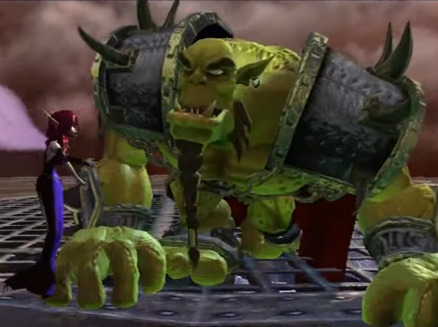
Player’s Role
Play as Kameo
Search for the 10 Elemental Warriors
Save Family members captured by Kalus and Thorn

Slide 8
Player’s Role (Cont..)
Help the knights fight the troll army in the badlands
Help citizens on the enchanted kingdom

Slide 9
Installation
For CD Disk – Place in disk tray and done
For Game Store- Search Kameo on Rare Replay and Install

Slide 10
User Inferface
Easy to use
Easy to ready
Few button clicks to get to intended action
Hotkeys

Slide 11
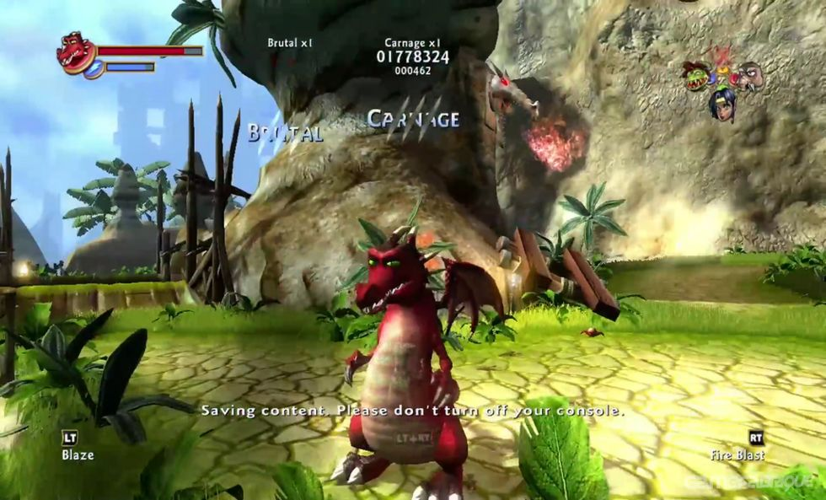
User Interface
Health & Stamina
Score & Multipliers
Quick Morph
Multiplier Animation
Trigger Actions
2
2
1
3
4
4
5

Slide 12
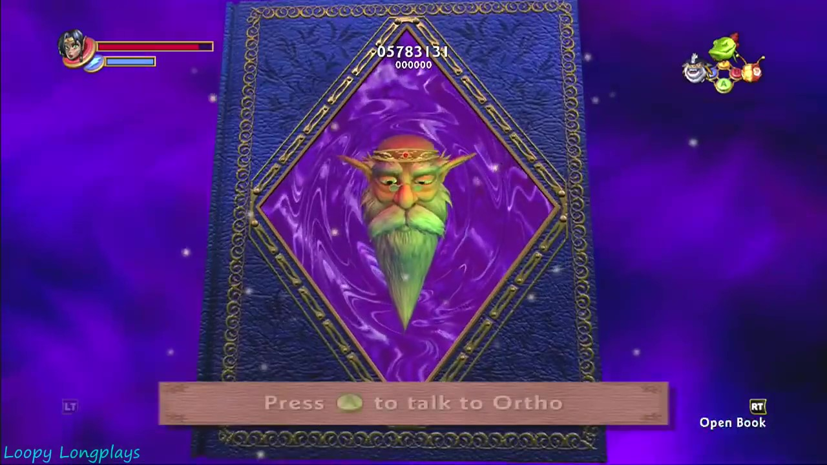
User Interface (Pause Menu)

Slide 13
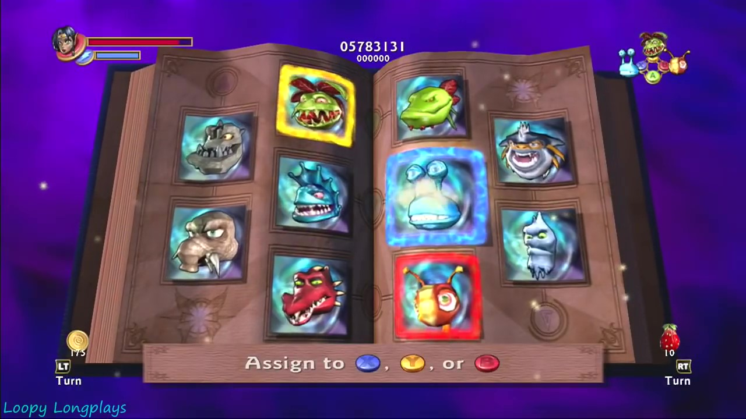
User Interface (Elemental Warriors)

Slide 14
User Interface (Warrior Upgrade)

Slide 15
Game Play
Tutorial is awkward and not needed
Use morph abilities to solve puzzles and defeat enemies
Game Loop- Dialog->Defeat Shadow Troll -> Go to Designate Level-> Defeat Boss-> Badlands-> New Location-> Dialog Again
Levels and be peaceful puzzles, Arenas, noisy puzzles.
Wotnot book wizard provides hints if needed

Slide 16
Game Play Clip (Arena)

Slide 17
Game Play Clip (Badlands)

Slide 18
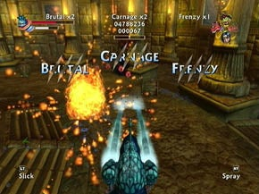
Scoring
Get points by defeating enemies
Defeat with style to get a multiplier
3 Multipliers Brutal, Carnage, Frenzy
Warrior focus (Fast combo in short time)
Rank determined by Score

Slide 19
Artwork
Vibrant and colorful
A fantasy side of nature
Fancies particles and God Rays
Day night cycle

Slide 20
Artwork 1

Slide 21
Artwork 2

Slide 22
Artwork 3

Slide 23
Sound
Orchestra Score
Grand sound design for morph and enemy effects
Solid voice acting - ok for some bad for others

Slide 24
Sound Sample

Slide 25
Special Features
Split Screen Co-op
Multiple skins for Characters
Hidden challenge Arena
Replay Completed Levels for Cheat codes and skins (Score Attack)
Export mode (DLC only)

Slide 26
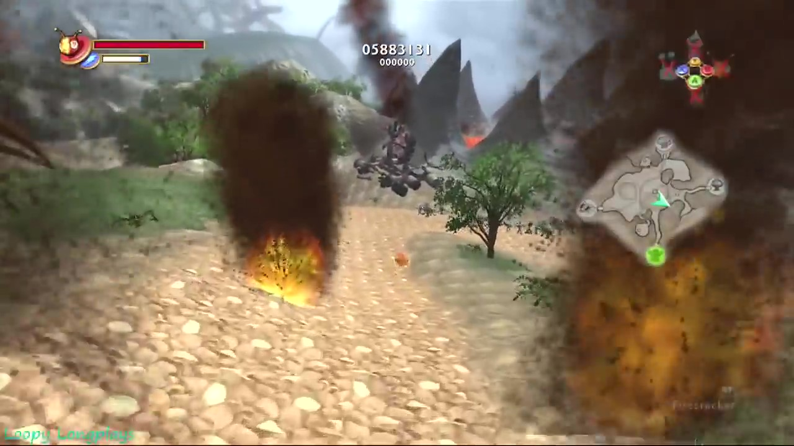
Bugs
Slopes are very slippery
Camera cannot keep up with fast moving player

Slide 27
Game Review

Slide 28
The Good
Bad Lands open combat – Can practice abilities
Frequent Checkpoints - no punishment for death
Puzzles are fun, require some thought
Explored areas are open at all times
Collectables and Earnables
Unique warriors, Multiple strategies to progress
Split Screen CO-OP
Incremental Story Reveal

Slide 29
The Bad
Forced Warrior Combo- No Player Choice
Brainless Self Destructing Spider crabs
Most morphs need at least one upgrade for proper use.
Badlands clear after game ends

Slide 30
Design Mistakes
Controls for Elemental warrior Morph -Deep Blue
Elemental Warrior –Thermite is overpowered
Badlands clear after game ends – hurt replay value
Expert difficulty is locked behind a dlc
Inconsistent fall kill zone

Slide 31
Similar Titles
Rachet and Clank, Jak 3
Simpler puzzles and arenas
Narrative Driven Action
Those games are shooter related
Different warriors are similar to different weapons

Slide 32
Title Comparison
Jak 3 has better open world
Rachet and Clank have better puzzles
Enemy variation is better in Kameo, more strategy
Kameo has better collectables

Slide 33
Appropriate audience
Young teens
Fantasy and Violence

Slide 34
Summary
Worth the price 9.99 for great experience
Strengths
Open combat
Elemental enemies and themed levels
Improvements
Controls for Deep blue

Slide 35
Credits
Loopy Longplays for GamePlay Footage

