Slide 1
Hollow Knight, an Evaluation
By Daniel Feldman

Slide 2
Technical Details
Developer: Team Cherry
Price: $14.99 USD + Tax
Min Specs: Recommended Specs:
Intel core 2 duo Intel core i5
4GB RAM 8GB RAM
GeForce 9800GTX+ GeForce GTX 560

Slide 3
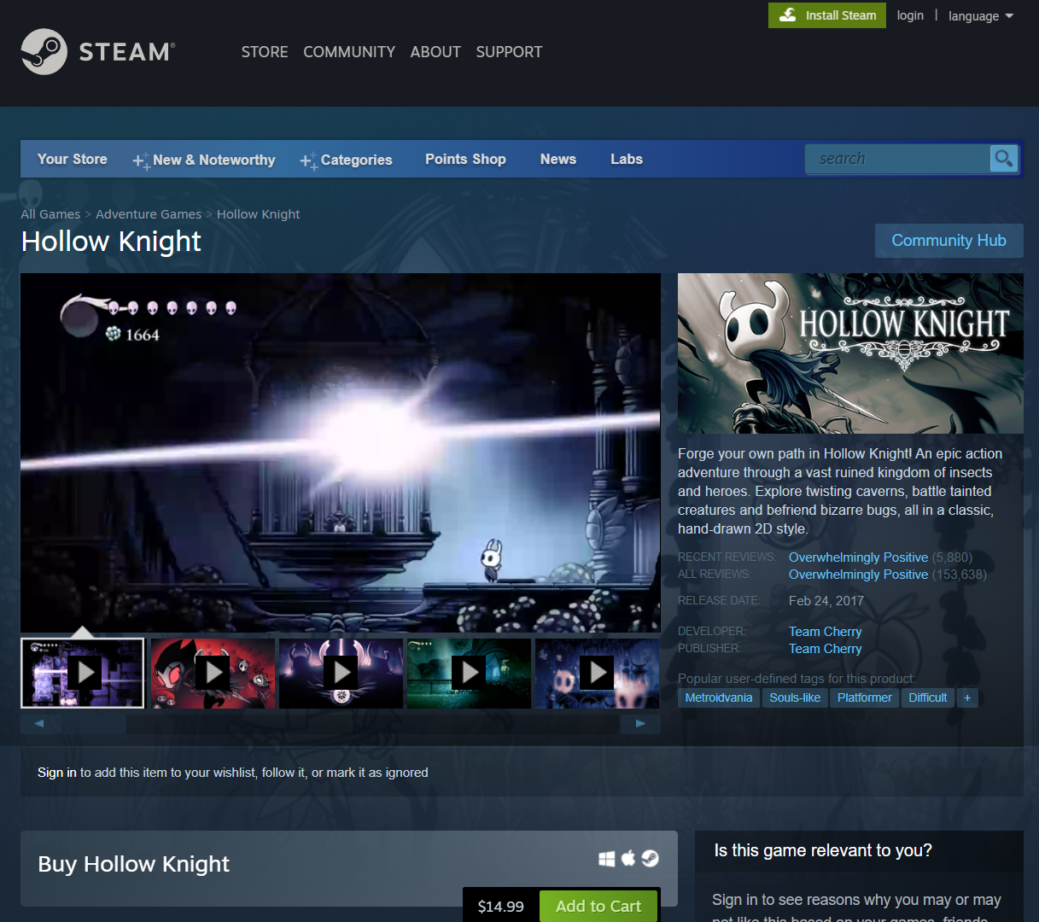
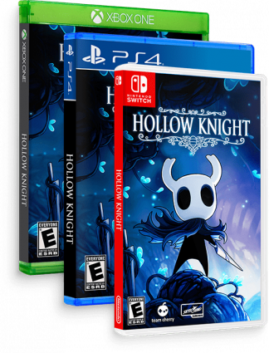
How to Install
The easiest way to install hollow knight on PC is to use the Steam service by Valve software
It should be available on all major consoles’ eshops and available on disks

Slide 4
Manual
The manual is simple and short, yet conveys all relevant information that you would need to know to start the game.
Accompanied by gorgeous illustrations, this manual is easy to read and contains useful information.

Slide 5
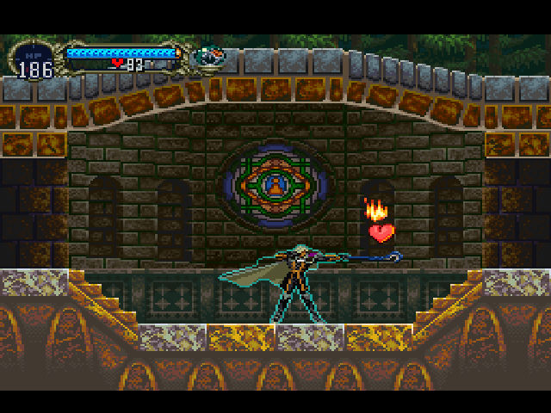
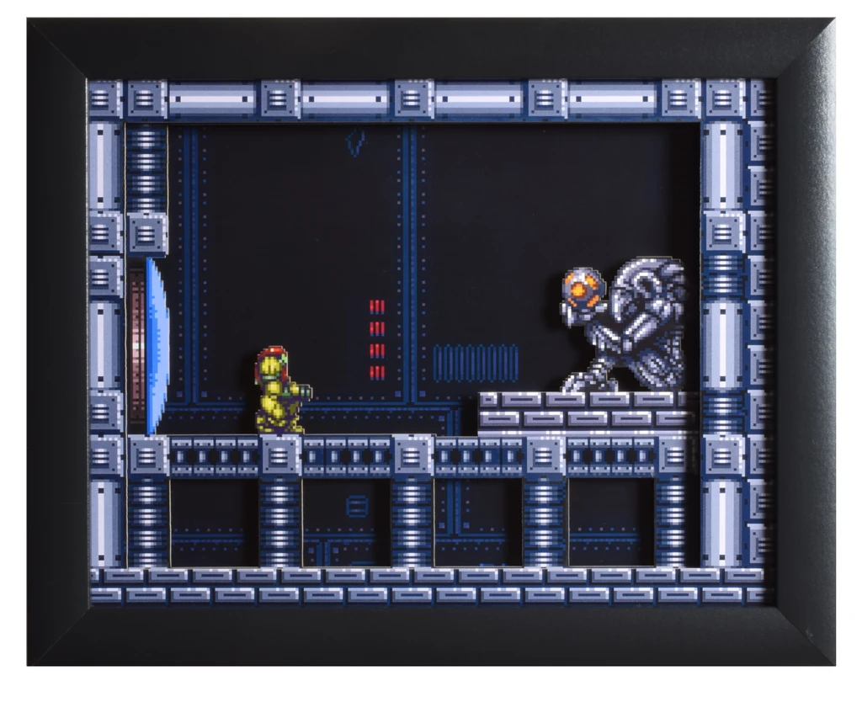
Overview
2d platform adventure game where you journey across a ruined kingdom collecting new abilities and fighting frightening monsters.
In the subgenre ‘metroidvania’ (a portmanteau of the game Metroid and castlevania)
also loosely in the ‘souls-like’ subgenre

Slide 6
Story
You take the role of a nameless bug-like knight entering the kingdom of hollownest. The kingdom is beset by a plague that haunts the mind and drives those infected to madness. You set out to explore the ruined kingdom, learn its secrets and try to stop the infection.

Slide 7
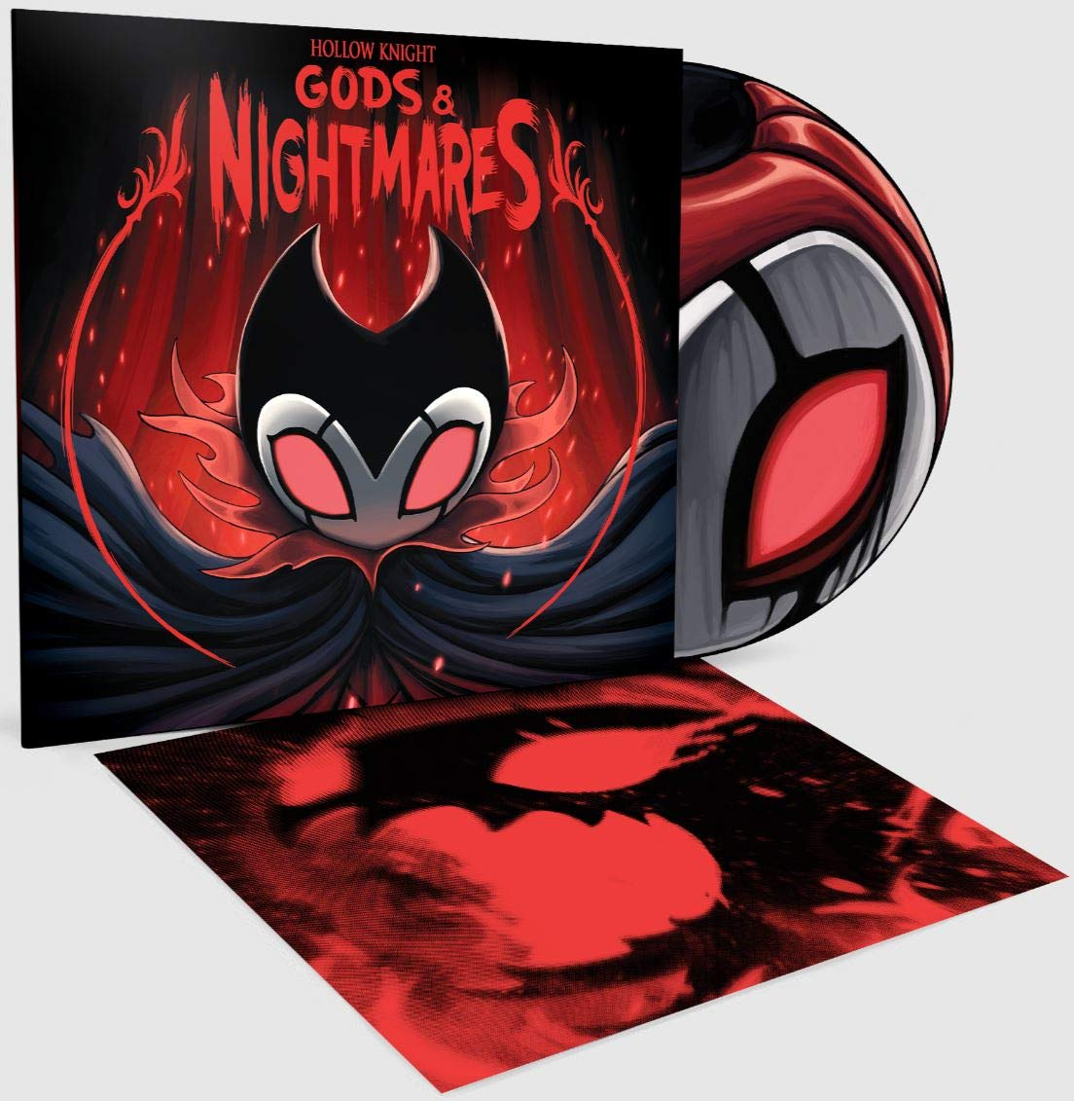
Music and Art
Hollow Knight was made as a passion project by artists
As a result it has some of the most stunning artwork i've seen
The musical score, composed by Christopher Larkin, is unbelievably amazing.
From slow ambient and somber pieces like ‘Dirtmouth’ to high tempo exenterating boss fight music like ‘Nightmare King’. Few games can compete with the musical scoring of hollow knight.

Slide 8
Bugs and Glitches
Hollow Knight contains a fair amount of bugs, and not just the kind that crawl around
Hollow Knight was a kickstarter backed small indie game that on release had a large of number of bugs
Hollow Knight has received many patches that have fixed all major bugs that a player would reasonably expect to encounter

Slide 9
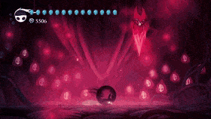
What's fun?
Fighting bosses
Platforming challenges
Getting new upgrades
Learning more lore
Exploring

Slide 10
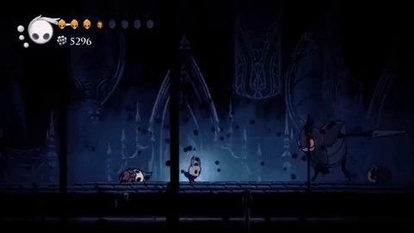
What’s not fun?
When progress stops the game can be frustrating
Progress typically stops when:
You can't beat a boss
You get lost/don't know where to go

Slide 11
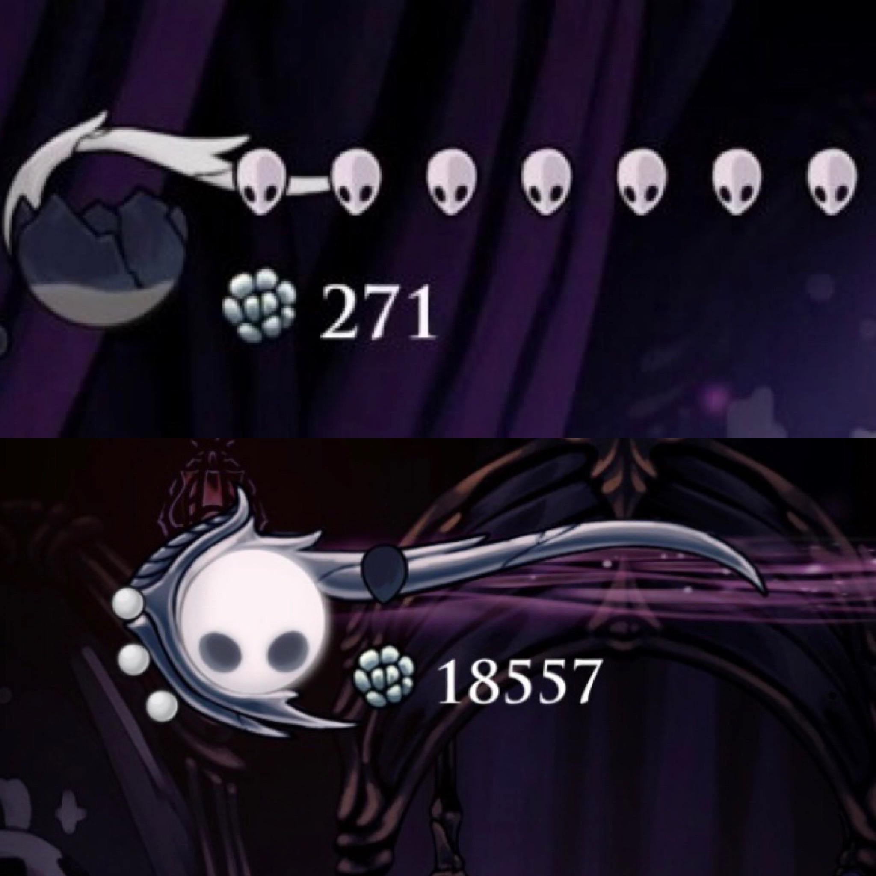
Why is it better or worse then similar games?
Hollowknights most unique mechanic is its SOUL system.
When you deal damage to enemies you gain SOUL.
You heal by consuming a large amount of SOUL, or you cast devastating spells.
This encourages the player to be aggressive while punishing poor performance and rewarding those who don't need to heal.

Slide 12
What is an appropriate audience for this game?
Hollow knight has dark themes, fantasy violence and mildly frightening imagery.
This lands it an ESRB rating of E10+ and a PEGI rating of 7.
These are reasonable assessments in my option

Slide 13
Summary
Hollow Knight is a wonderful adventure with stunningly beautiful artistry and satisfy combat.
While its difficulty, and maze of caverns may be too much for some people to enjoy.
For 15 dollars it's a steal that i recommend anyone should at least try.

