Slide 1
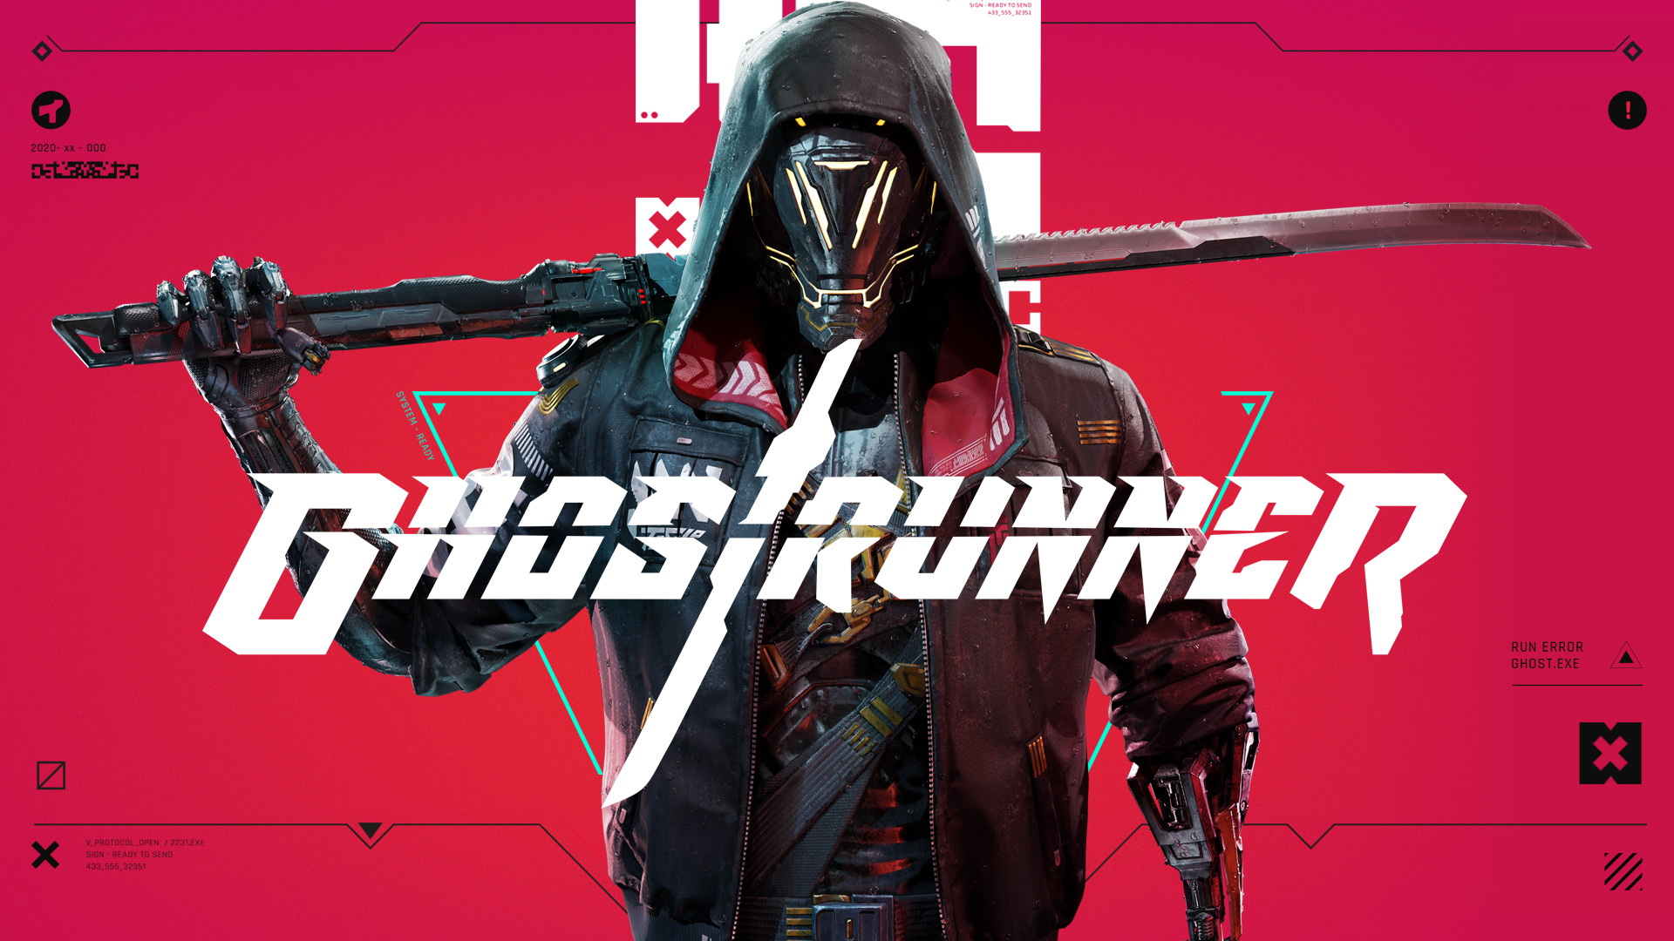
A Cyberpunk Action Platformer

Slide 2
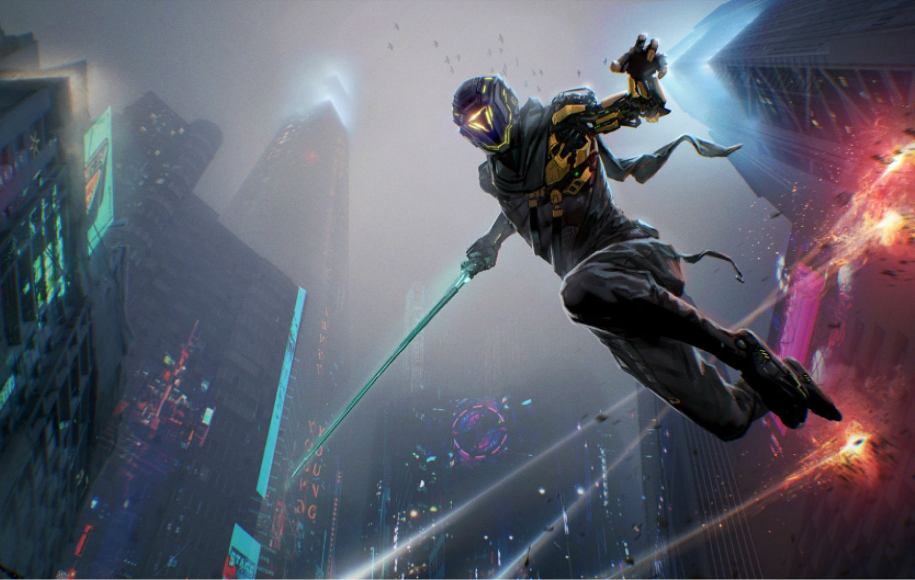
Basic Information
Game Title: Ghostrunner
Composer: Daniel Deluxe
Developers: One More Level, All In! Games SA, Slipgate Ironworks, 3D Realms
Publishers: 505 Games, All In! Games SA.
Genre: Platform game, Fighting game, Adventure game.
Price: $29.99
Minimum Requirements:
OS: Windows 7, 8.1, 10 x64
Processor: Intel Core i5-2500K / AMD Phenom II X4 965 or equivalent
Memory: 8 GB RAM
Graphics: GeForce GTX 1050 / Radeon RX 550
Storage: 22GB Available space
Recommended:
OS: Windows 7, 8.1, 10 x64
Processor: Intel Core i7-6700K / AMD Ryzen 5 1500X or equivalent
Memory: 8GB RAM
Graphics: GeForce GTX 970 / Radeon RX 5700
Storage: 22GB Available Space

Slide 3
Game Summary
Overview
Ghostrunner is a Cyberpunk Action Platformer set in Dharma Tower.
Storyline
The Ghostrunner, Jack, wakes up in Dharma Tower, a massive cyberpunk skyscraper-like setting, with no memory of his past. He is greeted by an entity knows as the Architect, who is currently being held captive by Mara, his former subordinate. His mission is to free the Architect and defeat the Keymaster, Mara. He is aided by both the Architect and Zoe, a surviving Climber.
Player's Role
The Ghostrunner's role is to navigate the Dharma Tower, while performing advanced parkour and assassinating enemies. He must free the Architect and free the Tower from Mara's rule. He also must learn the truth about himself and the tower as he climbs.

Slide 4
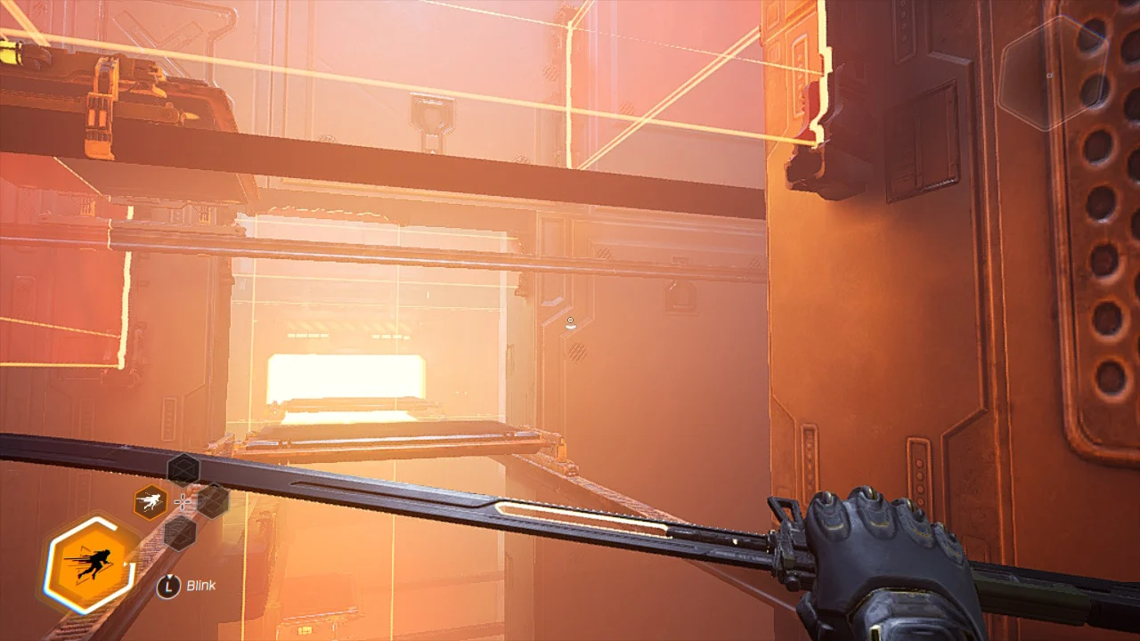
Game Summary (cont.)
Installation
On PC/Computer, Ghostrunner can be installed very easily through the steam client.
User Interface
The UI is relatively simple, The ability meter is in the bottom left, and the minimap in the top right.

Slide 5
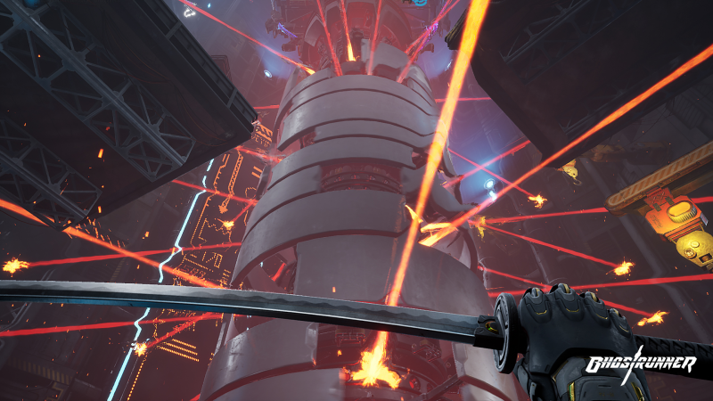
Game Summary (cont.)
Game Play
Ghostrunner consists of advanced, free-roaming parkour, as well as a satisfying combat system with a variation of different enemies. The gameplay can best be described as fast-paced and violent. Almost any surface can be ran on or interacted with, and the map boundaries are obvious, with each zone being surrounded by a deep fog. Players can be as creative as they'd like when attempting each zone. The zones are developed so that players can find the most efficient pattern of assassinating enemies, but they also have the option of doing whatever they want, whether it be to run in aggressively, or dispatch enemies in silence. The boss fights are also amply difficult, and good mechanics alone will not be enough to complete the boss fights. Each boss has different phases, as well as a different strategy to deal with each phase. However, the developers do a great job of keeping the difficulty manageable and enjoyable for players of all skill levels.

Slide 6
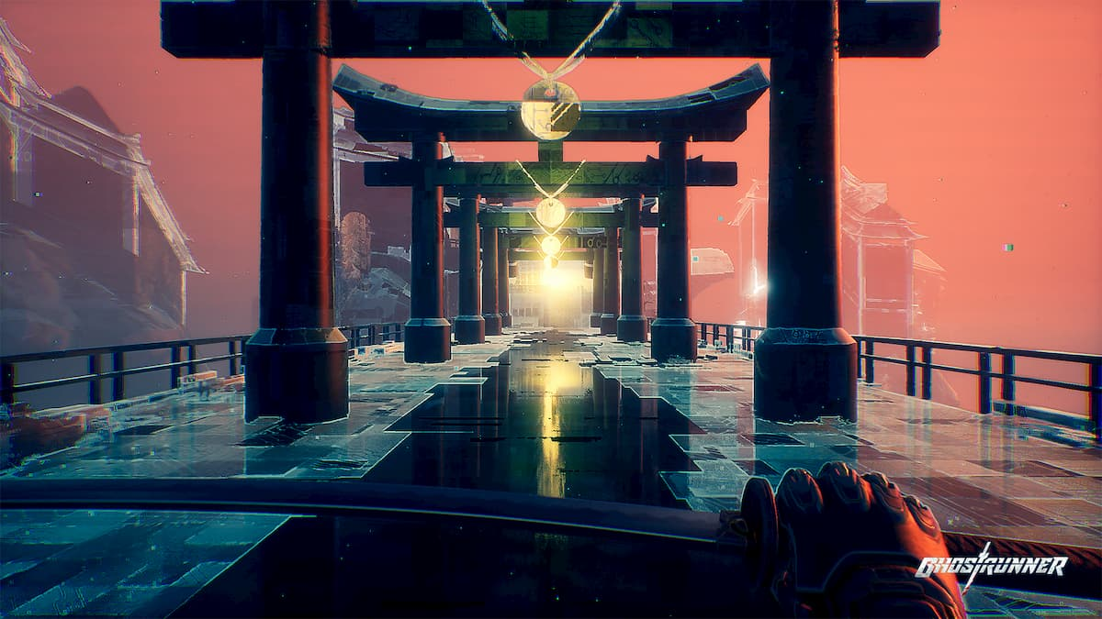
Game Summary (cont.)
Scoring
Ghostrunner doesn't have any exact scoring system. However, the level completion time is recorded, adds a competitive aspect to the game. Also, there is an upgrade opportunity at the end of most levels, where the Ghostrunner taps into his inner workings and completes puzzles and other challenges to receive a new ability/upgrade.

Slide 7
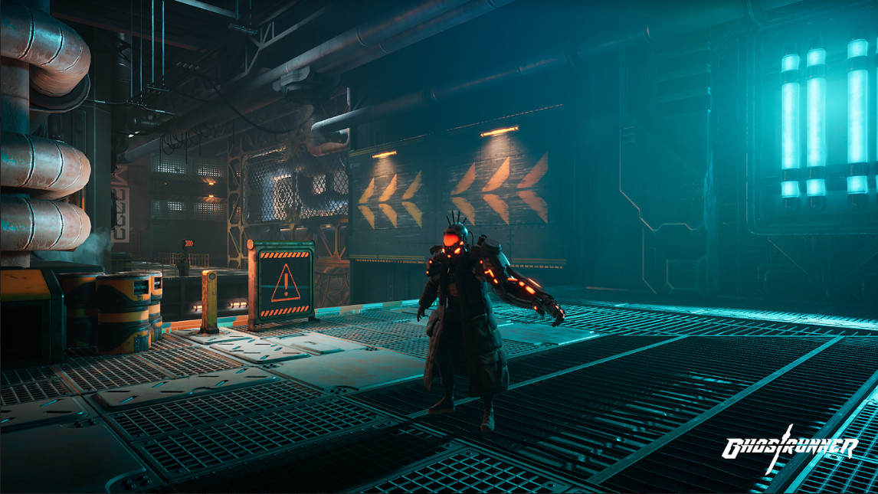
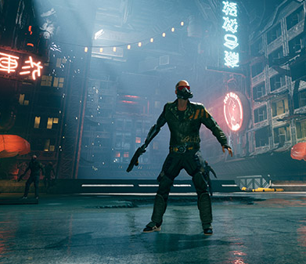
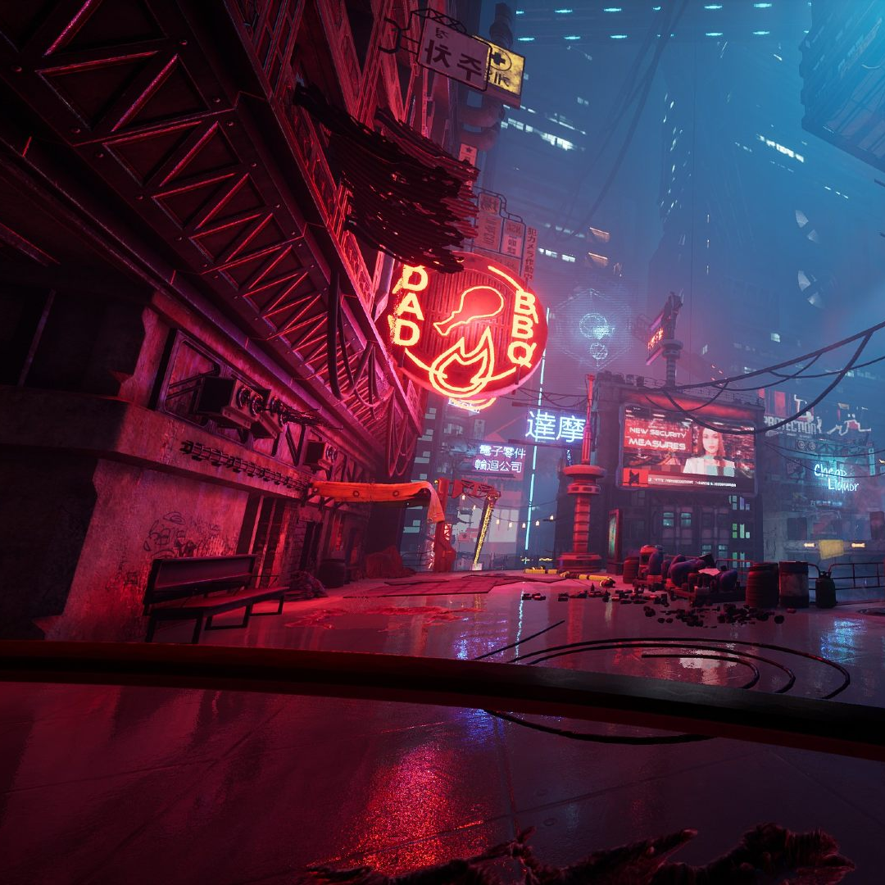
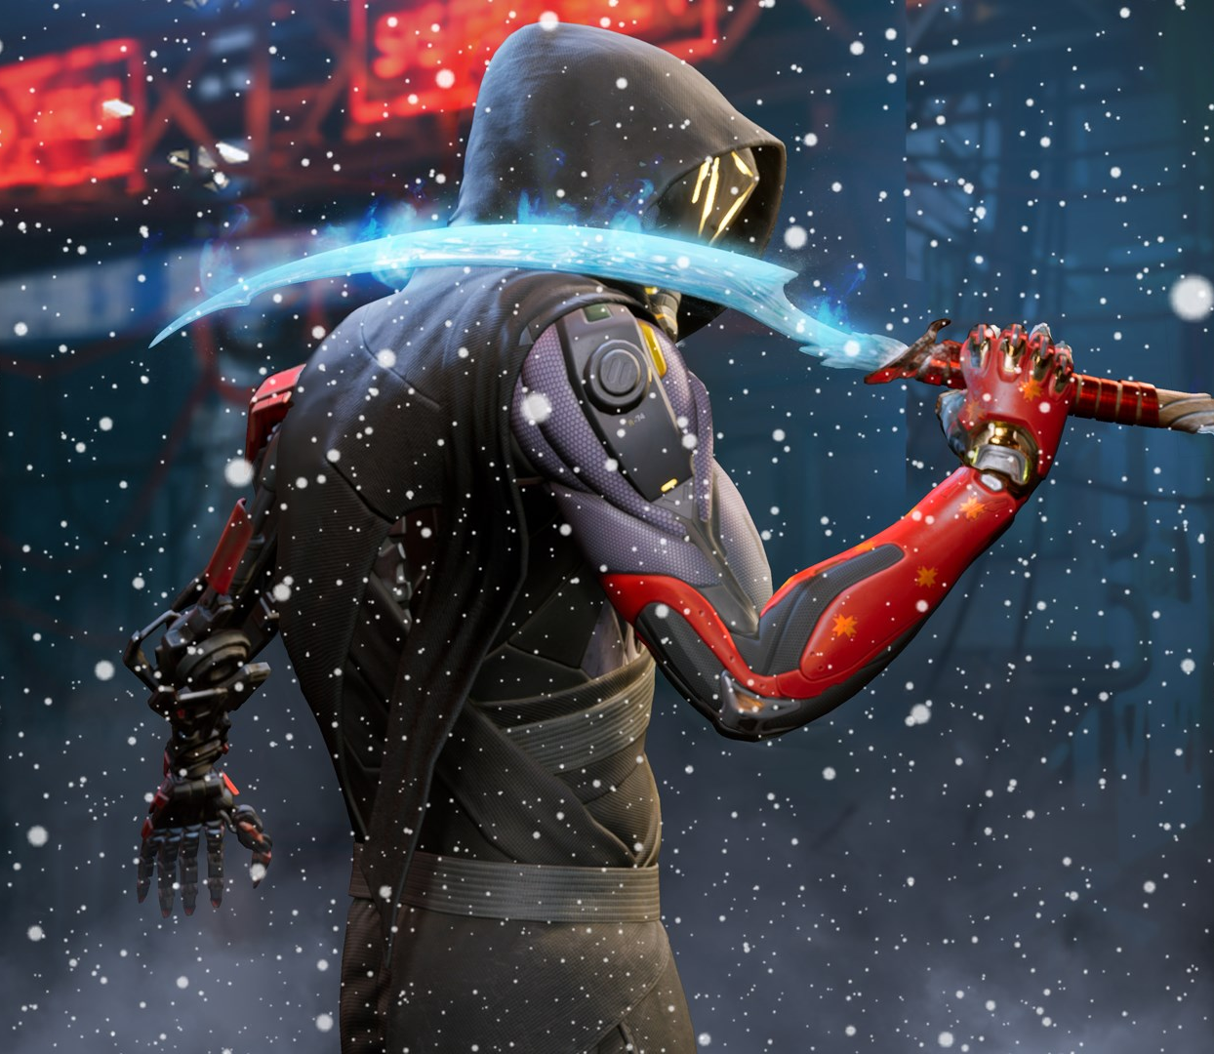
Game Summary (cont.)
Artwork
The artwork in Ghostrunner follows a Japanese, Urban Cyberpunk style. The overall feel of the zones is dystopian, and there is frequent appearances of Japanese characters. The design of the Ghostrunner himself is based off of the Japanese Samurai. The overall setting of the game can be described as a dystopian, post-apocalyptic, sci-fi nightmare.

Slide 8
Game Summary (cont.)
Sound and Music
There is nothing special about the sound design of Ghostrunner, but it is up to industry standards and does not lack in any way. The soundtrack fits the feel of the game and is highly praised.
The Music is of the Synthwave/Dubstep genre. It was composed by Daniel Deluxe and is available for purchase as Vinyl.
Special Features
There are no notable "Special Features" of the game, but the game is doing great without the need for these features and is highly critically aclaimed.

Slide 9
Game Summary (end)
Manual
Ghostrunner does not have a manual, but it does begin with a tutorial directly after the cutscene, and subsequent tutorials are provided when needed, such as when a new mechanic is introduced (new abilities/upgrades).
Bugs
Because of a successful demo period, Ghostrunner did not have game-breaking bugs or many major bugs at all upon release, and all other bugs were dealt with swiftly. Overall, the developers did a great job maintaining the game.

Slide 10
Game Review
The Good
The game is very fun overall. It has one of the most satisfying and adrenaline-inducing gameplay systems, and pairs that with a well-developed story. The gameplay alone is hard to get bored of, and the story is original, with great pacing and plenty of twists to shock the player. The writers also do a great job of informing the player of the lore of the Tower and the Ghostrunners, leaving enough out to keep the player curious. The story was set up for a sequel, and it will have exactly that, as the developers announced that a sequel is in production.
The Bad/Design Mistakes.
The only quarrels I have with the game that may affect its playability is the fact that there isn't much to do. There are parkour courses and a wave survival game mode, as well as items and skins to collect in the regular game mode, but after the story is complete the game doesn't have much to keep it interesting. This is definitely a big flaw in the design, and I feel that the developers didn't exactly design Ghostrunner with the long-term in mind, but instead expected it to survive well enough to make time for the production of the sequel. However, I don't believe that the game's player base has survived much at all, and the game was forgotten prety quickly.

Slide 11
Game Review (cont.)
Comparison to Similar Games
I believe that Ghostrunner stacks up well against the top action platformers similar to it, and beats out most of them. This game does all of the classic components of both an action game and a platforming game extremely well, and with a unique and impressive style and story to complement it.
Better or Worse than Similar Games
As I said, I believe that it is much better than games in its genre. This is because most action platformers compromise on the combat system and action, and focus far too much on the platforming aspect, while Ghostrunner gives a perfect balance of both aspects, and does both extremely well. It's story also can compete with the stories of other big action platformers. It is because of this perfect balance and the high quality of the game that it is among the best of the games in the action platformer genre.

Slide 12
Game Review (end)
Appropriate Audience
The appropriate audience listed for Ghostrunner was originally listed as PEGI 16 but was increased to PEGI 18 based on the developers' interpretation of the rating criteria for violence.
So, the appropriate audience can be listed as anyone above the age of 18.
Design Mistakes
I spoke on the design mistakes in earlier slides.

Slide 13
Summary
Strengths:
Action/Fighting to Platforming balance
Impressive graphics
Fitting and energetic soundtrack
Balanced difficulty
Satisfying combat
Smooth and skillful parkour
Freedom of play style and freedom in zones.
Enjoyable and unique story
Likeable Main Character
Set up for a sequel
Weaknesses:
Lack of replayability
Lack of publicity, was popular for a short amount of time
Weak branding
Doesn't run very well even on recommended hardware, overall, pretty demanding to run
Worth it?
The game is definitely worth it at $29.99, as most games nowadays are $60. The amount of work put into the game is evident and it will bring you far more than 30 dollar's worth of enjoyment.
Room For Improvement
There is definitely room for improvement, especially in regards to the longevity of the game.

