Slide 1
Doom Eternal: Game Evaluation
By: Nathanael Butler

Slide 2
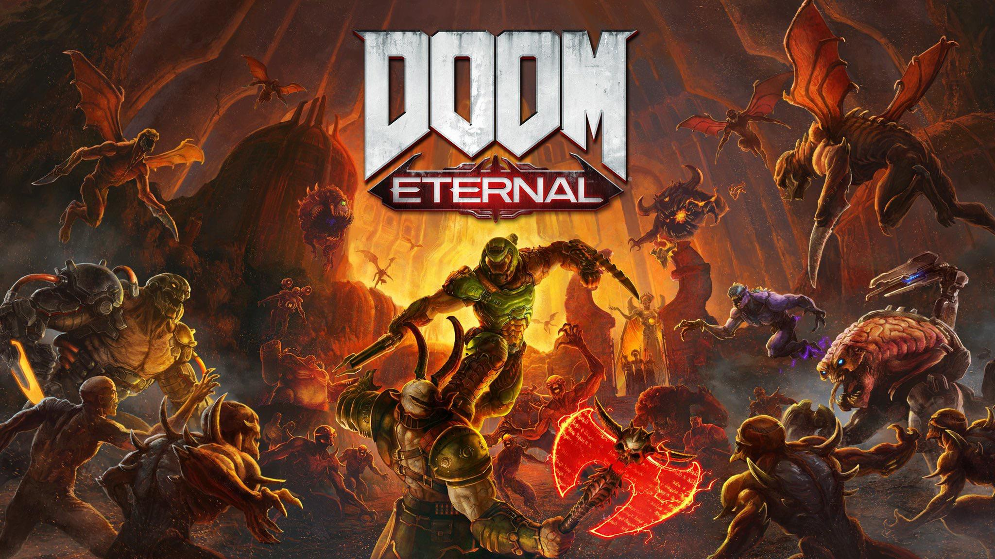
Doom Eternal
Developed by id Software
Published by Bethesda Softworks
First Person Shooter Game
The base game retails for $59.99
There is a Deluxe version that retails for $89.99

Slide 3
System Requirements
MINIMUM:
Requires a 64-bit processor and operating system
OS: 64-bit Windows 7 / 64-Bit Windows 10
Processor: Intel Core i5 @ 3.3 GHz or better, or AMD Ryzen 3 @ 3.1 GHz or better
Memory: 8 GB RAM
Graphics: NVIDIA GeForce GTX 1050Ti (4GB), GTX 1060 (3GB), GTX 1650 (4GB) or AMD Radeon R9 280(3GB), AMD Radeon R9 290 (4GB), RX 470 (4GB)
Network: Broadband Internet connection
Storage: 80 GB available space
Additional Notes: ( 1080p / 60 FPS / Low Quality Settings )
RECOMMENDED:
Requires a 64-bit processor and operating system
OS: 64-bit Windows 10
Processor: Intel Core i7-6700K or better, or AMD Ryzen 7 1800X or better
Memory: 8 GB RAM
Graphics: NVIDIA GeForce GTX 1060 (6GB), NVIDIA GeForce 970 (4GB), AMD RX 480 (8GB)
Network: Broadband Internet connection
Storage: 80 GB available space
Additional Notes: ( 1080p / 60 FPS / High Quality Settings ) - *On NVIDIA GTX 970 cards Texture Quality should be set to Medium

Slide 4
Quick Overview
Sequel to Doom(2016)
First person shooter with exploration aspects
Major focus on combat
Fantastic graphics and sound design
Can be crushingly difficult at times.
Highly replayable

Slide 5
Story Line
Earth has been attacked by demonic forces and it is up to the Doom Slayer to take back the planet and free it’s people by exterminating every single demon. This involves traveling into Hell itself, killing all that stands in his way. You go to several different locations, tracking down and eliminating Hell Priests, the commanders of the demons and servants of the evil Khan Maykr.
Upon killing all three of the Hell Priests you then travel to Urdak, this universe’s version of heaven, and you kill the Khan Maykr but not before she can awaken the Icon of Sin and unleash it on Earth. The Doom Slayer must then travel back to Earth and stop the Icon once and for all.

Slide 6
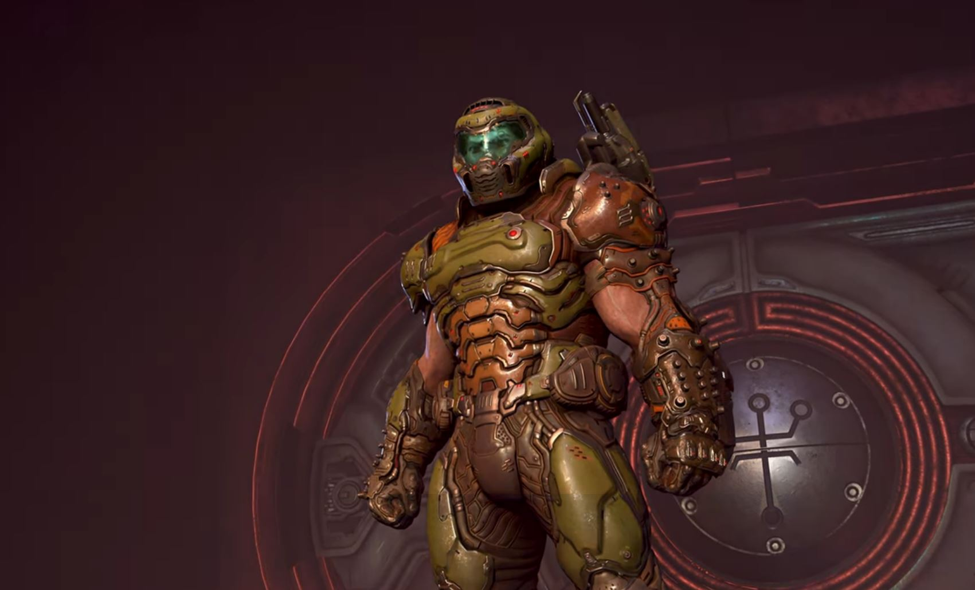
Player’s Role
Players take on the role of the Doom Slayer, a near mythic figure intent on saving the earth and killing any and all demons he comes across.
You shoot, stab, explode, and chainsaw your way through demons to reach your goals.

Slide 7
Installation
The game is available on PC, PS4, PS5, Stadia, Xbox One, Xbox Series X/S and Nintendo Switch
Each console installs it from their built in store
PC users can install it on Steam and the Bethesda.net Client

Slide 8
User Interface

Slide 9
Gameplay
Consists primarily of shooting
Fast paced shooting, weapon switching, and melee
Find and unlock new weapons as the game progresses
Contains parkour elements
Enemies lose parts of their bodies when attacked as a way to show how much health they have left instead of a health bar
Encourages variety in the way you take on groups of enemies
There are secrets to collect such as little toy figures of the enemies

Slide 10
Artwork, Sound and Music
Very vivid art style
Vibrant colors and detailed character designs
Clear sound design
Sound can be lighthearted as well, such as a popping sound when removing an eyeball from a large enemy
Fitting music consisting of songs from the metal genre which help set the fast-paced killing vibe

Slide 11
Special Features
Multiplayer vs mode
2 story DLCs

Slide 12
Game Review: the Good
Very easy to learn but hard to master
Varied enemies, ways to deal with them, and new weapons
Replayability is high
Has its serious moments as well as lighthearted moments through easter eggs and collectables
Storyline is engaging and interesting
Finding the best way to kill certain kinds of demons can be fun and keep the game fresh
Varied locations

Slide 13
Game Review: the Bad
Can be overly challenging at some points
Difficulty scale makes it hard to determine what is the ideal way to play
Some story points are hard to follow without reading the optional collectable entries
Some fights can be very repetitive

Slide 14
Similar Games Comparison
Wolfenstein: Very similar, franchise created around the same time
Wolfenstein is also focused on shooting and killing as many enemies as quickly as possible
Doom Eternal is set in an alternate future, but Wolfenstein is set in an alternate past
Wolfenstein tends to take itself seriously whereas Doom Eternal has its lighthearted and more unrealistic side, which I tend to prefer.

Slide 15
Audience and Design mistakes
Doom Eternal is designed for a mature audience
The game can be very gory and has over the top violence
The difficulty in the game can very wildly
Gameplay can get repetitive at times

Slide 16
Summary
Easy to learn
Enjoyable gameplay and varied methods of fighting
Too challenging at points
Story requires optional reading to understand full backstory
Doom Eternal is very worth purchasing with hours of enjoyment available.
Improvements could consist of less difficulty spikes and better explanations of story points.

