Slide 1
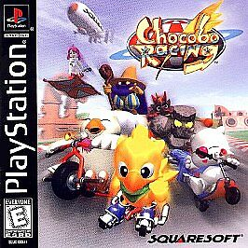
Matthew Bryce
Game review
Chocobo racing

Slide 2
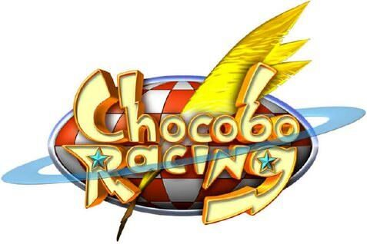
Basic info
Game title: Chocobo Racing
Developers: Squaresoft (currently Square Enix)
Type : Racing/Arcade
Required Hardware: PS1
Actual hardware: ps1
Price: copies are no longer being sold so you can only buy them at secondhand shops where the prices may vary depending on conditions and quality.

Slide 3
Overview
Its an arcade racing game featuring final fantasy characters
Is part of the Chocobo spin off series
No installation required, you just pop the disc into the ps1 and start playing
I lost the manual to the game but its is not needed as the game teaches you all the basic mechanics of the game in the story mode
You win a race by being the first one to do 3 laps around the track
did not encounter any bugs when playing the game so its very stable from what I remember and what I played for the review.

Slide 4
modes
There are 5 different game mods in Chocobo racing
Story mode: self explanatory, is where you will spend majority of the game unlocking stuff, takes about 2 hours to beat, it also serves as the game's tutorial.
Time attack: also, self explanatory, you race around the lap for the best time per lap and best overall time
Vs mode: compete with multiply players or race against the computer in a single racer
Grand prix: choose 4 tracks to race consecutively and the one with the most overall points wins
Relay race: the most unique of all the modes, you can play with 2 players or a computer, you choose 3 characters each once you finish a lap with one character you switch over to the next one.

Slide 5
Story
Story is lighthearted and barebones, will sometimes break the 4th wall, its also set up to make it seems like you are reading a pop-up book with each chapter being a different book
There is a total of 10 chapters each consisting with just one race
General story is that one day a Chocobo who is assumed to be the main character of the Chocobo story series (most characters and game just refers to him as Chocobo) received some jet skates from Cid.
after testing them out in a track Cid made, you are challenged by Mog the Moogle, who wants to take your spot as the main character of the game, after beating him you are told about the crystal around Chocobo’s leg which granted him the powerful ability to dash.
After hearing that there exists others that have these crystals Mog and Chocobo decided to set off on a journey to find the others

Slide 6
gameplay
Gameplay is standard for arcade racers though this game has a unique system to help it stand out
Before each race you choose a character to play as and an ability, character choice matters very little, but the ability does affect gameplay
While you race a gauge will fill up on the top left corner of the screen
Once full you can press L1 to activate the ability, the charge time and what said ability does depends on what ability you chose
You can also pick up magical stones on the racetrack which function like items in other arcade racers.
They can be fired with the r1 button, and some will allow you to pick up multiple version to power up the item you can used
For example, if you have a thunder stone and you pick up another thunder stone you can use a more powerful version of the thunder stone item.

Slide 7
Visuals and audio
All the songs minus the credit theme is remixes of past final fantasy songs
UI is easy enough to follow and understand, however its nothing too interesting visually
Graphics are alright, FMVs are pretty good for the time period and aged pretty alright, games uses a mix of 2d and 3d elements for its visuals
Characters and background elements of the tracks are 2d sprites while the stage itself is a 3d space
Most tracks minus the last one in the story visually uninteresting to look at and mostly consists of corridors without much areas to explore.
Characters themselves are varied and often ride vastly different vehicles from one another.

Slide 8
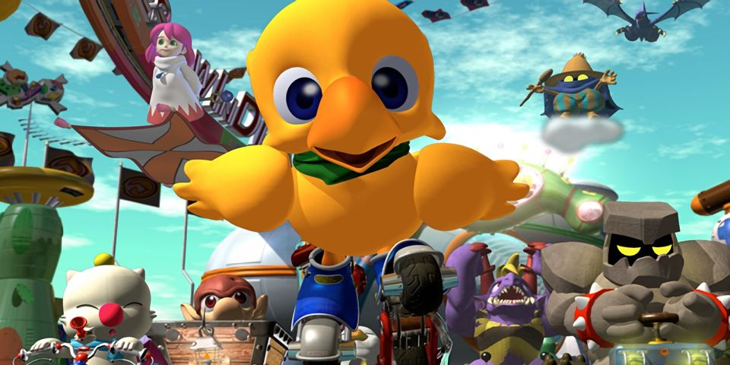
Positives of the game
Visuals are charming and aged surprisingly well for a ps1 game.
Having a story mode in an arcade racer was also rare at the time.
Game also has a surprising amount of unlockable characters
Game item and ability system is also unique.

Slide 9
Negatives
There is a sever lack of content,
Story mode unlockable are mostly just padding
There are only 10 tracks in the entire game
Most of the tracks are visually uninteresting minus the last one you race in the story

Slide 10
Design mistakes
There is no rubber banding in the ai
The Ai will not slow down when you are farther behind or speed up when you are farther ahead, the items you get will not improve or worsen depending on your placement.
Once you or a CPU is far ahead of there is nothing you or anyone else can do to turn the race around.
Track design is a mess.
First 2 tracks are fine
But later tracks will try to force you to turn suddenly and in the last couple tracks do a very sudden 90 degree turn, or you fall off the map
Another track has very slated turn bite where even at max normal speed you can easily find you self slipping backwards and into a pit

Slide 11
Design mistakes continue
Items and abilities are unbalanced
One spell ultima can cause everyone to be spin or crash depending on its level, you can get it even in first place
There is only one item you can fire behind
Half of the items are useless when you are in first place
“FLAP” ability is supposed to allow you to go over off-road terrains
There is very little off road terrain in the entire game so its essentially useless beyond going up hills or going over ice
Dash while seemingly very helpful early on becomes hard to use due to the game constantly forcing you to do sudden sharp 90-degree angles in later courses
“MUG” ability makes stacking spells nearly impossible due to it short cool time and almost always will steal the player spell
“MEGA FLARE” while having the longest cool down ruins the pace of the race since it causes a long-drawn-out crash animation for everyone but the user.
Its also unavoidable

Slide 12
Compared retrospectively to other games at the time
To say Chocobo racing had stiff competition is an understatement
It NA it came out after crash CTR was released. Beating Chocobo racing in nearly every aspect
Chocobo racing also lack the depth of other arcade racers,
There's no driving techniques to help you go faster
Standards techniques like drift boosting are not in Chocobo racing.
While good enough to not be considered shovelware, it is not a good game compared to other arcade racers at the time due to a lack of content, balance and any depth to the gameplay
Its especially lackluster when compared to Mario Kart 64 and Crash CTR.

Slide 13
Audience
It was aimed at kids who were a fan of the final fantasy series at the time and racing games
Especially if they were a fan of the chocobo story series like chocobo dungeon.
Sound design and visuals are colorful and appealing to kids

Slide 14
strengths
Visually the game has a strong sense of style, with each character looking unique,
Story modes were also rare for arcade racers at the time
Despite lacking in content there is a surprising amount to unlock as each non secret character has their own grand Prix victory cutscene, and there are also 8 secret characters
the ability and item system is also unique compared to other racing games.

Slide 15
weakness
lack of meaningful things to do in the game
lack of any depth in the racing
Ability and items are unbalanced, and races more often come down to luck then skill
Most of the tracks are visually uninteresting and are corridors with a few exception
Tracks are designed poorly with very little shortcuts and often just have unnecessary amount of turns
Lacks rubber banding in the CPUS and items

Slide 16
Is the game worth purchasing?
Unless your curious, a ps1 game collector, or a fan of final fantasy then there is nothing here for you
If you were interested in it, it would need to be in the 10-dollar range for it to be worth the money.

Slide 17
How to improve the game
Adding more tracks would help improve the game a lot
Rebalancing items and abilities would also be a plus
Making the tracks have more hazards, alternative paths, visually more stuff going on, and are better designed with everyone abilities in mind would also help make the game better overall.

