Slide 1
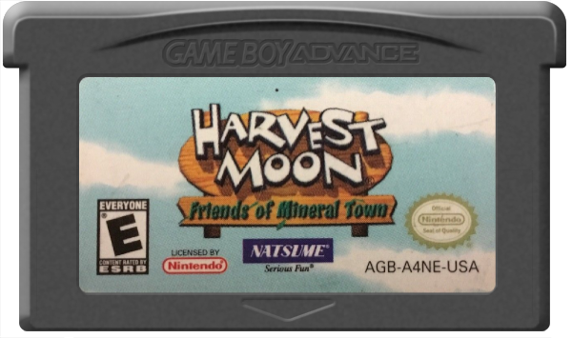
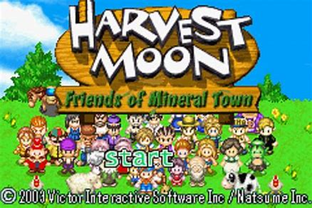
Harvest Moon: Friends of Mineral Town
Elise Ambriz
Notes:
Game Card af410022-4a6d-4493-945e-296cb919e125.png (600×355) (launchbox-app.com)
Home Screen Harvest_Moon-_Friends_of_Mineral_Town_-_2003_-_Natsume,_Inc..jpg (1440×960) (bp.blogspot.com)

Slide 2
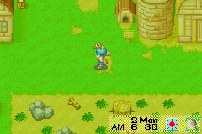
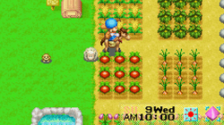
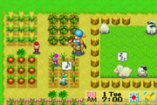
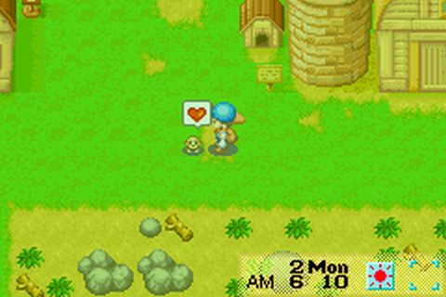
Basic Information
Company & Author: Marvelous Interactive & Miki Miyagi
Type of Game: Farming/Simulation/Role-Playing
Price: $20 - $40
Played On: Game Boy Advance, Nintendo DS Lite
Notes:
Top 44506-Harvest_Moon_-_Friends_of_Mineral_Town_(U)(Mode7)-4.png (240×160) (mprd.se)
Left 250px-HMFOMT500ppx.png (250×140) (wikimedia.org)
Middle 699157618-hmfa-harvest-moon-fans.jpg (300×200) (quotesgram.com) Right 44670-Harvest_Moon_-_Friends_of_Mineral_Town_(E)(GBA)-1464233116.jpg (480×320) (mprd.se)

Slide 3
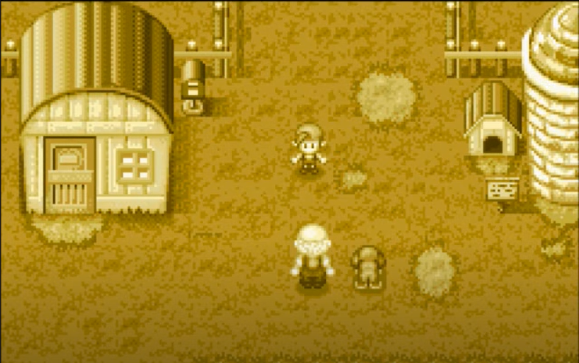
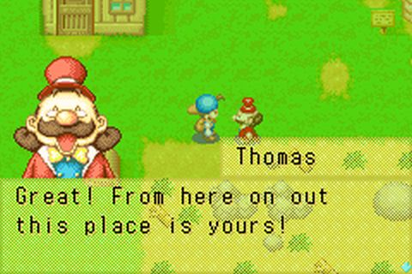
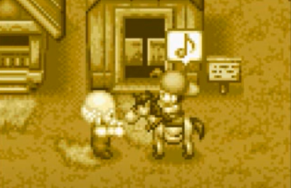
Game Summary
Storyline: Inherited farm from old friend Continues based upon the actions you take
Notes:
As a child, you are taking a trip to the country with your family. You get lost and an old man helps you back to your parents. He then offers to let you stay at his farm for your trip as he lives alone and is lonely. You become pen pals with him and when he stops writing you. You go to check up on him. The mayor of the town informs you the old man has died and left his farm to you.
There isn’t a set course you follow in the game. You can do whatever you like. Different things you can do are…
Thomas 44670-Harvest_Moon_-_Friends_of_Mineral_Town_(E)(GBA)-1464233037.jpg (480×320) (mprd.se)

Slide 4
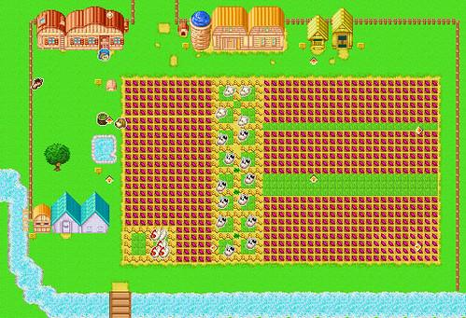
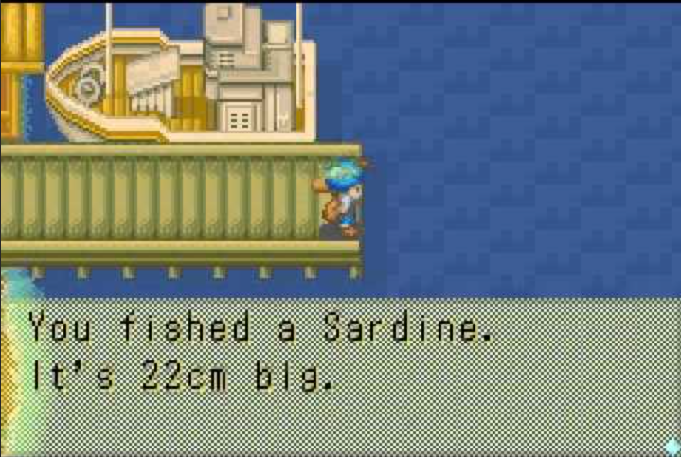
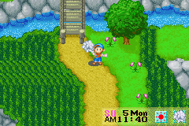
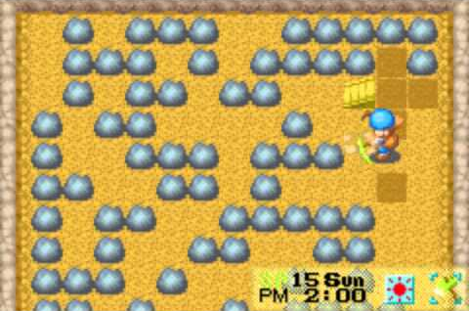
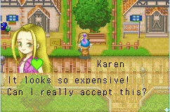
Game Summary: Game Play
Farming
Fishing
Foraging
Mining
Building
Relationships
Notes:
Farm: crops and animals. You name the animals (naturally). You can collect eggs, milk, or wool as well as sell your animal.
Fishing. Caught fish. You can caught s,m,l fish
Foraging. Different items different seasons
Mining (get supplies for tool upgrades or sell)
Building Relationships. By gifting towns people things they like. People are nicer to you if they like you. You can also get married. You can see how much eligible bachelorettes like you by the color of their heart when talking to you. When the color changes, you now will trigger a heart event when you go to a specific location in a time range. A heart event is a little cut scene where you make a decision that affects the other person’s opinion of you
The Artwort is cute, simple, bright, colorful, fun
The Sounds and Music are just the same. Very fun. Each season has a different music. Different times of the day have different music. Locations have different music.
Farming 172612952_bf92258fb7.jpg (499×341) (staticflickr.com)
Fishing hqdefault.jpg (480×360) (ytimg.com)
Foraging latest (240×160) (nocookie.net)
Mining hqdefault.jpg (480×360) (ytimg.com)
Building Relationships latest (242×160) (nocookie.net)

Slide 5
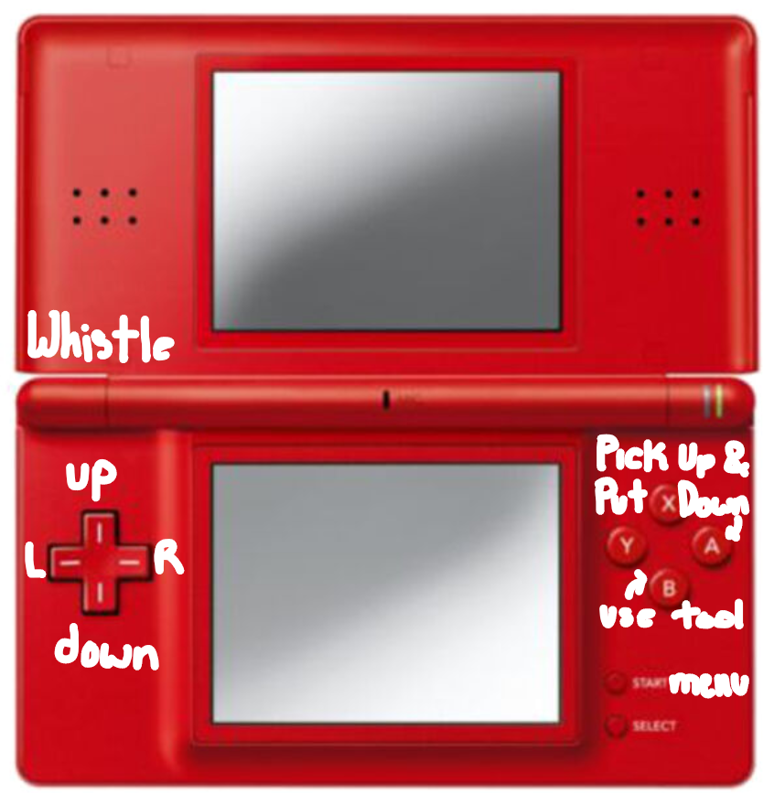
Game Summary
L Key: whistle
Standard U,R,D,L
L Key + B Key: swaps tools
L Key + A Key: eat food
A Key: Pick Up & Put Down Items
B Key: use a tool
Start Button: see menu
R Key: opposite of defaulted speed (walk/run)
Notes:
Red DS s-l640.jpg (640×640) (ebayimg.com)
DS Screen 250px-HMFOMT500ppx.png (250×140) (wikimedia.org)

Slide 6
Game Review What is good (fun) about the game? Why
Freedom
Characters and Lore
Aesthetic / Decorating
Animals
A Sense of Accomplishment
Notes:
Now, onto the review
What is good / fun about Harvest Moon. Well, the game gives you freedom in choosing how you want to play. You can only plant crops and never go mining. Or, you can only have animals and no crops. You could spend all your time fishing.
The characters are interesting. Each of them is different and has different pasts, which you learn about them as you become better friends through giving them gifts and triggering cutscenes.
In regards to the aesthetics, it is very cute, simple. It’s a nostalgic design. And, you can design as well. Chose if you put down fencing You can get house upgrades
In the same, realm of cute. The animals! Well I suppose you build relationships with them too. The better relationship you have with your animals, the better they listen to you and quicker they produce higher value products. You can enter them in contests where they can win prizes, It feels good to have your animals your attached to be grow and be successful.
And on the same note as seeing your animals progress, you can feel a sense of accomplishment. When playing, you can feel the direct result of your actions. For example, a different example from animals is you planted a bunch of crops and watered them. Now, you can harvest and sell them for a bunch money. Or going back to house upgrades, it is fun to progress.
Farm 699157618-hmfa-harvest-moon-fans.jpg (300×200) (quotesgram.com)

Slide 7
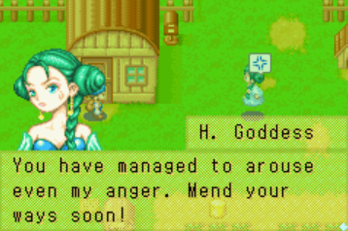
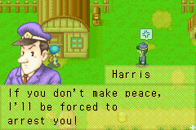
Game Review What is bad (not fun) about the game?
Runs out of lore
Runs out of stuff to work for
50 years post marriage to “finish”
Getting married is hard!
Mining is boring
Notes:
What is bad / not fun about Harvest Moon.
Harvest Moon is limited by its lore. It just runs out. There aren’t new things to learn about the characters or the town. Which dulls the game.
Harvest Moon is also limited by there eventually aren’t anymore upgrades you can do. And, both of those things would be alright. Time to start a new save file, Except, I complete everything when I play a game. I want to see every cutscene. I want to collect every point. In Harvest Moon you can’t get the mountain cottage until you’ve been married for 50 years.
Getting Married is really hard to do. You have to give the bachelorette sufficient gifts without missing a heart event and being careful of triggering rival heart events, which means the bachelorette is growing closer to another character. You need to be at a specific place at a specific time to trigger events and must do them in the right order. Also, if you trigger the last rival heart event, the bachelorette will marry the other character in 3 days.
Since getting married is so difficult, it makes the 50 years of waiting feel even longer because you’ve already finished most of the stuff. One of the only things you have left is saving for the 1 billion dollar cottage
Mining is boring. Every time you go to the mines you start on level 1 and have to go down as far as you wanted. Very repetitive and frustrating. Especially because you can get to a level that doesn’t have a stairway down. So, you got to start again!
Harvest Goddess Ranch Story Blog: Image (tumblr.com)
Cop

Slide 8
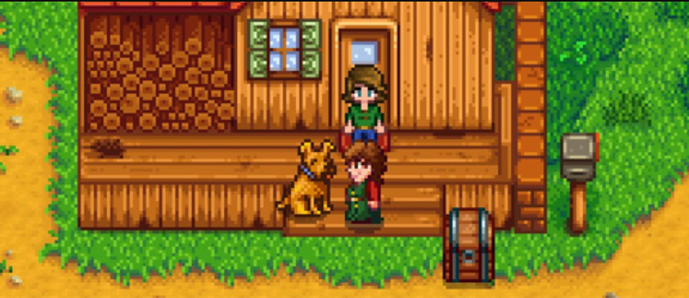
Game Review
How Does it Compare to Similar Games in the Same Genre? Why is it Better or Worse than Similar Games?
Stardew Valley was based off Harvest Moon.
Very comparable
Notes:
Harvest Moon is similar to Stardew Valley because Stardew Valley was based off it. Stardew Valley was made trying to correct Harvest Moon’s shortcomings.
Stardew Valley has questions and bundles to be filled to keep some structure if the free leaves you not knowing what to do. So, Harvest Moon is worse in that respect.
It is also worse in terms of mining. Stardew Valley made the mining more interesting with having to face monsters, and having 1 mine that saves you level progress and 1 mine where you have to start at 0.
The appropriate audience for Harvest Moon is most people, but not as much so as Stardew Valley, so younger people as the storylines aren’t as deep sometimes.
There were definitely some design mistakes. Harvest Moon was translated into English from Japanese, so some spelling and grammatical error are littered throughout the game. They are fun to catch. For one, the sign outside the hospital is spelled hospitel with an e. And, inside the hospital if you click on the sofa it is spelled with a ph instead of a f.
Stardew Valley StardewValleyHarvestMoonThumb.jpg (926×248) (gamer-network.net)
Harvest Moon 44670-Harvest_Moon_-_Friends_of_Mineral_Town_(E)(GBA)-1464233116.jpg (480×320) (mprd.se)

Slide 9
Summary Overall Strengths and Weaknesses
Strengths
Aesthetic
Sense of Accomplishment
Easy to play for the most part and fun
Weaknesses
Loops once main material is through
Mining is not efficient
The parts that are hard are hard!
Notes:
Harvest Moon’s strengths are its cute aesthetic in terms of songs and graphics. When you play you can develop a sense of accomplishment. And, the game is easy to play and fun for the most part.
Harvest Moon’s weaknesses are repetitiveness of material once main material is completed. Mining is a pain. And, The parts of the game that are hard are very hard.
I definitely think the game is worth purchasing if you have something to play it on. It is still great fun despite its shortcomings.

Slide 10
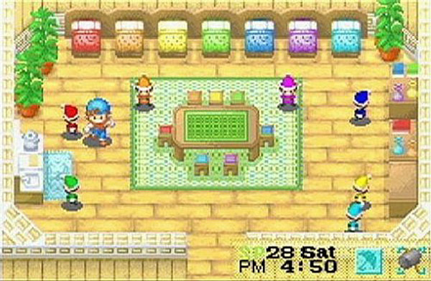
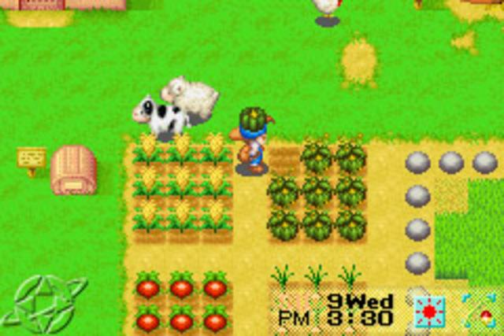
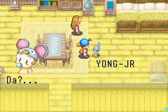
Summary How could it be improved?
Fixing mining like Stardew Valley did
Add some longer term lore
Simplify the marriage process
Notes:
Harvest Moon could be improved by improving the mining experience like Stardew Valley did. Adding more events/ more lore. Maybe adding lore that unlocks after a certain number of years. And, Simplifying the marriage process would improve Harvest Moon.
Sprites Harvest-Moon-Mineral-Town-2.jpg (600×392) (games-guide.de)
Kid 81639-harvest-moon-friends-of-mineral-town-game-boy-advance-screenshot.png (240×160) (mobygames.com)
Farm harvest_moon_friends_of_mineral_town_harvest_moon_friends_of_mineral_town_screenshots_pictures_wallpapers_game_boy_advance_ign_6wzBrCMT.sized.jpg (640×427) (bp.blogspot.com)

