Slide 1
xenoblade chronicles 2
By: Mohammed Alkadmi

Slide 2
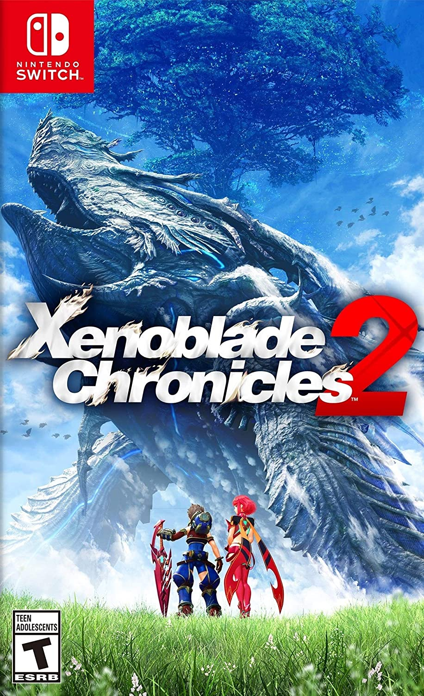
Game Info
xenoblade chronicles 2
Developers: Monolith Soft
JRPG
59.99
It can only be played on the Nintendo switch
Can either be bought on the Nintendo store and installed or bought on a game cartridge.

Slide 3
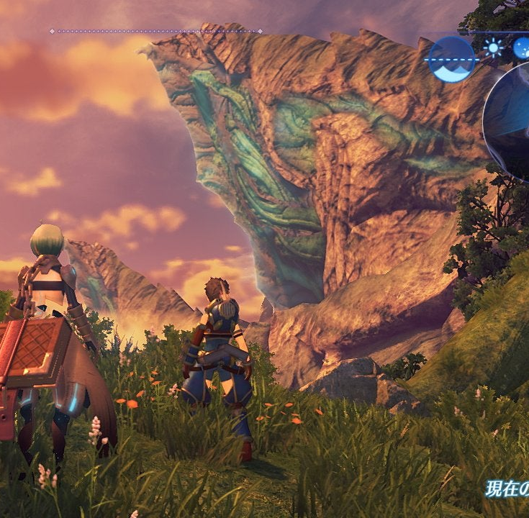
Game Summary
Xenoblade chronicals 2 is a JRPG made in Japan which is a part of the xenoblade and xenosaga game series. You follow a 15-year-old boy named rex through his adventures across the world of alrest to find the utopia of the world elisium
As you freely travel the world you can complete quests fight monsters and collect new characters called blades who serve as your companions.

Slide 4
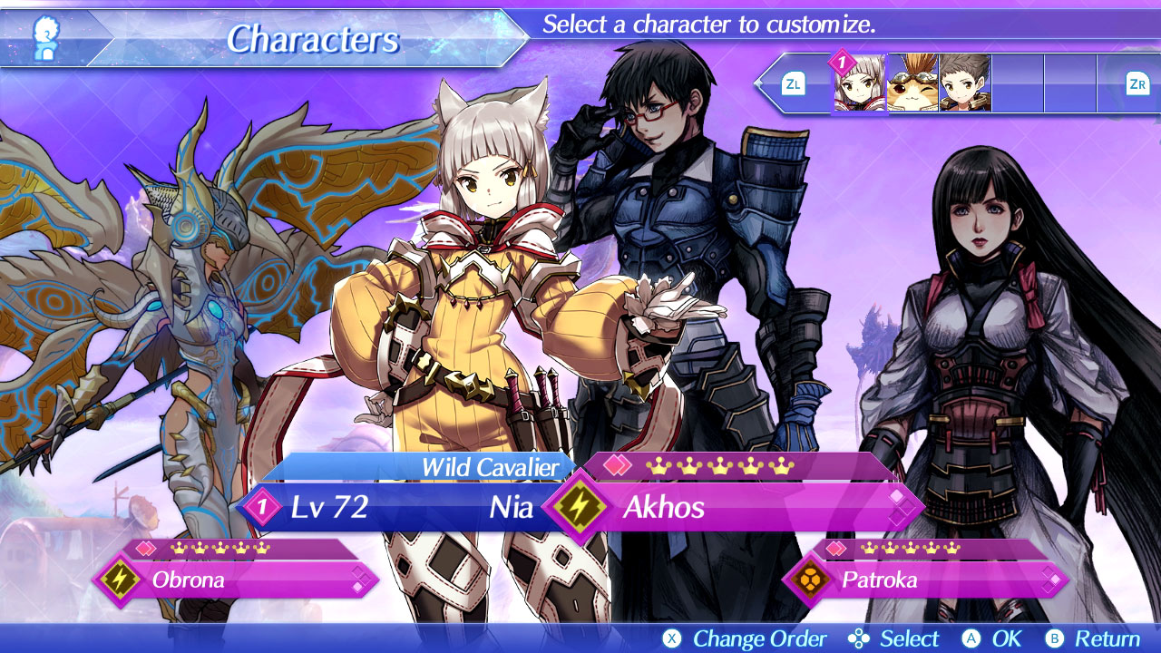
Game aesthetic
The artwork follows a similar style to traditional Japanese anime.
The music in the game is varied and unique each area in the game has different music, battles have their own music, and certain scenes have their own music.

Slide 5
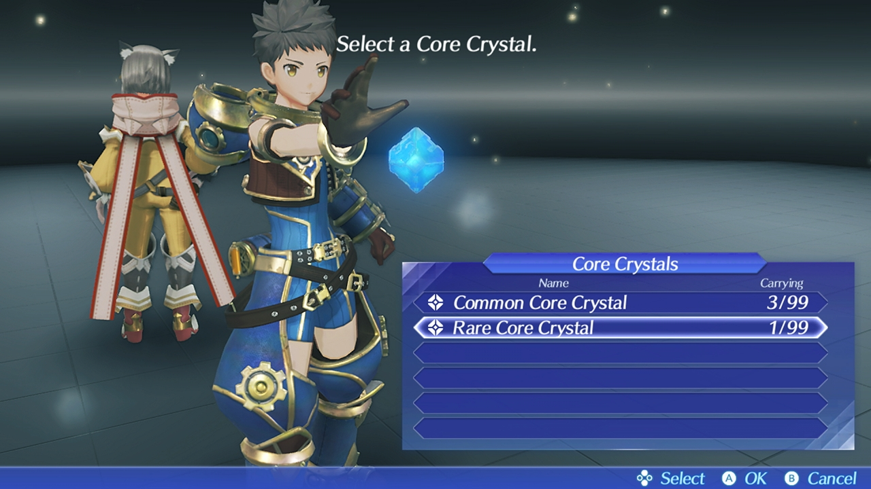
Game Review
Positives:
Strong story that keeps you wanting to play
Rich world that can be explored freely
Negatives:
Gacha type system for the recruiting mechanic
This game compared to other games following the JRPG theme is better than them in most aspects as it has an extremely compelling story and enjoyable gameplay
Intended Audience: This game is intended for teens and young adults

Slide 6
Summary
A game that leaves you wanting more. I would consider that this game is definitely worth it’s price
It provides with around 90 hours of gameplay with interesting characters, rich story, and fun combat.
The only thing that I would consider needs to be changed or overhauled would be the game recruitment system

