Slide 1
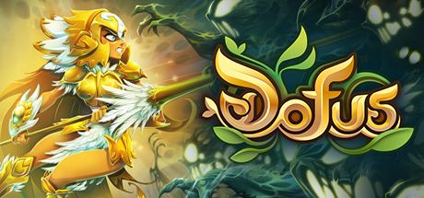
DOFUS
Othman Alaansi CIS 487 Mr. Maxim Bruce

Slide 2
Game title : Dofus Company & Author: Ankama , Mathieu Bourgain Type of game: Mmorpg Price: About 52 Euros for a year membership:
Basic information
Minimum Requirements
Recommend Requirements.
Windows XP SP3 or Higher | OS Windows XP SP3 or Higher
PROCESSOR Pentium IV 2.8 GHz | PROCESSOR Intel Core 2 Duo
MEMORY 1 GB | MEMORY 2 GB
NETWORK Broadband Internet connection | NETWORK Broadband Internet connection
ADDITIONAL NOTES OpenGL 1.3 | ADDITIONAL NOTES OpenGL 1.3
GRAPHICS — | GRAPHICS GeForce 4Ti

Slide 3
Game Summary
Quick overview
Story line (if any)
Player's role
Installation
User Interface
Game Play
Scoring
Artwork
Sound and Music
Special features
Manual (if any)
Bugs
Dofus is a turn-based massive multi-player online role-playing game, suit for all age groups and genders. Thanks to its turn-based combat style, the game doesn't require too much handling. ... Although the game is processed along with the in-game scenario, players own their freedom to go anywhere at any time as they wish.
Dofus takes place in the World of Twelve, a Dark fantasy universe, Players must find six primordial Dofus, dragon eggs conferring great power on their bearer, which are scattered around the world.
There are 16 classes to choose from currently.
Must download the 3gb game.
Whenever there is a bug there are maintenance’s to fix it.

Slide 4
Game Review
I enjoy the game because of the Player vs players function there are lots of group fights and I personally just enjoy the unique gathering method.
I do not enjoy the toxicity of the game also the French centric feeling I get from how the game treats its players.
It is doing okay but there are bigger and better games/ Dofus had potential but did not make the right decisions and listen to their players regarding the dying size of the community.
It’s good in the aspect that if you played it for a long time, you’ll understand the unique playstyle and system to win however its hard for absolute beginners.
It depends on the reason why you play it but I believe all ages can play it.
At the moment there aren’t but sometimes they may mis align the characters hat to their head.
What is good (fun) about the game? Why?
What is bad (not fun) about the game? Why?
How does it compare to similar games in the same genre?
Why is it better or worse than similar games?
What is the appropriate audience for this game?
Are any design mistakes present?

Slide 5
Summary
Overall strengths and weaknesses.
Is the game worth purchasing?
How could it be improved?
The game strength is the massive world and the rich history of the game. However, the weakness is that the game lacked to cater to players out of France. So, while its’s still massively popular in France it significantly died all over the world. Currently I would say it depends if you want to subscribe you either must be a returning player or are willing to catch up too many players who’ve already reached end game, hence people usually buy in currency with real life money to catch up.
It could be improved if it advertised and catered to newer players.

Slide 6
This video represents a meme video about a mis click I had during one of my turns back in 2016, the video now has over 3.000 views
.

