Slide 1
Moon: Remix RPG Adventure
Review
By: Daniel Westfall
Notes:
Hello my name is Daniel Westfall and this is my review of Moon.

Slide 2
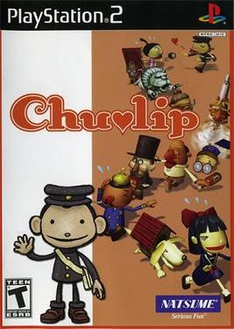
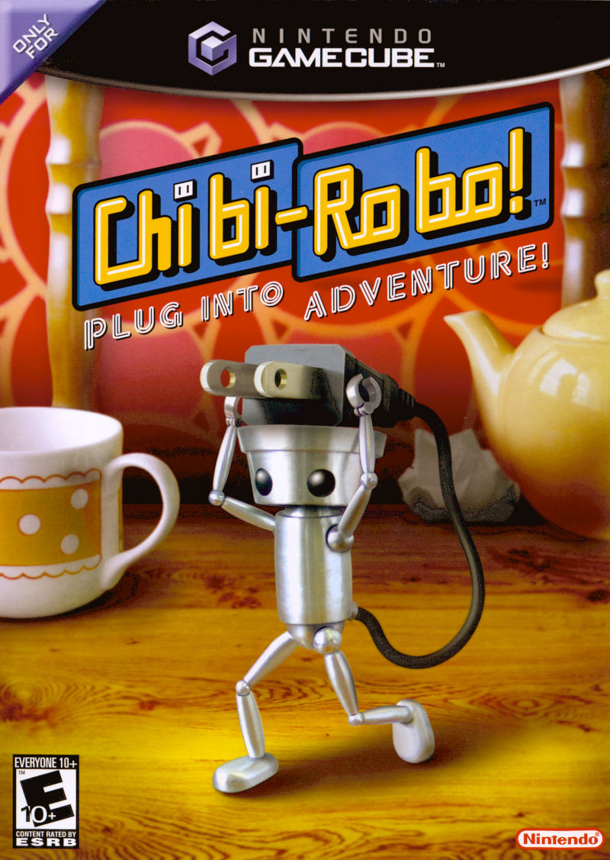
Basic Information
Game title: Moon: Remix RPG Adventure
Company & Author: Love-de-lic
Type of game: Adventure/RPG
Price: $20
Minimum stated hardware requirements: None
Actual hardware required: Nintendo Switch (for English translation)
Game Summary: You play as a boy who is sucked into the world of an RPG and must adventure through it collecting Love in order to return home.
Notes:
Some basic information to go over. Moon was released in Japan in 1997 on the Playstation as Moon: Remix RPG Adventure. It was developed by Love-de-Lic and was recently ported to the Nintendo Switch in 2020 by Onion Games along with an English translation and simply titled Moon. For the purpose of this review I will be evaluating the Nintendo Switch version, but it is very faithful to the original Playstation version with the only differences being text and controls.
Beyond that, Moon may technically be classified as an Adventure/RPG. Though it has more in common with point-and-click adventure games than it does RPGs. It’s most direct descendants are games like Chibi-Robo, Chulip and Undertale somewhat. So, in future, these will be what I compare it against.
For the summary, Moon is a game about a young boy who finds himself sucked into the world of an RPG he was almost done playing, re-living its plot, In order to return home he must collect Love from the animals that have been slain by the game’s hero and by helping the various inhabitants of the world.

Slide 3
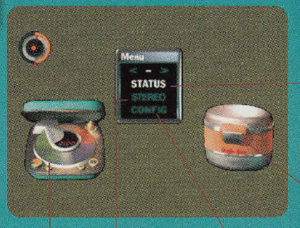
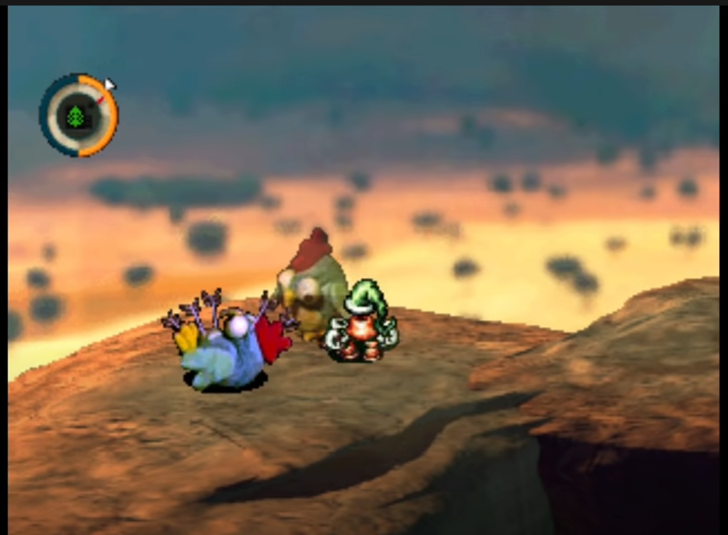
Quick Overview
User Interface
Player's role: To control the boy who is sucked into the video game and help him escape.
Installation: Download through the Nintendo eShop
Manual (if any): Available online
Game Play: Walking around the world, presenting items to characters, changing songs, and fishing
Artwork: Claymation, CG renders, and 2D Sprites
Sound and Music: Folk, Jazz, Rock, EDM, Classical, and others
Special features: MoonDisc system
Scoring: None
Bugs: None that I know of
Notes:
For the overview, the player’s role is to control the boy and help him collect Love, which is this game’s version of experience, in order to help him deepen his level and get home.
The game can be downloaded on the Nintendo eShop and a translated version of the original manual is available online via Onion game’s website.
The gameplay is primarily walking around the game’s world, presenting items to the various characters to accomplish quests, as well as a fishing minigame. The player is also able to change the game’s music at any time.
The game’s art is a mixture of claymation, CG rendered backgrounds and 2D sprites. With a diverse soundtrack featuring Jazz, Rock, EDM, Classical and others.
One of the game’s most unique aspects is the MoonDisc system. Where the player can buy various songs in a shop in the game, create a custom playlist to listen to while walking around,
The user interface is fairly minimal with the only permanent feature being a dial that tells you what day of the in-game week it is and how long you have till you must rest or risk getting a game over. As well as menus for managing MoonDiscs, your status and inventory.

Slide 4
Game Review
What is fun?
The story and world are very unique and novel to explore. Always something new to find.
What is not fun?
The waiting can be tedious and some puzzles can be very hard to solve.
How does it compare to other games in the genre?
It compares favorably to similar games that came later .
Why is it better or worse than similar games?
It can feel antiquated in some ways due to the age of the hardware. But the novelty of its story, great atmosphere and clever puzzles keep it engaging in ways few games manage.
Appropriate audience
Rated Teen due to references to alcohol. Best enjoyed by players looking for puzzles or comforting atmosphere.
Design Mistakes present
Some quests can be hard to find. And one in particular requires hours of grinding to achieve.
Notes:
What is fun? The story and world are very unique and novel to explore. Always something new to find.
What is not fun?
The waiting can be tedious and some puzzles can be very hard to solve.
How does it compare to other games in the genre?
It compares favorably to similar games that came later.
Why is it better or worse than similar games?
It can feel antiquated in some ways due to the age of the hardware. But the novelty of its story, great atmosphere and clever puzzles keep it engaging in ways few games manage.
Appropriate audience
Rated Teen due to references to alcohol. But mostly tame and relatively suitable for all ages. Best enjoyed by players looking for puzzles or comforting atmosphere.
Design Mistakes
Some quests can be hard to find. And one in particular requires hours of grinding to achieve.

Slide 5
Summary
Overall strengths and weaknesses
Strengths: Unique and immersive atmosphere, great soundtrack and visuals, and engrossing story
Weaknesses: Limited world interaction and traversal and more helpful hint system
Is the game worth purchasing?
Yes.
How could it be improved?
The main quest could be made slightly easier to find and pushed towards.
Could use more interesting overworld navigation.
Notes:
Strengths:
Moon’s greatest strength is its story and world. It is constantly interesting to explore and interact with and always feeds you just enough to make you wonder what else could be waiting for you. As well as the MoonDisc system which makes what might have otherwise been tiresome waiting into something more fun and personable, letting you find an atmosphere to relax.
Moon’s weaknesses can depend on who’s playing. For me I never felt the amount of waiting for things was too long, an in-game day is around 6-8 minutes with plenty of ways to skip some time, some may be less patient and take issue with it.
The more contentious issue though is how difficult and obscure some solutions can be. Some puzzles are real stretches of the mind and while I grasped most of them, some did stump me. There are hints to help let players know where some of the remaining love may be, but not all of them are great at guiding what to do.
I do take issue with some of the obscurity that exists in finding the main path to the end. While I’m glad it is fairly open ended, there are steps that are very easy to miss and I had to look up a guide to know what to do. And it’s in this less optional content that it would have been nice to have more help.
Is the game worth purchasing: Yes. It remains to this day a very unique experience. There is a real passion in the game that can be felt and for $20 it’s more than worth the price.
Could the game be improved? Yes. While it is okay for some puzzles to be a bit more obtuse and easy to miss, as mentioned in the weaknesses section, the critical path to the game’s ending can be trickier than needs be. How to correct it though can vary based on your perspective. To me, having more hints to use the decryption machine would have been nice and the scene to talk to the king about the rocket made more mandatory would have been enough. As well as a bit more times to visit the firework factory. May also be nice to have the fishing contest made easier so players looking to get 100% of the love aren’t forced to grind for hours, since, as it stands now, it can eat up a considerable amount of time.

Slide 6
Thanks for Watching!

