Slide 1
Tom Clancy’s Rainbow Six Siege
By Avian Calado

Slide 2
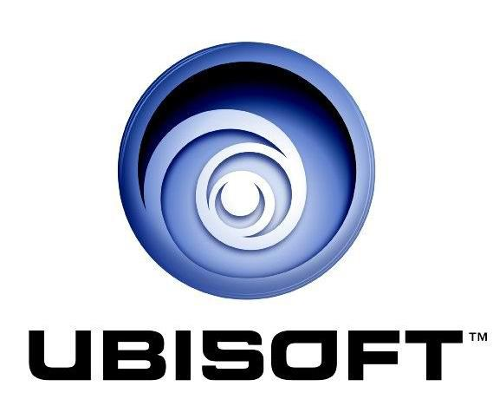
Company
Company & Author
Developer Ubisoft Montreal
Publisher Ubisoft

Slide 3
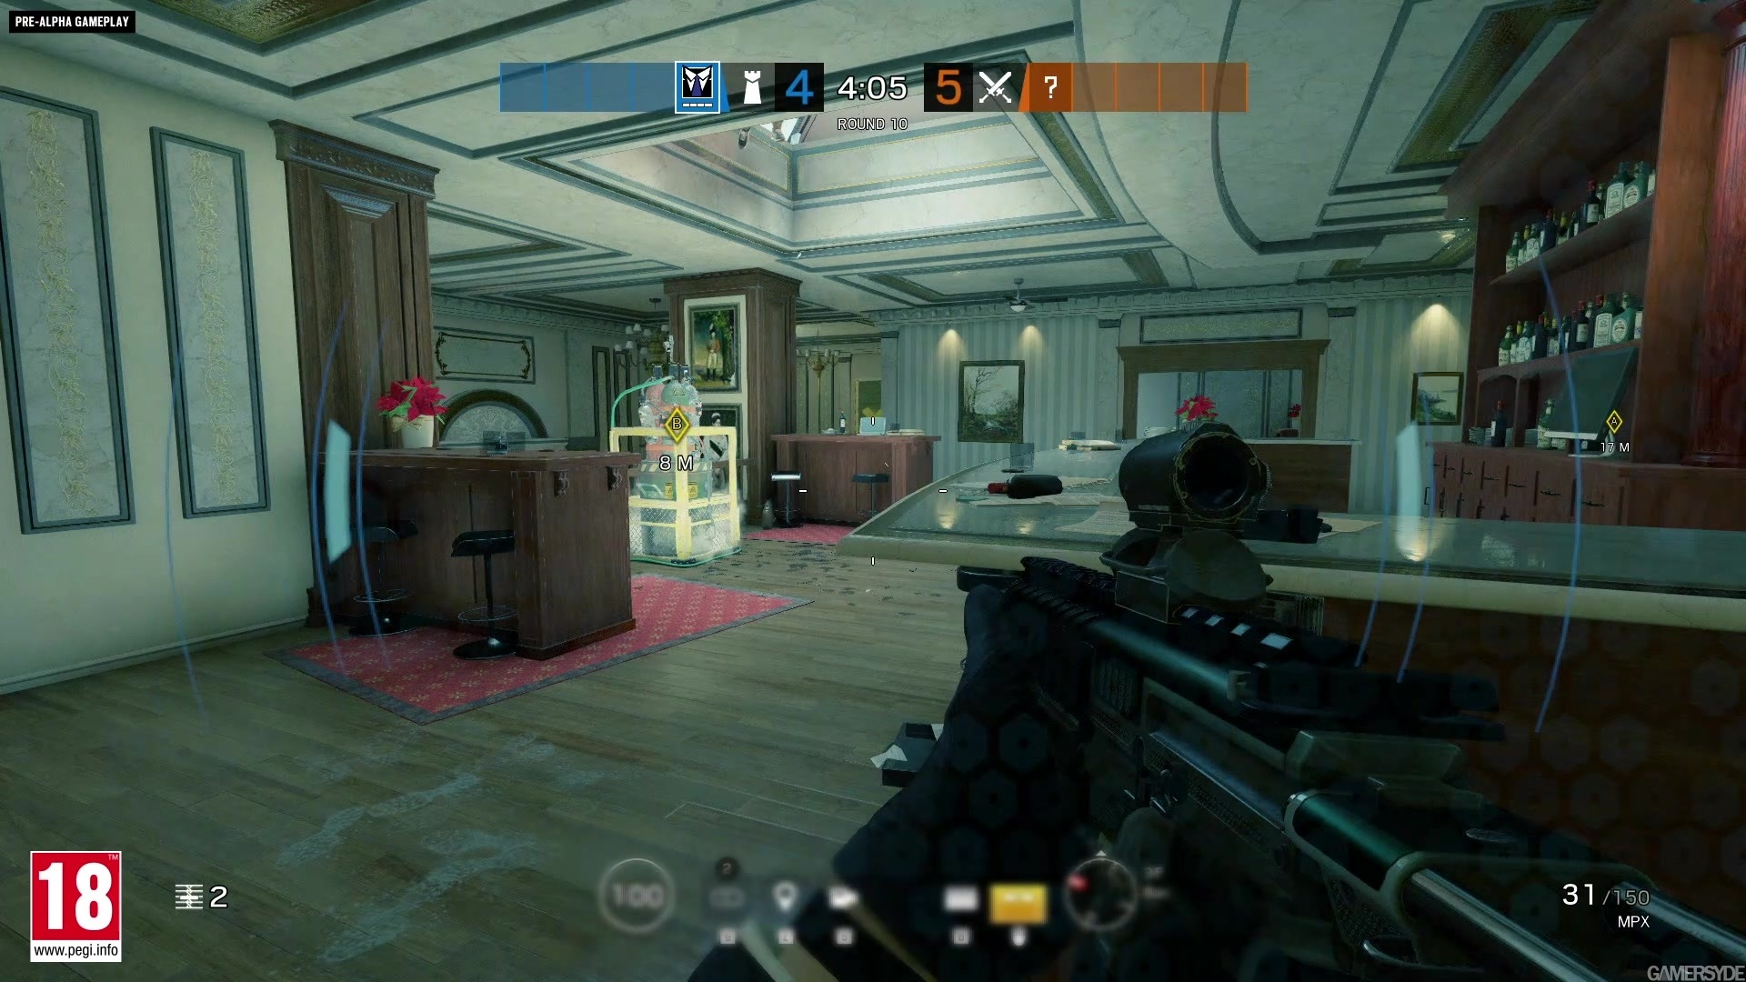
Type of game
Action
FPS
Multiplayer Only
$20

Slide 4
Basic Info
OS: Windows 7, Windows 8.1, Windows 10 (64 bit versions required)
Processor: Intel Core i3 560 @ 3.3 GHz or AMD Phenom II X4 945 @ 3.0 GHz
Memory: 6 GB RAM
Graphics: NVIDIA GeForce GTX 460 or AMD Radeon HD 5870 (DirectX-11 compliant with 1GB of VRAM)
Network: Broadband Internet connection
Storage: 61 GB available space
Sound Card: DirectX® 9.0c compatible sound card with latest drivers
Minimum Hardware
OS: Windows 7 SP1, Windows 8.1, Windows 10 (64 bit versions required)
Processor: Intel Core i5-2500K @ 3.3 GHz or better or AMD FX-8120 @ 3.1 Ghz or better
Memory: 8 GB RAM
Graphics: NVIDIA GeForce GTX 670 (or GTX 760 / GTX 960) or AMD Radeon HD 7970 (or R9 280x [2GB VRAM] / R9 380 / Fury X)
Network: Broadband Internet connection
Storage: 61 GB available space
Sound Card: DirectX® 9.0c compatible sound card
Recommended Hardware

Slide 5
Game Summary

Slide 6
Synopsis
Rainbow 6 siege is a tactical multiplayer first person shooter with semi destructive environments and high lethal rate. In a 5v5 match one side as offense and another on defense. On each side pick a unique operator that fits your style to win your team the game in a best of x round game

Slide 7
Story line
Rainbow six is a international highly secretive organization that recruits the best of the best operators and soldiers from around the world to perform counterterrorism efforts and undercover missions

Slide 8
Player Role
Offense
Kill all enemy defenders
Plant the defuser and wait for the timer to run out
Kill enemy gadgets
Gather information
Communicate with teammates
Defense
Kill all enemy attackers
Defend the bombsite and prevent defuser to be planted
Disable defuser if planted
Destroy drones
Gather information
Communicate with teammates

Slide 9
Installation
Install the game through Steam
Install using Uplay launcher where you can get off the ubisoft website

Slide 10
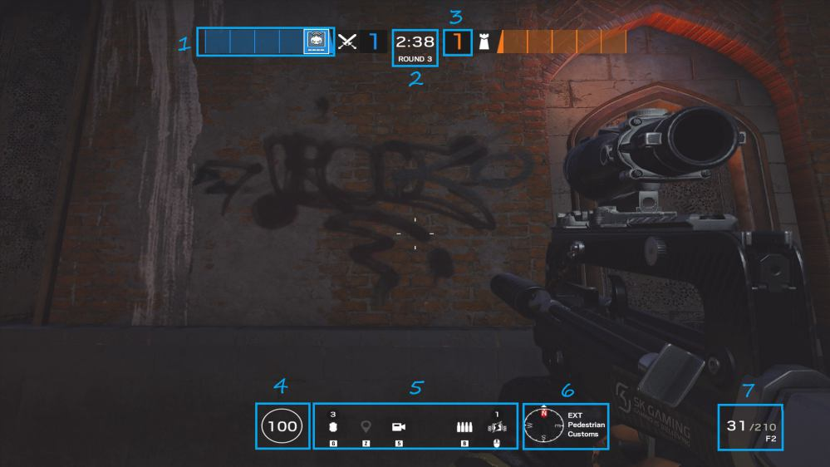
User Interface

Slide 11
Gameplay
https://clips.twitch.tv/SweetBashfulHamburgerBCWarrior

Slide 12
Scoring
Offense
Kill all enemy defenders
Plant the defuser and wait for the timer to run out
Kill enemy gadgets
Defense
Kill all enemy attackers
Defend the bombsite and prevent defuser to be planted
Disable defuser if planted
Destroy drones

Slide 13
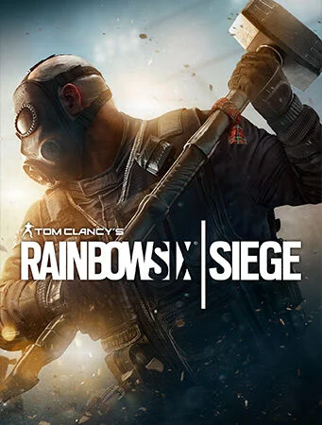
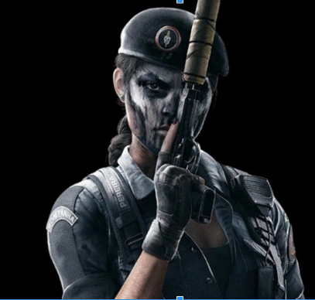
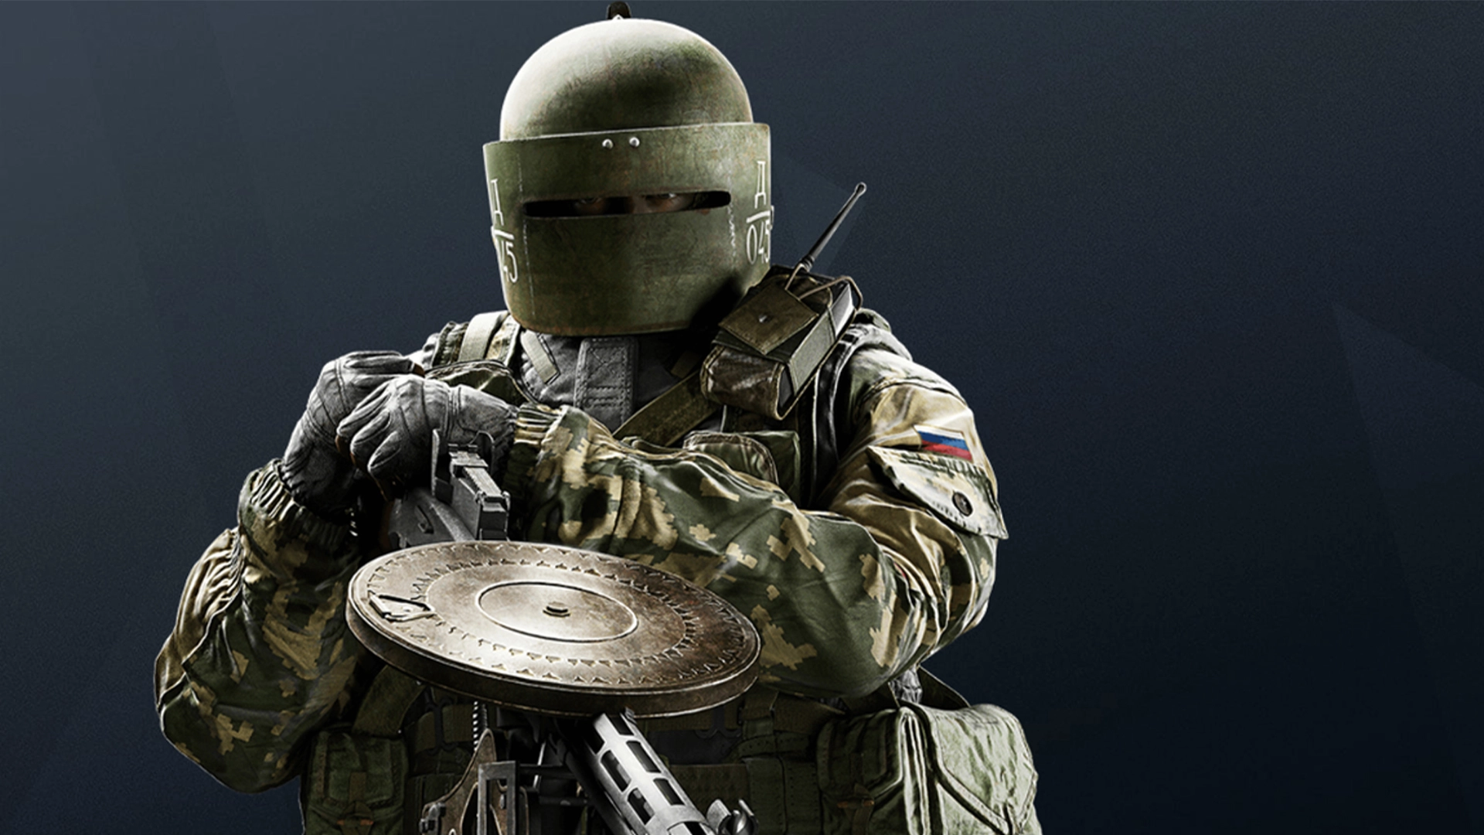
Art work

Slide 14
Sound and Music
Sound is fitting and important for players to listen and gather information on
Music is minimal with songs appearing with new updates when new operators come out.

Slide 15
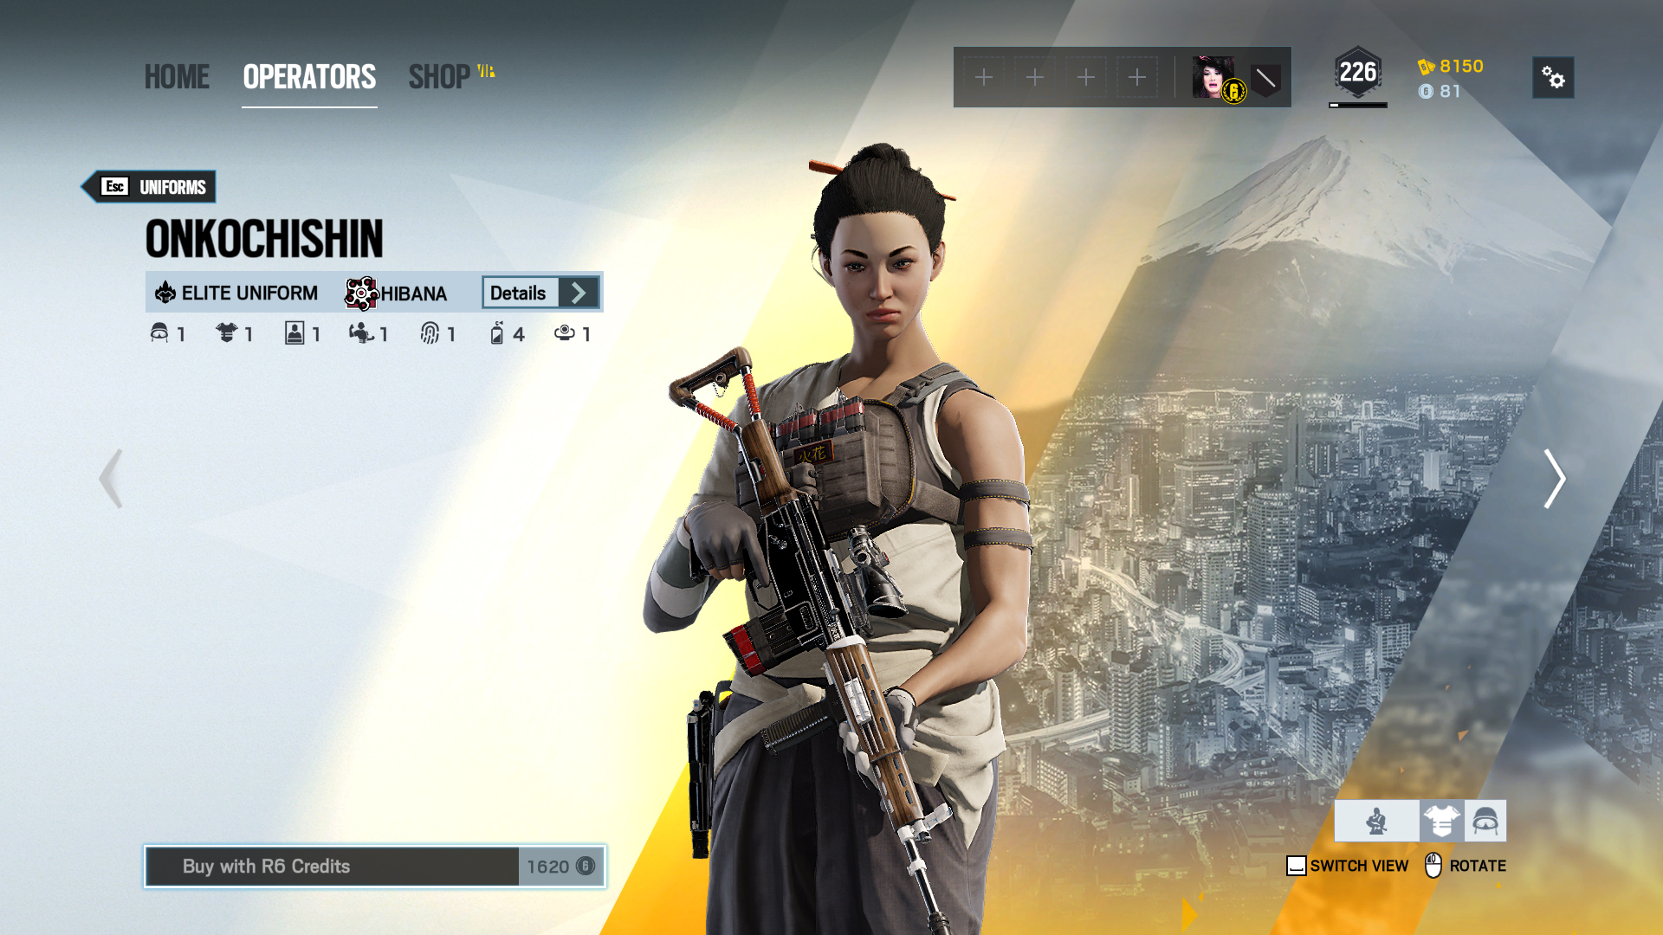
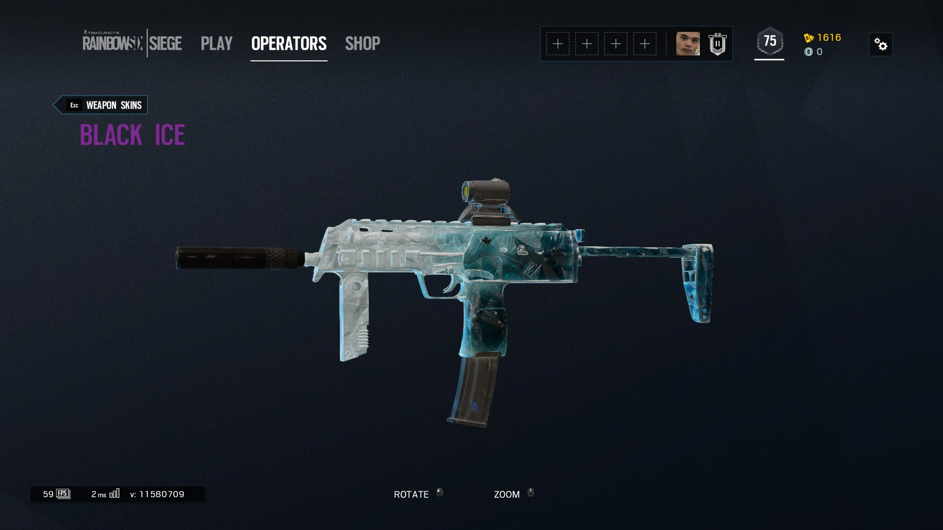
Special Features
Skins
Ranked game mode
VOIP

Slide 16
BUGS
Explosions on breakable walls don’t always work
Shield operators don’t always block bullets

Slide 17
My Review

Slide 18
What is good about the game? Why?
What is bad about the game? Why?
How does it compare to similar games in the same genre?
Why is it better or worse than similar games?
What is the appropriate audience for this game?
Are any design mistakes present?

Slide 19
The Good
Large pool of unique Operators allow for diversity and different play styles that everyone can play
Steep learning curve - Always something new to learn
Individual skill is rewarded
Refreshing and new mechanic that allows for outplays (tilt)
Constant game updates

Slide 20
The Bad
With unique operators comes the viability of each one and need for each one for a team in order to win
Toxicity and hackers
Peekers advantage and tick rate

Slide 21
Similar games
Valorant - fantasy with abilities with standstill aiming relatively equal or less lethality
CSGO - tactical and stand still aiming relatively equal or less lethality
Call of duty - less tactical and less lethal

Slide 22
Better or Worse?
Interaction with environment is dynamic and adds more depth compared to the other shooters.
A good in between for call of duty and csgo that fills that niche.

Slide 23
Audience and design mistakes
Young adults 18-30
Design mistakes in past :
Operator intended to be a support, but in reality becomes a duelist (DOC)
Operator on release had a 500hp anti headshot shield

Slide 24
Summary

Slide 25
Strengths
Weaknesses
Tactical yet mechanically intensive shooter
Constant Updates and new content every year
Large unique pool of operators and different loadouts
Steep learning curve
“Meta” operators picked every time
Toxicity and hackers
Loadouts aren’t diverse enough

Slide 26
Worth it?
Yes for $20 with high replayability and steep learning curve for anyone interested in the first person shooter category

Slide 27
Improvements
Add more operators to increase diversity
Balance changes to guns in different operator loadouts
Better anti cheat
Harsher punishments on toxic people and hackers
Higher tickrate servers / Dedicated servers

