Slide 1
Armed with Wings: Rearmed Review
Review By Muaz Alhaidar

Slide 2
Review Structure
Basic Information
01
Game Summery
02
Game Review
03
Final Summary
04

Slide 3
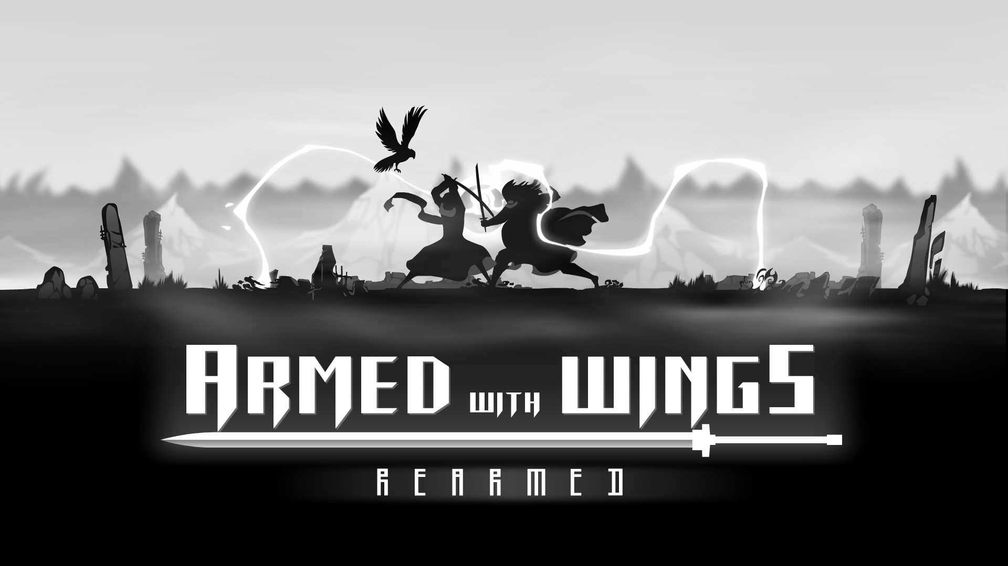
01: Basic Information
Game Title: AwW: Rearmed (2017)
Company: Super-Sun-Studios
Genre: 2D Action/Platformer/Hack’n Slash
Price: 10.00 USD
Platforms: PC

Slide 4
01: Basic Information
Minimum Hardware Requirements
Memory: 4GB RAM
CPU: 2.5 GHz
GPU: N/A
Size: 100 MB
There is no recommended hardware for this game.
There is also no GPU Recommendation.
I ran this on a GTX 950M (2015) and It reached and stayed on the fps cap.
My GPU stayed at around 20% usage.

Slide 5
02: Game Summary
Quick Overview
AwW: Rearmed is a hack and slash game with some puzzle elements and story. It follows a Lone Warrior in his pursuit to dethrone a tyrant king and end his tyranny once and for all.
Player’s Role
The player takes the role of the Lone Warrior and battles through enemies with his crow companion by his side. In hopes of reaching the tyrant king’s throne and defeating him once and for all.
Installation
This game is purchasable on steam, and is easily installed through steam by the click of a button

Slide 6
02: Game Summary
Story Line
After being slaughtered by the hand of Vandheer Lorde. The Lone Warrior is resurrected by the Blackmist to once again face Vandheer. He traverses through guarded regions, bringing death to the guards and soldiers of the king. Upon reaching the throne, the Lone Warrior comes face-to-face with the king once again. This time with the title and blessing of he who is Armed with Wings.

Slide 7
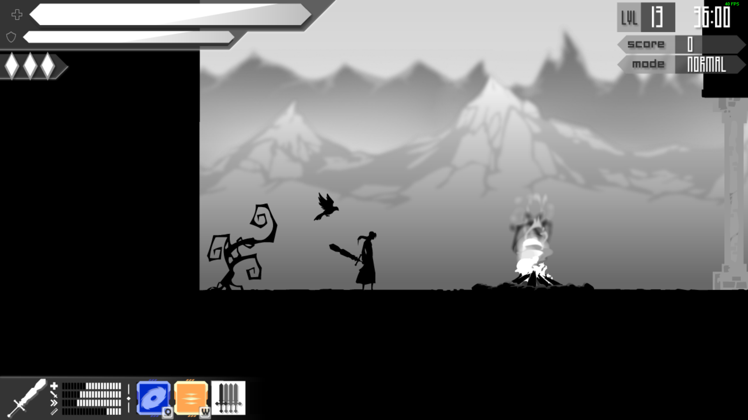
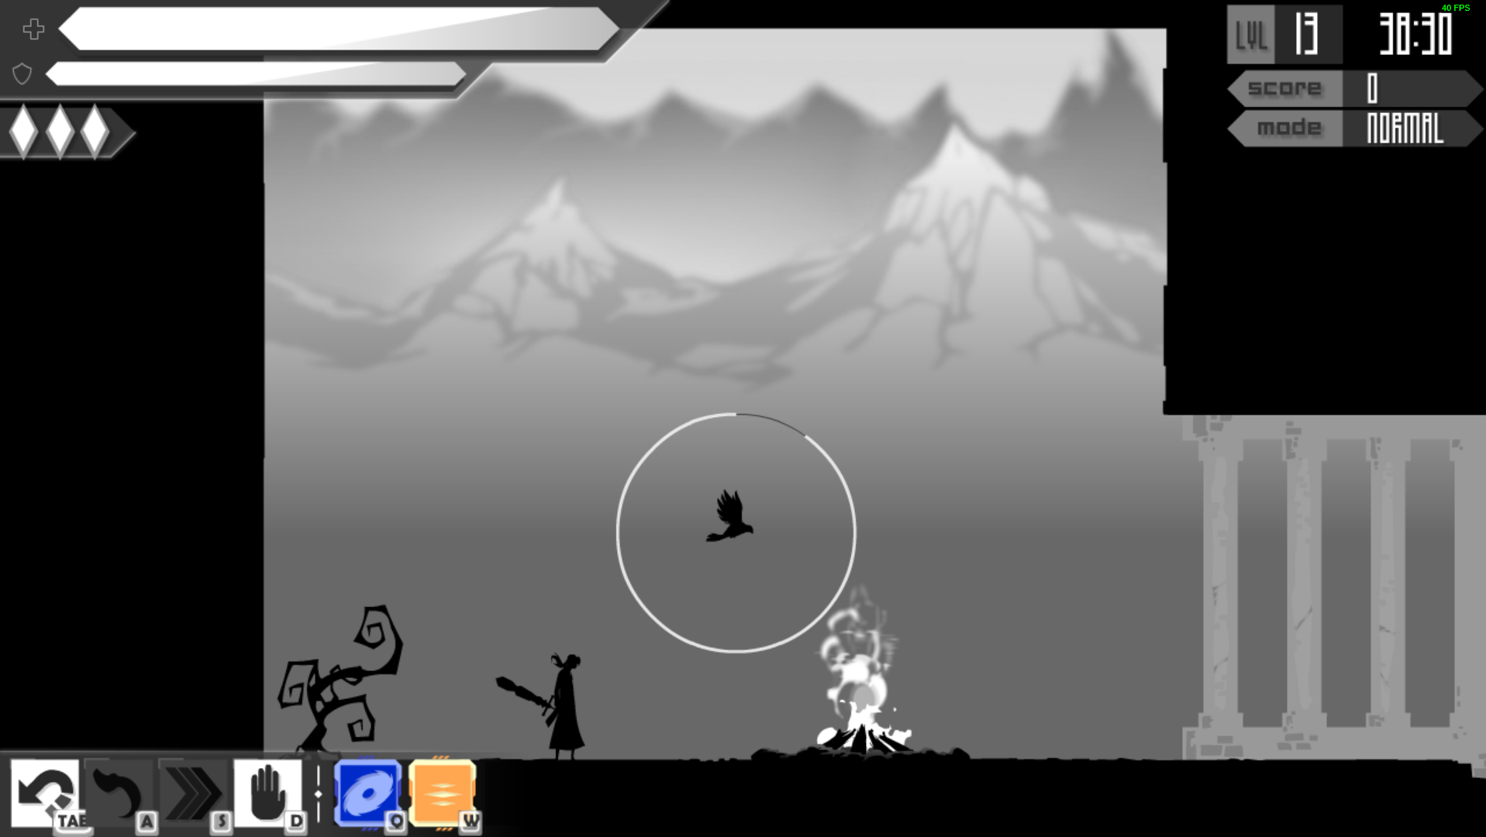
02: Game Summary
UI
The UI is minimal and elements such as the health, poise, weapon stats, and abilities have clear, unique, and recognizable icons that allow it to be as minimal as it is.
The game also always keeps the player at the center of the screen, so they always know where they are.

Slide 8
02: Game Summary
Gameplay
The gameplay consists of attack combos using light attacks, heavy attacks, special abilities, parries, and dodges to create a fluid and violent symphony of swordplay.
The player also gets to use his companion to distract enemies and solve puzzles.
White orbs drop from enemies and around the level that regenerate player health.
As the player gains points and progresses, they will unlock new swords that have their own set of stats and special ability slots.
Scoring
When the player uses all their lives, all the points the player has accrued so far go to unlocking new swords and abilities
The player can increase their points gained per kill by killing the enemy while they are on a combo streak.
The white orbs also reward points when picked up.

Slide 9
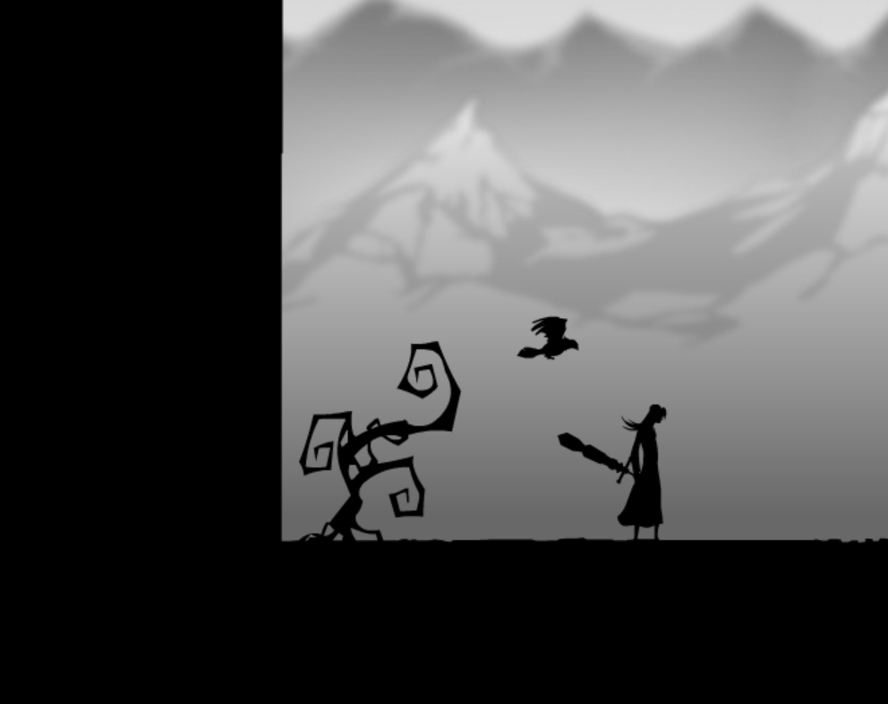
02: Game Summary
Artwork
The game offers an elegant, swift, and monochrome art style. Creating an environment that gives off a very prominent bleak feel.
Rare trees and broken rocks emphasize a somewhat windy land devoid of life.
The art style is what drew many players in and is a very prominent and well-loved part of the game by fans of the series.

Slide 10
02: Game Summary
Sound & Music
The sound design for dodging, parrying, and sword swipes (be they up or down) are very well done.
The sound design of the heavy attacks is especially weighty and powerful.
Most of the music can be categorized as techno, with the general musical ambiance being calm during the early levels and getting faster and more violent during the mid-late levels as the player gets closer to the final boss.
Special Features
In addition to the main story, the game offers several other game modes:
Survival
VS Battle
Juggling Mode

Slide 11
02: Game Summary
Manual
The game does not give a manual but rather has the first few levels be a tutorial.
Later in the game, the player is introduced to new mechanics such as using their special ability to open other paths.
Bugs
At this point in the games life there are no bugs that I have encountered.
It is safe to assume that all the bugs in the game have been ironed out over the past few years since its release.

Slide 12
03: Game Review
What’s so good?
Exploration:
Finding different end points to levels can give you an advantage in the place you spawn in the next level
Finding all the collectables rewards the player with a special mission after the game is over.
Art:
The game offers a beautiful background and some lovely scenes
The silhouette art is especially good in this game and does a good job of showing the Lone Warriors character and style through his slim and swift figure.
Combat:
Combat tends to be very fluid in this game and offers great opportunities to pull off some very stylish combos that reward the player with points (multiplicatively) for maintaining the combo
Being able to pull off the attack sequences can be very rewarding.
Tight controls and maneuvers make it easy to learn but hard to master.
What’s so bad?
Two out of the 3 bosses felt a bit uninspired and boring.
They only had 2-3 kinds of attacks as apposed to the final boss who was much more exciting, fast-paced, and left a much better impression on me.
While the combat is very good and the combos are fun to pull off, at some point it feels like you had pulled off all of the combos.
This may be an issue when it comes to replay ability in the game.

Slide 13
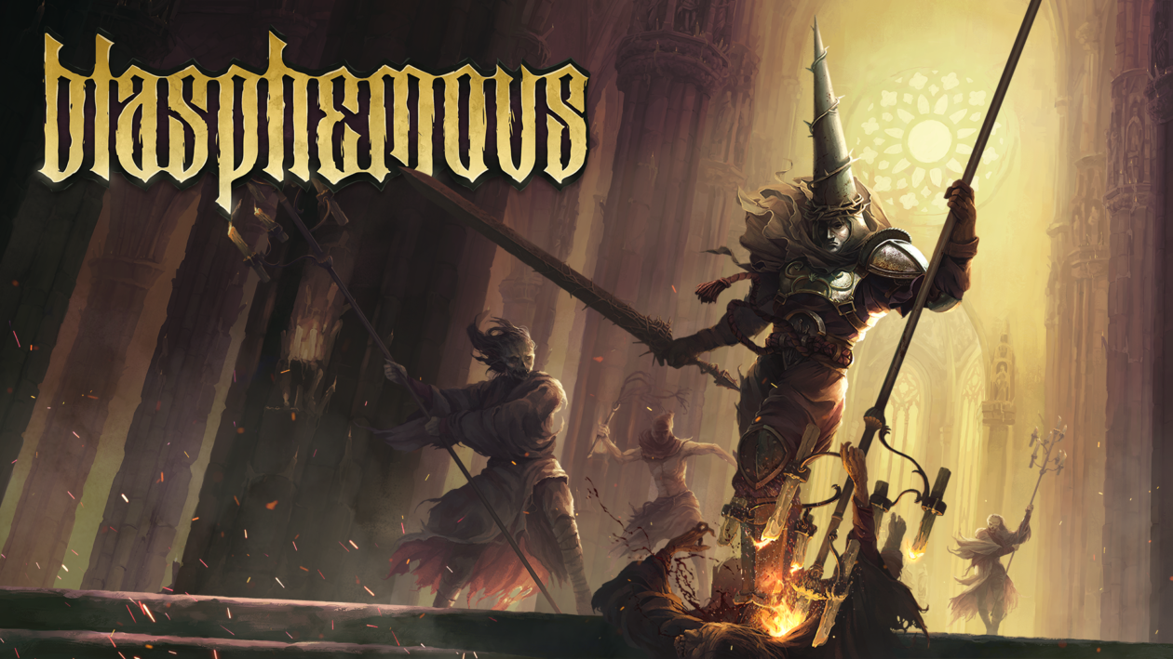
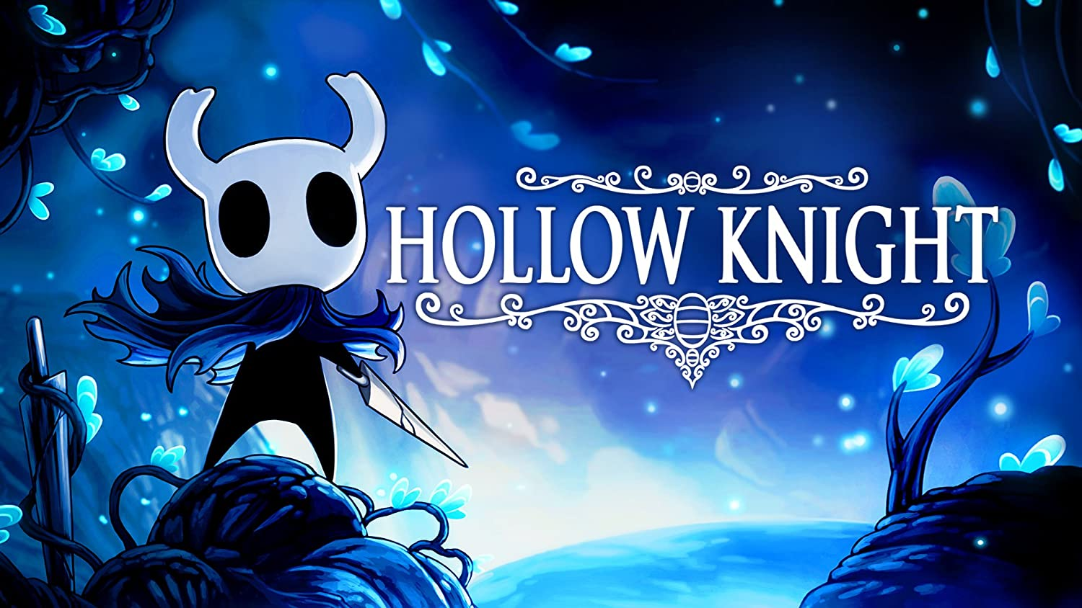
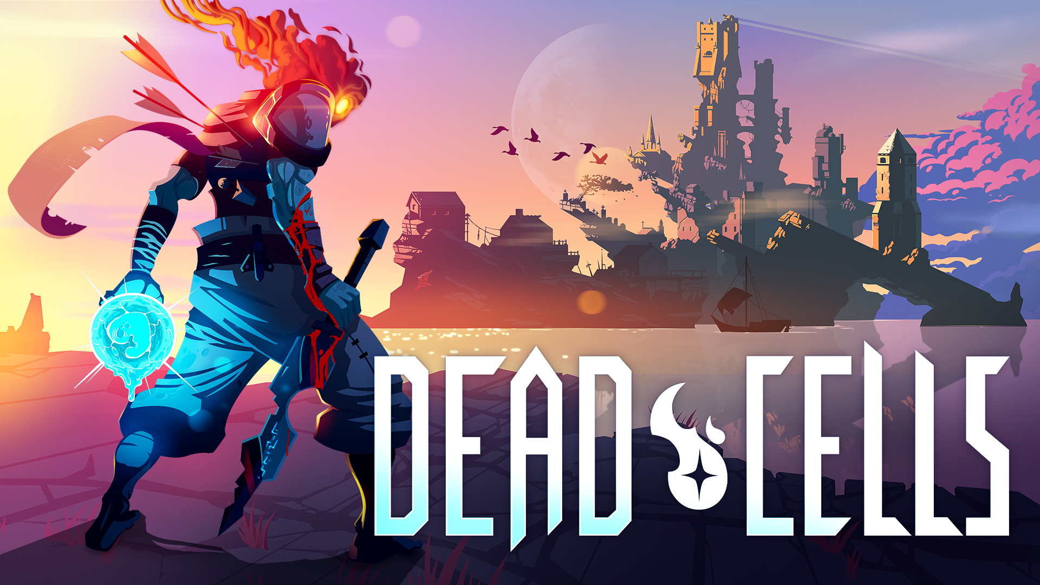
03: Game Review
How does it compare?
When it comes to other games of the same genre, AwW: Rearmed does decent job.
What I've notice though is that other 2D action/platformers where likely metroidvania games and I can't help but feel that the game would have benefited greatly from being one as well.
Adding a jump button would have also allowed the developer to create more verticality in the game and allow for even more exploration options.
A design decision to make the game a metroidvania may give the game a much larger feel and sink the player further into the world. I would deem this a missed opportunity on the design part of the game.
Adding a jump button may also make combos and juggling more energetic and powerful instantly.

Slide 14
03: Game Review
The Audience
Players who like tight controls and fast-paced fighting, especially with the other unlockable characters.
Design Mistakes
Two out of the three bosses where not interesting enough
Bosses are meant to be biggest and most unique baddies around for them to be affective.
If the bosses are forgettable then the designer has failed to make them a good boss just based on principle alone.
Let alone making what’s meant to be the more exciting points of buildup have a disappointing payoff and leaving a bad taste in the player’s mouth.

Slide 15
04: Final Summary
Overall
Strengths:
Art style
Combat
Music (if you like techno)
Good puzzles
Weaknesses:
Bosses could be better
Not very replayable
Room for Improvement
The only design complaint I had was the bosses.
I had a constant feel of “I wanted a bit more”
Don’t get me wrong, I do think this is a good game and does a pretty decent job with its strengths.
But I can't help but feel like it could have been more than it is. That there was potential that the designer missed, and it could have benefitted very much from more exploration options and verticality.
Worth the Money?
I deem the game worth the money if the art draws you in. Otherwise, I would recommend a metroidvania like Hollow Knight for just an extra five dollars instead. As it offers fixes for all the things I complained about for this game.

