Slide 1
Game Review: DemonCrawl
By David Adrian
CIS 487/587
Fall 2020

Slide 2
Outline
TODO

Slide 3
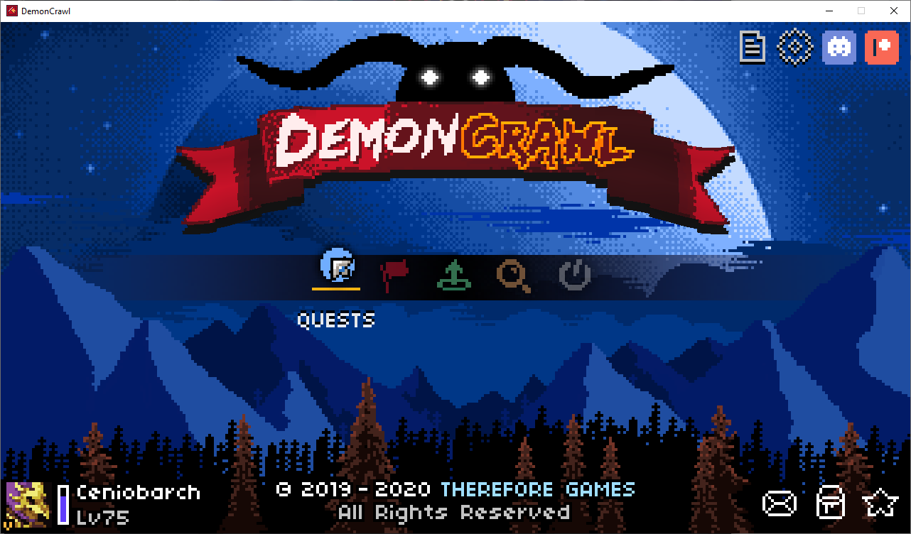
Basic Info
DemonCrawl
Creator/Publisher: Therefore Games
Released: November 5, 2019
Available on Steam for $15
Minimum Requirements:
Windows 7; 512 MB RAM
Also available on Mac
Rougelite Minesweeper

Slide 4
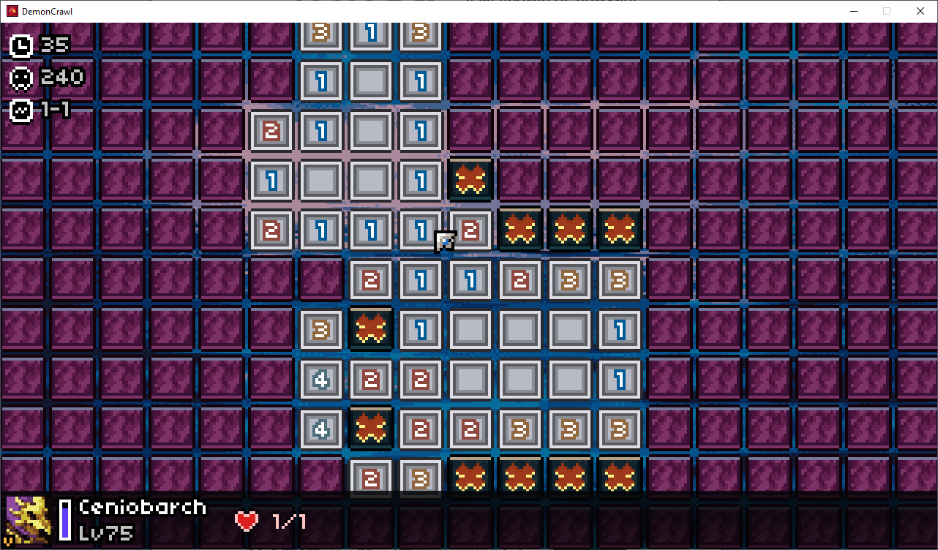
Classic
Goal: reveal all cells without clicking on a monster
Numbers = monsters in neighboring cells
Left click - Open cell
Right click - Flag cell
Middle click and drag - Move field

Slide 5
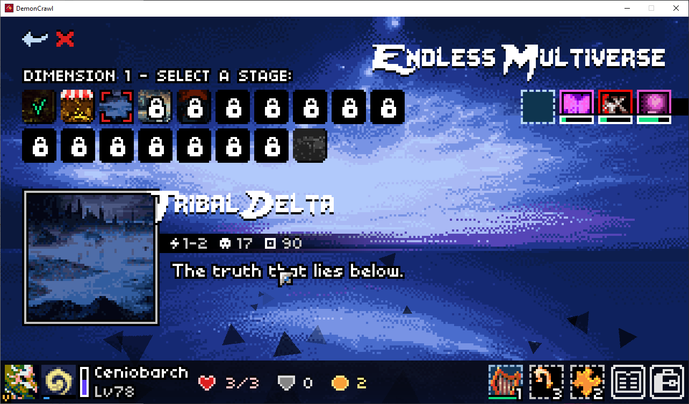
Item Types
Magic (blue background) - activate to do something, then needs to recharge
Consumable (green background) - activate to do something, then is lost
Passive (black background) - Always in effect; they can have different triggers
Legendary (gold background) - Powerful passive items; limited to one at a time.
Omen (red background) - Harmful passive items

Slide 6
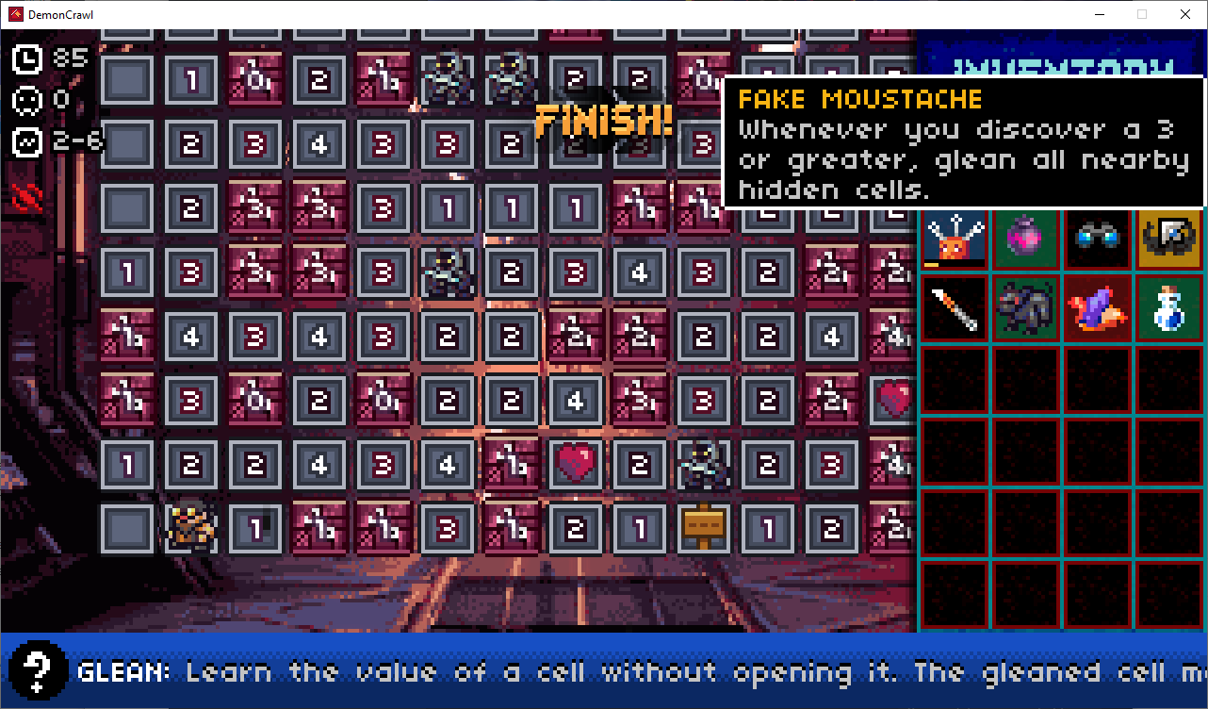
Items
Acupuncture (magic; 250 mana) - lose one life and gain 2 defense
Smoke bomb (consumable) - leave current stage without completing
Binoculars (passive) - Minions spawn in wild
Fake Moustache (legendary) - Whenever you discover a 3 or higher, glean all nearby cells
Scalpel (passive) - When you lose exactly one life, remove a random omen.
Minion (consumable) - Solve one cell; if about to take damage, the minion sacrifices itself to take one damage
Jester Hat (omen) - Monsters always deal max damage
Mana potion (consumable) - Gain 100 mana.

Slide 7
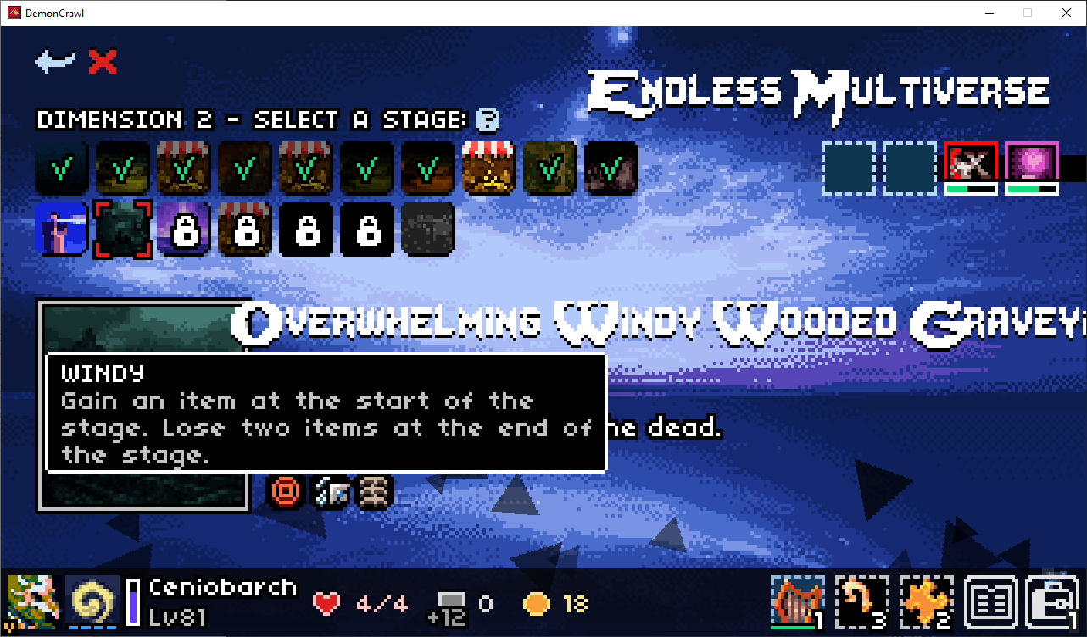
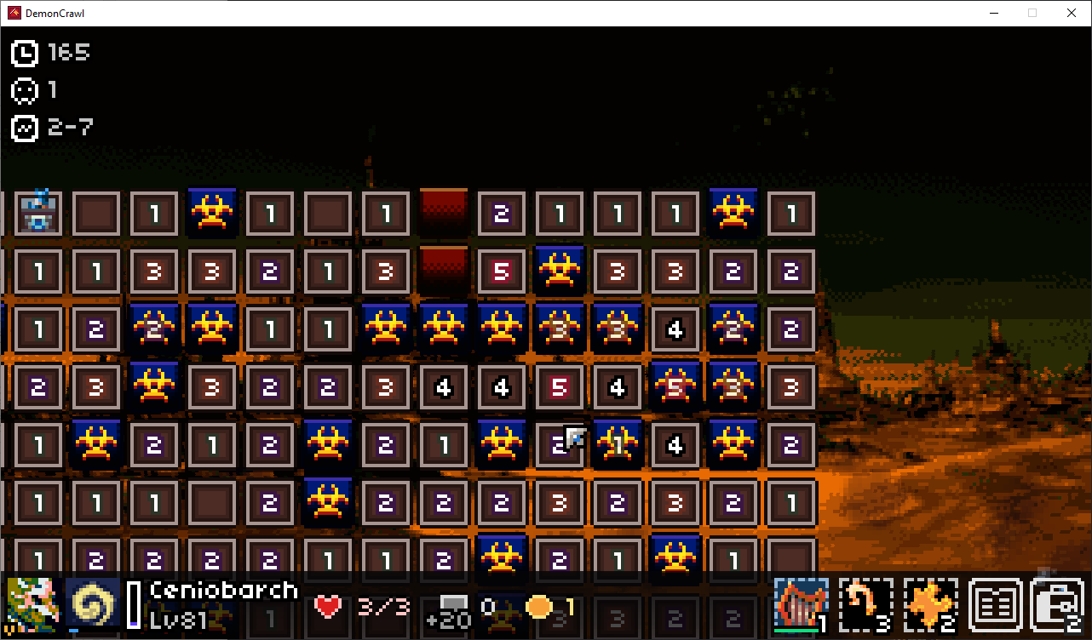
Mods

Slide 8
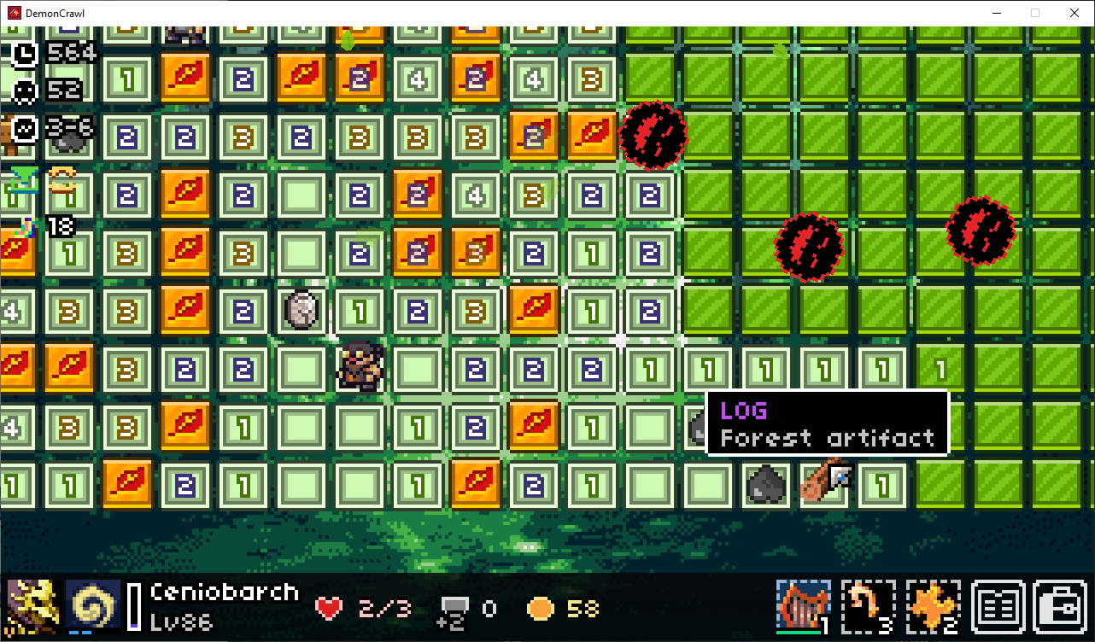
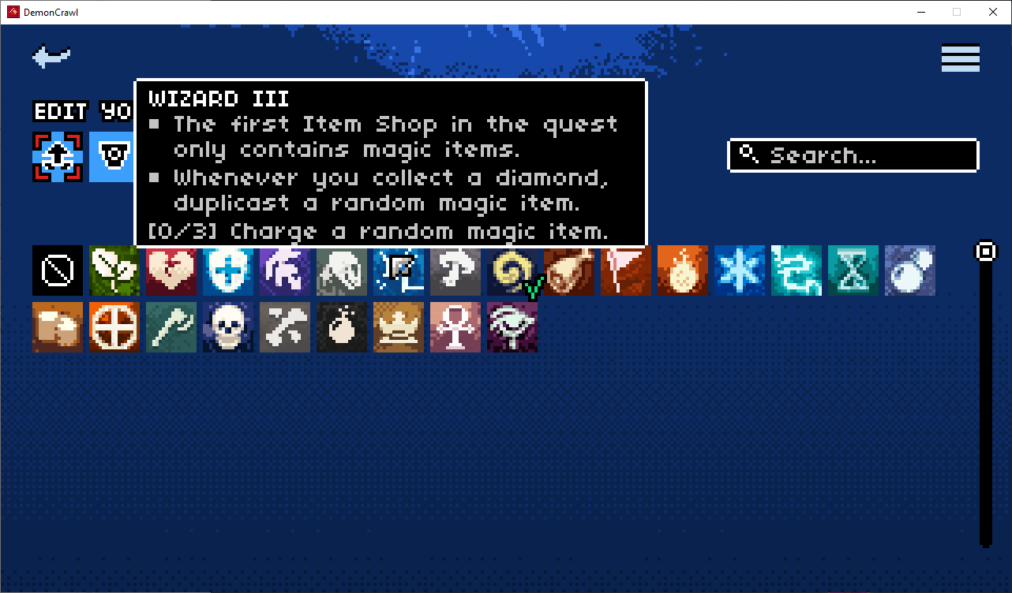
Progression

Slide 9
Review
Puzzle games
600 items
Magic
Consumable
Passive
Legendary
Consumable
70 stage mods
Shiny
Trusty
Nightmare
Unchained
22 classes (or masteries)
Spy
Knight
Firefly
Daily quests
Endless Multiverse

Slide 10
Thank You!

Slide 11
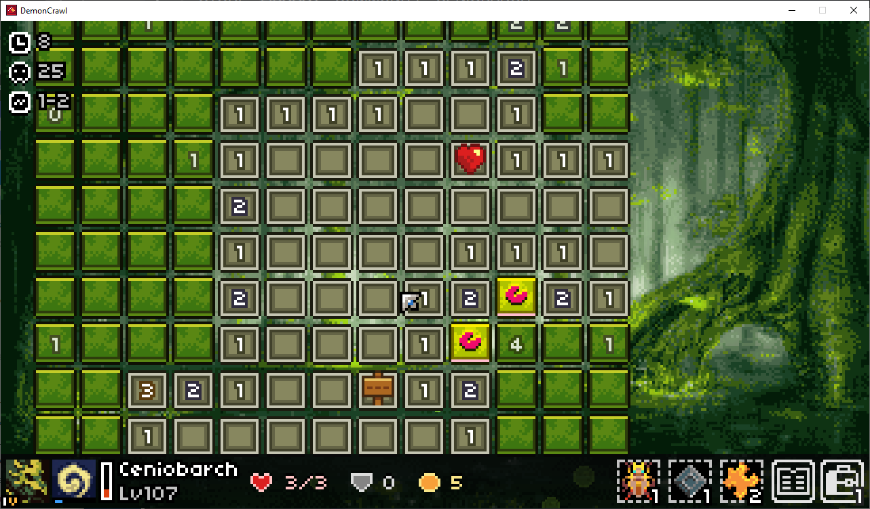
Quest Mode
Top left corner (top to bottom):
Time
Number of monsters
Damage range for revealing monster
Bottom (left to right):
Portrait
Mastery (spy)
Name, experience and level
Current life/Max life
Defense and Armor
Coins
Heirlooms (craftable, one per quest)
Information/dictionary
Inventory

