Slide 1
Batman: Arkham Knight Game evaluation
By: Ali tarraf

Slide 2
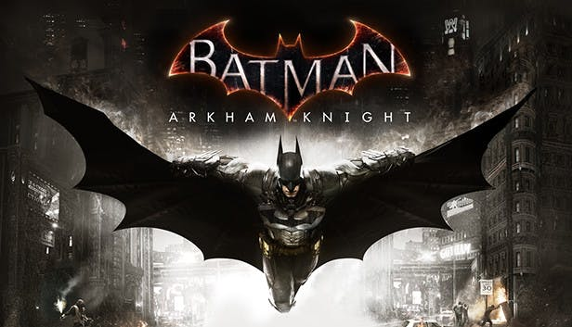
Batman: arkham knight
Developed by rocksteady studios
Published by warner bros.
action-adventure video game
Notes:
Batman: Arkham Knight was developed by Rocksteady Studios
And published by Warner Bros. Interactive Entertainment.
It’s a action-adventure video game

Slide 3
hardware requirements
Minimum
Actual
Memory: 6gb ram
Graphics memory: 2gb
Processor:
Intel Core i5-750
Amd phenom ii x4 965
Storage: 45GB
Memory: 8gb ram
Graphics memory: 3gb
Processor:
Intel Core i7-3770
Amd fx-8350
Storage: 55GB

Slide 4
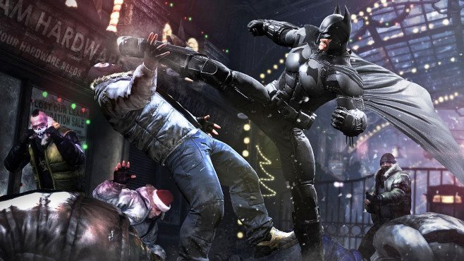
Game summary
The main story of the game takes place in Gotham city where scarecrow is planning a fear gas attack.
Scarecrow and the arkham knight attempt to finally destroy batman by uniting batman's worst enemies.
Third person game play
Hand to hand combat
Weapons
Vehicles
Notes:
The main story of the game takes place in Gotham City where Scarecrow one of Batman's enemies has planned an attack on Gotham. He plans to release fear gas in the streets to create chaos all over.
With the help of the mystery character the Arkham Knight he unites all of Batman's worst enemies to finally destroy the Batman so they can finally take control of Gotham.
The game play is in a third person perspective.
For the main plot you play as Batman and fight the Arkham knights army of men and tanks.
You can fight enemies with hand to hand combat, or using any gadgets in your belt that you acquire throughout your mission.
A new extension to Batman’s arsenal is the Bat mobile.

Slide 5
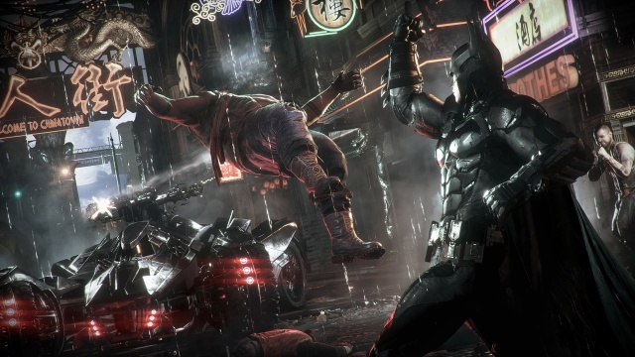
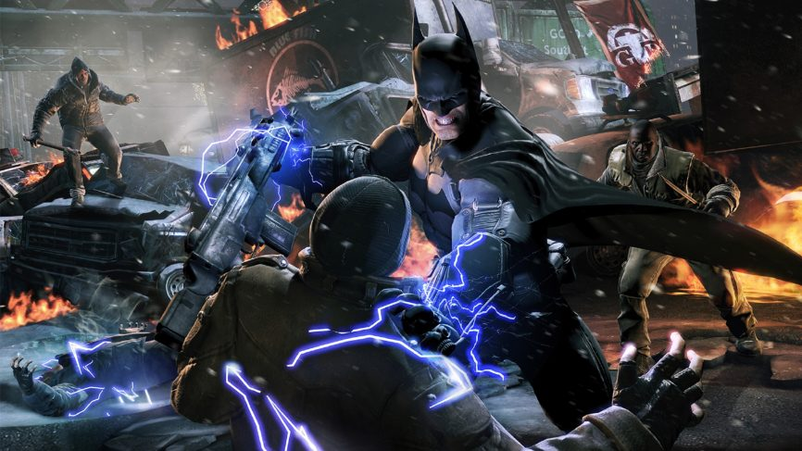
Game summary cont.
Bat mobile
Utility belt
Grappling
Gliding
Notes:
With the new ability to utilize the Bat mobile, Rocksteady incorporated a unique way of changing the game play.
This added boss battles with tanks. Being able to maneuver the batmobile out of the line of fire and shoot down anyone in your way.
This also includes the ability to shoot down people with rubber bullets.
The instillation of the bat mobile really darkened the storyline. Batman now shooting down people with heavy fire power certainly catered to the M rating it was branded.
Rocksteady also found interesting ways to make use of the bat mobile in side missions.
Along side the bat mobile we are introduced to a variety of tools and weapons that can be used to your advantage in combat or when investigating.
the most useful tool in the belt is the grapple gun.
You can use this to grab enemies that try to run, or grapple on to buildings to escape large gangs or glide in the air.
The best way to travel through Gotham is gliding.

Slide 6
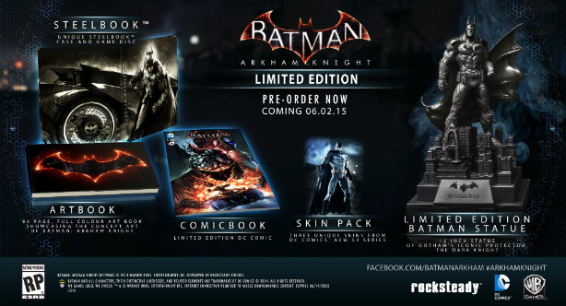
Game summary cont.
Manual
Installation
Sound and music
Artwork
Special features
Bugs
Notes:
The manual contains all information needed to aid you in the game.
Installation can be done using disk or online download through steam.
Sound effects in the game were very well implemented
Anything from clanking noises when crawling through vents to beating down criminals
All sound perfect.
Music was quite until playing missions and completing the main storyline.
Artwork is acquired throughout the game and can be viewed later on.
Special features include a season pass that gives access to new content that was released every month for 6 months.
The pc release of this game came with lots of bugs causing the game to be removed from steam and was patched up before being released again.
Some of these bugs included constant hitching and frame-rate drops
Though this problem only happened to devices with 8gb of ram or less.

Slide 7
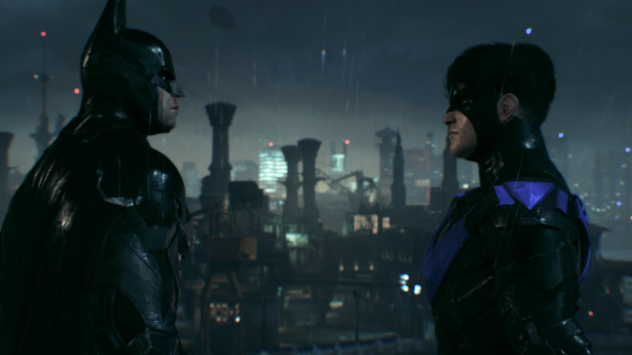
Game review
The good
Mechanics
User interface
Side missions
The bad
bat mobile
Notes:
the mechanics of the game are perfect
The hand to hand combat feels smooth and fast paced
Hitting an opponent gives you subtle feedback through the controller making you more apart of the game.
Grappling and gliding through Gotham is one of the most enjoyable parts of the game.
Even after completing hours of gameplay to finish the main storyline rocksteady created multiple side story's that you can play at anytime or finding them while playing in the open world.
These stories include more of batman's enemies.
These missions add more to the story and once complete you unlock the real ending to the game.
The worst part of the game is the excessive use of the bat mobile.
The bat mobile is fun to use when you want to. But rocksteady seamed to just overly force you to use the bat mobile to complete tedious tasks that could be done better by not using the batmobile at all.

Slide 8
Game review cont.
Does it compare to similar games in the same genre?
Why is it better?
What is the Audience?
Design mistakes?
Notes:
Most superhero games were never well built until rocksteady released the arkham series.
Arkham knight was the best game in the series.
There are other companies building similar games in that genre, like spider-man for the ps4.
Spider-man's mechanics are close to arkham knights, however arkham knight does a better job with drawing the player into the open world of Gotham and its story.
This game is for people who enjoy a good story and want to experience the finale of the arkham series.
Anyone who enjoys action games with engaging hand to hand combat, driving, and shooting.
This game is more on the dark side and probably shouldn't be played by children, since there are very detailed scenes and foul language used in the game.
There are no design mistakes present.

Slide 9
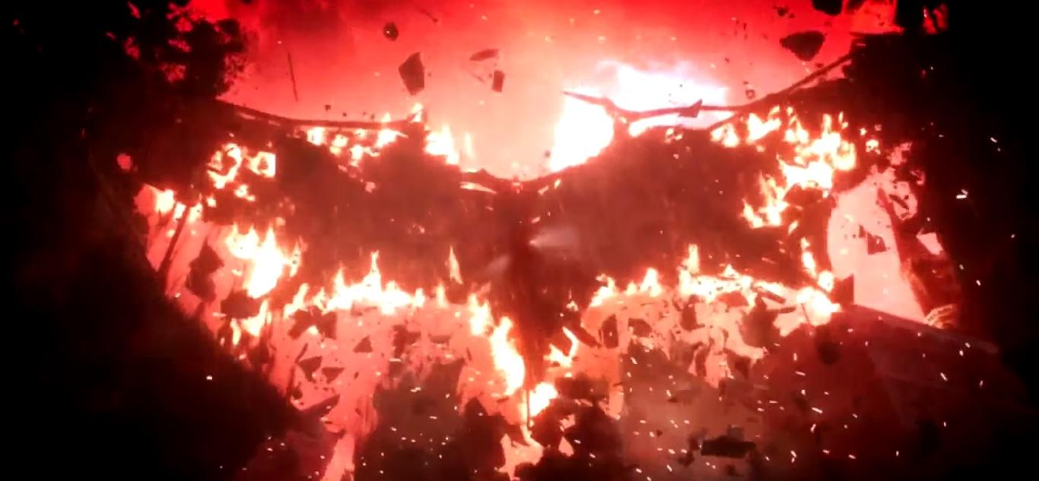
summary
Strengths?
Weaknesses?
Improvements?
Worth it?
Notes:
The games strong points are its story and game play
The only weakness is the over use of the bat mobile
It could be improved by making the bat mobile less required in missions.
This game is definitely worth the money
And the time you spend exploring gotham and watching the plot of the story unfold for what is a great ending to the series.

