Slide 1
osu! Game Review
Thomas Opolski
https://www.youtube.com/watch?v=YKaU9KkahgU&feature=youtu.be

Slide 2
Basic Information
osu! is a free-to-play, open source rhythm game created by Dean Herbert (also known as peppy) on September 16, 2007. Inspiration was taken from Elite Beat Agents on the Nintendo DS.
osu! will run on just about any hardware, as long as you have a graphics card. However, a solid up to date graphics card is required for good performance.
The main website is: https://osu.ppy.sh/

Slide 3
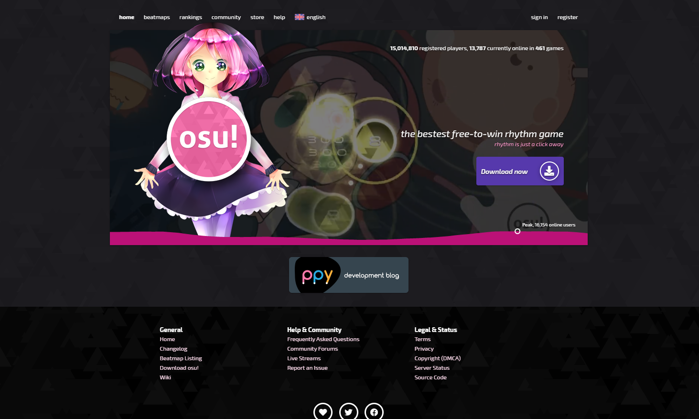
Installation
To install osu!, simply go to the website at https://osu.ppy.sh/, and click the download osu! button located to the right of the screen.
You will be taken to the downloads and can install the setup file from there. Then just follow instructions to get started.

Slide 4
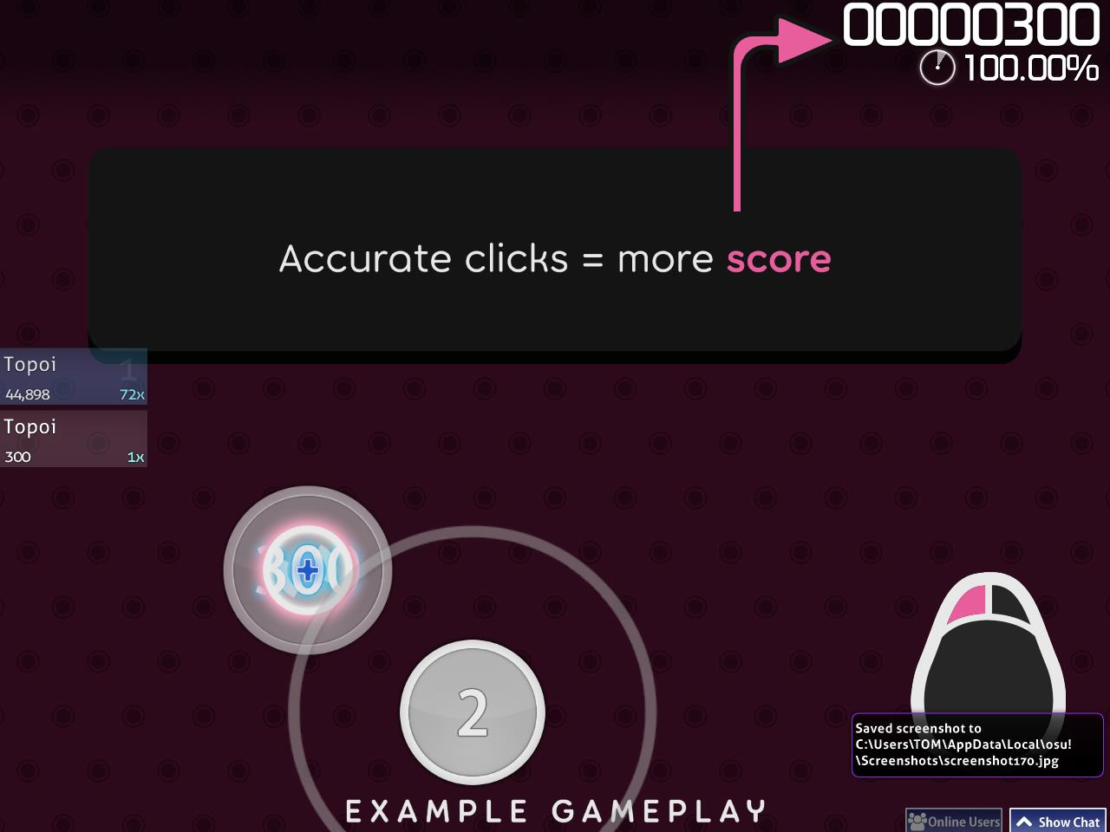
Game Summary
There are 4 game modes to choose from, osu! Standard, taiko, mania, and catch the beat (I will cover osu! standard)
In all essence, osu! is your most basic of basic games. You simply aim your cursor, click circles to the rhythm of songs and score points.

Slide 5
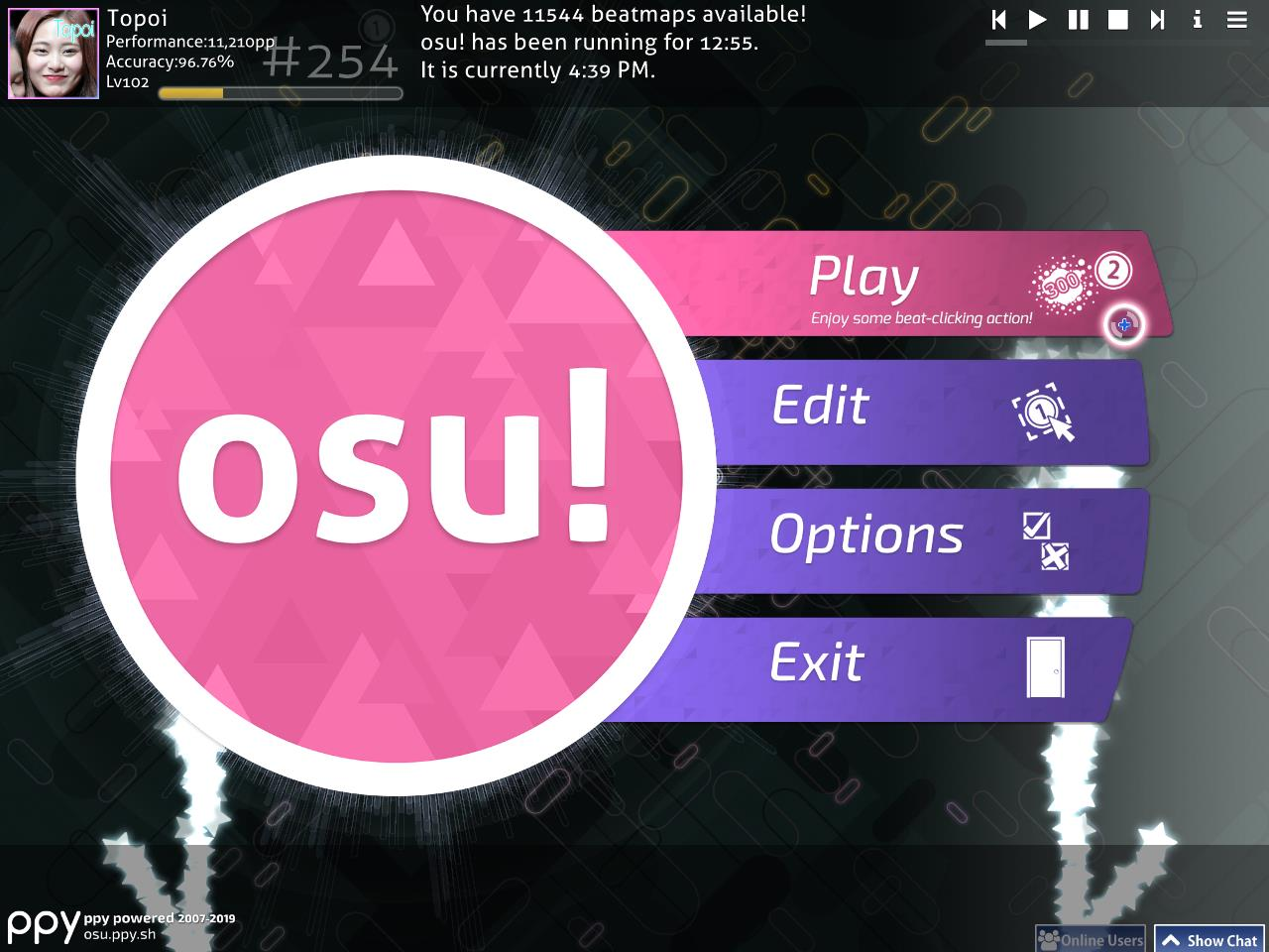
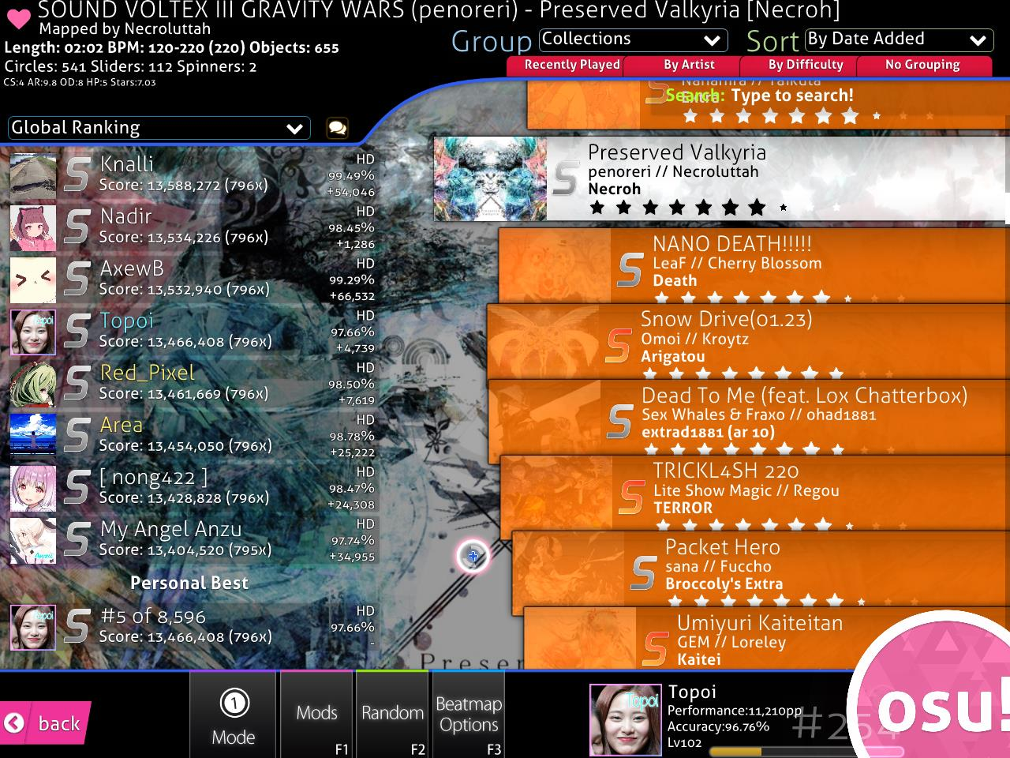
User Interface
The user interface is pretty basic as well, with options such as play, edit, options, and exit.
Once in the play menus, there will be a list of playable maps that you currently have downloaded.
While it may looks slightly intimidating at first, the levels are simply listed and you can click on any one to start it.

Slide 6
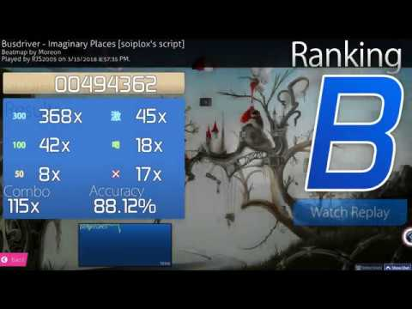
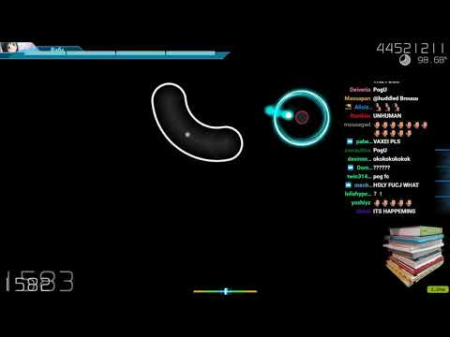
Gameplay
Beginner
Professional

Slide 7
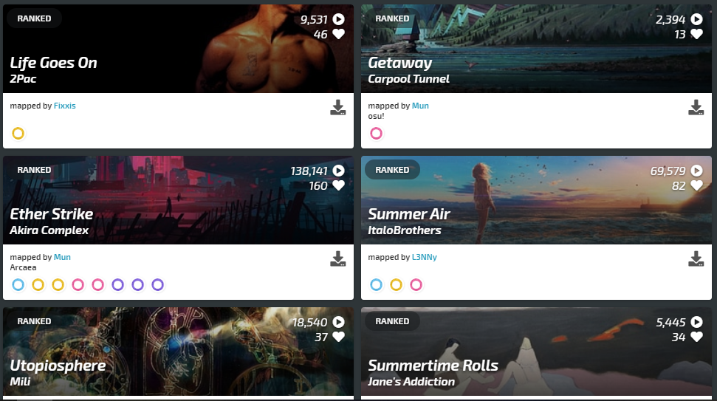
Music and more...
Almost all of osu!’s maps are user uploaded, and uses music not specifically licensed to osu!. This is where it falls into a legal grey area to fair use, as the content is not being used for monetary or illegal usage purposely, but still uploads songs to use from users that don’t own the music.
The same with images, users simply use others artwork generally and don’t own it, but are only using it to share their work.

Slide 8
Good and Bad of osu!
Pros: Simple, easy to learn, lots of competition with leaderboards and scoring. Many active players (10,000+ daily and concurrently) and a large community. Hundreds of thousands of ‘beatmaps’ to play. Completely free!
Cons: Too simple, repetitive, possible copyright issues, a lot of anime, too difficult, small team.

Slide 9
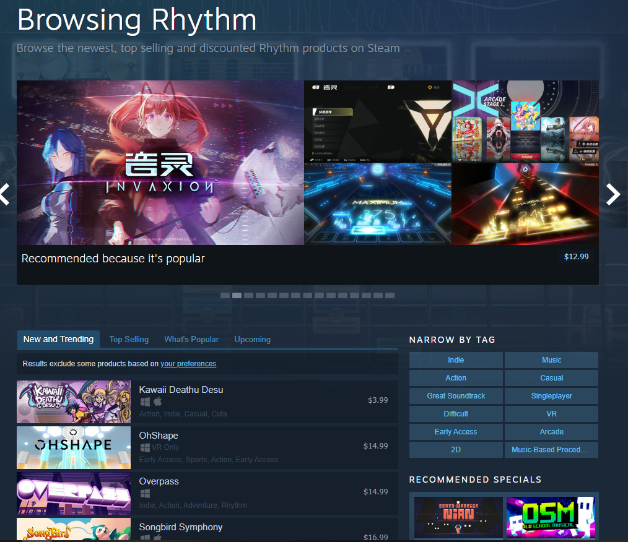
osu! and Rhythm games
When comparing the two; osu! isn’t too similar to most other rhythm games.
osu!: Multiplayer, online leaderboards, ranking system, user content.
Most rhythm games: licensed music, only music based gameplay, single-player paid.

Slide 10
Design and Audience
Because of the customizability and simplicity, there are not many visible design flaws. There are a few bugs here and there, but otherwise, osu! is a simple concept and well executed through the design of the game.
As for audience, the game has many players ranging anywhere from young (10) to old (40). While most of the best players are younger, there is still a lot of room for enjoyment if you are older.

Slide 11
Summary
Strengths: Simple, free, community-driven, and a global performance rating.
Weaknesses: Over-simplified, repetitive, and possible copyright infringements.
In my opinion, osu! is well on its way to becoming better and improving over time, however, as the development team is smaller, it takes a lot of time. It is also open-source so many people are starting to develop their own game modes as osu! opens its code to a public audience.

