Slide 1
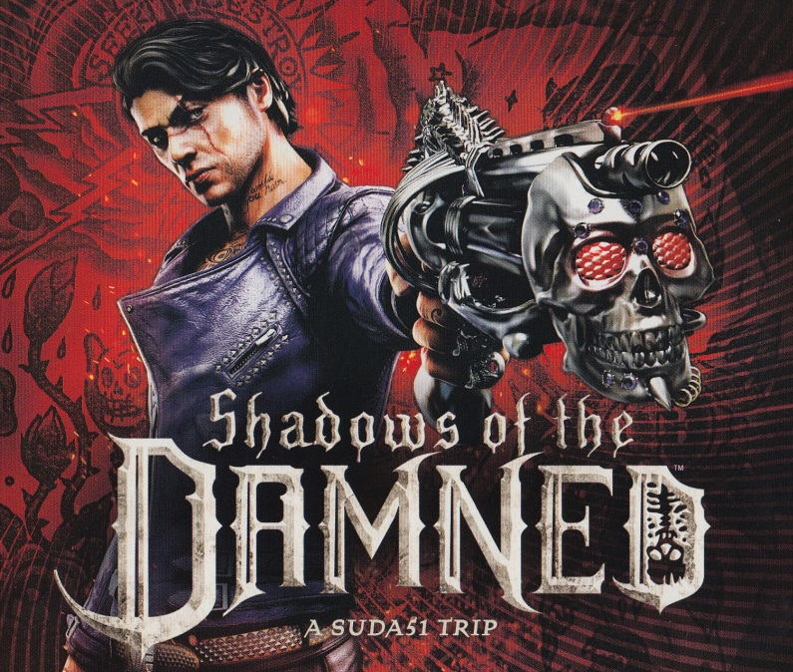

Slide 2
Basic Information
Title: Shadows of the Damned
Developed by Grasshopper Manufacture
Published by Electronic Arts
Directed by Massimo Guarini
Produced by Shinji Mikami and Steven Matulac
Written by Massimo Guarini, Goichi Suda (AKA Suda51), and Brian Gray
Genre: Third-Person Shooter
Price: $59.99 MSRP Upon Release ($10 to $20 Now)
Hardware Required: Xbox 360, Xbox One (Through Backwards Compatibility), or PS3

Slide 3
Game Summary
Story Line: A demon hunter named Garcia Hotspur returns to his apartment after a successful hunt to find that his girlfriend, Paula, has been abducted by Fleming, the Lord of Demons, and taken to the Underworld. Garcia chases and traverses the various layers of the Underworld in the hopes of rescuing Paula.
Player’s Role: The Player takes control of Garcia from a third-person perspective.

Slide 4
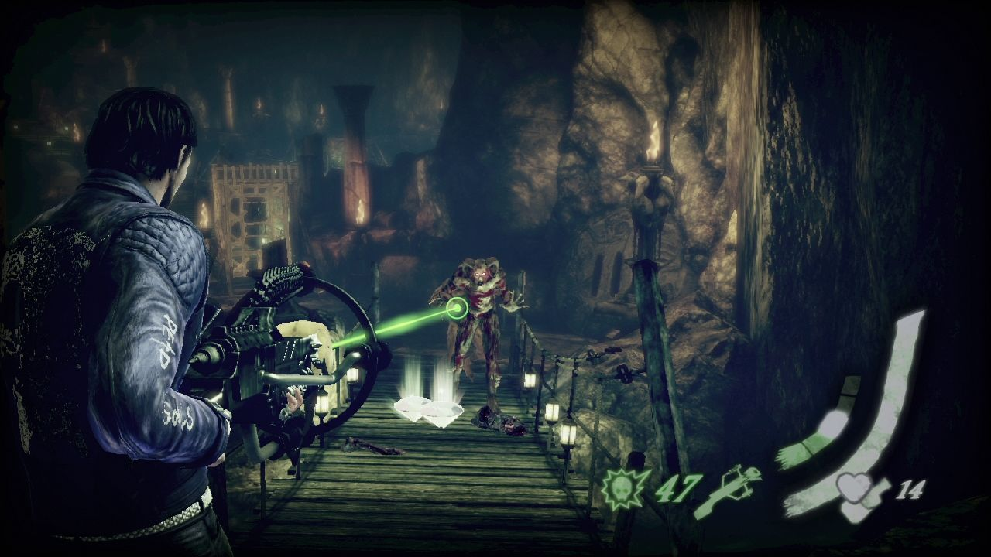
Game Summary (cont)
User Interface

Slide 5
Game Summary (cont)
Gameplay: The game consists of two different types of levels. There are the more common third-person shooter levels where you progress through the fighting demons with your fellow demon companion Johnson. He acts as your torch as well as your firepower. He can turn into a pistol, shotgun, or machine gun. You’ll also be solving puzzles with Johnson’s Light Shot. In certain situations you will be shrouded in darkness which will slowly drain your light meter. You must find a way to return light to the area by solving various puzzles and eventually lighting goat heads which act as light sources. In the 2D levels, you progress through the levels just by eliminating all the enemies as you go along and eventually the boss at the end.

Slide 6
Game summary (cont)
Scoring: The game doesn’t have any sort of conventional scoring system, but it does rewards you with gems when you defeat enemies. You can then use these gems to upgrade either the effectiveness of your weapons or other things like your health or your stamina. When you defeat bosses, you receive a special blue gem that unlocks a new ability for one of your weapons.

Slide 7
Game Summary (cont)
Sound and Music: The soundtrack in the game was composed by Akira Yamaoka, known for his masterful work as composer for the Silent Hill franchise. Every song utilizes a ton of weird noises creating a bizarre and quirky feel that perfectly fits the tone of the game. The main theme for the game also features vocals from popular voice actor Troy Baker and Mary Elizabeth McGlynn who has provided vocals for Yamaoka’s Silent Hill work.
Bugs: Occasional small bugs like the gun disappearing from Garcia’s hands. There are a few bugs that can impede progress in the game such as one that allows you to walk to a platform that has no pathway to it. If you do this, you cannot progress in the level, but if you reset to the nearest checkpoint, it will be fixed.

Slide 8
Game Review
Pros: The shooting is very satisfying and has a good weight to it. The game consistently introduces new mechanics so it never feels too repetitive. The amazing soundtrack and voice acting keeps you immersed in the bizarre demon world the game creates.
Cons: The game is quite short and doesn’t include any sort of “New Game Plus” mode. Some of the gameplay mechanics that are introduced can be quite annoying specifically the chase sequences. Several points in the game require you to run away from an enemy that will instantly kill you if it reaches you. These can cause a lot of annoying and cheap deaths. There is also a slight lack of enemy variety.

Slide 9
Game Review (cont)
While its lower budget can show through at times, it is mostly able to keep up with similar games of the genre. The shooting doesn’t always feel as responsive as games like Resident Evil 4 for example. However, its quirky sense of humor and style stands out far more than any of its peers.
The appropriate audience for this game is fans of games like Resident Evil 4, fans of Suda51’s previous works and fans of crude and absurd humor.
Design Flaws: No inclusion of a New Game Plus makes it very difficult to acquire all of the upgrades and significantly hurts its replayability

Slide 10
Summary
Strengths
Gameplay Variety
Soundtrack & Voice Acting
Satisfying Shooting Mechanics
Weaknesses
Short Length
Lack of Replayability
Some Annoying Gameplay Mechanics
I would highly recommend this game. It’s incredibly underrated and is something incredibly unique in an industry flooded with sequels, remakes, and reboots.
If the annoying chase sequences were removed and a New Game Plus mode was added for better replay value, this game would be even better.

