Slide 1
CIS 487 GAME REVIEW
By Hassan Harajly

Slide 2
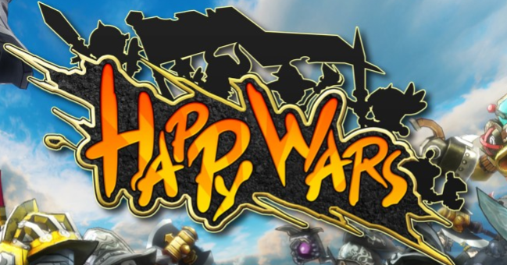
A comical multiplayer action game developed by Toylogic Inc.
Developed for the Xbox One/Xbox 360 platform.

Slide 3
System Requirements
The game is only playable on Xbox one or Xbox 360
Xbox360(minimum required hardware)
Custom ATI Graphics Processor
500 MHz processor
10MB of embedded DRAM
48-way parallel floating-point dynamically scheduled shader pipelines
Custom IBM Power PC-Based CPU
Three symmetrical cores running at 3.2 GHz each
Two hardware threads per core, six hardware threads total
VMX-128 vector unit per core, three total
128 VMX-128 registers per hardware thread
1MB L2 cache

Slide 4
Price
Game is free but requires a xbox live membership $9.99/month to play
Xbox live membership includes
Multiplayer Gaming
Get 2-4 free games to play every month
Save up to 50-75% store discounts on Xbox One Games.

Slide 5
Game description
The Multiplayer mode puts the user into one of 2 teams of upto 15 players that battle each other in order to destroy the enemies castle.
The players can choose from three classes: warrior, mage, and cleric.
Each class has its unique ability and and as the player levels up through killing enemies, the player gets more abilities.

Slide 6
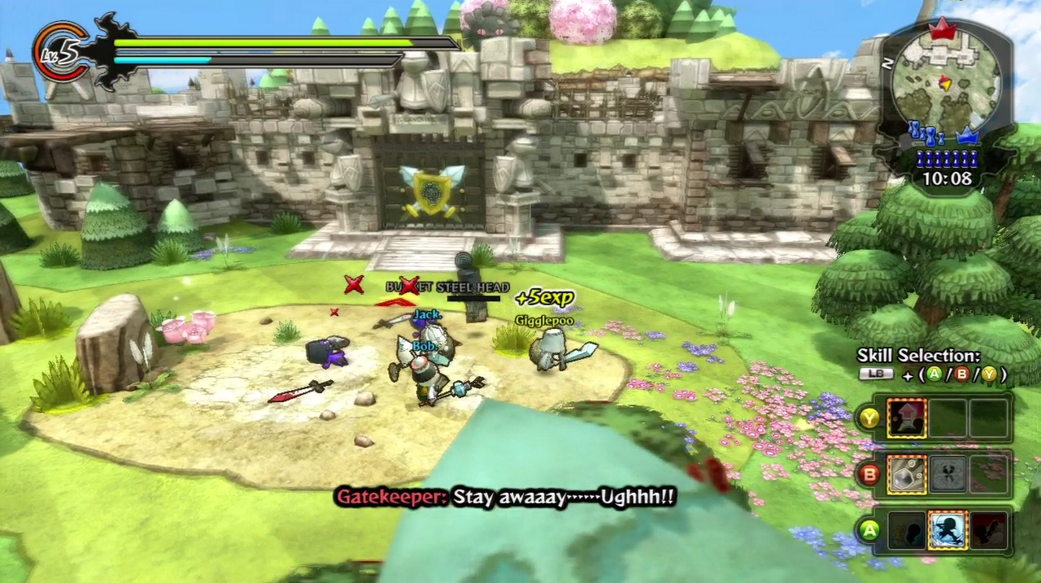
User Interface
Bottom Right menu shows the user which abilities are ready to be used or are on cool down.
Top left corner shows health left and mana left
Navigation Menu in top right corner

Slide 7
Gameplay
Player moves their character with the joy sticks on xbox remote
Use a,b,y buttons on xbox remote to launch abilitys against enemies to damage them.
You can also use abilities on structures such as turrets and castle doors to deal damage to the structure.
When a player dies they respawn at the designated spawn point.
When the players break down the castle the enemy players stop respawning
While players advance throughout the map they may build towers that deal damage to enemy players.
These towers can be destroyed by enemies
The objective is won when the enemies castle is destroyed.

Slide 8
Game Play Problems
When match making the game doesn’t wait for the teams to be filled with real players, after a certain amount of time in a lobby the game fills the teams with AI players that replace real players due to a low player base.
The game favors veteran players over new players due to the ability to buy weapons based on points gained during gameplay.

Slide 9
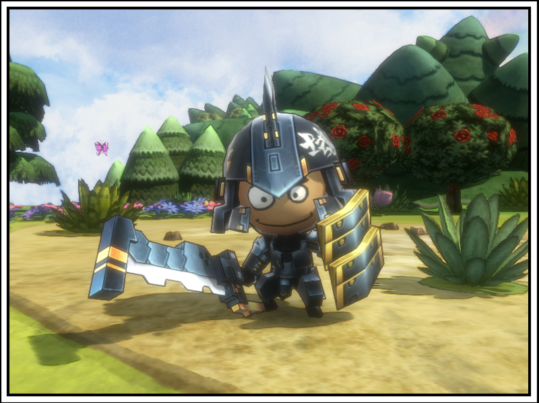
Art Work
Comical art work
The game developers have a design contest sometimes where players design new items and characters.

Slide 10
Music
Music is developed by Toy logic Inc.
Has many different sound tracks based on map and if you’re in the main menu.
https://www.youtube.com/watch?v=ugnm_thR-ts

Slide 11
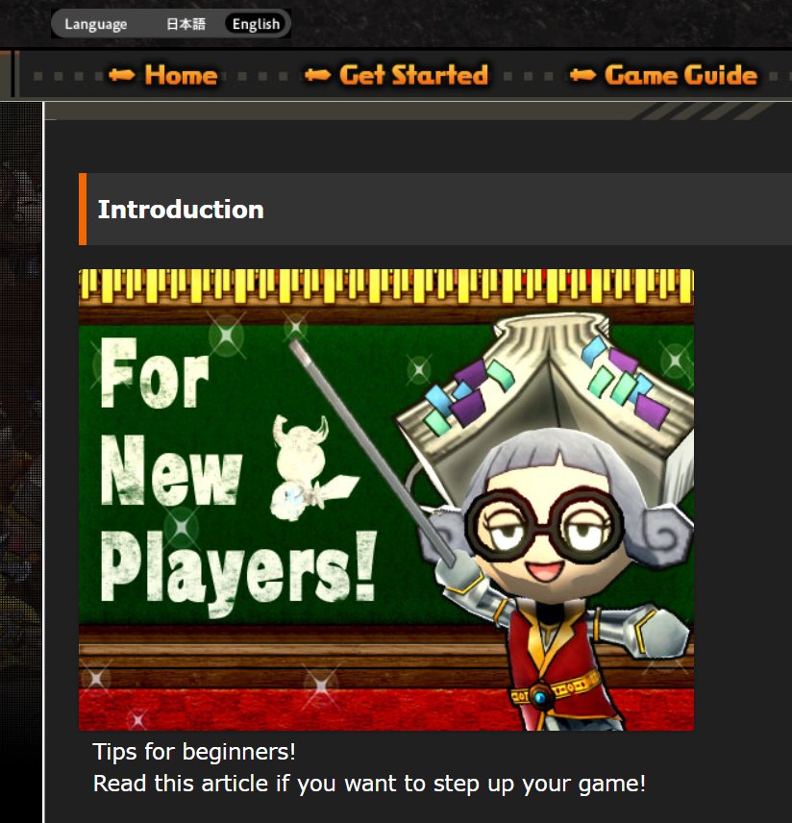
Manual
Website contains an online tutorial
https://www.happywars.net/en/beginners_guide

Slide 12
Special Features
When Player is idle during gameplay the character begins dancing until the player begins playing again

Slide 13
Bugs
Match making server occasionally disconnects making gameplay frustrating.
rarely enemy hits aren’t registered.

Slide 14
Game Review
The reason this game is fun is the freedom of the gameplay, for example some abilities can knock an enemy character across the map. Not many limiting factors like walls.
The game isn’t fun when the lobby is filled with AI bots because they aren’t as intelligent and difficult like normal players.
It doesn’t compare well to other games in its genre.
The connection issues coupled with the AI bots can ruin a game easily. Where most successful online games don’t usually have connection problems, and a low player base.

Slide 15
Game Review continued
The appropriate audience is the average teenage kid and beyond.
There is a flaw in the game where an attack on enemies doesn’t register sometimes.

Slide 16
Summary
The game is worth downloading if you have a existing Xbox live membership since its free with it.
The game can be improved by ramping up marketing for the game and increasing the player base, and fixing the various weaknesses.
Weaknesses
Poor connectivity.
Low player base.
Lack of balance in gameplay due to veteran players holding an advantage over new players.
Strengths:
Fun when working correctly.
Immersive multiplayer gameplay.
Great graphics and sound tracks.

