Slide 1
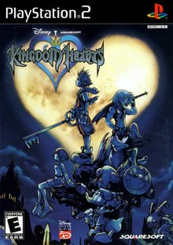
Kingdom hearts
Maxx Achtman

Slide 2
Basic information
Kingdom Hearts
Made by Square Enix and directed by Tetsuya Nomura
RPG
$8 as of today according to sources
294 Mhz processor, 32 MB Ram, GPU clocked at 147 Mhz, 4MB video RAM
PlayStation 2

Slide 3
Overview / Story Line / Player role
A boy on an island whose world gets engulfed by darkness. Need to save the worlds
Adventure to Disney worlds

Slide 4
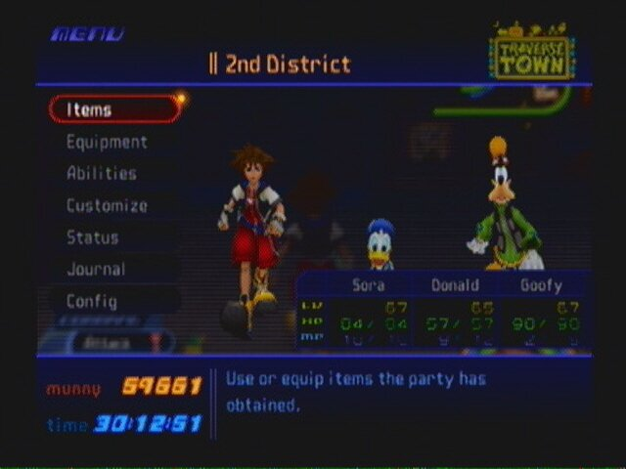
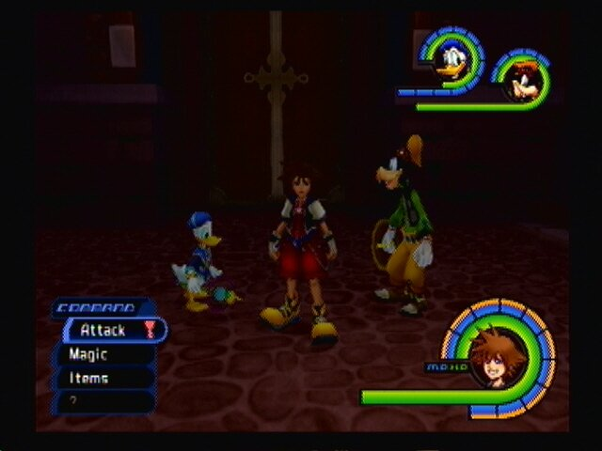
Installation / User Interface
Disc ran on the PlayStation 2
HUD that shows magic and health
Menu options for equipment, items, controller changes, etc.

Slide 5
Game Play / Scoring / artwork / Sound and music / special features / manual / bugs
Platforming mixed with RPG open world fighting
“Scoring” is leveling up
Cartoon / animated design.
Orchestral soundtrack that sets the mood in the game
N/A
Attached in the case of the game
Not found while playing the game

Slide 6
Game Review
The story is incredible
Characters are memorable
Camera controls are awful
Some dialog comes off as very cheesy
It is different in terms of RPGs at the time
Better because it puts two different entities that never thought possible of blending

Slide 7
Game review (CONT.)
All ages can enjoy the game
Lip dub to the American audience is relevant
Voice movements in general with less rendered characters are more obvious

Slide 8
Summary
Good gameplay
Compelling story
Memorable characters
Camera controls are bad
Cheezy commentary at times

Slide 9
Summary (Cont.)
Game is still worth purchasing today
Have more enemy types
More bosses
Take itself more serious

