Slide 1
Hot shots tennis
By: ian simon

Slide 2
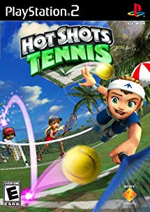
Game information
Developed by Clap Hanz, published by Sony
Action/sports designed for kids
Developed for PS2, brought back for PS4
Currently $10 on PSN store

Slide 3
Hot shots tennis overview
Cartoon graphics with an engine that has stood the test of time
Multiple modes including challenge mode to unlock collectables, fun time tennis to play AI and locally, and a practice mode to hone in on becoming more accurate
User interface is easily navigable, colorful, and useful
Allows for varying length of tennis games from one to five sets and one to seven games (to win)
Easy to pick up and play for first timers, hard to become good enough to beat many of the high levelled AI’s

Slide 4
Hot shots tennis overview
No story to the game, just defeating all the characters in game allows for more challenging opponents
Each character has skill in one place and weak in another. Some are good servers, some are fast, but they each come at a cost
Bugs
In training mode, if a player hits a corner of a target, the target may not register
If a swing is a bit late/early, the animation will swing as if they were missing when the ball was clearly hittable (very rare)

Slide 5
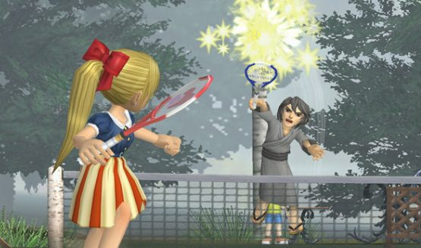
gameplay
Either singles or doubles events allowed
Accurate rule sets for real tennis feeling
Four shot types: front-hand, back-hand, lob, and smash
Story mode has no real story behind it, the player must defeat every unlockable character in the game, each with their advantages
Catchy menu music with eclectic sounds during gameplay

Slide 6
Good aspects of hot shots tennis
Game engine is consistent
Very minimal bugs, smooth gameplay, consistent shooting and movement
Low skill floor, high skill ceiling
This game is very easy to learn, minimal controls and straightforward gameplay
The difficulty increases greatly once the player finishes the first round of opponents
Highly re-playable
Even after 10 years, I can still have a fun time playing this
Cartoon graphics, real representation of tennis
There have been many tennis games on the market, but this one finds a perfect balance of being a real tennis simulation and being an arcade style game

Slide 7
Bad Aspects of hot shots tennis
Re-playable, but stale content
The content of the game is strictly to playing tennis against harder and harder opponents, there’s no story to grab your attention
Some characters are inherently stronger than others
The final characters you unlock are much stronger than the first characters, in some cases these characters will just be overpowered against others
Collectables are useless
Once you unlock every character, the only other things to unlock are new outfits for these characters, with no in-game benefit other than cosmetic

Slide 8
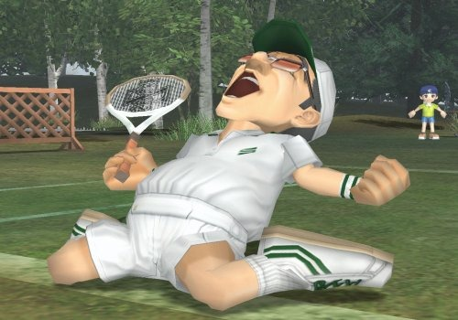
Review Topics
A well-built tennis simulator
This game is one of the highest rated tennis games on the market still. It doesn’t take itself too seriously, while still having core mechanics to tennis gameplay
A kids game?
This game was clearly intended for a more childish and playful side of tennis. Although, there is enough of a skill ceiling that allows for more experienced gamers to play
Design mistakes
Other than feeling clunky as some points, the gameplay is very smooth and easy to figure out

Slide 9
Strengths and Weaknesses
Strengths
Re-playable
Game engine is smooth and consistent
Colorful
Easy to pick up
Hard to master the controls
Aged beautifully
Weaknesses
Feels childish at points
Stale content
Training mode is frustrating
Overpowered characters

Slide 10
Conclusion
I enjoyed this game a lot during my childhood and the same feelings stayed with me when I picked it up again this year
The game is well worth $10 in the PSN store
The game could be improved by adding another dynamic to the challenge mode. Maybe have the player play a single character looking to be the best tennis player in the world. There is no coherent story to grab the player
4.2 / 5

