Slide 1
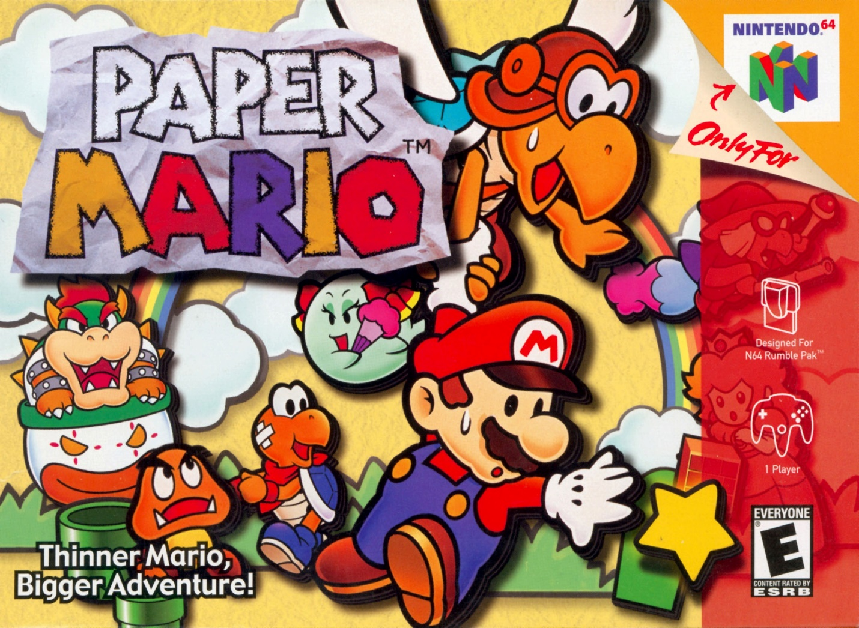
Paper Mario
Game Evaluation by Chris Schram

Slide 2
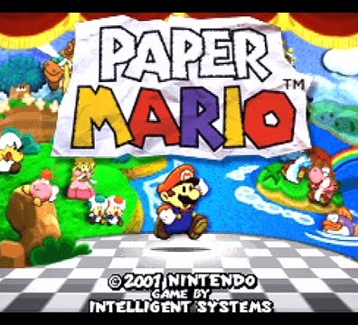
Basic Information
Produced by Nintendo, made by Intelligent Systems.
Single player 3D RPG
Price $49.99 upon release Today Loose - $36.59, Complete - $92.83 https://www.pricecharting.com/game/nintendo-64/paper-mario
Requires: Nintendo 64 and a TV that still takes RCA cables.

Slide 3
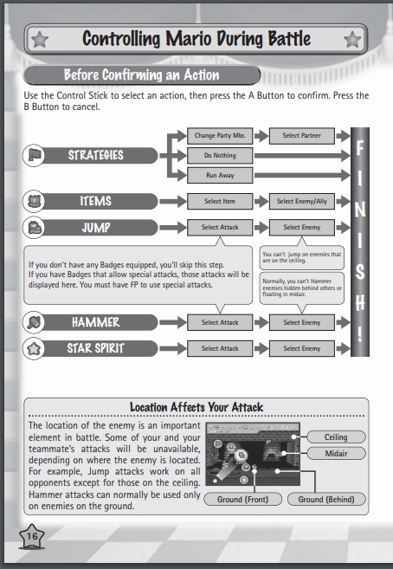
Game Summary
Overview-
3D world exploring turn based RPG
Player can level up, gain partners, and abilities.
Story-
Save the seven star spirits, stop Bowser, save Princess Peach.
Player’s Role: explore each world linearly, overcome enemies and puzzles to save each star spirit from some greater enemy.
Installation: Load cartridge into N64 and play.
Scoring: Complete the game, perhaps faster or 100%
Game Play: (See Manual ->)
Bugs: only affects text and models

Slide 4
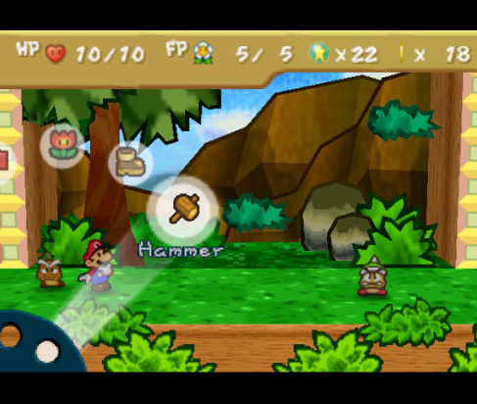
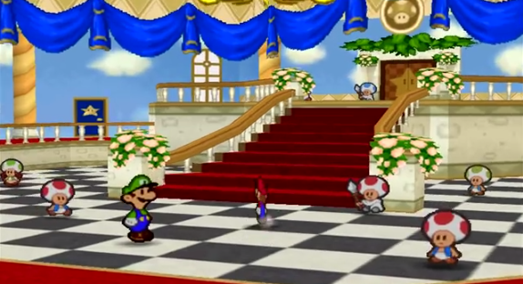
Game Summary (continued)
Artwork: Paper, pop-up, theater
Sound and Music: Matches the world that you’re in, intense for bosses.
User Interface: (see top left)
Special features: enemies need to be defeated differently, partners and abilities can be used in and out of combat, leveling up HP or FP or BP

Slide 5
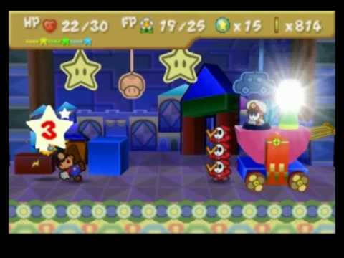
Game Review – The Good
Combat is fun! Simple but can be logical.
Action Commands, strategy
Game allows many playstyles
Leveling up, items, badges, partners
Game is forgiving
Fun out of combat
Minimal story, humorous characters, dungeon-like puzzles, combat outside of combat
Unique bosses – Ex. Tubba Blubba →
Good pacing

Slide 6
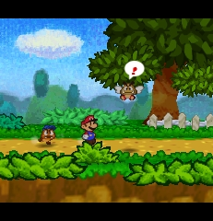
Game Review – The Bad
Repetition in combat
An unrewarding grind
Backtracking
Long time to reach actual combat

Slide 7
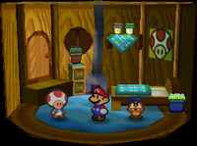
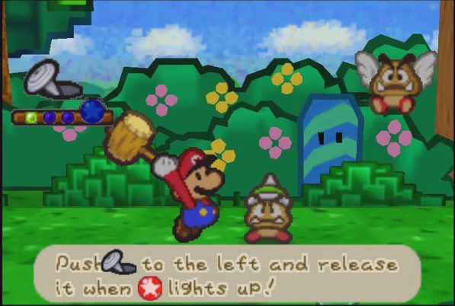
How does the game compare to similar games in this genre?
This game is better than similar games thanks to:
The unique combat, well paced minimal story, and the games accessibility.
This game is meant for people who don’t want an overbearing story, and want a softcore RPG.
Design flaws: possibly too easy or repetitive

Slide 8
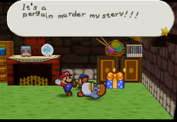
Summary
Strengths: Unique combat, interactive environment in and out of combat, unique enemies, important bosses, easily accessible, play styles.
Weaknesses: Grind, unrewarding leveling if the player is strategic and reflexive.
Worth buying? Highly recommended! This game includes at least a nice spin on combat for RPG fans.
Could it be improved? Yes, new game+ would be best.

Slide 9
Image Sources
https://myboxeduniverse.files.wordpress.com/2015/11/papermario-2.jpg?w=549
https://i.ytimg.com/vi/Y8kryi8EOEI/hqdefault.jpg
https://www.kinephanos.ca/wp-content/files/Fig-3-Paper-Mario-N64.png
https://edgeemu.net/screenshots/n64/Named_Snaps/Paper%20Mario%20(USA).png
https://cdn02.nintendo-europe.com/media/downloads/games_8/emanuals/nintendo_8/Manual_Nintendo64_PaperMario_EN.pdf
https://www.lukiegames.com/assets/images/N64/n64_paper_mario_p_kbu98s.jpg
https://vignette.wikia.nocookie.net/papermario/images/8/86/PMTubbaBlubba.png/revision/latest?cb=20180127233637
https://vignette.wikia.nocookie.net/papermario/images/0/04/Tubba_Blubba_Heart.jpeg/revision/latest?cb=20111115173356
https://i.ytimg.com/vi/cDduSnKZ4sA/hqdefault.jpg
https://www.mariowiki.com/images/thumb/d/d1/Penguin_murder.png/250px-Penguin_murder.png
https://www.mariowiki.com/images/thumb/2/2e/ToadHouseGoombaVillage.png/200px-ToadHouseGoombaVillage.png
http://4.bp.blogspot.com/-LCEKKk8RXas/UNKHYM_DZhI/AAAAAAAAAiY/uOK-wvWOZI0/s1600/Paper+Mario+Action+Command.png

