Slide 1
Allison Ramasami

Slide 2
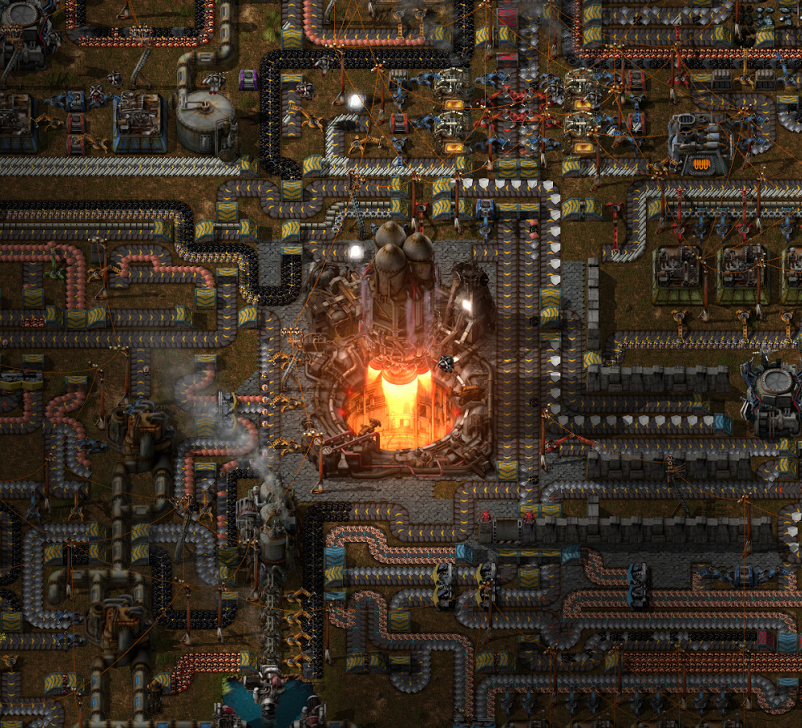
Overview
Game Name: Factorio
Author: Wube Software
Genre: Building, Sandbox
Price: $30
Minimum Software Requirements:
64-bit operating system
4GB RAM
512MB dedicated video memory
Dual core 3GHz+ processor
1280x720 screen resolution
1GB of disk space

Slide 3
Setup
Having crash-landed on an unknown planet, you have to start from scratch and somehow launch a rocket to get back home. To do this, you need to build a factory and produce all the items you need to build a rocket. As your factory grows, however, your pollution cloud spreads, angering the natives of the planet and causing them to attack your factory.

Slide 4
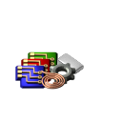
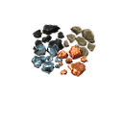
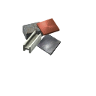
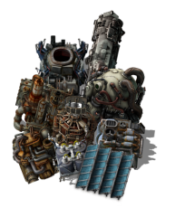
Main Gameplay Loop
Mine Ores
Smelt Ores
Make
Intermediates
Make Science & Do Research
Expand!
Unlock New Things

Slide 5
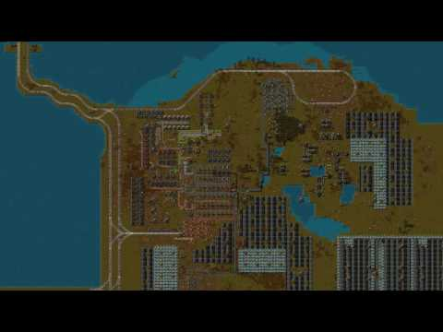
Gameplay

Slide 6
Review
The appropriate audience for this game is everyone, although kids might have trouble wrapping their head around everything. The game is quite good:
There is always something to be doing when you play. This can lead to really long and interesting gaming sessions, to the point where losing track of time and becoming addicted to the game is very common. There are a variety of reasons for this.
You unlock new things to manufacture and play with much faster than you can set those things up, leading to a constant backlog of things you want to do but haven’t gotten around to building yet.

Slide 7
Review
Trying to build one thing may lead you to realize you don’t have enough of another thing to build it, which doesn’t have enough of this, so you need to build this, and so on. It can lead to a game of “chase the bottleneck for 3 hours” because there are so many things that need to be improved. A common example of this is blue circuit production needing absurd amounts of green circuits, leading to a “how do I expand green circuits for blue circuits?” situation.
There are many levels on which you can optimize factories: there are the setups of individual item production (getting correct ratios, how do I get enough belts/inserters into and out of the machine), overall structure of your factory (how many of this item do I need in the first place, will I use a main bus/train network/logistics network), power setups (steam power, solar/accumulator ratios, nuclear builds), defenses (gun/flamer/laser turrets?, wall thickness/shape, logistic networks for automatic repairs), leading to a lot of time you can spend just planning out one aspect of the factory, further extending your playtime.

Slide 8
Review
The game has a really good dynamic difficulty curve: as you progress further down the tech tree and get closer to unlocking the rocket, the recipes get more complicated and resource intensive, requiring the player to organize their factory better and improve their infrastructure further.
The game has full modding support, making it very easy to make or install mods. There are already various mods that make the base game much harder than usual (Angel’s, Bob’s, Pyanodon’s mods), add content that wasn’t present before (airplanes, cargo ships, automatic research of technologies), or just make the game easier to play. Even when the base game becomes boring, there is still a wealth of content to explore through mods.

Slide 9
Review
There is no other game really like Factorio out on the market: the inspiration came from heavily modded Minecraft, which is a less refined and focused experience than Factorio is. It’s really defining a genre of “automation games.”
The game has virtually no bugs, and is very well optimized due to the hard work of the developers.

Slide 10
Review
Most of the issues arise in very large factories called “megabases,” built to produce as much science as possible after the rocket has been launched, usually pushing the game to its limit in the process.
Fluid mechanics are very unintuitive and hard to work with at the moment: factories will randomly not receive enough fluid due to the order in which the factories are placed, and fluid flow itself is controlled by a quantity called fluid pressure that is not explained and is incredibly hard to understand. These issues multiply when working with large quantities of fluids.
People tend to build megabases with bots instead of belts. While belts offer more interesting design decisions, bots are much easier to use, have higher throughput, and lag the game less.

Slide 11
Review
At the moment, the only thing you can do after launching the rocket is infinite research: there is no post-game content other than trying to make a megabase.
When building very large bases, one needs lots of modules, which are the most expensive items in the game and produce extremely slowly. This can lead to a lot of waiting around on modules to produce so you can build the next part of your base.
In the end though, these issues only really arise for those who are trying to build very big, which is a small percentage of the playerbase. Otherwise, the game has no serious flaws, only minor issues that the devs are actively working to fix.

Slide 12
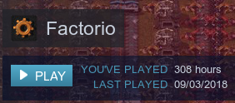
Overall
Buy this game! The game can be improved by fixing some of the issues I’ve listed, but the devs have considered/are working on all the issues I’ve listed.

