Slide 1
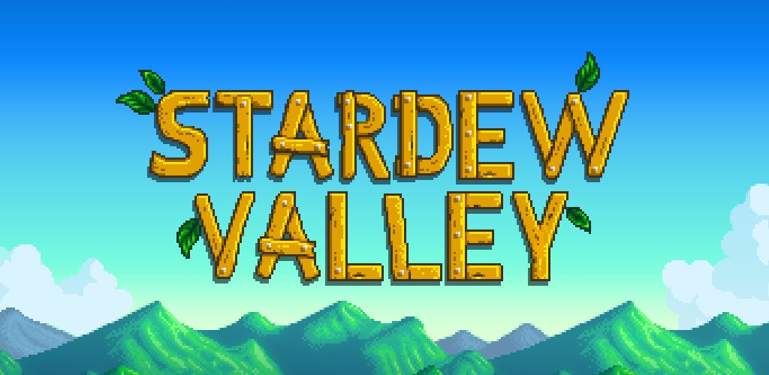
Justin Paul - CIS 487

Slide 2
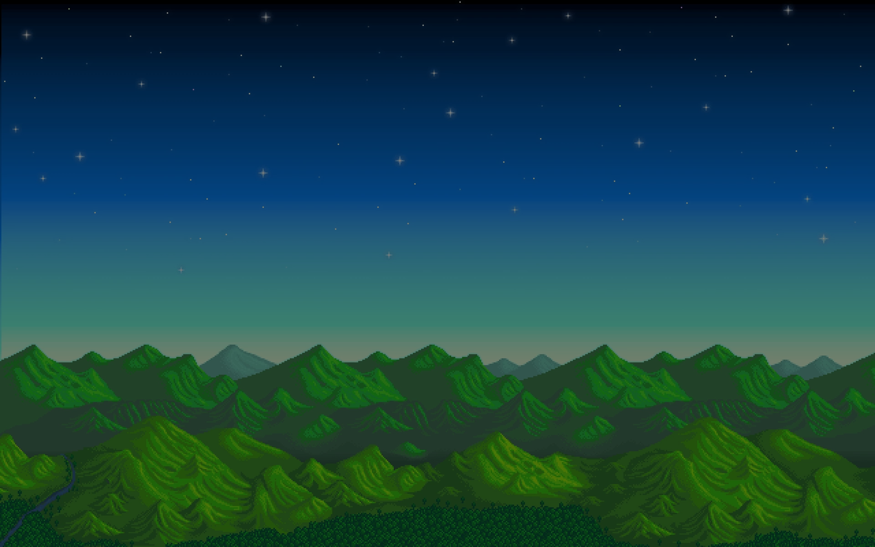
Before we start...
Copyright Disclaimer Under Section 107 of the Copyright Act 1976, allowance is made for "fair use" for purposes such as criticism, comment, news reporting, teaching, scholarship, and research. Fair use is a use permitted by copyright statute that might otherwise be infringing. Non-profit, educational or personal use tips the balance in favor of fair use.
All images are credited to Eric Barone, the sole developer/creator of Stardew Valley, and publisher Chucklefish LTD.

Slide 3
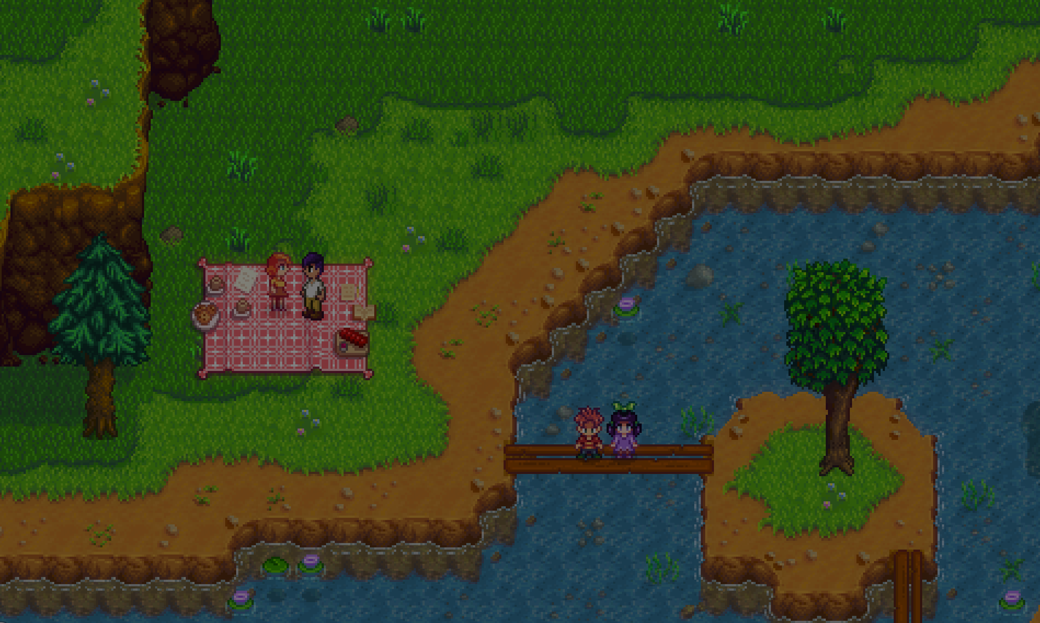
Basic Information
Author: Eric Barone.
Genre: Farming/Simulation/Indie
Price: $14.99
Available on: PC, Mac, Linux, Xbox One, Playstation 4, Playstation Vita, and Nintendo Switch.
Very low requirements for PC, Mac, and Linux.

Slide 4
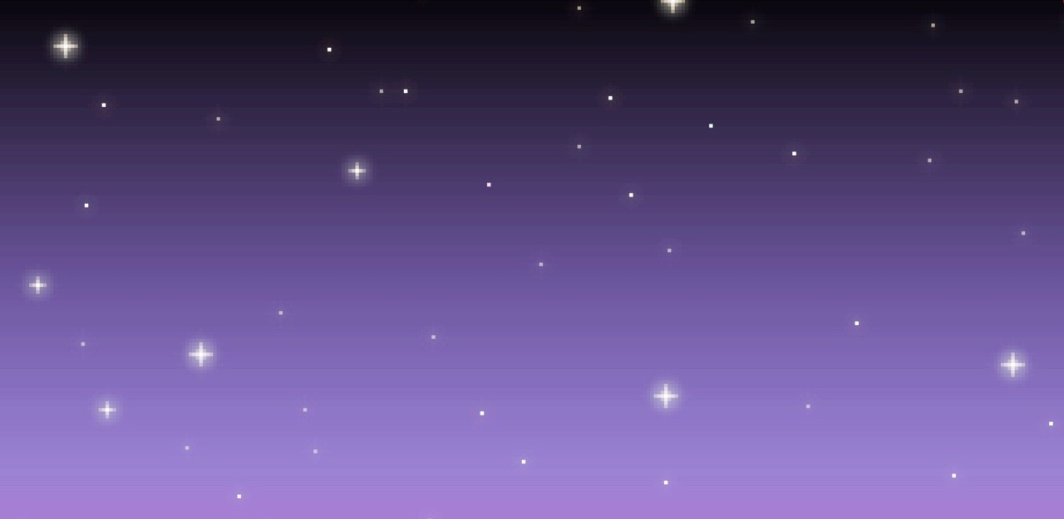
Quick Overview
Stardew Valley is a farming simulation game that was created by Eric Barone aka ConcernedApe and published by Chucklefish LTD. It has been a huge success in the indie game realm and has won several awards for Best Simulation Game at the NAVGTR Awards in 2016, and has also won the Breakthrough Award at the Golden Joystick Awards, also in 2016.
The game is greatly loved by its many fans due to the simple, yet fun gameplay and its loveable (literally) characters.

Slide 5
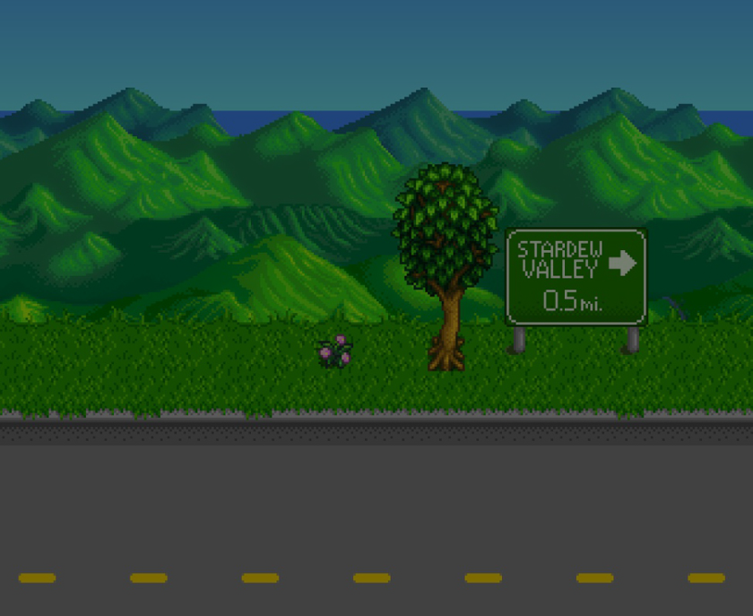
Story
Your grandpa has passed away, and has given you a letter, and tells you that you must open it when you feel bored with your everyday life.
After working at your boring, corporate desk job at JojaMart, you remember Grandpa’s letter, and open it, to realize you are the recipient of his old farm in Pelican Town, which is located in Stardew Valley.

Slide 6
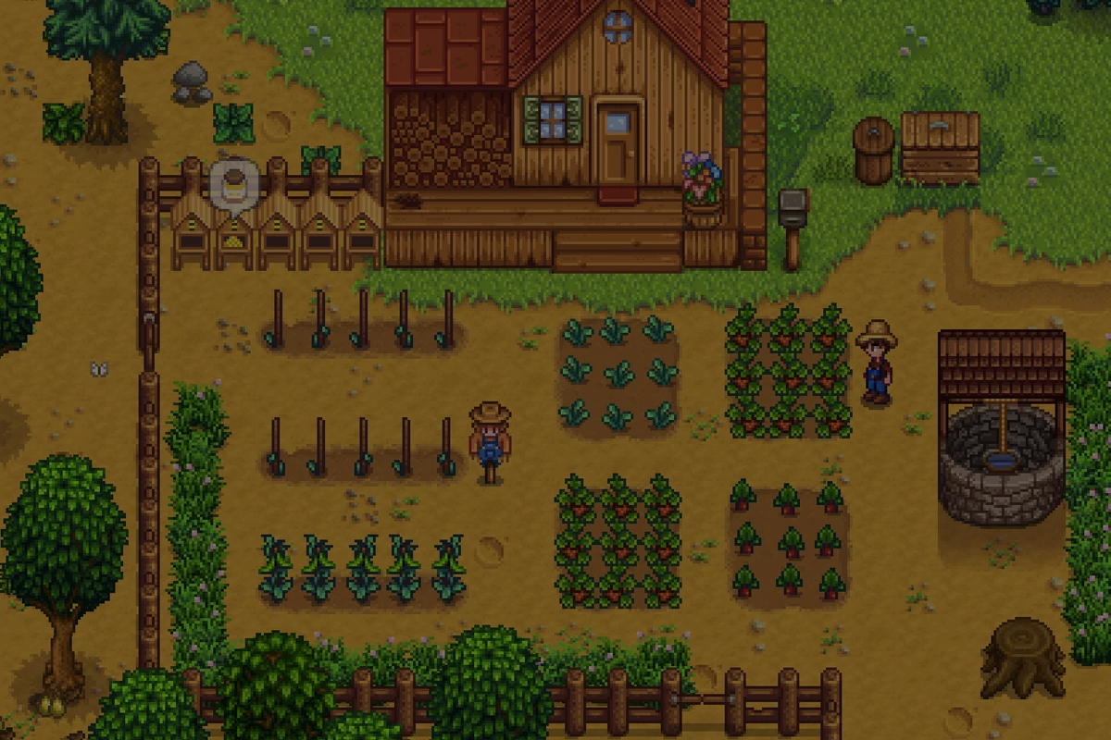
Gameplay
There are five main skills in Stardew Valley you can level up: Fishing, Foraging, Mining, Combat, and of course, Farming.
The game lets the player explore to their heart’s content, with a lot of options being available right from the start of the game. The player doesn’t even need to farm if they choose to do so.
Socializing is also a major aspect of the game, each town member has their schedule they adhere to, and allows the player to gain items, form relationships, and eventually possibly marry a bachelor/bachelorette.

Slide 7
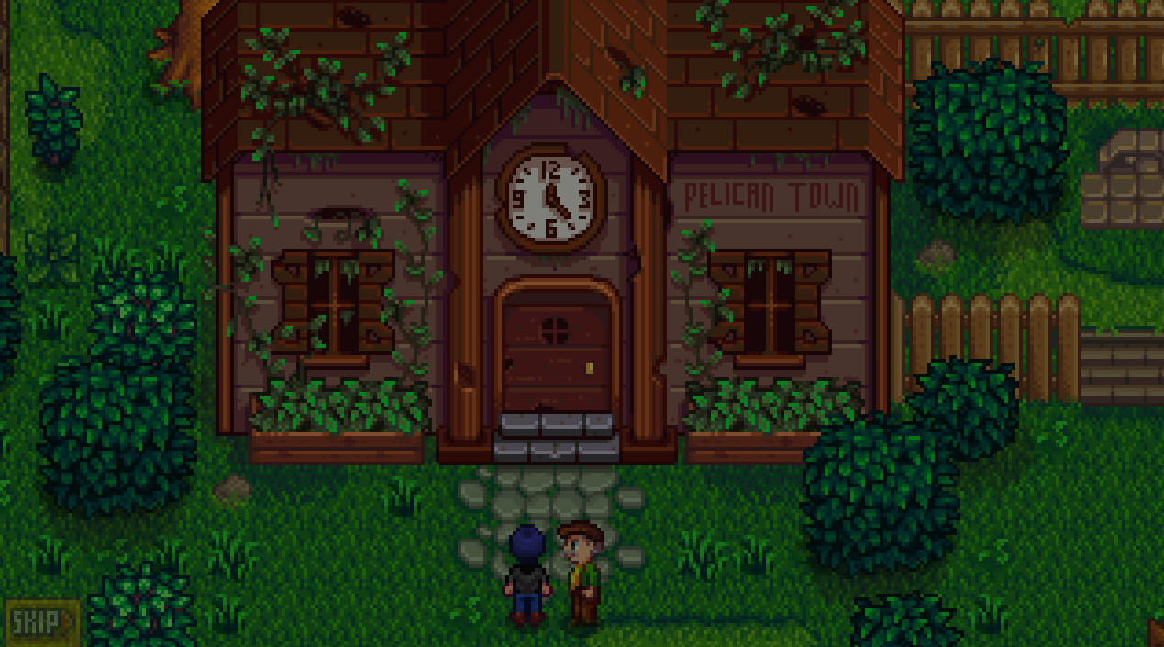
Main Objectives
The Community Center in the town has been dilapidated for awhile, which represents the town’s spirit fading. To repair the Community Center, you must complete bundles, which make the player to obtain certain items to complete them. Once you complete an entire room of bundles, you are rewarded with items and new mechanics.
There is a JojaMart in town as well, you can alternatively pay Joja Corporation to fix everything in the town, and doing so will demolish the Community Center and will build another JojaMart instead! (Not recommended, only for achievements.)

Slide 8
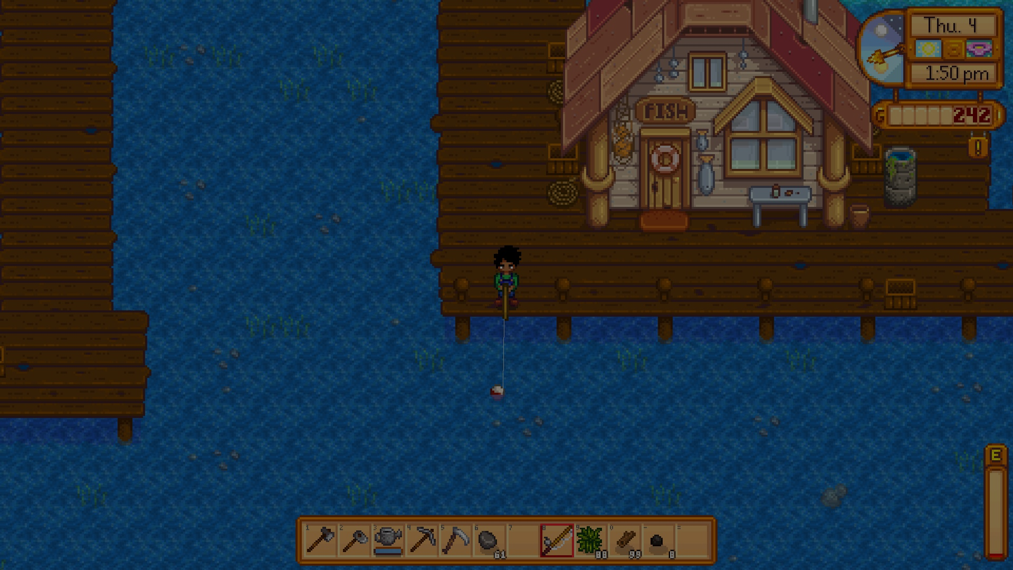
What’s good about Stardew Valley?
The freedom that is given to the player is astonishing.
Fun, addicting gameplay that never gets old.
A sense of accomplishment when completing bundles/organizing your farm.
Great characters that feel like real people.
Tons of content, which in return can take hundreds of hours to unlock.
It is fun to play for everyone, no matter who you are!

Slide 9
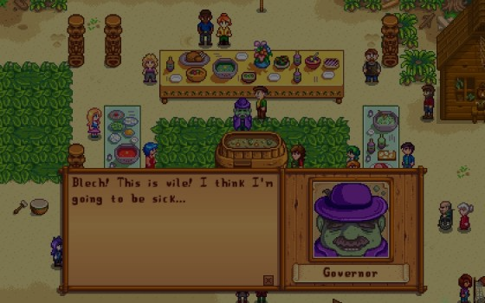
What’s bad about Stardew Valley?
Not much at all.
Can be very similar to Harvest Moon or Rune Factory.
After Year 2, the game goes on loop forever and nothing really huge changes.
Combat system is too simple.
Not a lot of farm layouts.
Fishing can be frustrating.

Slide 10
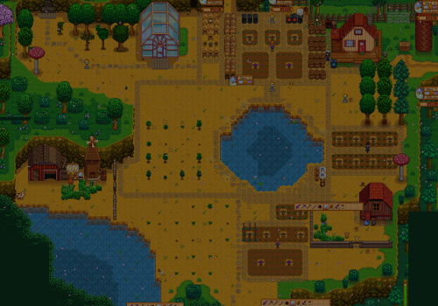
Strengths and Weaknesses
Strengths:
Tons of content.
Easy and fun to play.
Immersive.
A sense of accomplishment when doing tasks.
Weaknesses:
Can be very similar to Harvest Moon and Rune Factory.
Game loops after certain point.
Combat system is a bit too simple.

Slide 11
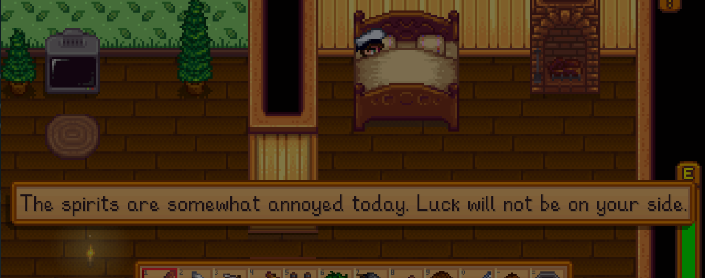
Possible Improvements to Stardew Valley
More events after the second year.
More customization to your farm space (only a couple of plots to choose from)
More fleshed out combat system.
Better fishing.

Slide 12
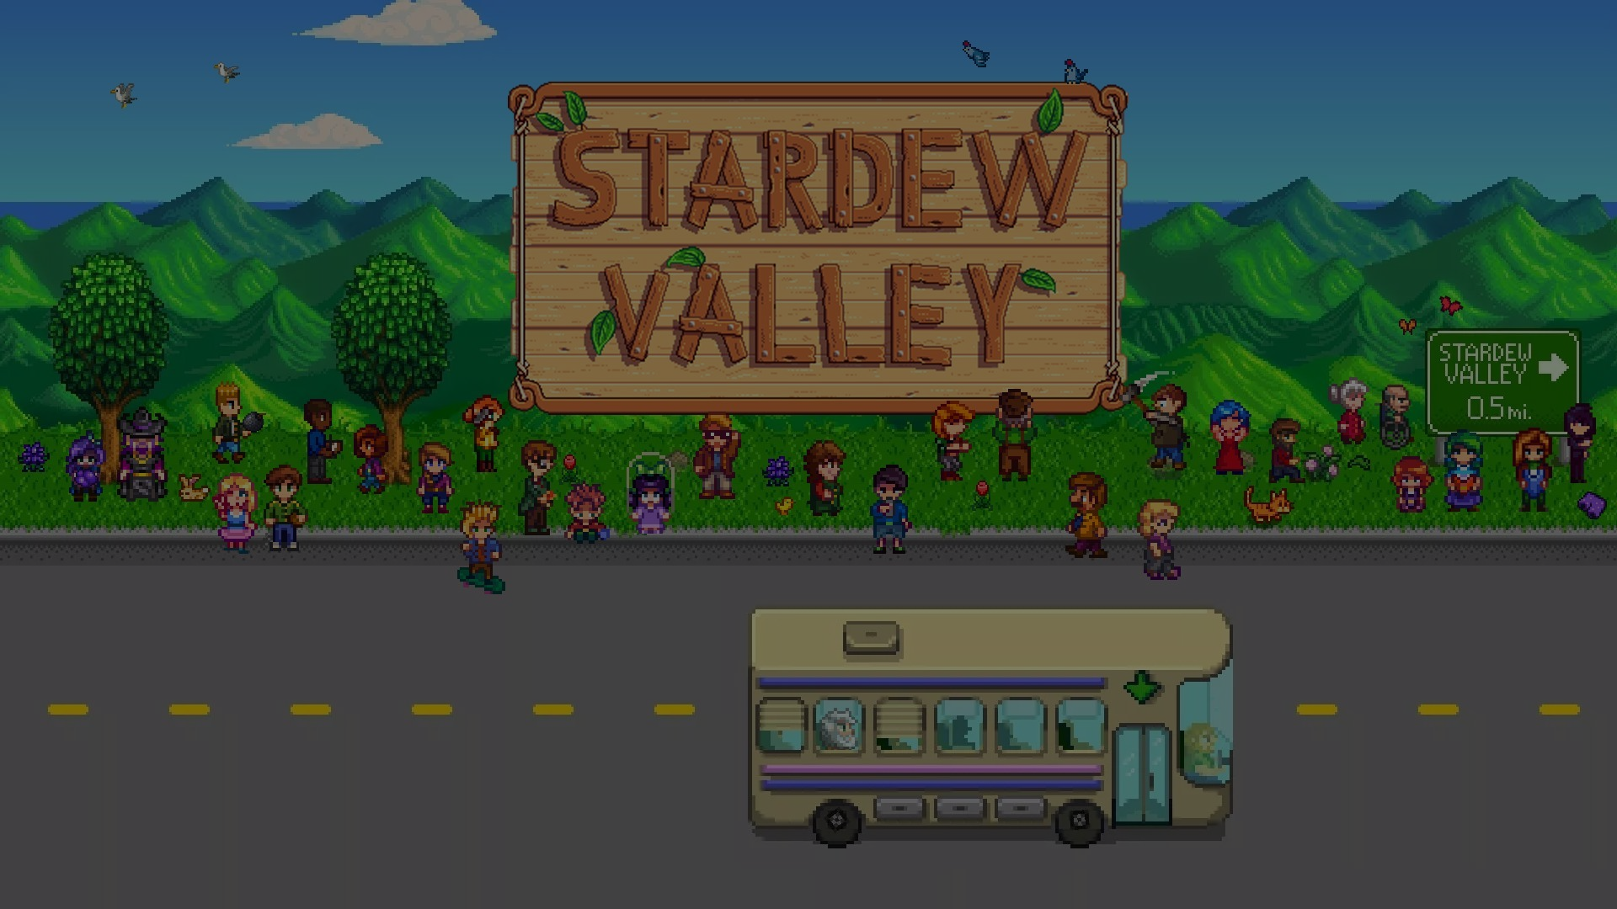
Is It Worth It?
It is DEFINITELY worth $14.99. This is a must have game if you love RPG’s, Farming Simulators, Pixel-Graphics, etc.
I have bought it on multiple platforms just because I love it so much.
I cannot recommend this game enough. Buy it.

