Slide 1
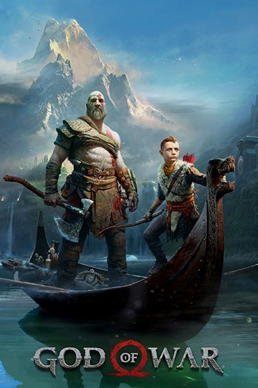
God of War (2018) Review
Zachary Nelson

Slide 2
Basic Info
Company: Sony Interactive Santa Monica
Type: Action/Adventure
Price $60
Hardware: PS4

Slide 3
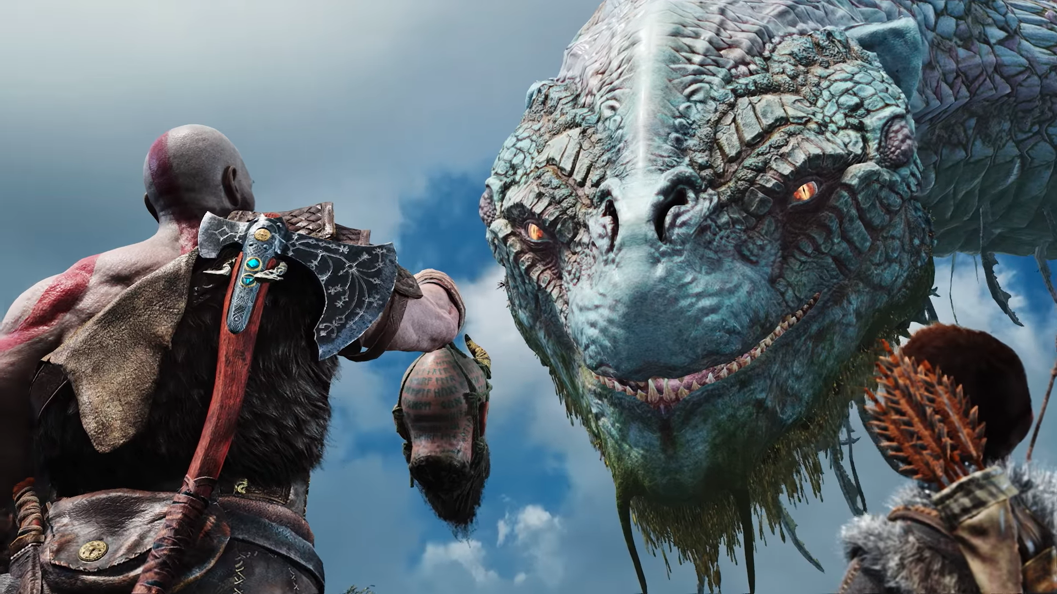
Game Summary
User plays as Kratos, and main storyline is to climb up a mountain with Kratos’s son
Loosely based on Norse mythology
Installation can be done on Playstation Store, or disk can be purchased at retailers
Notes:
Kratos is Greek God of War in this storyline, actively play as Kratos, but user has some passive control over boy

Slide 4
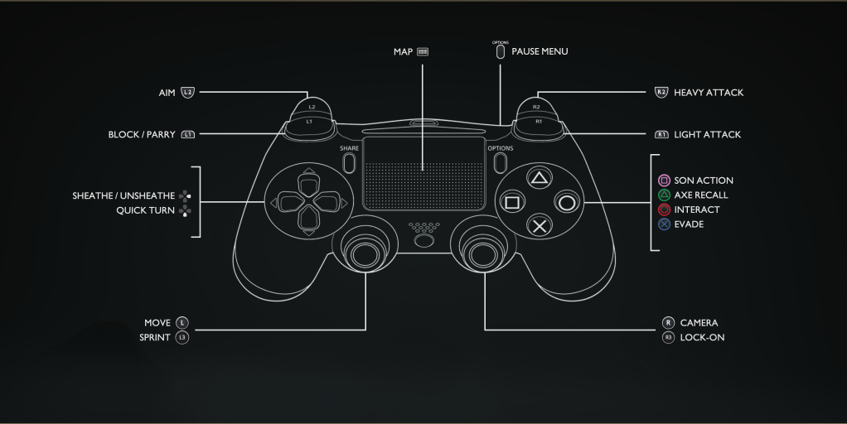
Game Summary
3rd Person free camera
Linear style progression through game, most of game consists of exploring, simple puzzle solving, and combat against groups of monsters/villains
Scoring done by gaining XP - which can be done by fighting monsters in combat, and completing objectives to progress story
Music done by Bear McCreary
Rated M

Slide 5
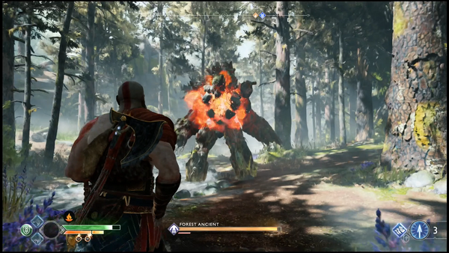

Slide 6
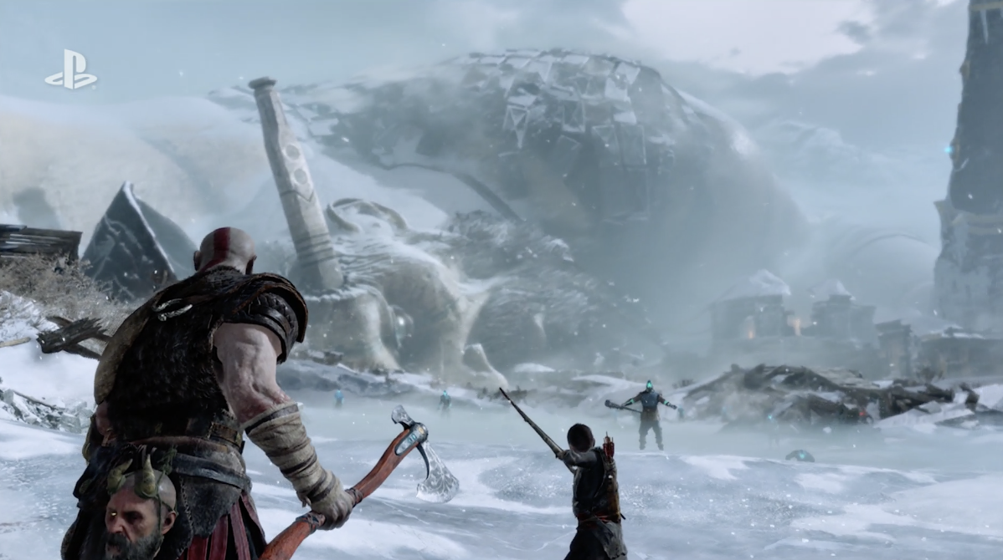
Game Review - The Good
Combat system at its core is simple and intuitive, yet as the player progresses evolves to become much more complex. As the game becomes more difficult, combat turns from simple button smashing to very strategic and coordinated.
AI was designed very well for most part, especially AI for boy

Slide 7
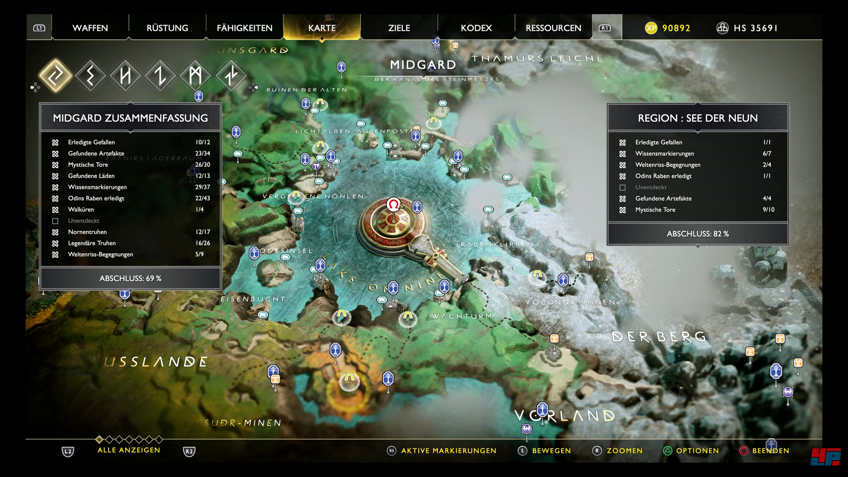
Game Review - The Good
Developers created a linear world, branching out from a central hub, which provided several advantages
Developers focused on intricate quality, and stellar graphics, and created the sense of a complete and intricate world in the game, instead of creating a large empty open world that many games mistakenly create
Linear game reflected the linear storytelling of the game, which felt like a long movie, and allowed for more character development, and larger focus on story than typical video games

Slide 8
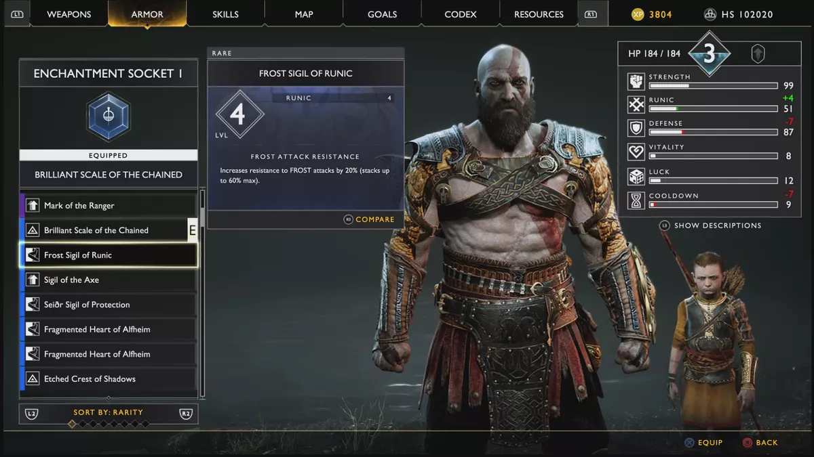
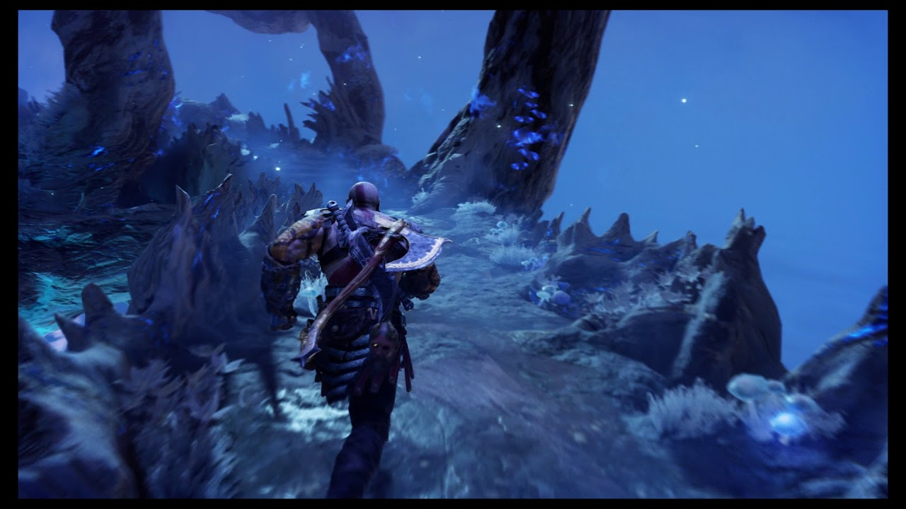
Game Review - The Bad
Progression and upgrade system overly complicated by crafting
Fast travel system inconvenient
Some of the boss fights were long and not engaging
Only available on PS4

Slide 9
Summary
Strengths include a detailed story, a fun combat experience, and a intriguing world to explore
Improvements could be a simplified upgrade system based on in game currency instead of crafting, a fast travel system that allows you to easily travel back to explored areas, and replace long boss fights that require range attacks to shorter, fast paced boss fights with focus on blocking, countering, and combo strikes
Worth purchasing if already own PS4

