Slide 1
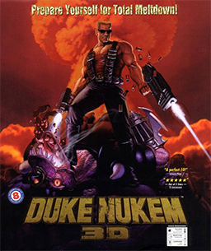
Daniel Neamtu

Slide 2
Developer
Based in Garland, Texas
Released in 1996

Slide 3
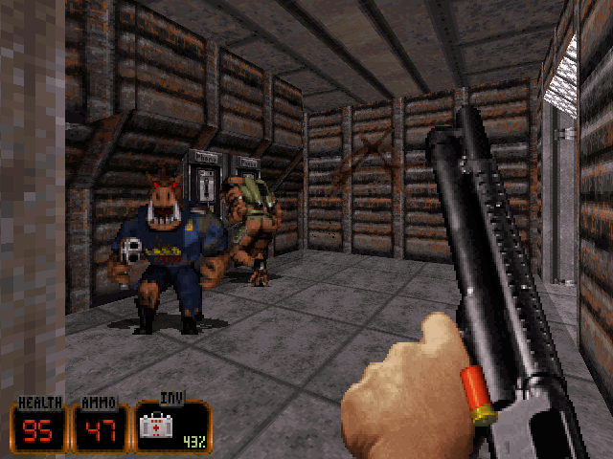
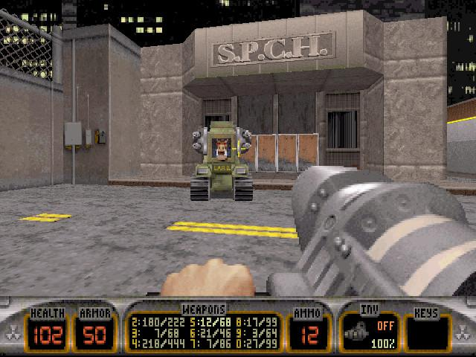
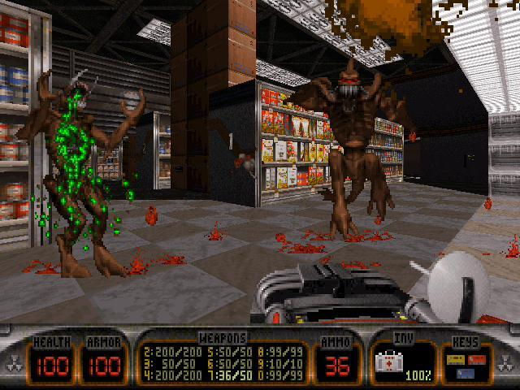
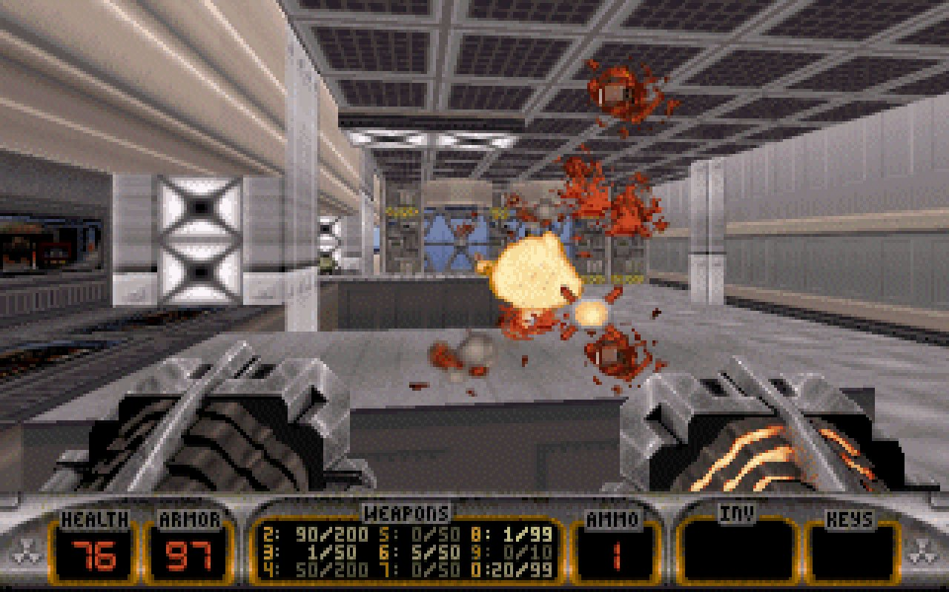
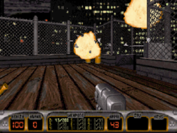
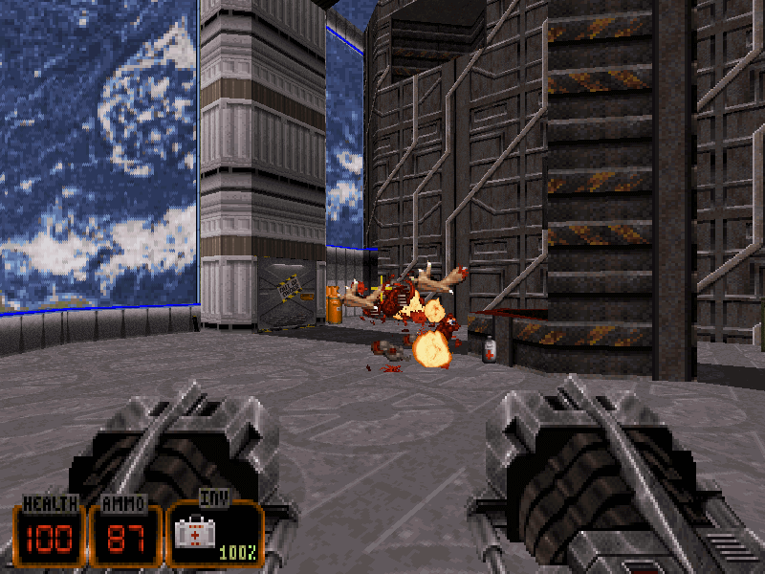
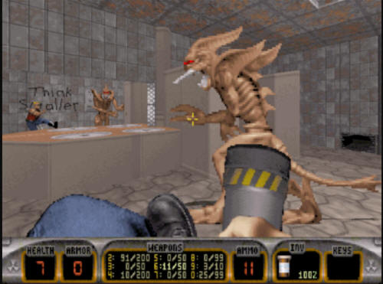
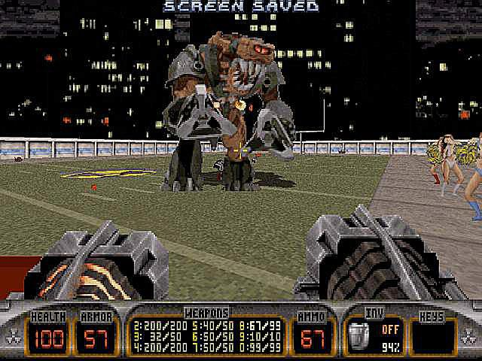
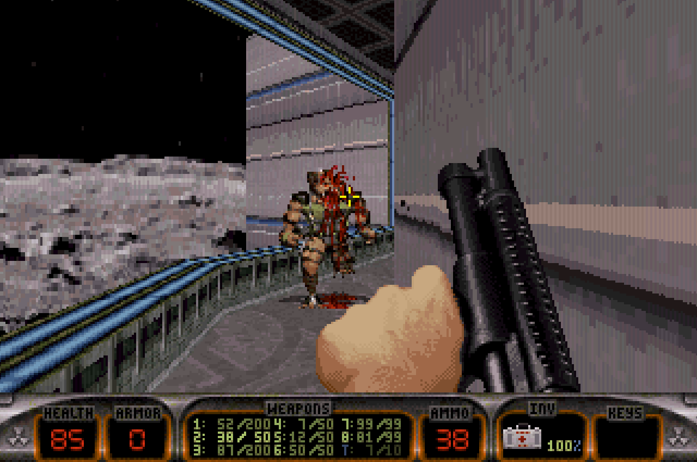
Type of Game:
First Person Shooter
“Classic” type of shooter that relies on good level design and smooth gameplay, not fancy graphics and cinematic scenes

Slide 4
Price
Currently only obtainable through Steam at a price of $19.99
It is not the original version though; it ia a repackaged garbage version by Gearbox
Don’t give them any of your
money

Slide 5
Hardware Requirements
Keep in mind this game came out in 1996, and was designed to maintain 30 fps on a 486, so its hardware requirements are attainable by pretty much any system today.
The original game was made for MS-DOS and runs smoothly with DOSBox. Modern versions are ported to Windows. 3D Realms official system requirements are:
Windows XP, Windows Vista, Windows 7 or Windows 8.
Intel Core 2 Duo or higher.
Minimum 2GB of RAM.
Even though realistically the game requires much less than that.

Slide 6
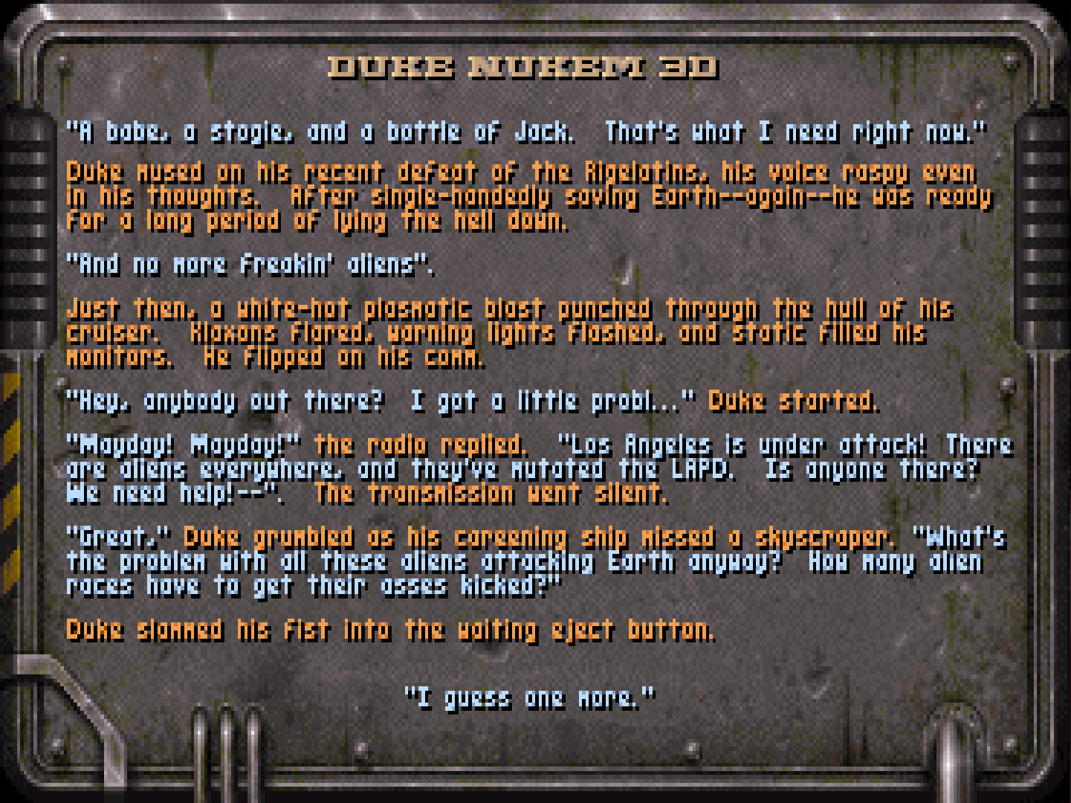
Game Summary
Storyline: The “storyline” is a text file you only see if you press F1.
Player’s role: You are Duke Nukem, and your job is to exterminate alien scum.
Installation: Through Steam.
User interface: Uses WASD on modern systems.
Gameplay: The game is comprised of 4 episodes that you can start at any time. You then progress through each episode by playing each level in order.
Scoring: The game is beaten when you get to the final boss in each episode.

Slide 7
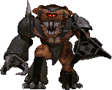
Art, Sound, & Music
The art style is mostly 128 x 128 pixel tiles. Most sprites are view-aligned.
All sound files are uncompressed, low-bitrate wav files.
Every level has unique music. The original game uses MIDI, though most modern versions include sampled tracks.

Slide 8
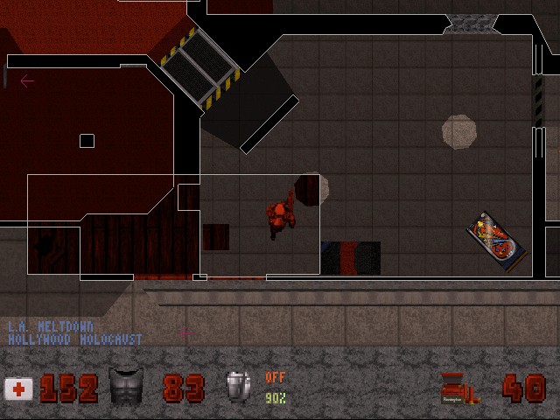
Special Features & Bugs
The interesting hitscan system of this game gives rise to interesting clipping bugs.
It is possible to clip through some walls, or even teleport to different areas if the sectors are right on top of each other.

Slide 9
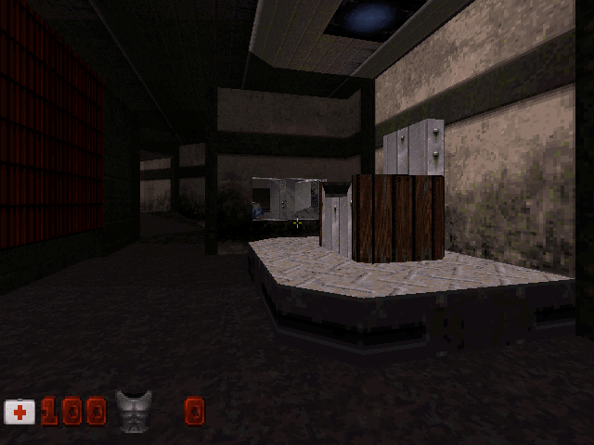
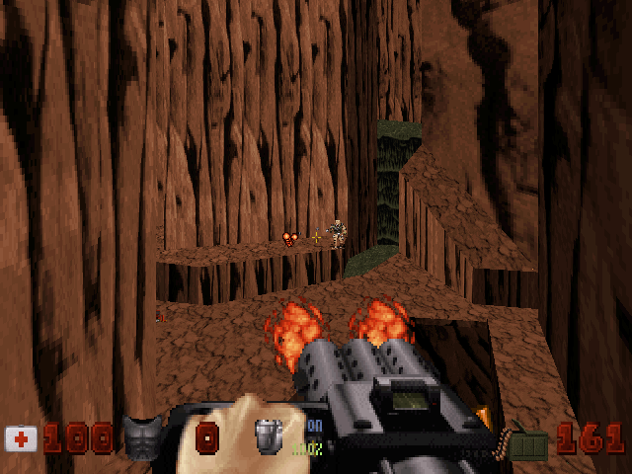
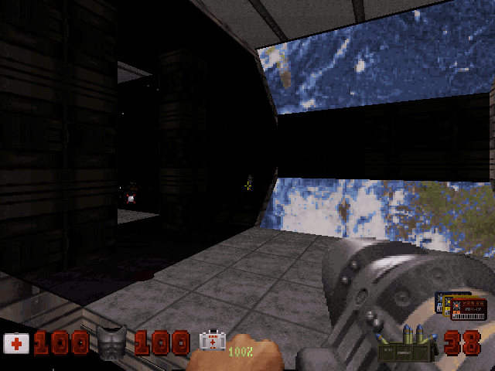
What is fun?
It is easily one of the most well-developed shooters in history. It has amazing flow and balance.
The level design is perfect.
It has a very elegant “minimalist” design which does the most with what was possible in 1996.

Slide 10
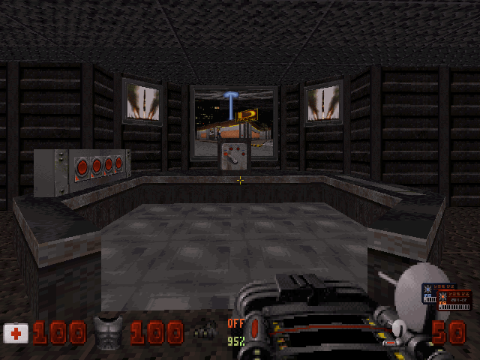
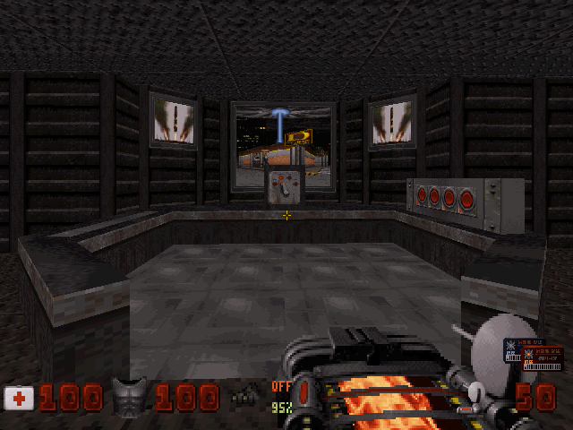
What is bad?
A lot of people don’t like that older shooters tend to be “puzzle” oriented. It is easy to get “stuck” and not know how to continue a level if playing it for the first time.
This may have been a good excuse in the 90s, but nowadays you don’t even need a player guide, you can just YouTube the game to find out how to continue.

Slide 11
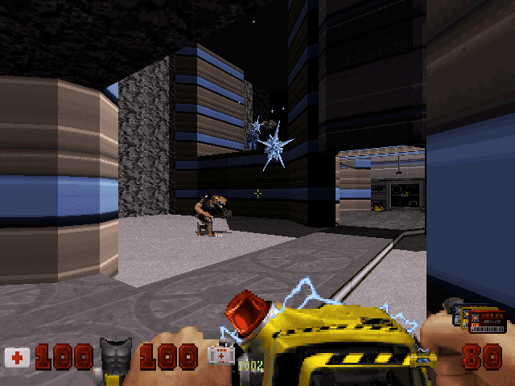
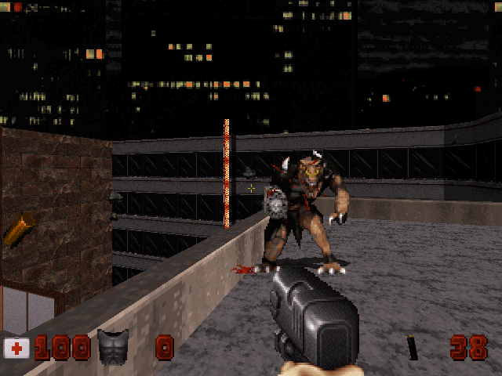
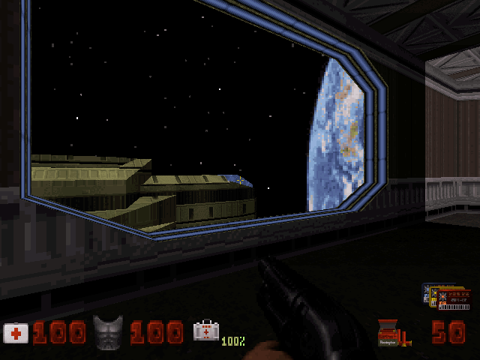
How Does It Compare to Similar Games
The game is much more fast-paced. Duke runs much faster than they do in modern games.
The game relies on many puzzles, almost as if it expects the player to be “smarter” than what new shooters expect.

Slide 12
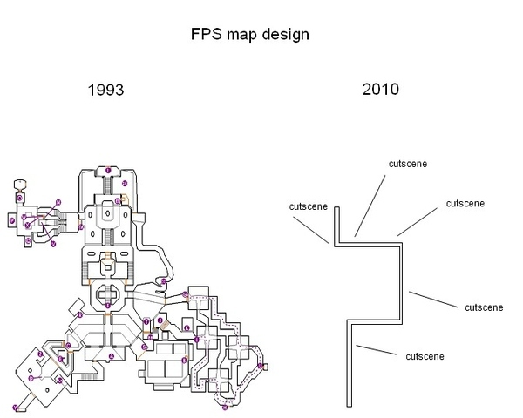
How Is It Better or Worse than Similar Games?
Most shooters today are more cinematic and focus on graphics instead of game quality. That’s not to say ALL modern shooters do this, but it’s especially true of some of the best selling ones like the CoD franchise.
Many new shooters do not implement health
pickups but instead use “regenerating”
health. In my opinion, that is lazy game
design.
Most games today limit the number of
weapons you can carry. Duke allows you to
carry all 11 weapons and toggle between
them using the number keys.

Slide 13
How Is It Better or Worse than Similar Games? Continued
Many shooters implement the story element of the game incorrectly. They focus on cutscenes and dialogue in order to convey the story.
In Duke3D, the game itself, is the story. Every level connects and focuses on a different area that resembles places you’d visit in real life, ex. a movie theater, bookstore, sushi restaurant, bank, office, train station, radio station, fire department, hotel, stadium, etc.
Target Audience: Mature

Slide 14
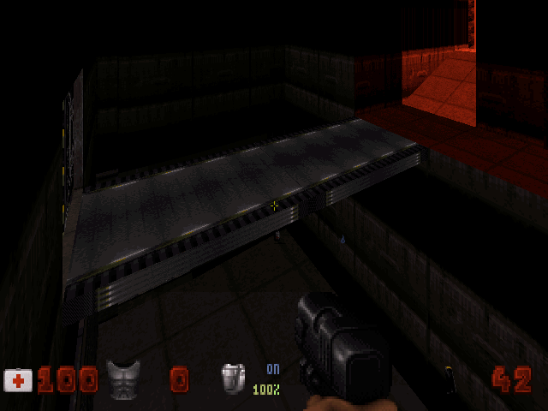
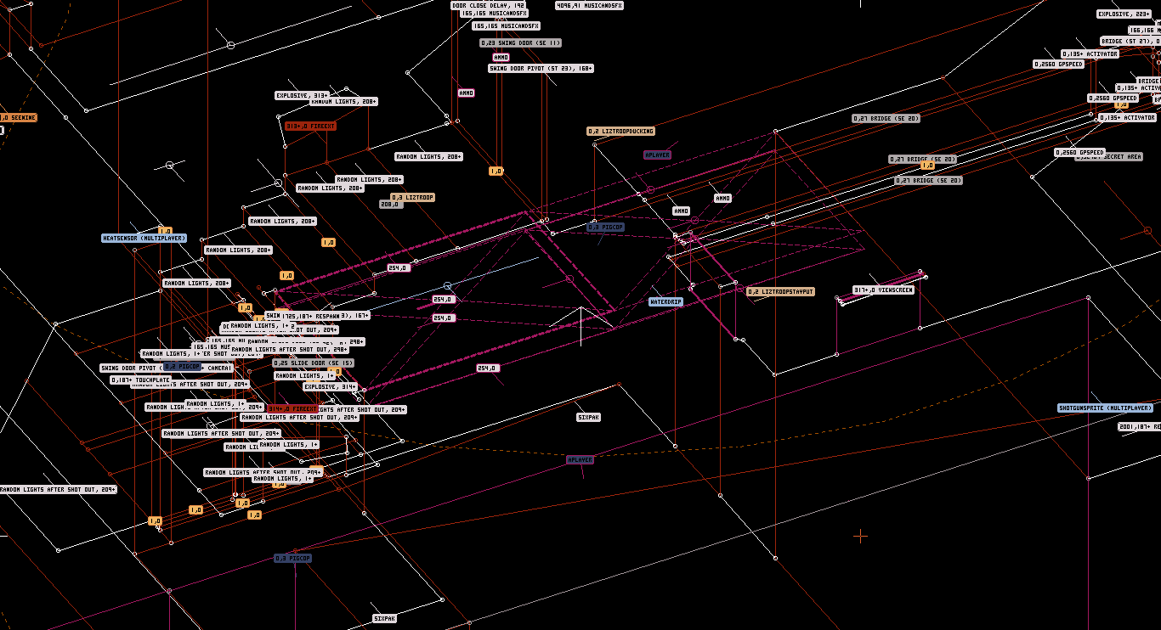
Design Mistakes
Since this was still the early days of shooters, some flaws are in the engine that were not fully understood during development (called “Build engine”).
For example, the lack of “true room over room”, which was corrected in later games that used Build engine.

Slide 15
Overall Summary
Strengths:
Great level design
Balanced gameplay
90s classic
Weakness:
Old game, so there could be compatibility issues
Some puzzles are complex, can be mitigated by referencing YouTube Videos
The game is 100% worth purchasing. The only available version though is a garbage version from Steam.
Improvement: For the best experience, I’d recommend copying the game files and running it with the EDuke32 source port.

Slide 16
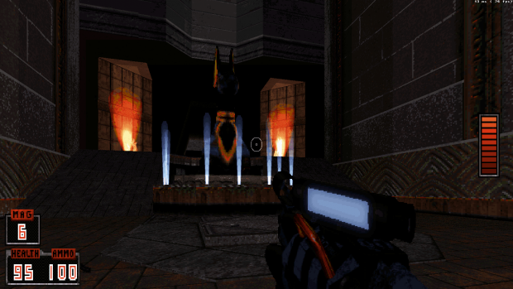
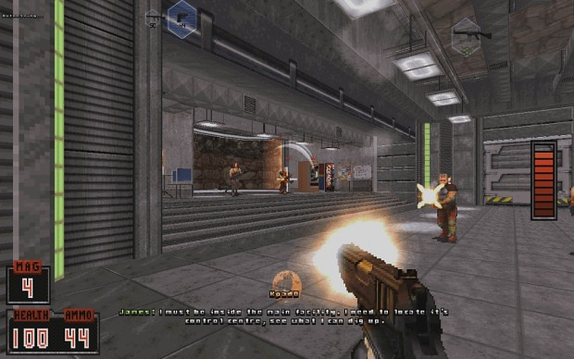
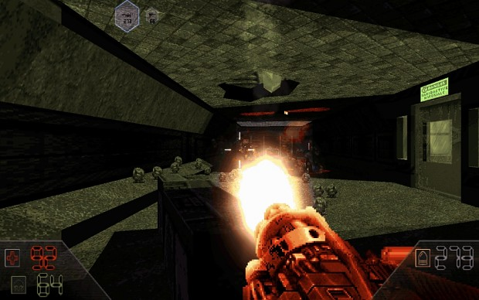
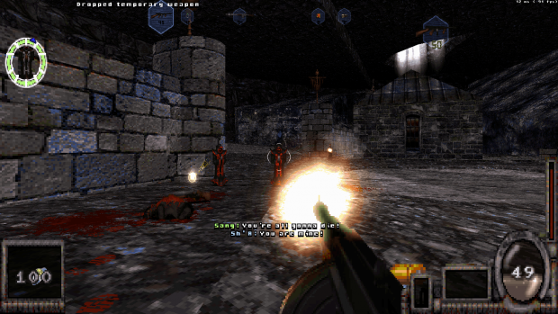
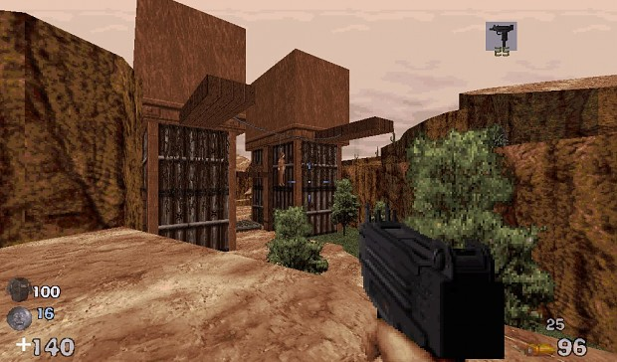
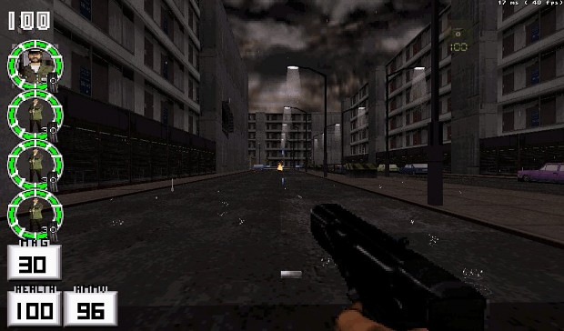
AMC TC
Standalone game based on EDuke32 source port. Completely free and does not require a copy of Duke to play.

