Slide 1
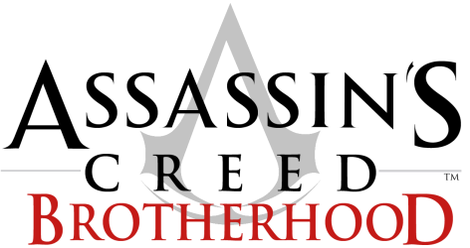
Maria Moore
9/19/2018
CIS 487

Slide 2
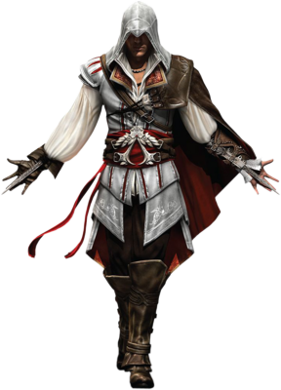
Basic Information
Game title:
Assassin’s Creed Brotherhood
Released in 2010
Developed by Ubisoft Montreal
Published by Ubisoft
Type of game:
Third person action-adventure
Price:
$8 on Steam
$5 used at GameStop
$60 release price

Slide 3
System Requirements
Minimum System Requirements:
OS: Windows XP (32-64 bits) / Windows Vista (32-64 bits) / Windows 7 (32-64 bits)
Processor: Intel Core 2 Duo 1.8 GHZ or AMD Athlon X2 64 2.4GHZ
Memory: 1.5 GB Windows XP / 2 GB Windows Vista - Windows 7
Graphics: 256 MB DirectX 9.0–compliant card with Shader Model 3.0 or higher
DirectX: 9.0
Hard Drive: 8 GB
Sound: DirectX 9.0–compliant sound card
Recommended System Requirements:
OS: Windows XP (32-64 bits) / Windows Vista (32-64 bits) / Windows 7 (32-64 bits)
Processor: Intel Core 2 Duo E6700 2.6 GHz or AMD Athlon 64 X2 6000+ or better
Memory: 1.5 GB Windows XP / 2 GB Windows Vista - Windows 7
Graphics: NVIDIA GeForce 8800 GT
DirectX: 9.0
Hard Drive: 8 GB
Sound: 5.1 sound card

Slide 4
Installation
XBOX 360
Insert physical disk and play
Download the game from the Xbox store and play
PS3
Insert physical disk and play
Download the game from the PlayStation store and play
PC
Download game from a physical disk or from Steam an play

Slide 5
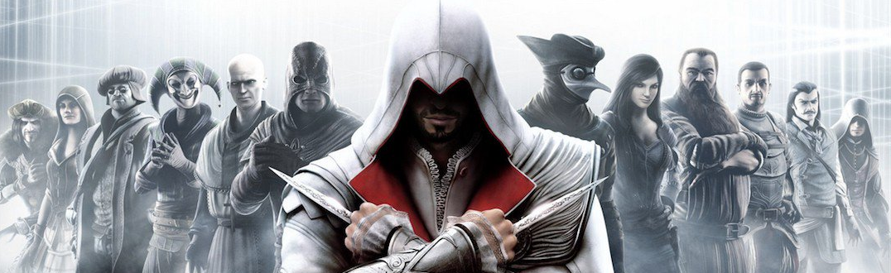
Game Summary
Quick overview:
AC Brotherhood is a third-person action adventure game with stealth elements. It has both a single player story mode and an online multiplayer mode. It is open world and is relatively non-linear but progression is driven by the overarching storyline. AC Brotherhood offers unique side quests and improved combat. The game promotes the player to progress but at their own pace with an emphasis on exploration.

Slide 6
Game Summary
Story line (if any):
Assassin’s Creed Brotherhood picks up where Assassin’s Creed II ended. We follow the main protagonist Ezio Auditore de Firenze through Renaissance Italy as he continues down the path of a master assassin and trying to balance the power between the Assassin’s Guild and the Templars.
Player's role:
You play as Ezio and Desmond, switching back
and forth trying to restore order and finding
the Apple of Eden

Slide 7
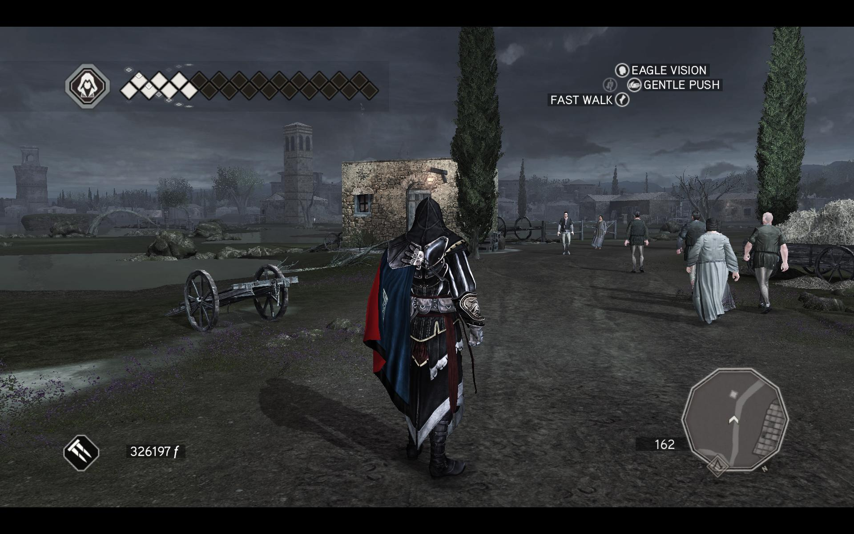
Interface
Health Bar
Actions
Detection Meter
Mini Map
Equipped Weapon
Bank

Slide 8
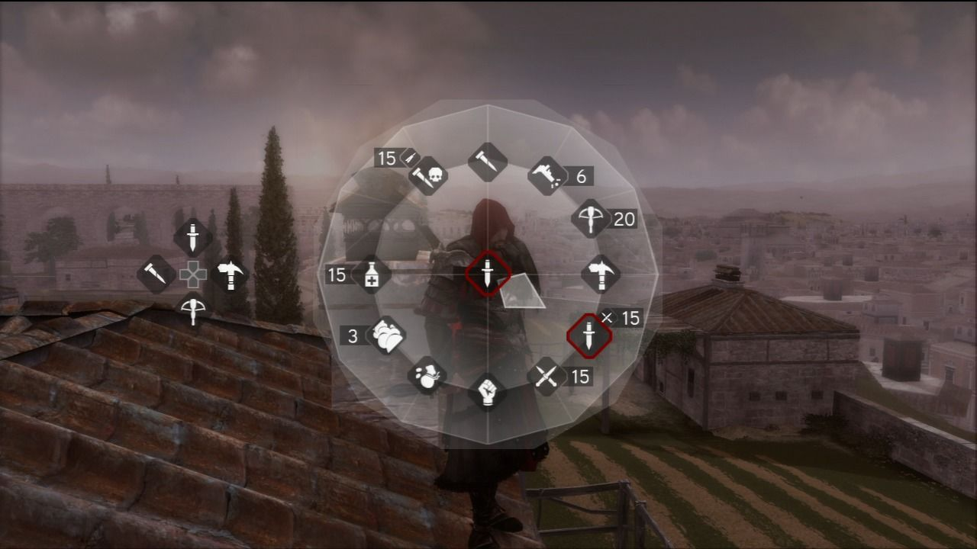
Interface
Weapons Wheel
Customizable Quick Selector

Slide 9
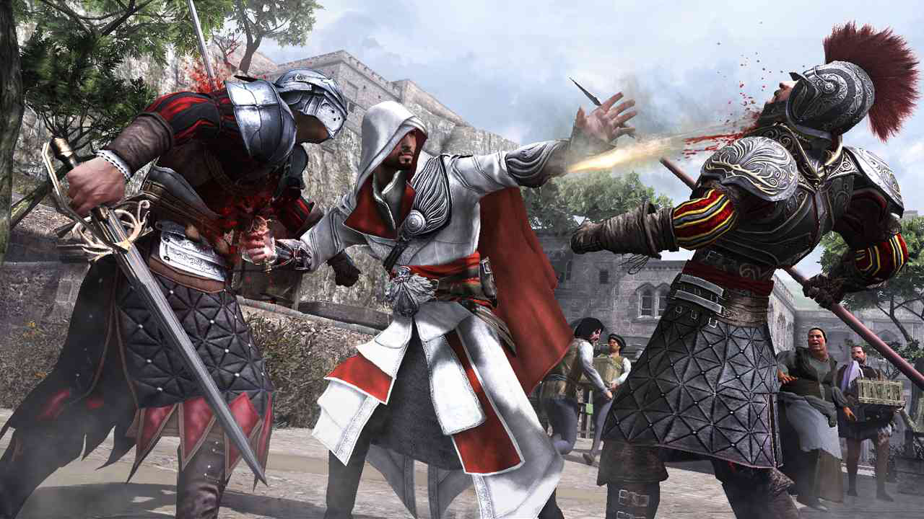
Game Summary
Game Play
Parkour
Improved combat
Double counters and assassinations
New weapons were added
Arm gun
Eagle Vision
Base building
Economy
Stealth
Blending
Distractions
Liberating Borgia controlled towers
Recruiting Assassins into the Brotherhood
Leonardo da Vinci’s War Machines
https://www.youtube.com/watch?v=1WNKvvxJbdo&t=1s
Scoring
Gain more health and learn new skills/ acquire new weapons

Slide 10
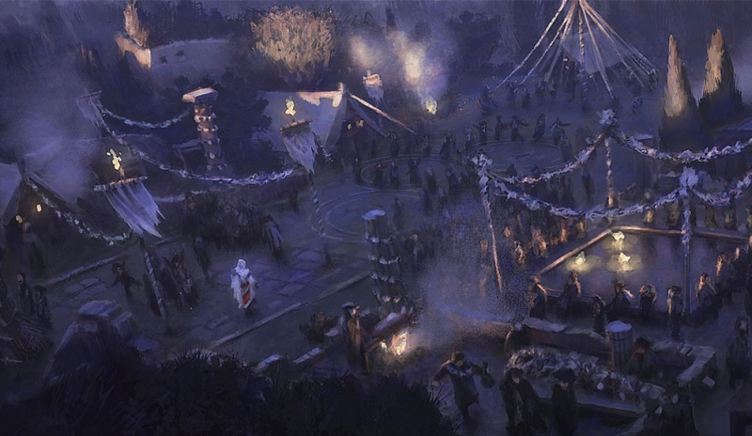
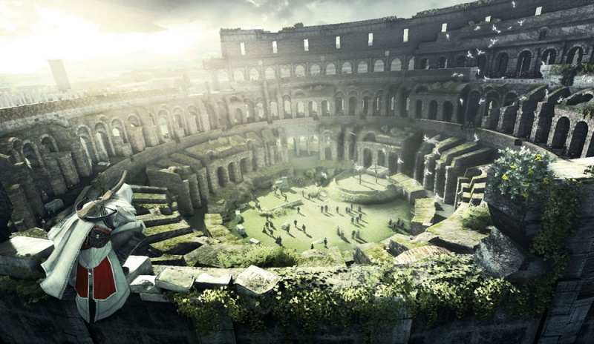
Game Summary
Artwork
Sound and Music
Music by Jesper Kyd
Voice Actors: Roger Craig Smith – Ezio
Kristen Bell – Lucy
Nolan North - Desmond

Slide 11
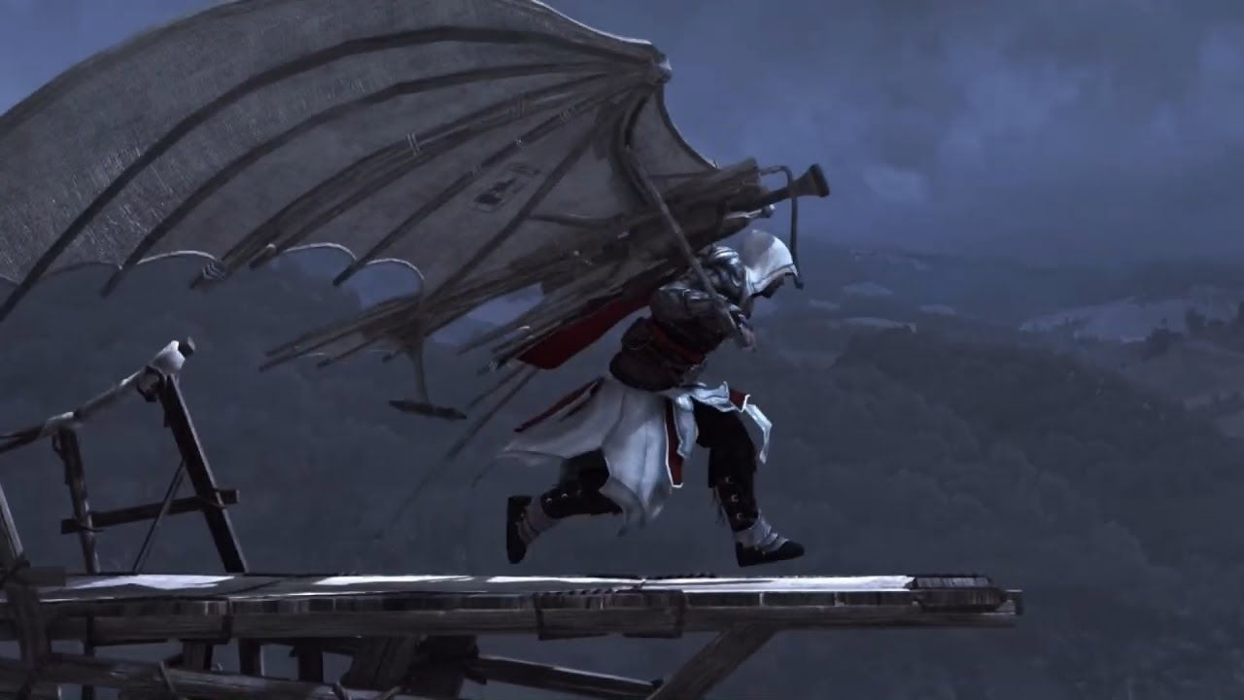
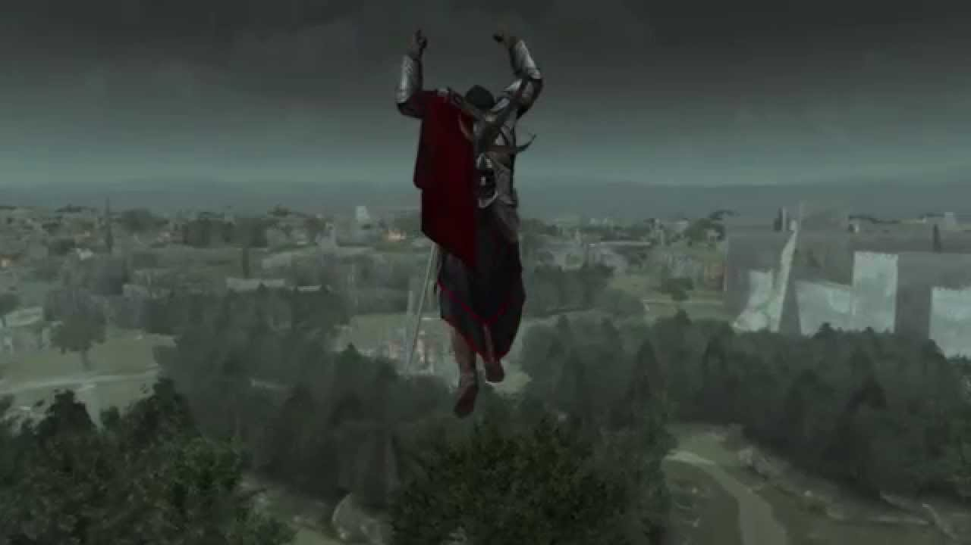
Game Summary
Special features
Online Multiplayer
Tomb of Romulus and Remus (Exploration climbing puzzles)
Manual (if any)
Comes with a guide with the button layout (360)
There are play through guides available throughout the internet and a physical manual is available for purchase
Bugs
Minor graphic bugs
Ragdoll physics
Clipping
All not game breaking

Slide 12
Game Review
What is good (fun) about the game? Why?
This game takes what worked in AC II and improved some of the mechanics and introduced new features that were carried into the future AC games
Flashback memories of Ezio’s youth added to the story and helped you feel more connected to the character
Online Multiplayer was a surprisingly fun feature
What is bad (not fun) about the game? Why?
Trailing missions were dull and did not give the satisfaction that is expected out of a assassin game.
There were quite a bit of chasing missions while on horseback or while driving a wagon, particularly in the Leonardo’s War Machine missions that felt out of place and did not add to the gameplay

Slide 13
Game Review
How does it compare to similar games in the same genre?
A game that came out around the same time as AC Brotherhood was Uncharted 3. Both are third-person action-adventure games. Uncharted 3 uses more long range combat with the help of a gun, while AC brotherhood rewards stealth and up close combat. The graphics in Uncharted 3 were arguably the best of the time in comparison to AC Brotherhood, but it does keep up. Both at the time were highly anticipated and had large following for each. If you didn’t buy AC Brotherhood, you bought Uncharted 3.
Other games that are similar (besides the other AC games) are Tomb Raider, Deus Ex, and Hitman
Why is it better or worse than similar games?
In my opinion, I believe that AC Brotherhood stands up well to other games with a similar genre. It offers unique mechanics and a story that holds the players interest.

Slide 14
Game Review
What is the appropriate audience for this game?
This is a violent game and has mature themes. So it is recommended for 18+. That being said, I played it when I was 14 and I credit it with really opening my interest with video games. So I would say that the appropriate audience is anyone that enjoys emersion and satisfying combat without the need for a lot of skill.
Are any design mistakes present?
There is a mechanic in the game that allows you to recruit assassins and send them on side missions to level up and gather coin. After recruiting you can call them to your aid in battles or as a distraction. This was something that was introduced to the game and given the fact that the game is focused around building up the Brotherhood, it was disappointing that this was only used as another tool in your wheel. I believe that it was a missed opportunity for Ubisoft to build upon this sort of “mini game”.

Slide 15
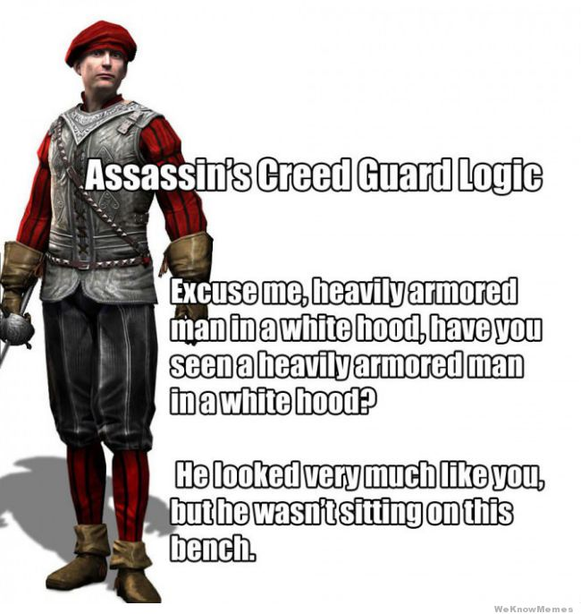
Summary
Overall strengths
Smooth gameplay
Immersive experience
Combat was easy to learn and master
Interesting story
Overall weaknesses
AI could have been more challenging and attentive.
The Brotherhood recruiting portion of the game wasn’t
as important to the game as it should have been
Is the game worth purchasing?
Yes, I recommend buying this game.
In my opinion AC Brotherhood is one of the best entries into the AC lineup.
How could it be improved?
Refine the Brotherhood recruiting mechanic
Make the guards more attentive

Slide 16
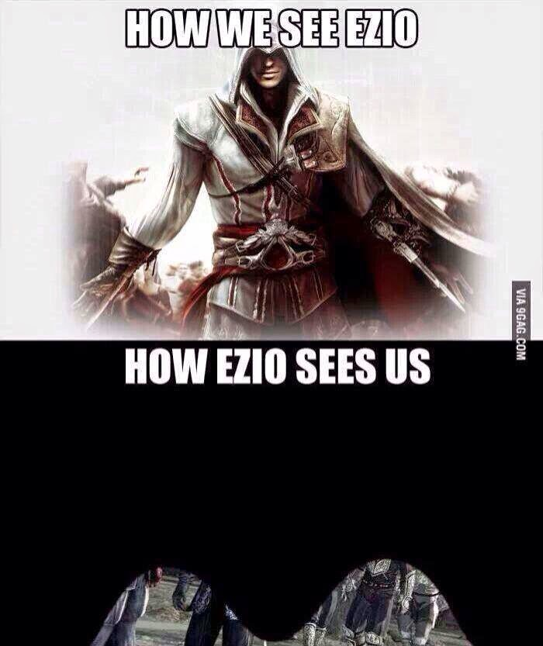
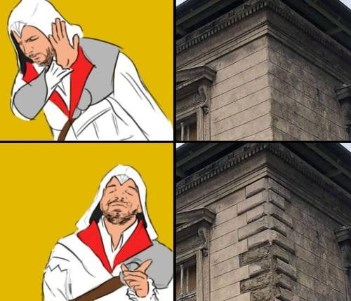
"Nothing is true; everything is permitted"

