Slide 1
Reviewed by:
Jerry Lee

Slide 2
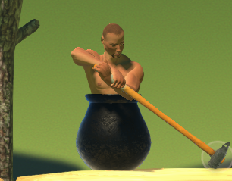
What is Getting Over it?
Getting Over it with Bennett Foddy is an intentionally frustrating 2D platformer/climbing game.
You play as a man in a cauldron and your only way to move is by swinging around a sledgehammer. There are no instructions. The way to beat the game however is to use your hammer to climb up multiple mountains to reach the ending.
As you progress through the game, Bennett Foddy (The creator) will discuss philosophy with you. And as you suffer setbacks he will he will provide quotations related to disappointment and perseverance.
There are no checkpoints

Slide 3
Basic information
The developer and publisher is Bennett Foddy.
The game is a 2d platformer
It costs $8 on steam

Slide 4
Hardware requirements
Minimum:
OS: Windows vista. Graphics: Intel HD 4000 . Memory: 2 GB ram
Storage: 2 GB.
Reccommended
OS: Windows 10. Graphics: GTX 970. Memory: 4 GB ram
Storage: 2 GB.

Slide 5
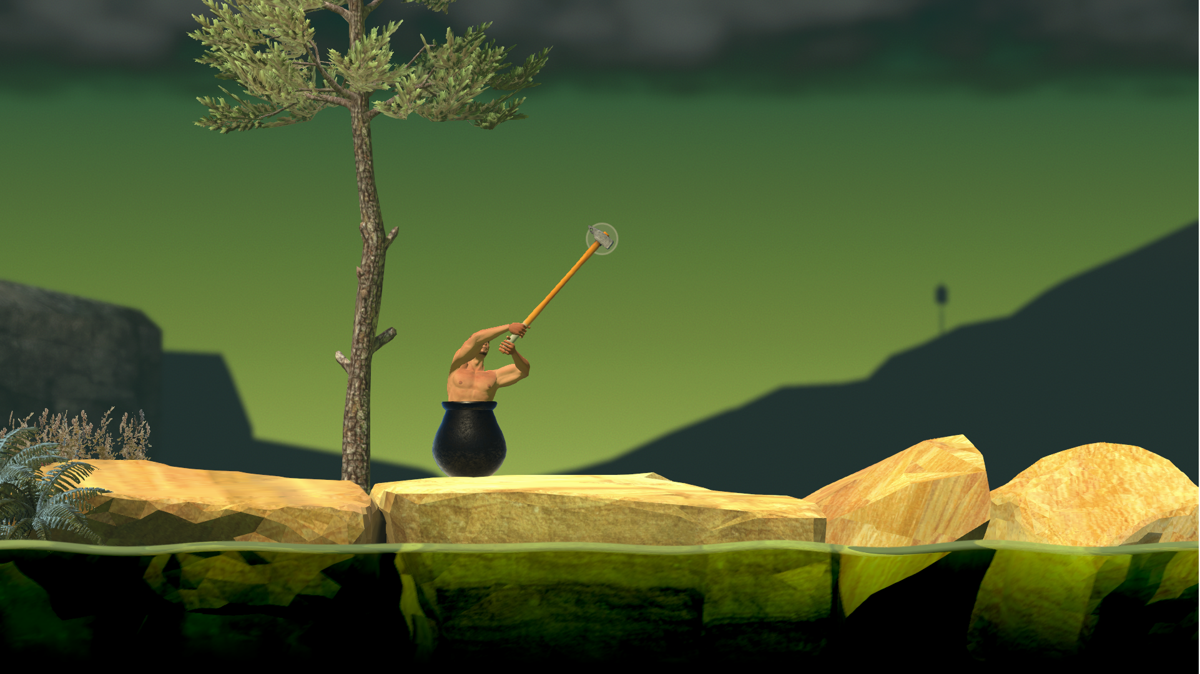
UI
The UI is very simplistic. In the main menu there are only 5 options.
Continue
New Game
Settings
Credits
Quit
In the game there are no menus or options. Just a circle where your mouse is and your hammer will follow that circle.

Slide 6
Gameplay
The gameplay is very simplistic. You can only do one thing in the game, move your hammer. Using that hammer you move and climb.
Another part of the gameplay is the voice over of Bennett Foddy. He will discuss philosophy when you hit certain points, and when you fall and lose progress he will provide quotations related to disappointment and perseverance.
Another gameplay feature is the lack of checkpoints. At any point you could become frustrated and lose dozens of minutes to hours of effort with one bad swing.

Slide 7
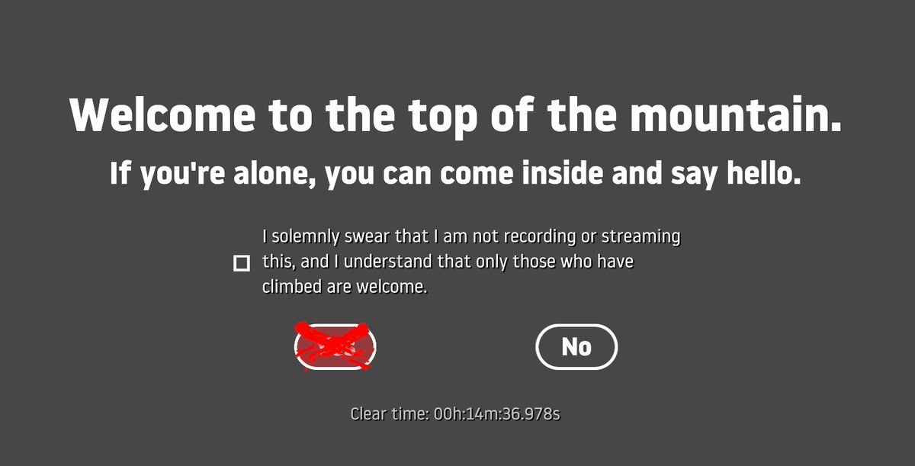
Scoring, artwork, sound, and music
The only metric the game keeps track of is your time.
Sound/music
Art, design, 3D Models, textures, sounds, voice overs, and music were created by Bennett Foddy
However, it’s also featuring 3D models, textures, music, and sound by “various other folks”.
The music is all public domain

Slide 8
There is no manual for the game and no game breaking bugs that the community is aware of
Manuals and bugs

Slide 9
What is good about the game?
The game as a spectator/streaming game is immensely entertaining
The game gained a lot of exposure through YouTube videos and twitch streams
https://youtu.be/jqFTJN3v-uY?t=12s
The game has a skill cap
Because everything else in the game is static but you, your ability to manipulate your character is the only thing stopping you from winning.
According to the description, the median time to beat the game is 5 hours. However there are dozens speed runners that can beat it in sub 3-minutes
The music is relaxing
Bennett Foddy
It’s fun to watch someone be upset at the voice lines.

Slide 10
What is bad about the game?
It’s frustrating. Intentionally so, due to unique controls/movement options and the physics engine
Players have lost dozens of minutes of progress with one wrong mouse movement
The hammer swings/ mouse movement is clumsy/slow
There are no new mechanics. From the beginning to the end the only thing you can do is swing your hammer
Bennett Foddy
It is not fun to be patronized by Bennett Foddy
https://youtu.be/7KUq9mmxPLA?t=2m49s

Slide 11
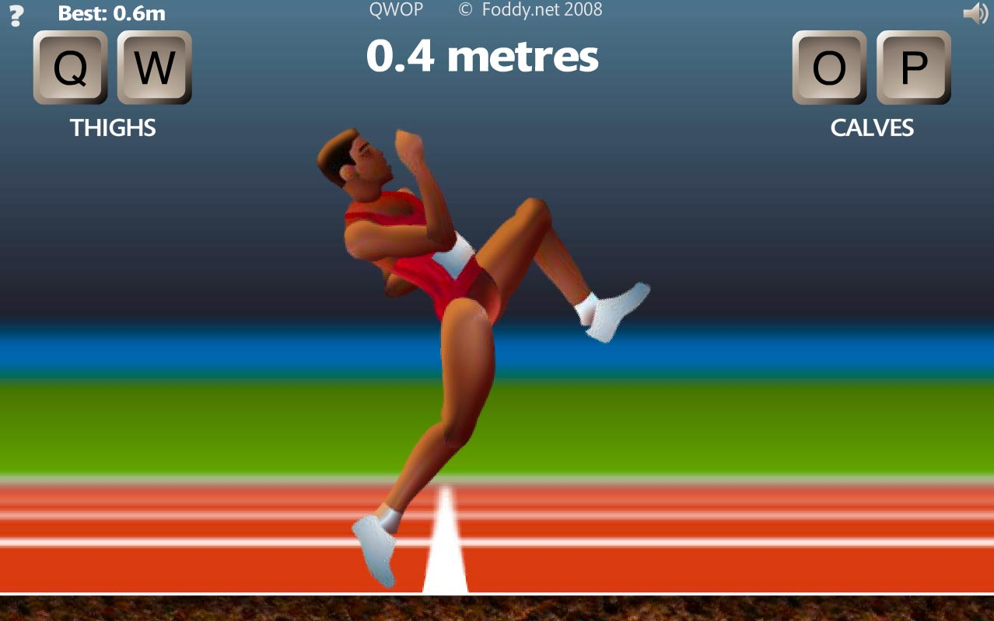
How does it compare to similar games?
The biggest games similar to Getting Over it, was also created by Bennett Foddy. Other notable mentions would be its spiritual predecessor Sexy Vikings, where you also climb with a hammer.
He also created QWOP and GIRP
Most other games of this style never become mainstream due to the starting difficulty
It got popular due to the simple controls and YouTube/twitch
Compared to QWOP the controls are much simpler to use, because instead of four keys, it’s just the mouse
Although it is a 2D platformer, it’s unlike most conventional platformers due to the unique movement system

Slide 12
Why is it better or worse?
Similar games have more complicated controls
What games have less complicated controls then just a mouse
Means it’s far easier to pick up
It’s better than similar games due to the lack of repetition.
Similar games such as QWOP and GIRP are very repetitive

Slide 13
Appropriate audience and design mistakes
The appropriate audience would be 18-21 year olds.
This is due to the fact that the high skill floor combined with the frustrating nature of the game makes it more unlikely for younger audiences
Older audiences don’t have the extra time or want to want to scale mountains for 5 hours.
I cannot see any design mistakes

Slide 14
Overall strengths and weaknesses
Strengths
Easy and quick to pick up
High skill cap
Decent replay ability
Addicting
Very difficult
Weaknesses
Purposely frustrating
Hammer movement is sometimes clumsy or slow
Very difficult

Slide 15
Is it worth it, and can it be improved?
For the price of a burrito bowl at chipotle($8), I think that it is worth the purchase.
However if you get easily frustrated and angry, you may play it once and then uninstall it forever
For such a simple game, the only thing that could be improved on would be level design or the physics engine.
However I believe that in its current state it is perfectly playable and does not need to be improved

