Slide 1
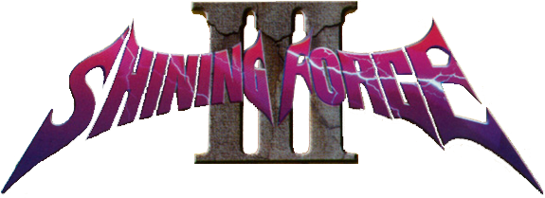
An Original Presentation By Jesse Jenkins

Slide 2
BASIC INFORMATION
Shining Force III was developed for the Sega Saturn by Camelot Software Planning.
Shining Force was developed as a 3 tier turn based fantasy role playing game.
The game came out in three scenarios, Scenario 1 came out December 11th 1997, Scenario 2 came out April 29th 1998, and Scenario 3 released on September 23rd 1998. Each cartridge would have run about $50 when they released. If you were to try and buy the game from Amazon today the three together run for about $290.

Slide 3
BASIC INFORMATION
SF3 released for the Sega Saturn, whose hardware specs are listed below:
2x Hitachi SH-2 @ 28.6 MHz
Internal RAM Storage (16Mbits work RAM, 12Mbits video RAM, 4Mbit for sound, 4Mbit for CD buffer, and 32KB backup battery RAM . . . that’s around 4.5MB of RAM)
Supports resolutions from 320x224 to 704x224 pixels and can display up to 16.77 million colors at one time.

Slide 4
BASIC INFORMATION
The most popular Sega Saturn emulator (SSF) can be run with these minimum requirements:
OS: Windows 2000/XP/Vista or above
CPU: Any Pentium 4, Athens 64 or above (basically anything modern)
RAM: 256MB or above
GPU: Anything that supports DirectX9 or above.

Slide 5
OVERVIEW
The game follows three scenarios. Scenario 1 and 2 happen simultaneously in the plot while scenario 3 begins a little before the climax of its predecessors and continues passed the end of them.
Each scenario follows a different main character but in combat zones you control that characters fighting force which can be up to 12 fighters.

Slide 6
STORY LINE
As a JRPG the story line is the most important motivating component of the game.
The three Scenarios follow the stories of a Young Lord of the Republic of Aspinia named Synbios officially (the player can name the three main characters whatever they wish), Medion a Prince of Destonia, and Julian . . . a mercenary as they travel throughout their continent trying to avoid open war between their countries and destroy an ancient evil.

Slide 7
PLAYERS ROLE/ GAMEPLAY
Players transition between rest zones and combat zones while traveling the world.
In rest zones players can talk to NPC’s to progress the story, gather information, or gain allies. Players can also search for or buy items/ weapons.
In combat zones players move the main character and their allies through the map to fight enemies who appear. In special circumstances players can find items and gain allies.

Slide 8
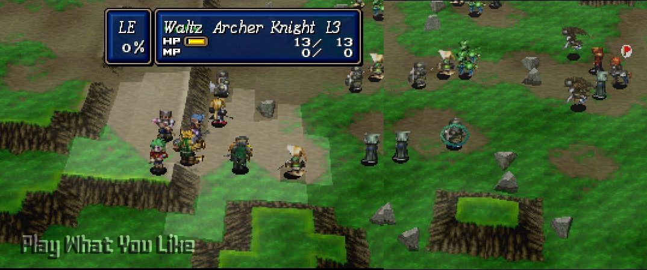

Slide 9
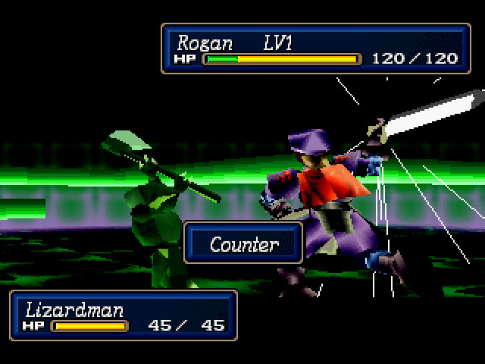
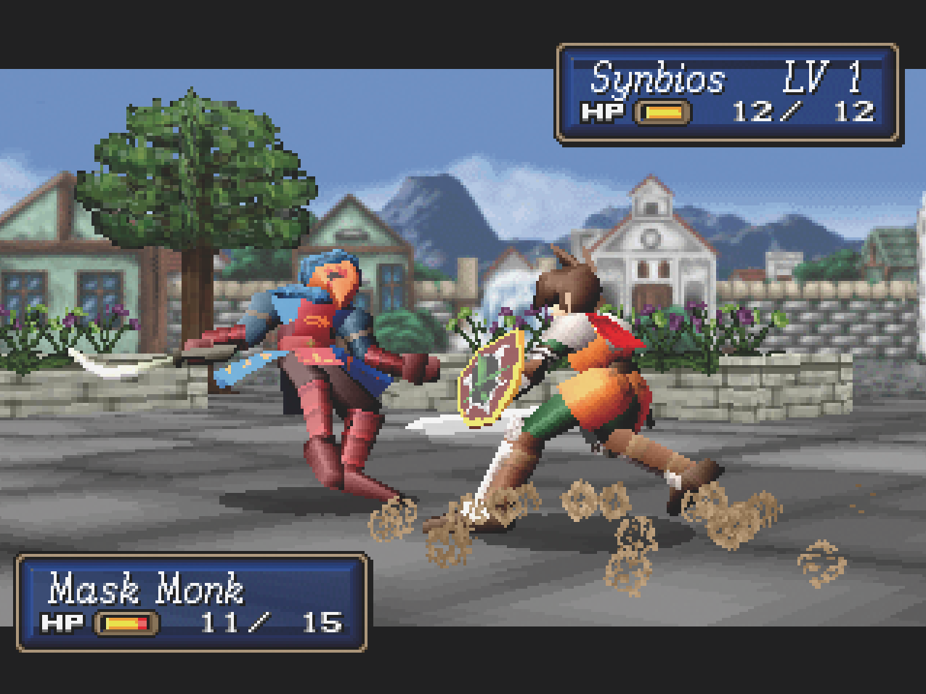

Slide 10
AUDIO AND ART
The soundtrack for the game was developed by Motoi Sakuraba who is also responsible for music in some of the Mario games as well as Super Smash Bros: Brawl.
The art for the game was headed by Hiroyuki Takahashi who has also worked with Enix on their Dragon Quest series.

Slide 11
GAME REVIEW - THE GOOD
Gameplay: Engaging, strategic, and fluid are exactly the three words I would use to describe SF3’s gameplay.
Strategic because characters can have advantages based off of map placement, class, and more.
Engaging with how characters level up and develop over the course of the game.
Fluid because the transition from the 2D map to 3D battle are quick and non-invasive.

Slide 12
GAME REVIEW - THE GOOD
The music in the game works well with the fantasy setting and is pleasant to listen to.
The story is well written and engaging. The player can influence it in quite a few ways but the concept of having a save file transport system from one scenario to the next worked brilliantly.

Slide 13
GAME REVIEW - THE BAD
This is a modern problem but the process of getting the game today (without owning an original copy and a Saturn) is pretty difficult.
The game can be grindy, which involves playing the same battles multiple times which can become tiresome.
Without a guide there are multiple items, characters, or situations that can be missed. This can affect future gameplay.

Slide 14
HOW DOES IT COMPARE?
SF3 is one of the only JRPG’s that I’ve played. Fire Emblem is about the closest comparison I can make. Both games feature turn based combat based on strategically moving your forces through a grid line map with one of the main differences being that SF3 doesn’t believe in character perma-death. Despite being older than many of the newer Fire Emblem games, SF3 stacks up well with its great storyline and progression system for its characters.

Slide 15
AUDIENCE AND DESIGN MISHAPS
The audience for this game isn’t limited by age. SF3 can be enjoyed by anyone who enjoys fantasy tropes, turn based strategy games, or RPGs with well written stories.
As far as I’ve played there haven’t been any noticable bugs or design mistakes. Searching the internet the only reported errors involve errors in emulating the game itself or performance errors because of bad emulation settings.

Slide 16
SUMMARY
Strengths: Fun and engaging plot. Fluid and progressive combat and leveling system. Music is on point and the art for the time is pleasant to look at.
Weaknesses: Hard to get ahold of today. The game can be fairly grindy, and a lot of characters, items and etc can be missed by players if they aren’t following a guide.
Is the game worth purchasing? Not for Amazon’s price, but it’s definitely on my “list of games to play before you die”

Slide 17
SUMMARY
Honestly the biggest improvements that could be added to SF3 would be to update the game entirely in terms of its graphics and increase the amount of EXP you get for defeating enemies.
The weakness involving missing characters, items or any plot elements is easily rectified by the many guides that exist on the internet and for those who prefer to find everything themselves they will probably enjoy the immense challenge of finding all the secrets SF3 hides.

Slide 18
REFERENCES
https://en.wikipedia.org/wiki/Shining_Force_III
https://en.wikipedia.org/wiki/Sega_Saturn
https://en.wikipedia.org/wiki/Camelot_Software_Planning
https://en.wikipedia.org/wiki/Motoi_Sakuraba
https://en.wikipedia.org/wiki/Hiroyuki_Takahashi_(game_producer)

