Slide 1
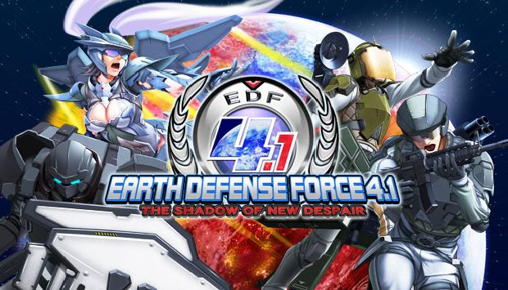
Developed by Sandlot
Produced by D3 Publisher Inc.

Slide 2
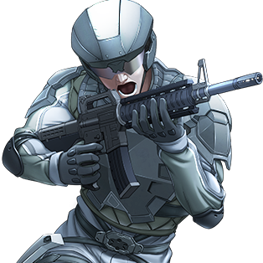
Basic Information
EDF 4.1 is an expanded and improved version of EDF 2025, which originally released in 2013. EDF 2025 and 4.1 are the sequel to EDF 2017.
NA PS3/Xbox360 release – December 8, 2015 NA Windows release – July 18, 2016
At its core, EDF is a third person shooter with horde combat.

Slide 3
The story so far
2017: In the year 2013 radio messages intercepted from deep space prove the existence of intelligent alien life. Due to the potential threat posed by beings with greater technology or perhaps physical ability, almost every nation on Earth pools resources together to form a unified military force known as the Earth Defense Force in 2015. In 2017 the world’s fears are realized with aliens (dubbed ravagers from then on) having hundreds of their UFOs hover above every major city on earth, led by a mothership above Tokyo, Japan. When the EDF is mobilized, the ships begin spewing out giant genetically engineered bugs, robots, and cybernetic monstrosities. Being unable to fight all the invaders coordinated by the mothership, Storm Team 1 decides to attack the mothership directly ending in it crashing to the ground in a great explosion. With the brains of the operation taken out, the remaining alien forces are scattered and disorganized, and eventually completely wiped out near the start of 2018. or so they thought…

Slide 4
Humanity is doomed!
2025:
After 7 years, an indescribable amount of giant insects bursts forth from the earth to reveal they have evolved. How could this be? The mothership destroyed in 2017 was only one of the many in earths orbit, which hid themselves behind the moon in wait for the giant insects to adapt for the final extermination of the human race.
The Earth is unprepared for another battle, but the EDF never gives up in the face of extreme adversity!

Slide 5
Okay, babe, get to the point. I just wanted to shoot some dudes.
In EDF 4.1 you play as an unnamed soldier in the EDF, and have a wide variety of weapons varying between each type of unit you can change between any time between missions. During this time, you can also change your weapon loadout and armor colors. Missions usually involve killing every enemy on the map, or surviving a certain amount of time. At random, enemies drop health crates (effect is obvious), armor crates (raise max health permanently at the end of the mission), and weapon crates (contains random mission-leveled weapons of your character’s type added to your equipment at the end of the mission).

Slide 6
Ranger
No gimmicks! This soldier relies on his firepower and evasive roll to survive. This character has access to all sorts of grenades, automatic rifles, shotguns, rocket launchers, flamethrowers, etc.
Anyone can be a passenger,
but rangers are the only ones besides
air-raiders that can drive vehicles.

Slide 7
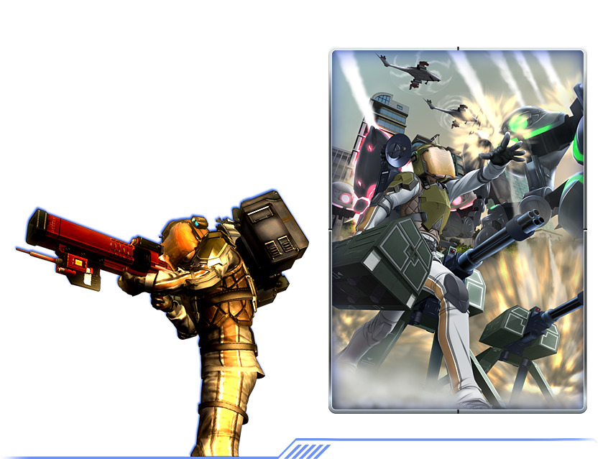
Air Raider
Air raiders are the technicians of the team. They can place turrets, claymores, health/damage boosters, call in many different types of air-strikes, call for vehicle drops, and more.
When not piloting
vehicles, they are not
defenseless, as the air raider also
has access to remote detonation
limpet guns, electro web launchers, etc.
Air raiders can also speed up the targeting
system of smart missile weapons used by their allies with their targeting laser.

Slide 8
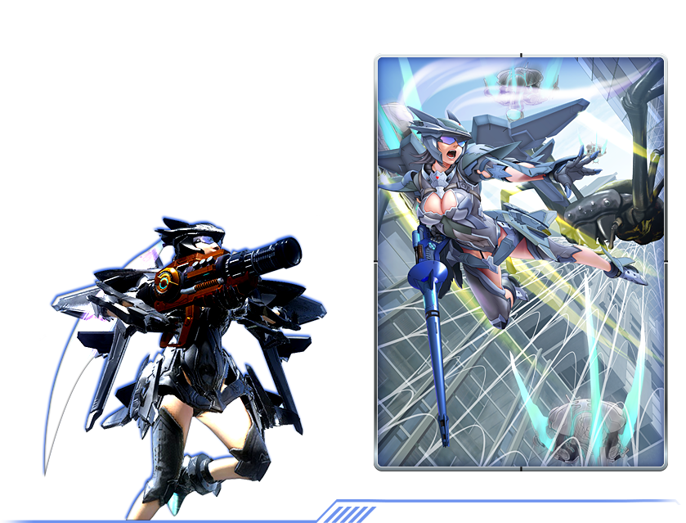
Wingdiver
Mobility is life! These characters can fly around the battlefield using their special jetpacks, and also use many types of energy based weaponry based off alien technology. Be wary, though, as their weapons draw from the same energy pool as their jetpack instead of using
the normal ammo system. If you don’t wait for your energy to recharge, you might overheat and plummet to the ground, defenseless.

Slide 9
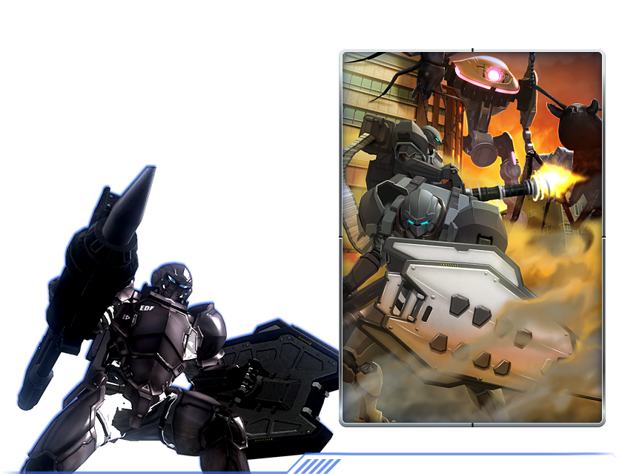
Fencers
With the most armor of any other character and the ability to use a weapon in each hand, this guy can take and deal a lot of damage. Can use all manners of heavy
weapons like missile launchers , gatling guns, etc. This dude can also use shields to block
damage and reflect projectiles Also has access to melee weapons
like hammers, energy blades, pile bunkers, which coupled with their jet boosters makes
them swift and deadly.

Slide 10
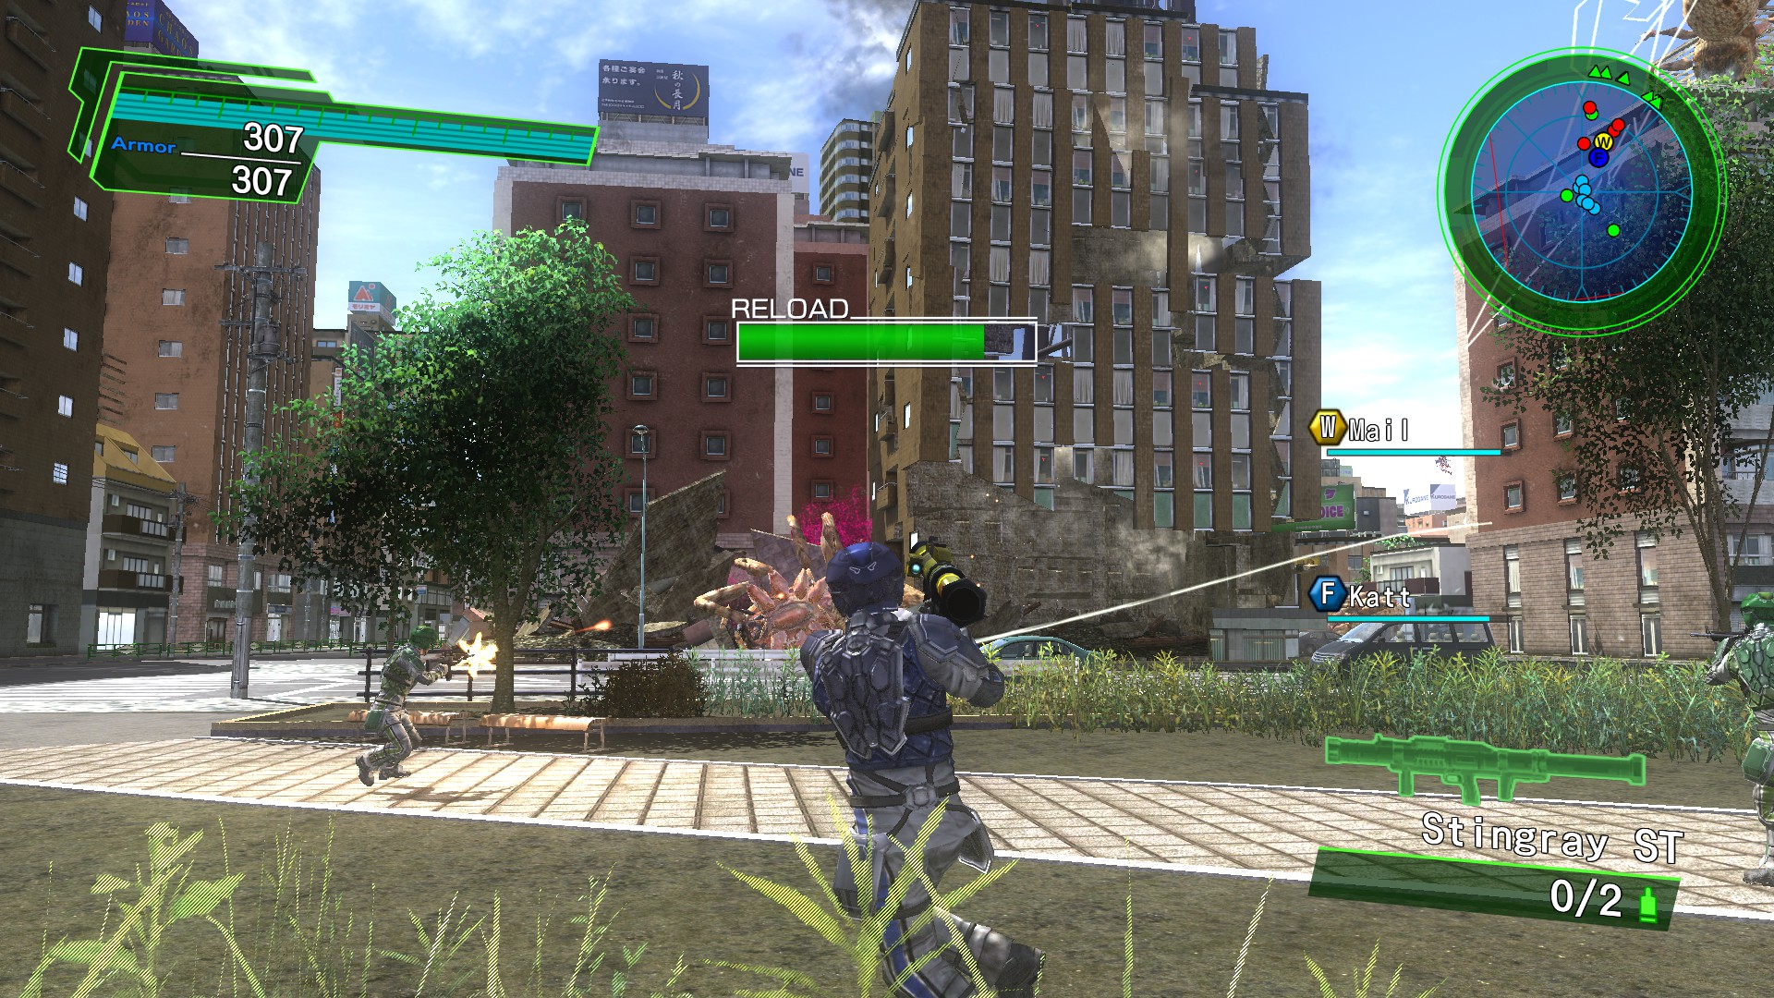

Slide 11
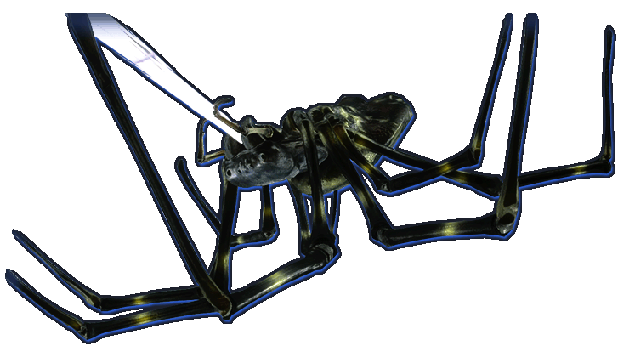
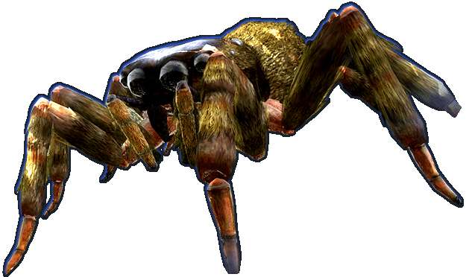
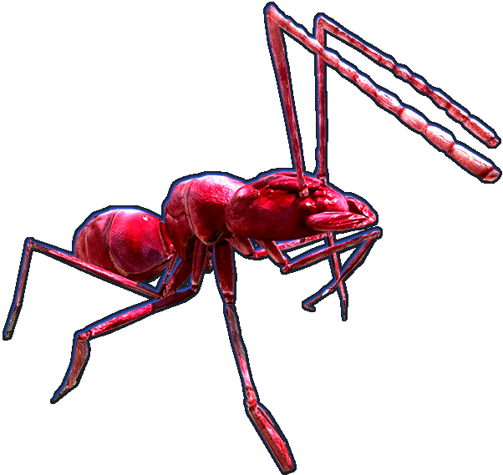
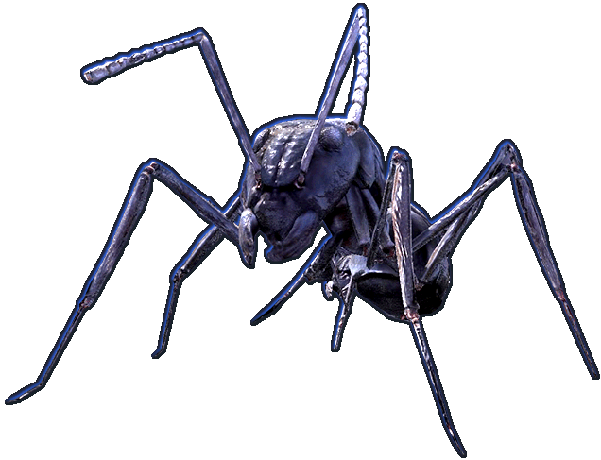
Bugs?

Slide 12
Actual bugs
Strange player ragdoll behavior that sometimes causes you to be flung across the galaxy.
Not much else.

Slide 13
Review - positives
Ridiculous amount of weapons to try out, missions to do, etc.
Difficulty ramps pretty well, with a few really hard missions here and there to surprise you.
New enemy types are foreshadowed in npc dialogue and introduced at regular intervals throughout the campaign.
Many ways to communicate with your team, whether it is voice-chat, text shortcuts (many are voiced by the character), or directly typing.
Online co-op is very satisfying and will have you yelling EDF after about an hour or two.
Splitscreen local co-op is supported which is a plus.
Npcs can respond to your communication shortcuts in a semi-random way that is pretty humorous.
Very accurate hitboxes.
Sense of scale that games don’t typically use. You can be fighting things in this game thousands of times larger than you at times, which is really neat to see.
Destructible buildings

Slide 14
Review - negatives
Art is rather basic and last-gen (even when the game first came out).
You can select any difficulty at any time, but is balanced for players to play through them in succession so they can build up their max health (they don’t tell you this).
Cheesy dialogue and setting (some people don’t like this).
Some weapons suck so bad that they usually end up killing you (pretty funny though).
Dragons are not insects, no matter how many times story dialogue asserts that they are.

Slide 15
Who is it for?
ESRB rates it at mature, as the word “shit” appears a couple time in dialogue, accompanied with “realistic gunfire”. Honestly, I think this is appropriate for people 12+, as the game is rather cartoonish. Younger children might get frustrated with the later missions though. Personally I find the game very enjoyable even at my age.

Slide 16
Related games and ways to improve.
EDF is a series, but this one is hands down the best one released in the west at the moment. I haven’t played any other games that can replace the feeling of EDF.
The game would benefit from better controls on certain vehicles like the grape APC, and the motorcycle which can’t even make a turn without flipping over. The game would also benefit from making more map variants, as throughout the game you can recognize old areas reused, and all of them currently look like Japan despite being supposedly around the world. Also, it cheapens the experience to play online with someone that has 10x your health, so lowering the max armor for each mission would be ideal.

Slide 17
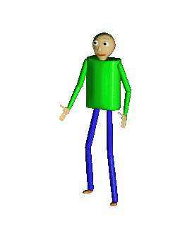
Final rating
4.5 outta 5
Okay, this is epic. -IGN

Slide 18
Summary
EDF 4.1 is fairly unique and offers an experience unlike other third person shooters.
The amount, variety, and size of enemies makes it fun to kill them.
There are over 800 weapons.
There are four types of characters to play as.
You can blow up entire city blocks to kill a couple ants.
Looks like a bad SyFy movie.
Good co-op game.
S’alright.

