Slide 1
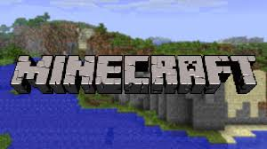
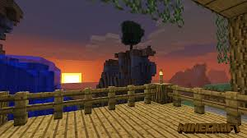
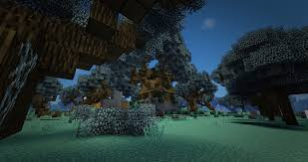
Minecraft Game Evaluation
Richard Curylo
CIS 487
F2018

Slide 2
System Requirements and Installation
CPU: Intel Core i-3210 3.2GHz / AMD A8-7600 APU 3.1GHz or better
RAM: 2GB or more.
GPU: (Integrated) Intel HD Graphics 4000 / AMD Radeon R5 series
or
(Discrete) Nvidia GeForce 400 series / AMD Radeon HD 7000 series
*OpenGL 4.4
Networking: Internet connectivity required for initial setup and multiplayer.

Slide 3
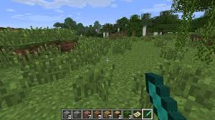
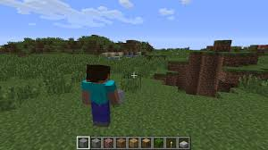
Player Perspectives

Slide 4
Gameplay
Single Player Multiplayer
Creative Creative
Survival Survival
Hardcore Hardcore
Spectator

Slide 5
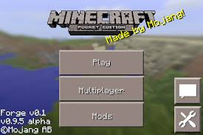
Moding

Slide 6
Looking to the future
Cross Platform
Customizable
Well established
Low graphics

Slide 7
Summary
Fun voxel based sandbox game.
Highly customizable through moding interface.
Large well established moding community.
Moderate cost.

