Slide 1
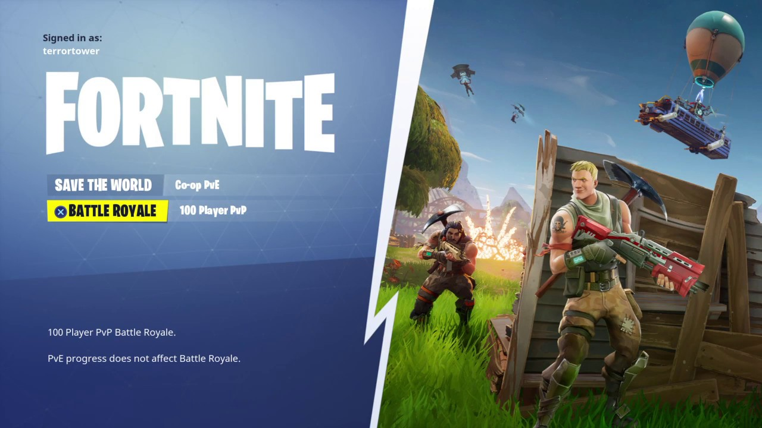
Game Review by Delson Christian
Just build lol

Slide 2
Basic info
Epic Games Known for making popular games like Gears of War and Paragon
Save the World PvE Tower Defense style
Battle Royale 100 player survival
Specs
Minimum Recommended
Processor Core: i3 2.4 Ghz
Memory: 4 GB RAM
Video Card: Intel HD 4000 -Basically a potato can run this b
Its literally free it does not cost anything
PogChamp
Processor Core: i5 2.8 Ghz
Memory: 8 GB RAM
Video Card: Nvidia GTX 660

Slide 3
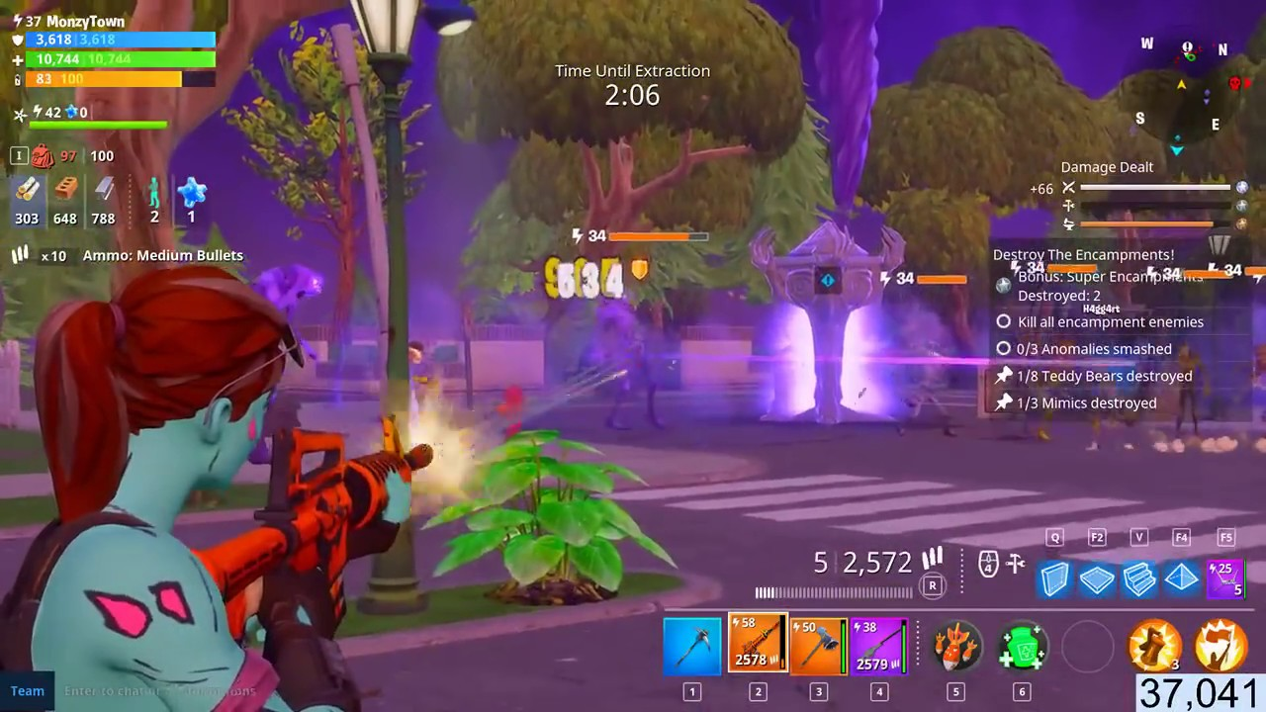
Game Summary
Save the World a storm knocks 98% of the Population and spawns zombies
You craft more powerful weapon with materials you harvest as you progress through the map
Player’s Role Defend against waves of zombies
Battle Royale
Players parachute into a large map and most avoid the storm and defeat other players until there is one player or team left standing

Slide 4
Game Review
Fun
You can build literally anywhere, very exciting to be the last survivor or try to win for your team
Very high skill gap with building
With a lot of low skill shenanigans like shotguns
Not fun
Lag server can’t handle many players in small area
Add too many items instead of balancing the ones in the game

Slide 5
Game Review Cont.
Competitors
Player Unknown Battle Grounds, PUBG
The dead meme known as H1Z1
Black ops 4 is going to have a battle royal mode also
For better or for worse
Almost all weapons are hitscan besides sniper rifles
Bloom mechanic meaning crosshair gets larger as you shoot randomize
PUBG uses realistic mechanics like bullet drop and recoil

Slide 6
Game Review Cont.
Skill Gap
Players are able to build structures in order to provide cover and game a positional advantage over players
Appropriate Audience All gamers
Uses cartoony graphics to make it appealing to everyone
Some people consider it a children’s game due to the graphics
Design Mistakes
Balancing issues with new items that are added -Aka pro 90 and double barrel shotgun
Nerfing the skill gap by lowering the effectiveness of building

Slide 7
Summary
Strengths and Weakness
Very fun and addicting Battle Royale
Its free and available on every platform of course its worth purchasing
Improvements
Making the Save the World side of the game better and supporting a more competitive playstyle

