Slide 1
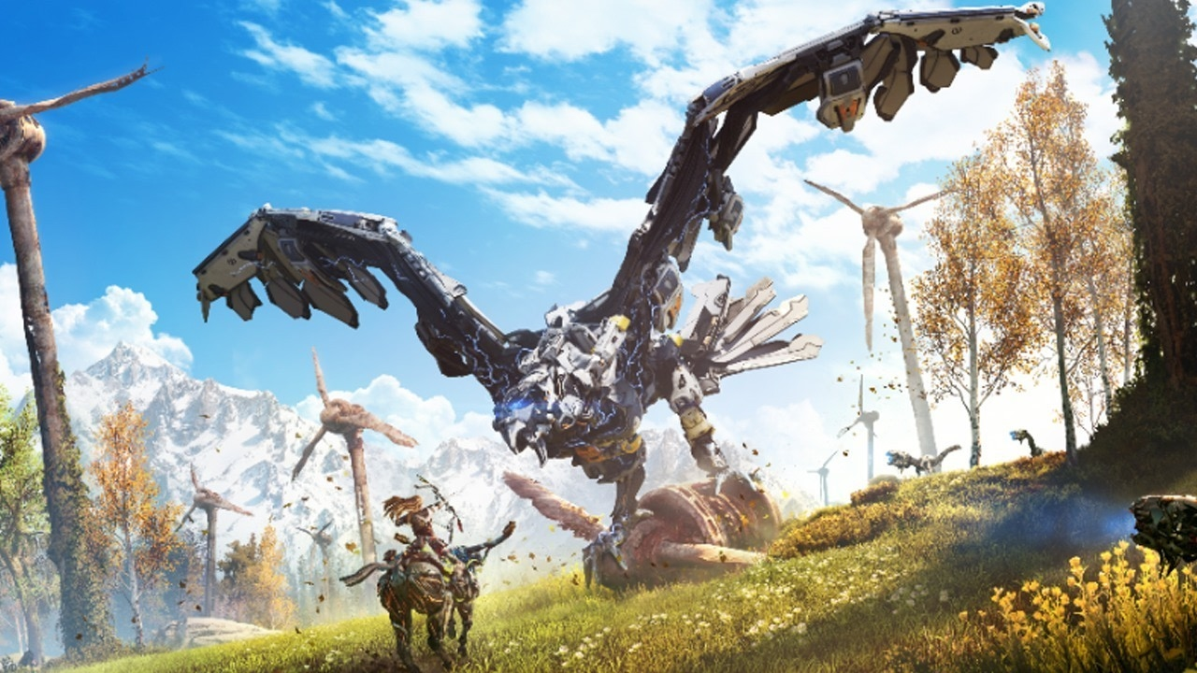
Horizon Zero Dawn
Developed by: Guerrilla Games
Authors: John Gonzalez, Ben McCaw

Slide 2
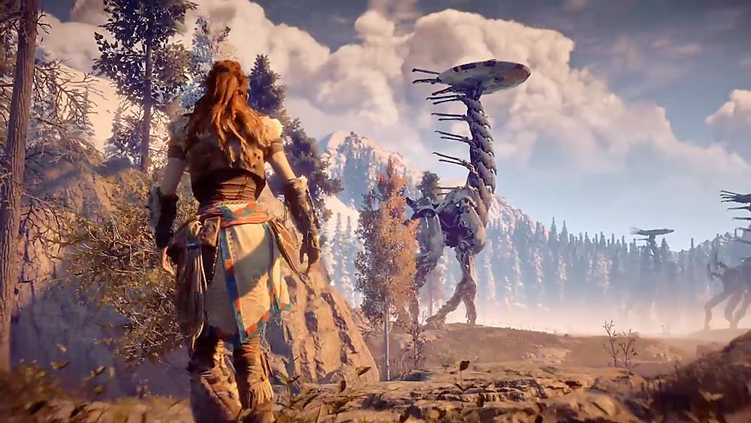
Basic info
Published: February 28, 2017(PS4), Winter 2018(PC)
Genre: Single player Action Role-Playing
Price: $20.00
Installation: Requires 50 GB of data to install
Minimum requirements:
Operating System: Windows XP SP3.
Processor: Intel Core 2 Duo 1.8 GHz or AMD Athlon X2 64 2.0 GHz.
RAM: 2 GB.
Graphics: 512 MB Video Card w/Pixel Shader 3.0 Support.
DirectX: Version 11.
Storage: 2 GB.
Recommended requirements:
Operating System: Windows 7
Processor: Intel Core i3/i5/i7 or AMD equivalent
RAM: 4 GB
Graphics: 1 GB ATI 4800 series or better, 1 GB NVIDIA 9800 or better
DirectX: Version 11
Storage: 2 GB

Slide 3
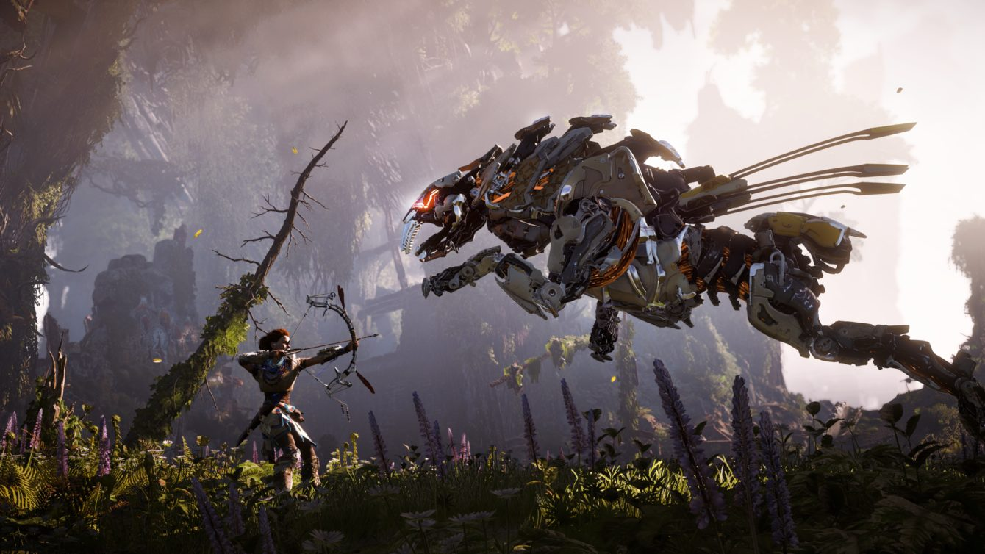
Story summary
Control Alloy as you wander through a destroyed earth, as she seeks revenge for her fallen mentor and guardian. While doing so she discovers her true origin and the truth behind why the world is in the state its in and why she has been seemingly chosen to fix it.

Slide 4
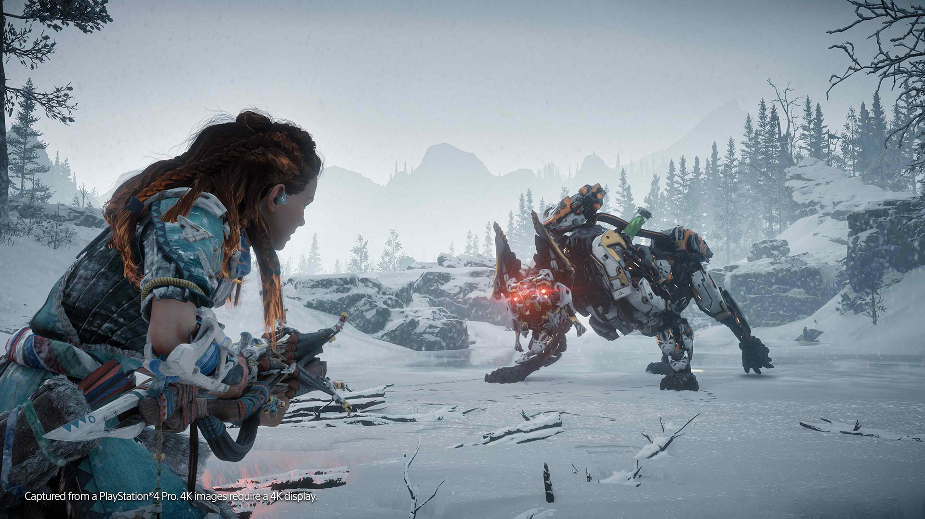
Game Play
Archery styled shooter with light hack and slash elements
Interactive free running (character responds dynamically
to environment and obstacles around the in game world)
Choose between multiple weapons( sling, blade, bow and arrow, ect.) depending on the enemy type and their weaknesses
Experience points based level progression (more experience is rewarded for stealthy or technical kills and the type and difficulty of enemy)

Slide 5
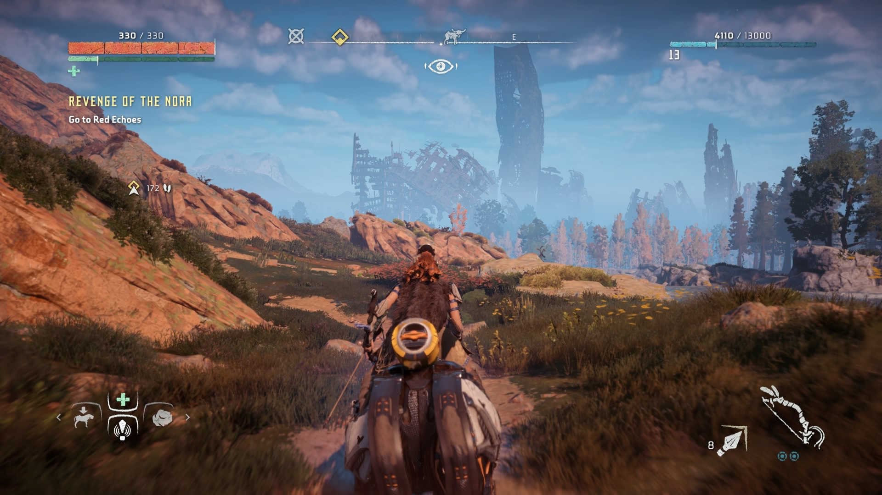
User InterFace
Controller/Mouse and keyboard input
Pause menu interface is easy to navigate and after the first 30 minutes of actual gameplay it is also quite easy to understand
Beautifully designed HUD (never feel like its in the way or that it’s too
clunky(except when your trying to place a trap).

Slide 6
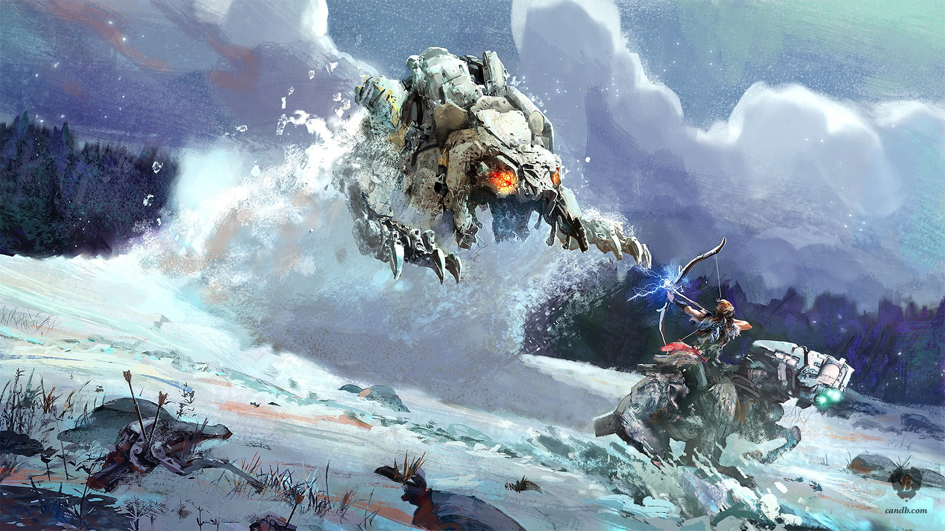
Art &sound
Artwork By: Jan-Bart van Beek
Composer: Joris de Man
Horizon was arguably the best looking video game that came out in 2017 the game takes place in for the most part 4 different terrains (snowy , desert, jungle/forest, and caves and they are all beautifully done with sound and music changes that help the player stay immersed in the world

Slide 7
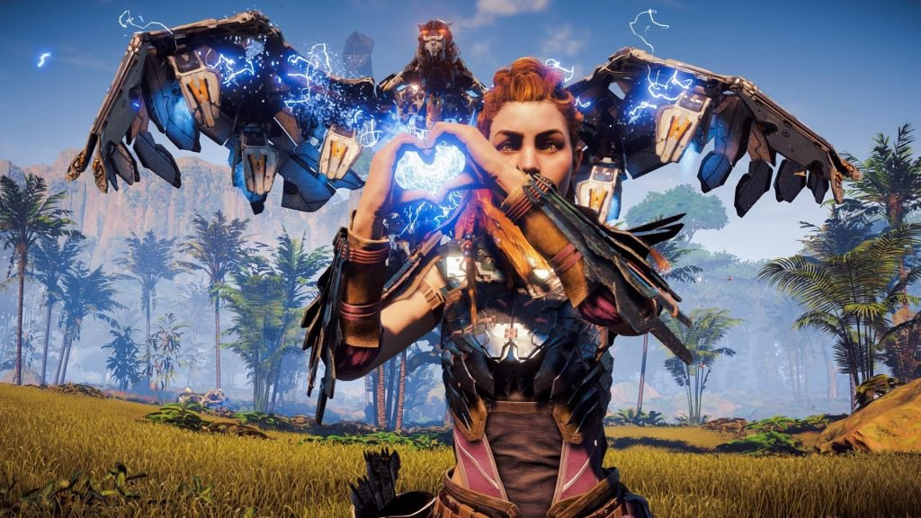
Special Features and Quality
Horizons Complete edition comes with an art book and also comes with an artbook and DLC (Frozen wilds)
Horizon is a very well polished game through 2 playthroughs I have encountered 0 bugs big or small which is very rare for most video games in the last couple of years.
Horizon also has photo mode which allows you to take creative pictures of the beautiful world laid out for the player

Slide 8
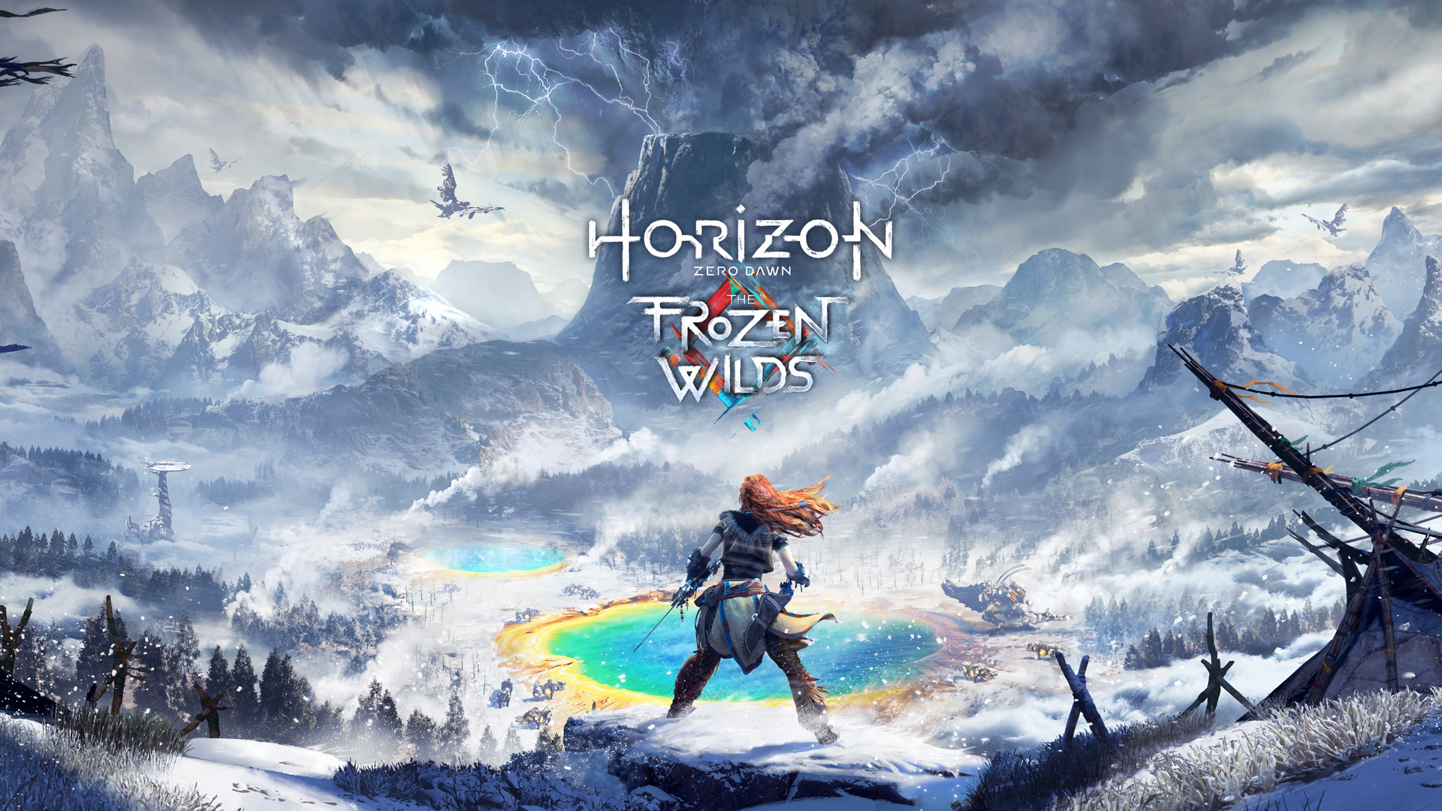
Game Review
What is good (fun) about the game? Why?
The three things that standout with Horizon the most are exactly why I feel it is a great game. It’s graphics ,story, and gameplay all kept me playing until I literally could not anymore.
The story is thrilling and intriguing due to the mystery behind the protagonist’s and antagonist’s origin. The graphics speak for themselves and the gameplay is original because of the system that allows you to pick specific parts of the enemies to dismember and if they are not defeated by your attack they are visually effected by your attack.

Slide 9
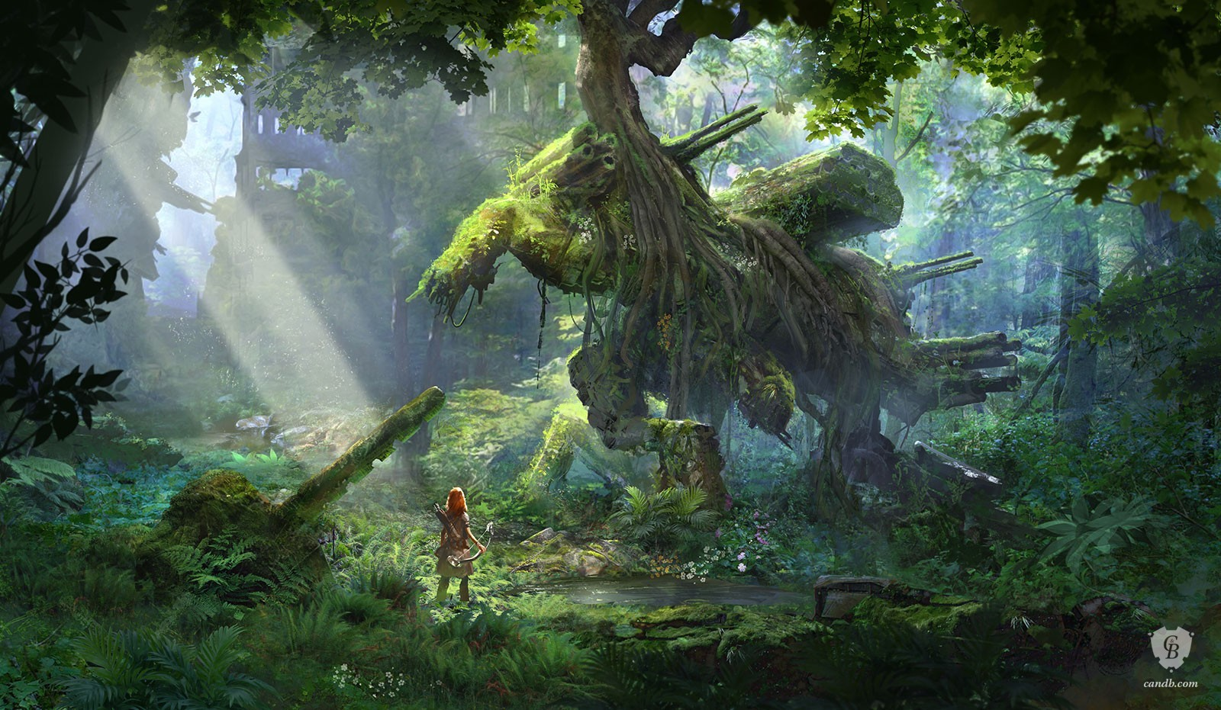
Game Review Pt.2
There are not many bad spots in Horizon but there is one thing that does stand out the story was a little bit dragged out there were certain points. Given context clues I figured out the details of certain events but the main character didn’t so there would be a whole mission dedicated to finding out something you are already aware of it just feels like I was being forced to play during those missions.

Slide 10
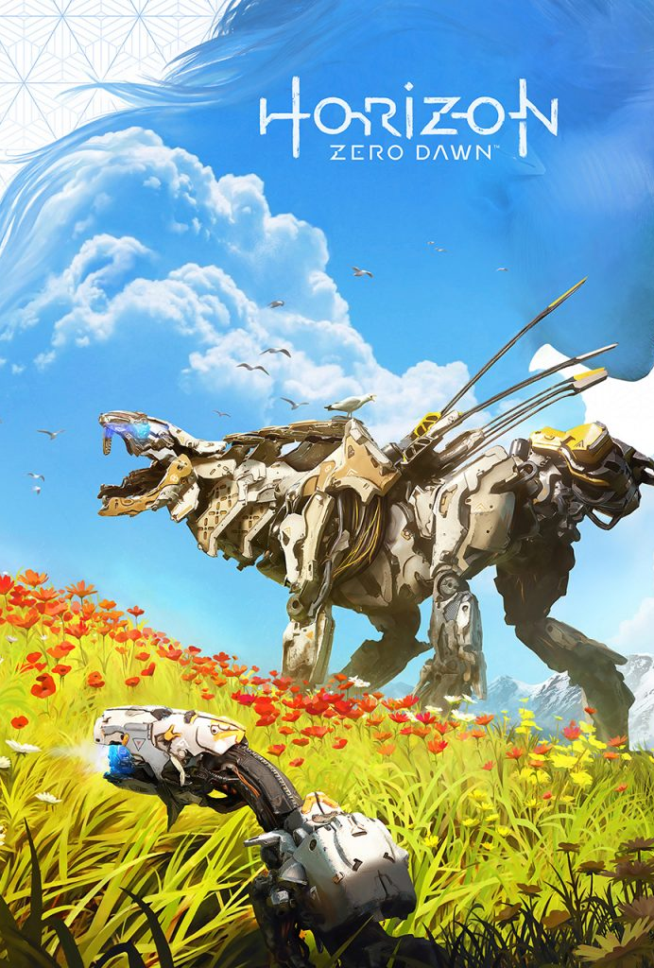
Related games
Rise of the Tomb Raider- similar archery and free running feel
Witcher 3: Wild Hunt- both are 3rd person lore heavy rpgs
I feel that horizon was the more enjoyable game because it was way easier to pick up and the lore was easier to follow for me

Slide 11
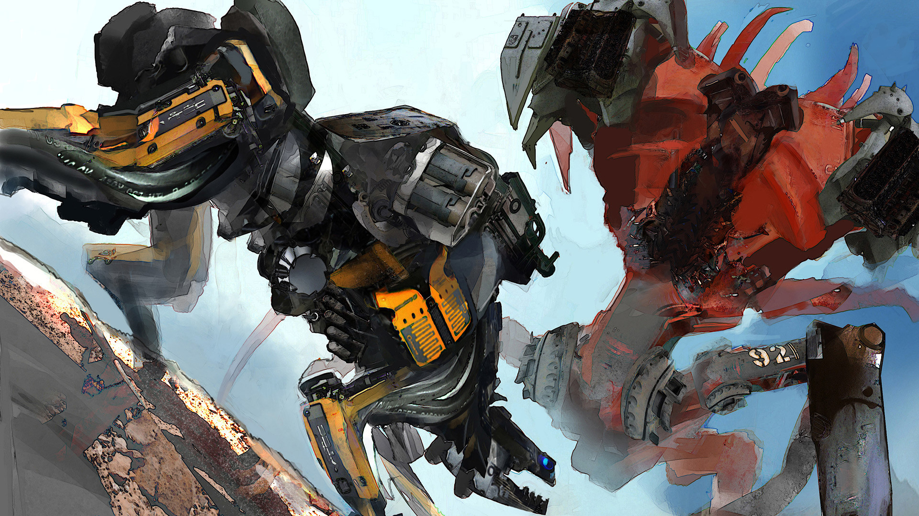
Audience and Design
Horizon features violence and harsh language though it is not excessive I feel it is a suitable game for anyone 10 or older
The only design flaw I saw in the game was that the enemies leveled by zone and forcing you to go through areas where enemies are impossibly stronger than you could be at that point forcing you to do side quest and farming for better equipment. But this was probably done purposefully to extend gameplay.

Slide 12
Strengths and weaknesses
Strengths: Story, gameplay, originality, graphics
Weaknesses: Boring main character, limited replay ability, choices did not matter the majority of time
Game could be improved by: Multiplayer, more enemy types and skill upgrades.

Slide 13
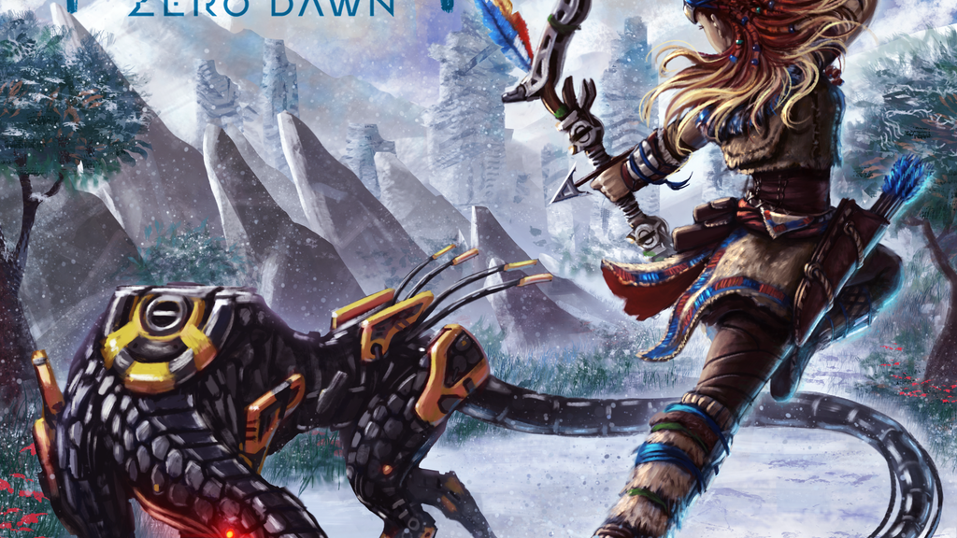
Should you buy
The complete edition of the game goes for $20 and that is way more than a fair price for a game of this caliber and it just came out last year.

