Slide 1
Dance Dance Revolution
By: Brandy Boggs

Slide 2
About
Known in Japan as Dansu Dansu Reboryūshon
Developed by Konami’s music game division BEMANI
The player presses arrows with their feet in time with the music
Performance is scored by arrow alignment with the target upon press
Newest version, DDR Ace, features 781 songs

Slide 3
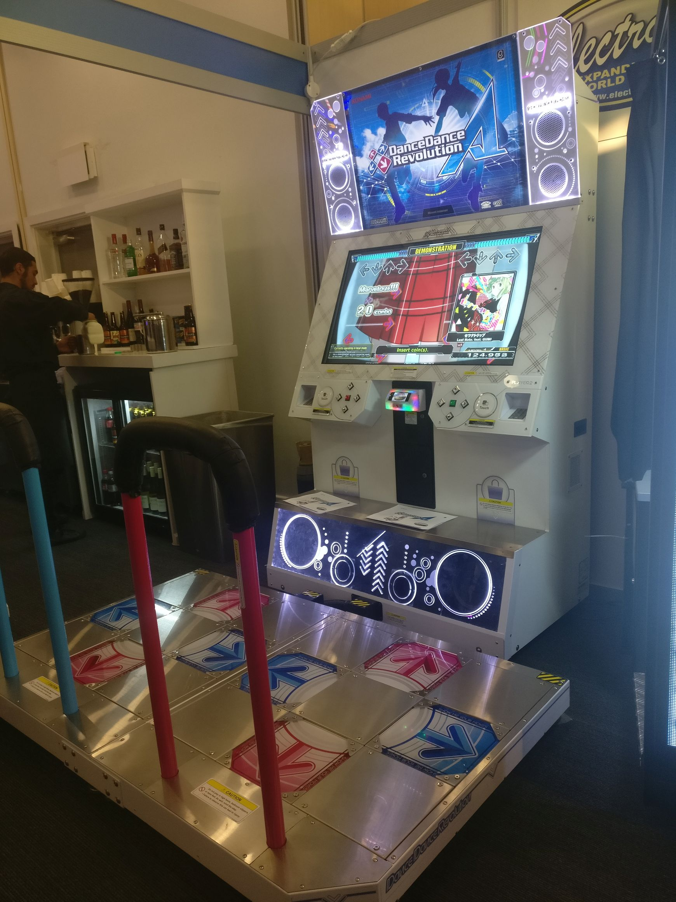
Hardware
Most recent version is found only on arcade cabinets
Cabinets can be found at Dave & Busters and Round 1 locations

Slide 4
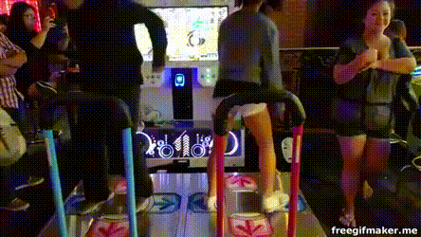
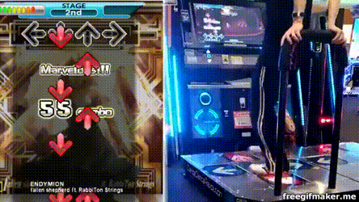
How to Dansu
Freestyle:
Dance routines performed while playing the game
Use of lower difficulty charts
“Stunts” performed during play
Technical:
Focus on timing and pattern reading
Score perfection
Most competitive form of play

Slide 5
Good
High Variance in music selection
Dynamic/interesting gameplay
Great cardio workout
Friendly competitive community

Slide 6
Bad
Repetitive Gameplay
Limited to only four panels
Little change to the “formula” over 20+ years
Some features locked behind PASELI (Japanese subscription service)

Slide 7
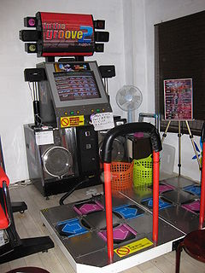
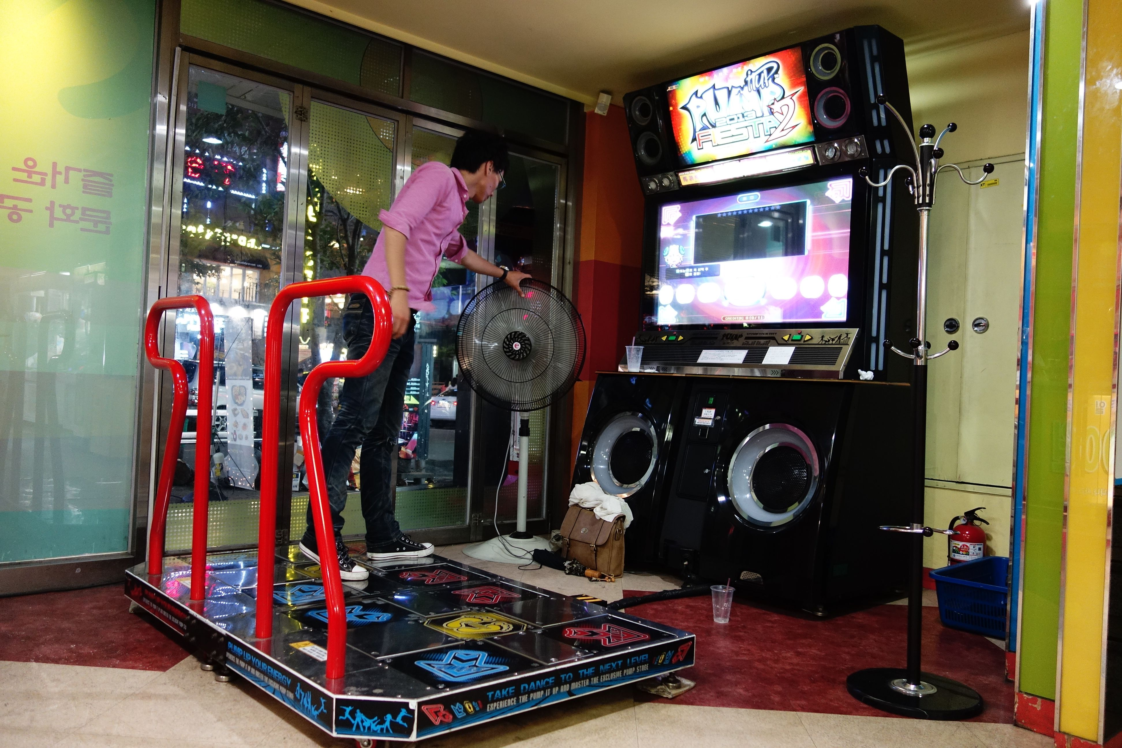
Similar Titles to DDR
In the Groove
DDR but American
Sued by Konami
Only exists in our hearts
Pump it Up
Korean foot rhythm game
Panels laid in a X pattern
Honestly not that great

Slide 8
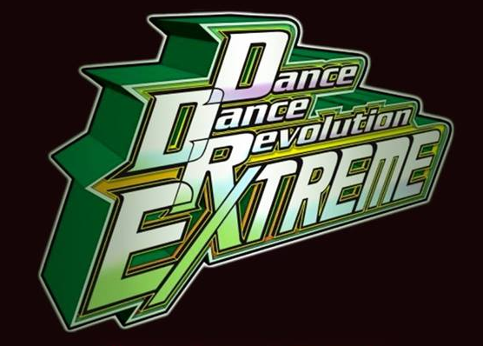
In Summary
DDR is a game for anyone who enjoys exercise and rhythm games
Has different styles of gameplay for hardcore and casual
Has withstood the test of time for over 20 years now

