Slide 1
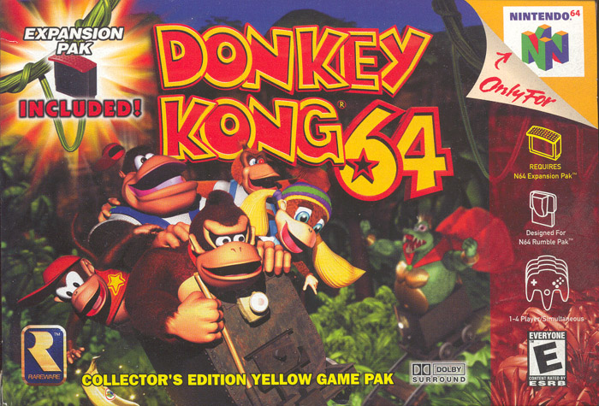
Image source: http://donkeykong.wikia.com/wiki/Donkey_Kong_64?file=Dk64.jpg

Slide 2
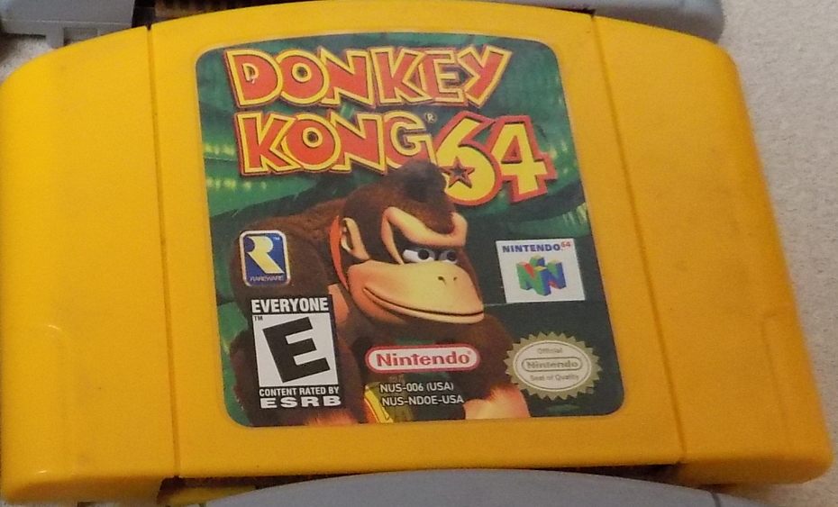
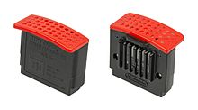
Basic Information
Title: Donkey Kong 64
Platform: Nintendo 64
Developer: Rare
Publisher: Nintendo
Type of Game: 3D Adventure Platformer
Original Price: ~$59.99 (Includes expansion pack)
eBay used: ~$15-20 (Cartridge only)
Wii U Virtual Console: $9.99 (Digital download)
Minimum stated hardware: N64 + Expansion Pak
Actual hardware required: N64 + Expansion Pak (or Wii U)
Image source: https://en.wikipedia.org/wiki/File:Nintendo-64-Memory-Expansion-Pak.jpg

Slide 3
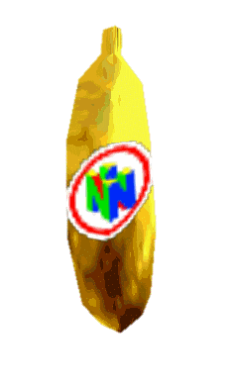
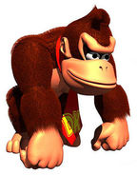
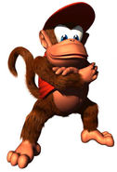
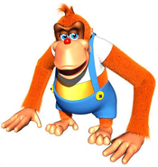
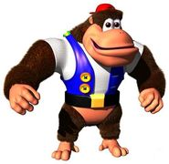
Game Summary
DK 64 is a 3D platformer adventure game that emphasizes on exploration and the collection of items.
The story involves King K. Rool wanting to cause harm to Donkey Kong’s island. K. Rool kidnaps Donkey Kong’s friends and steals his golden bananas to distract him before delivering his “lizard flavored surprise”.
The player’s role of the game is to play as the Kongs to rescue the Kongs and to collect golden bananas in order to defeat K. Rool.
Images source: http://donkeykong.wikia.com/wiki/Donkey_Kong_64

Slide 4
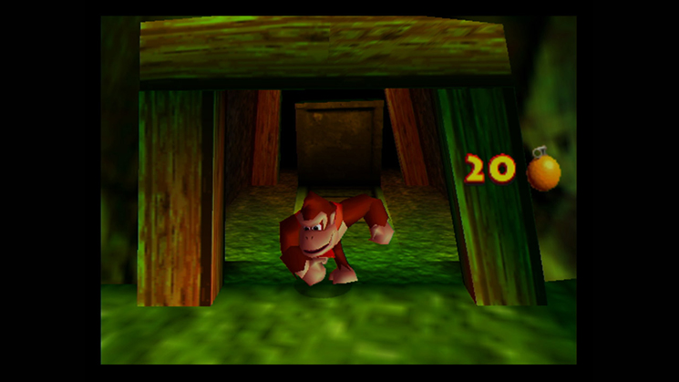
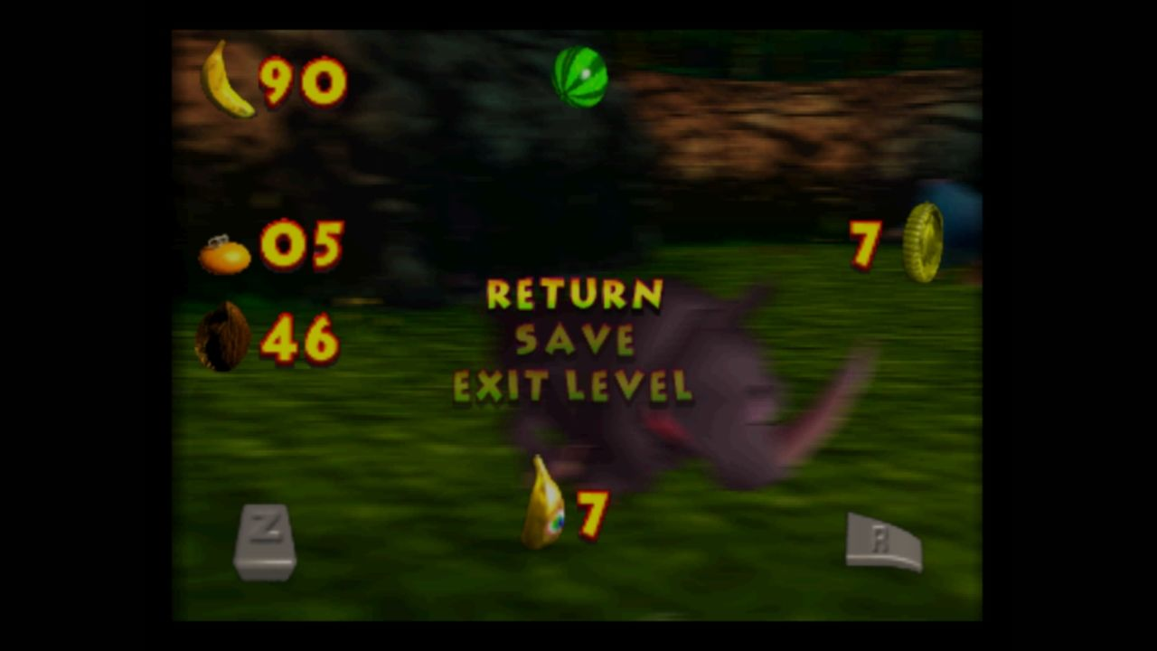
Game Summary
Installation is plug & play on original hardware or download & play on the virtual console.
The user interface is minimal.
The main menu allows you to manage options and save files.
There is no in-game interface during the majority of the game.
When your health, item count, or collectibles gathered updates, the new value is temporarily displayed on-screen.
The game can be paused at any point to view health, items, or collectibles.
Image source: https://www.nintendo.com/games/detail/-L-sytPSngSbZEEkyksX6NLu75c8srJS
Image source: http://www.mobygames.com/game/wii-u/donkey-kong-64/screenshots/gameShotId,775728/

Slide 5
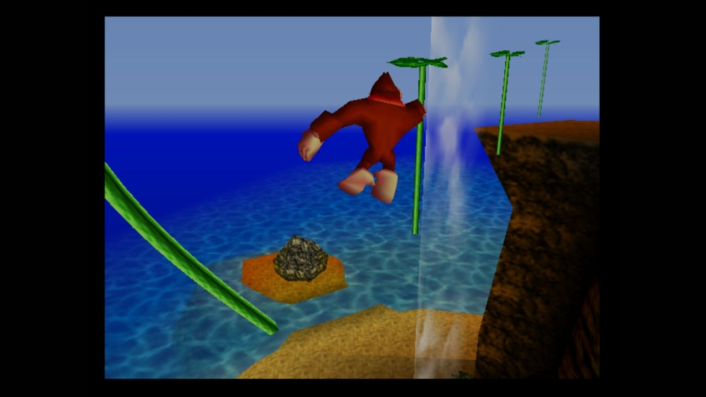
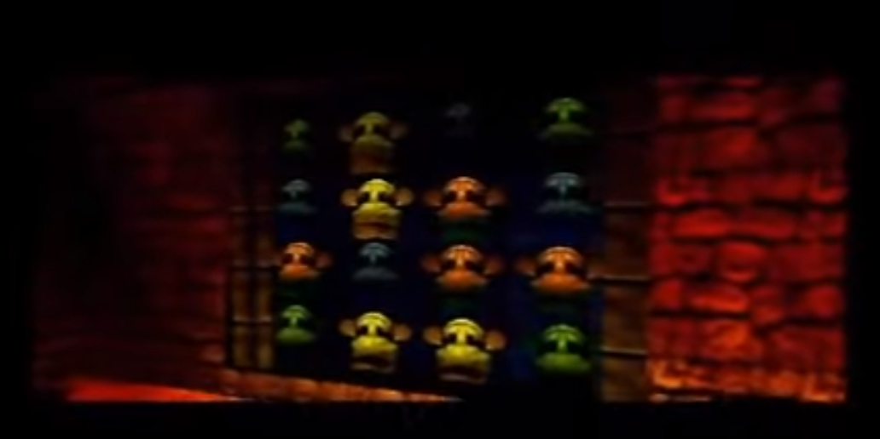
Game Summary
Gameplay consists of
Platforming & Exploring
Puzzles
Image source: http://www.mobygames.com/game/wii-u/donkey-kong-64/screenshots/gameShotId,775718/
Image source: https://youtu.be/vaZeZVbsIys?t=540

Slide 6
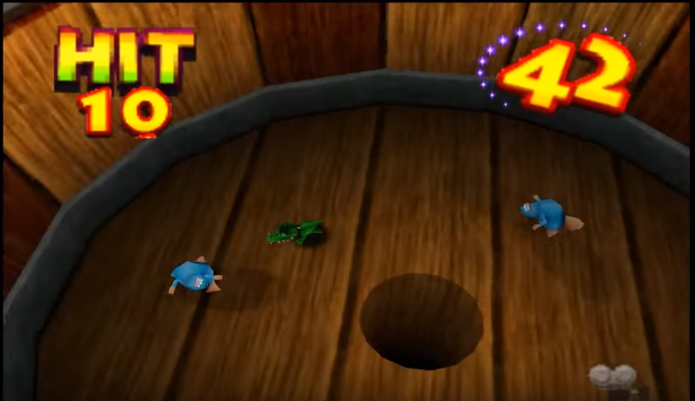
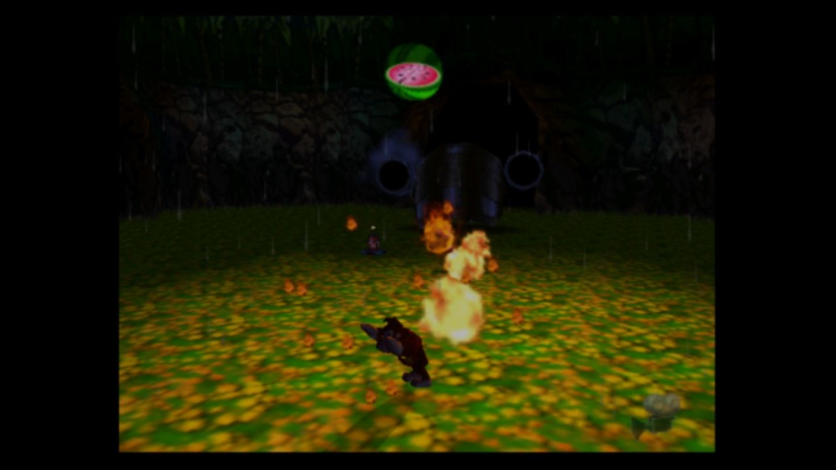
Game Summary
Gameplay consists of
Minigames
Boss fights
Image source: https://youtu.be/a0_DR4P6x8k?t=19
Image source: http://www.mobygames.com/game/wii-u/donkey-kong-64/screenshots/gameShotId,775765/

Slide 7
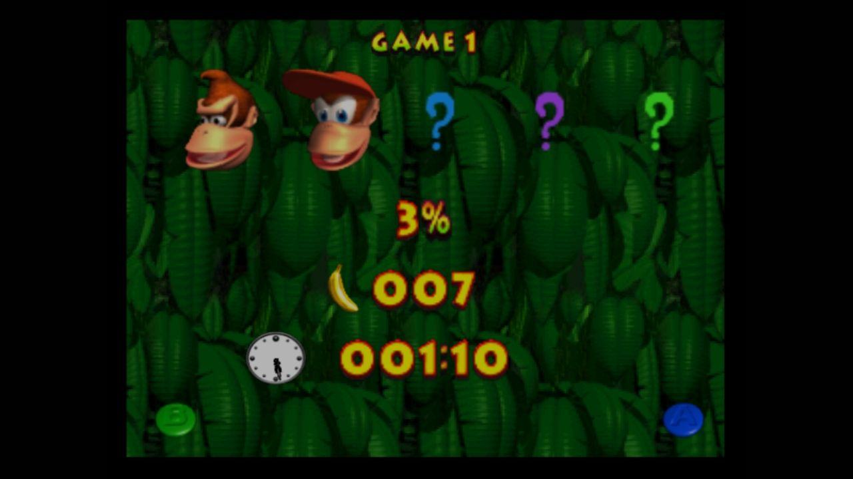
Game Summary
There is no game score, but a player’s collected items can be viewed, and game completion is tracked as a percentage.
Image source: http://www.mobygames.com/game/wii-u/donkey-kong-64/screenshots/gameShotId,775712/

Slide 8
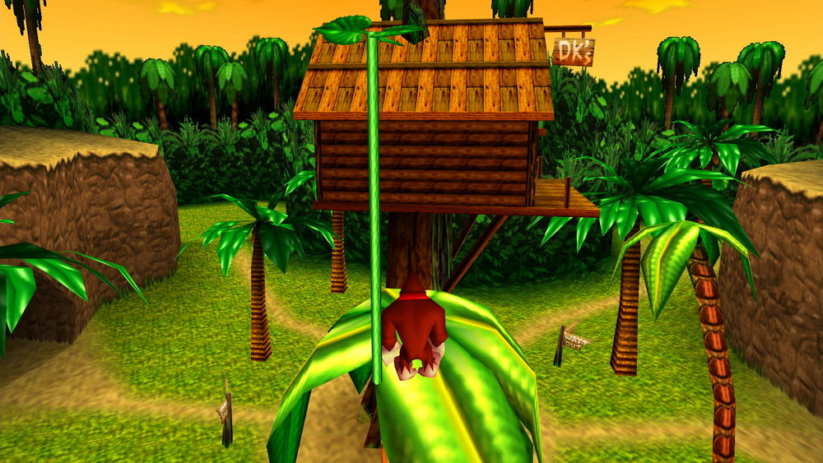
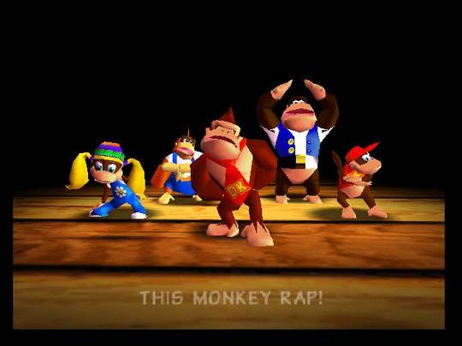
Game Summary
The artwork of the game is detailed and unique
9 large, detailed, worlds with good textures and lighting.
Many unique characters and enemies with good animation.
Although good at the time, low polygon graphics didn’t age well.
Sound and music are fantastic
Plenty of unique sounds throughout gameplay that are not too repetitive.
Great tracks that suit each environment.
Donkey Kong Rap!
Image source: http://donkeykong.wikia.com/wiki/Donkey_Kong_64?file=Project64_2011-12-21_10-33-05-69.jpg
Image source: http://donkeykong.wikia.com/wiki/DK_Rap?file=DK_Rap.jpg

Slide 9
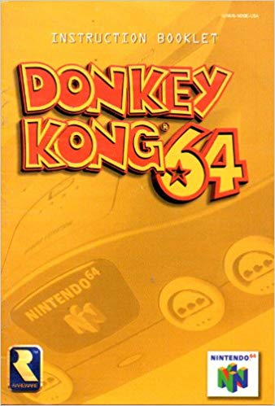
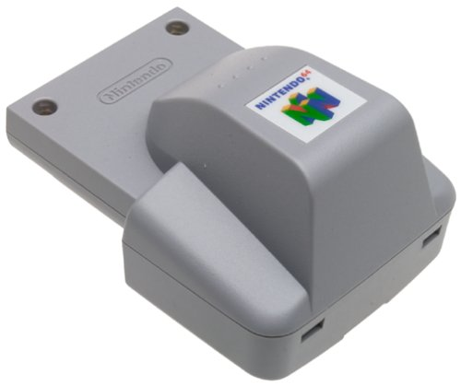
Game Summary
Aside from special minigames to be played, the game featured better framerates and better long-distance rendering thanks to the Expansion Pak. The game also featured compatibility with the Rumble Pak
Each game was packaged with a manual full of information about how to play the game.
Although very robust, the game suffered from a couple of bugs.
The camera is bad at times, either giving the player terrible angles or giving the player no sight of their Kong.
In recent years, a programmer noted that the Expansion Pak was required to prevent game crashes.
Image source: https://www.amazon.com/Donkey-Instruction-Booklet-Nintendo-Manual/dp/B0090UAU1A
Image source: https://www.amazon.com/Nintendo-64-Rumble-Pak-NUS-013/dp/B00004S9AA

Slide 10
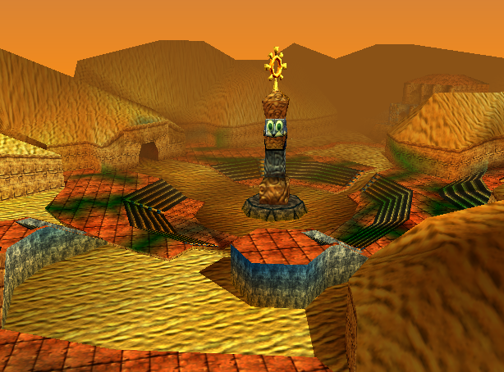
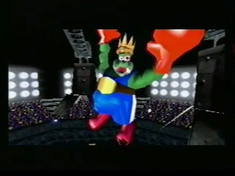
Game Review
The good
The game helps the player get on their feet through a good set of tutorials at the beginning.
The length of the game – 9 large worlds!
The variety of gameplay
Special moves and abilities for each character.
Minigames were good for taking short breaks from the platforming.
Swimming, racing, flying, shooting, fly swatting, and more!
Puzzles are fun and interesting.
Boss fights are both a reward and a challenge after collecting is done in a world.
The ability to explore, non-linearity.
Environments were so unique they almost felt like games of their own. Artwork, sound, and music are excellent.
Classic arcade gaming – Original Donkey Kong!
Awesome final boss fight that requires mastery of each Kong.
A cool multiplayer game mode to fight your friends!
Image source: http://donkeykong.wikia.com/wiki/Angry_Aztec?file=Angry_Aztec.PNG
Image source: http://donkeykong.wikia.com/wiki/King_K._Rool?file=Krool64.jpg

Slide 11
Game Review
The bad
Backtracking occurs way too often. Each collectible is unique to a specific Kong, and collecting requires too much character switching.
Repetition throughout the game makes it boring at times
Minigames later in the game are often just more difficult versions of previous minigames. Players might avoid these in order to dodge repetition.
Combat is too simple and not rewarding enough to engage any enemies; enemies are mostly a nuisance to platforming.
The camera and controls have a unique learning curve.
Too many collectibles?
Images source: http://donkeykong.wikia.com/wiki/Donkey_Kong_64

Slide 12
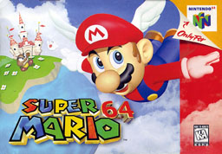
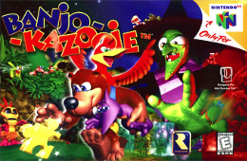
Game Review
Comparisons to other 3D platformers on the Nintendo 64
Super Mario 64
Donkey Kong has more content
201 bananas vs 120 stars
More than just a single playable character
Guns!
Better graphics
No rap music in Mario
Both games have great levels
Banjo Kazooie
Both games are “collect-a-thons”
Banjo focuses more on the platforming than Donkey Kong.
No backtracking in Banjo Kazooie, since the Bear and the Bird have all of the abilities
Donkey Kong has larger worlds
Image source: https://en.wikipedia.org/wiki/File:Super_Mario_64_box_cover.jpg
Image source: https://en.wikipedia.org/wiki/File:Banjo_Kazooie_Cover.png

Slide 13
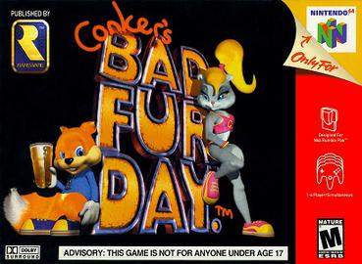
Game Review
Comparisons to other 3D platformers on the Nintendo 64
Conker’s Bad Fur Day (BFD)
BFD was created for an adult audience. It features adult humor.
Conker’s offers more than just gameplay. It features many cut scenes and voice acting, and it is all about the story.
What game is the best? It depends! Each game is unique in its own ways.
If all you care about is platforming, try Super Mario
If you just like collecting, try Banjo Kazooie
If you like a gaming experience with a good story line, try BFD
If you like everything and then some, try Donkey Kong!
My personal favorite? Donkey Kong!
Image source: https://en.wikipedia.org/wiki/File:Conkersbfdbox.jpg

Slide 14
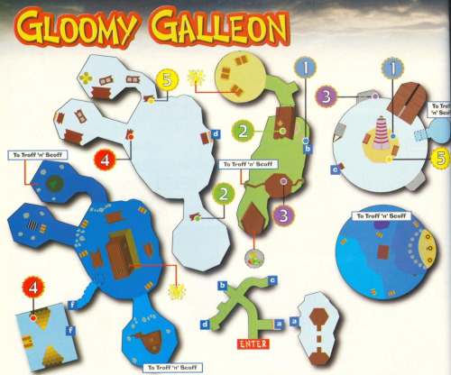
Game Review
Children are the appropriate audience for the game.
Rated E, no blood or extreme violence
Not very difficult, but still challenging
Can still be enjoyed by anyone!
A couple of design mistakes
The amount of backtracking is unacceptable. It takes away from the player’s desire to explore.
The recycled minigames and bosses are too tedious. Maybe this was a result of a time constraint.
Image source: https://commons.wikimedia.org/wiki/File:ESRB_2013_Everyone.svg
Image source: http://donkeykong.wikia.com/wiki/Gloomy_Galleon?file=Gloomy_galleon_map.jpg

Slide 15
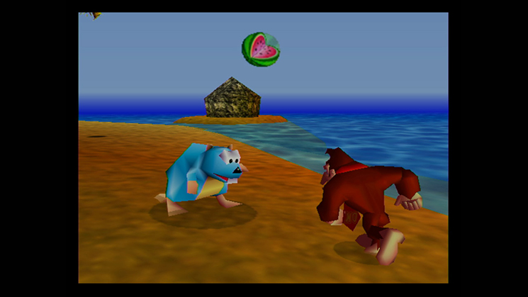
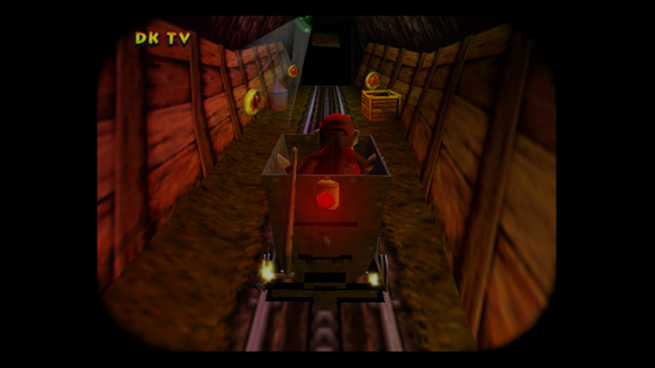
Summary
Overall strengths
A great 3D platformer with plenty of great mechanics to be enjoyed by people of all ages.
Plenty of varying content to keep you entertained for several hours.
An overall memorable experience.
Overall weaknesses
The game can be repetitive, which can make the player bored.
Rare made the mistake of forcing too much backtracking.
Images source: https://www.nintendo.com/games/detail/-L-sytPSngSbZEEkyksX6NLu75c8srJS

Slide 16
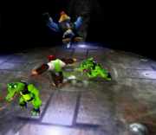
Summary
Is it worth purchasing?
If you have any interest in 3D platformers, then give this one a chance for $9.99 on the Virtual Console. You get a lot of bang for your buck, but just remember that the game has its flaws.
How could it be improved?
Include a feature to switch characters via the pause menu, rather than through the Tag Barrel.
Remove the repeated minigames in favor new ones.
Image source: https://www.nintendo.com/wiiu/eshop/virtual-console
Image source: http://donkeykong.wikia.com/wiki/Donkey_Kong_64?file=ChunkyFight64.PNG

Slide 17
End
Thank you!
Image source: http://donkeykong.wikia.com/wiki/File:DK64.jpg

